Slide 1
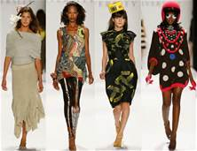
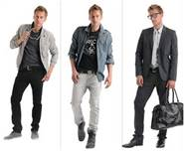
Careers In the Apparel & Fashion Industry
Textiles, Manufacturing, Sales, Merchandising, Management, Design & Retail

Slide 2
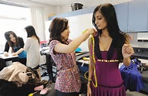
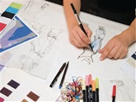

Career Areas
  Primary Level
  Textiles
  Manufacturing
  Design
  Sales
  Merchandising
  Management
  Sales Promotion

Slide 3

Careers in the Primary Level
Trend & Fashion Forecasters
  Who decides what the Latest Themes, Colors or Fabrics will be popular for next year?
  How far ahead of the retail season are these trends determined?

Slide 4
Careers at the Primary Level
  Trend or Fashion Forecasters
    The person responsible for predicting what fashions will be the next year. They combine their knowledge of fashion design, history, consumer research & business information to predict the trends that will affect consumers next year.
  Under the Forecasters are many Assistants & Employees.

Slide 5

Careers in Textiles
Textile Product Developers & Designers
  Textile Designers, Textile Stylists & Textile Colorists.
    Who designs the floral print on your dress or teacup print on your bathrobe?
    Who determines how designs can be applied to a fabric?

Slide 6
Careers in Textiles
Textile Designers – Create original designs in fabrics.
Textile Stylists – Modify existing textile goods by altering & redeveloping fresh new products.
Textile Colorists – Choose the color combination that will be used in creating new designs
  Under the Textile Development & Designers are many Assistants & Employees.

Slide 7

Careers in Manufacturing
& Design
Design Directors, Merchandisers, Creative Designers, Technical Designers, Pattern Makers, Sourcing Managers, Production Planners, Piece Good Buyers, Trimming Buyers & Quality Control Managers.
  Who designs products & buys the materials that are used in your favorite clothes?
  Who decides where these clothes items will be made?
  Who figures out how much a product costs to manufacture?

Slide 8
Careers in Manufacturing & Design
Directors of Product Development – Are responsible for the strategic plan of product development in the retail company.
Design Directors – Do the same for a design/manufacturing firm.
Merchandisers – Work with the Directors to decide what will be produced & then manages the product development process.

Slide 9
Careers in Manufacturing & Design
Creative Designers – Are responsible for the original design direction of the garment.
Technical Designers – Interpret the creative design concept into the development of a prototype.
Pattern Makers - Develop the patterns for the apparel products by either draping or flat pattern methods.
Sourcing Managers - Determine where a product will be produced, they negotiate a contract.

Slide 10
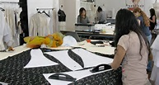
Careers in Manufacturing
& Design
Production Planners – Determine all of the parts that will be needed to make the final product.
Piece Good & Trimming Buyers – Purchase the fabrics, zippers, threads, linings, interfacings & trimmings for the product.
Quality Control Mangers - Are responsible for the final inspection of garments from the manufacture.
  Under all the careers in Manufacturing & Design are many Assistants & Employees.

Slide 11
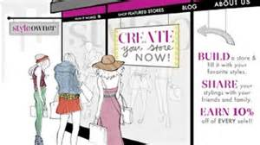
Careers in Sales
Manufacturers’ Sales Reps, Company Sales Reps, Merchandise Coordinators & Retail Sales Associates.
  Who actually gains the attention of the customer?
  Who determines customers’ needs & desires?
  Who sells the product, a service, the concept or the idea?

Slide 12
Careers in Sales
Manufacturers’ Sales Reps – Are independent business owners that sell the product lines of many manufactures.
Company Sales Reps – Work a given territory under a Manufacturers’ Sales Rep to sell the product lines to retail buyers.
Showroom Sales Associates – Works under the Sales Reps showing how to set up the showroom for the retailers.

Slide 13
Careers in Sales
Merchandise Coordinator – Work with the store owners. They service their accounts.
Retail Sales Associates – Perform the essential functions of maintaining the store.
  Under the Careers in Sales are many Assistants & Employees.

Slide 14
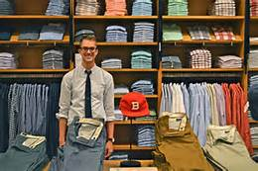
Careers in Retail Merchandising
General Merchandise Managers, Divisional Merchandise Managers, Buyers, Assistant Buyers, Planners & Allocators.
  Who decides which brands & styles of jeans will be sold at the store in your neighborhood?
  Who decides the price the consumer will pay for the particular clothes?
  Who really understands the customers & what they want?

Slide 15
Careers in Retail Merchandising
General Merchandise Managers – Are over the entire merchandising division within a retail store & manage everyone under them.
Divisional Merchandise Managers – Are over a division or regional area. They set up strategy & manage profits & losses.
Buyers – Are responsible for all of the product purchases of a particular dept. in the company.

Slide 16
Careers in Retail Merchandising
Assistant Buyers – Work under the Buyer & the many duties that they have.
Planners – Work with the Buyers to set sales forecasts, inventory plans & spending budgets.
Allocators – Are responsible for planning & managing merchandise deliveries received from vendors to retail locations.
  Under the Retail Merchandiser are many Assistants & Employees.

Slide 17
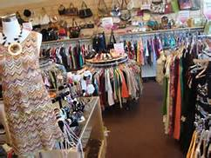
Careers in Retail Management
Retail Store Managers, Assistant Store Managers & Area Department Managers.
  Who loves the retail store experience?
  Who craves the excitement of the hustle & bustle of holiday shopping?
  Who thrives in a retail environment?

Slide 18
Careers in Retail Management
Retail Store Managers – Oversee all of the activities of a retail store’s operation including: marketing, sales, merchandising, inventory, personnel & profits.
Assistant Store Managers – Work under the Store Manager, may handle training, payroll & other duties.
Area/Department Managers - Are over specific areas or departments in larger department stores.
  Under the Retail Management are many Assistants & Employees.

Slide 19
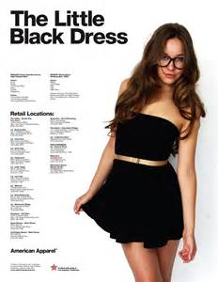
Careers in Sales Promotion
Promotion Directors, Advertising Directors, Public Relations Directors, Special Event Coordinators & Visual Merchandisers.
  Who writes the press releases?
  Who develops the Ad campaigns?
  Who makes the store look fantastic?
  Who writes about the newest fashions?

Slide 20
Careers in Sales Promotion
Promotion Directors – Guide the marketing activities of the retail store.
Advertising Directors - Develop & implement the company’s advertising strategy for the purpose of increasing sales.
Public Relations Directors – Find cost effective ways to promote the company & put it in a favorable spotlight.

Slide 21
Careers in Sales Promotion
Special Events Coordinators - Plan & coordinate special events such as trunk shows, fashion shows, bridal shows, parties, educational events & book signings that increase the companies visibility.
Visual Merchandisers – Design, develop, procure & install merchandise displays that enhance the environment of the store, whether it be displays, signage, fixtures, mannequins or décor that adds to the aesthetic appearance of the store.
  Under the Visual Merchandiser are many Assistants & Employees.

