Slide 1
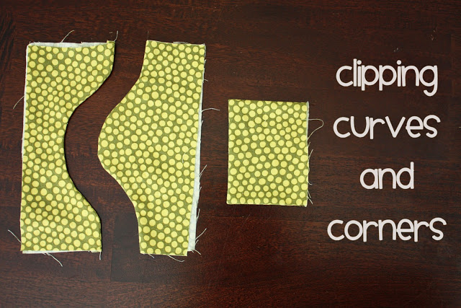
Clipping, Notching,
Trimming and Grading seams

Slide 2
Sometime the simplest little technique can really POLISH OFF YOUR PROJECT!!!
By taking an extra moment or two to finish something off right, you will start to see huge improvements in your projects.

Slide 3
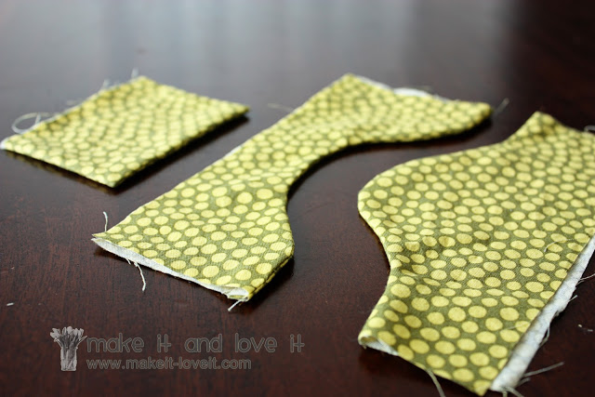
So, why do you clip and/or notch or grade your seam allowance:
--It removes bulk from the insides of seams and allows for nice smooth curves and corners.
--It keep things sharp and even
It will make your projects look more professional

Slide 4
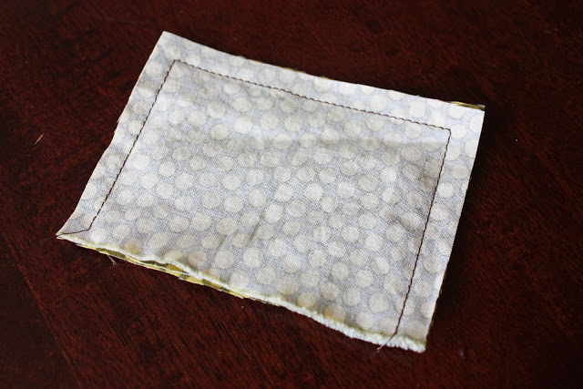
CORNERS
Sewing 2 pieces of fabric that have corners looks like this

Slide 5
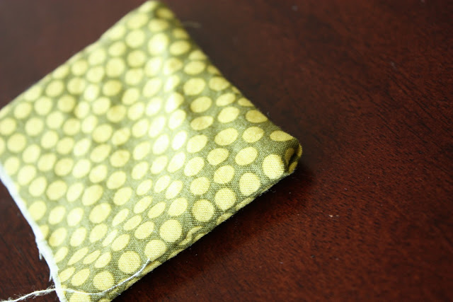
If you turn it right side out without clipping those corner, you will have messy looking corners that you can’t poke out because there is too much fabric in there jamming it up.

Slide 6
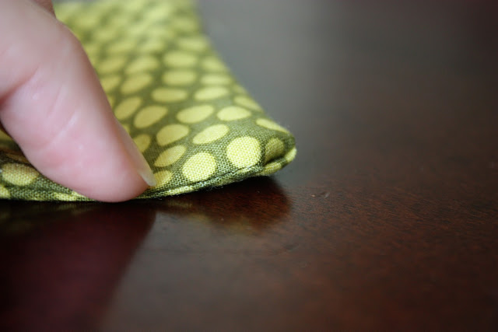
Those corners are also very bulky and will not lay flat.

Slide 7
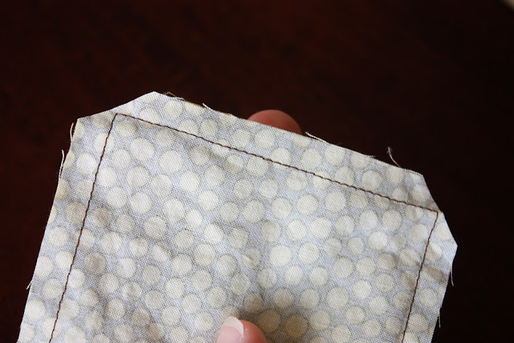
BUT if you trim off those corners at a diagonal, cutting near the tip of the seam, about 1/8” away….

Slide 8
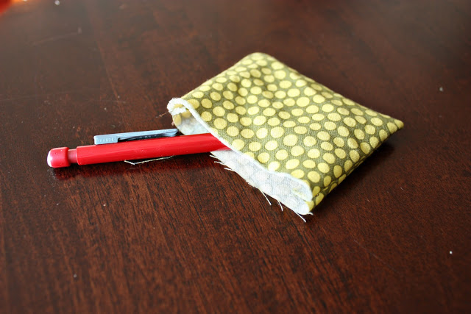
Then poke out the corners carefully…

Slide 9
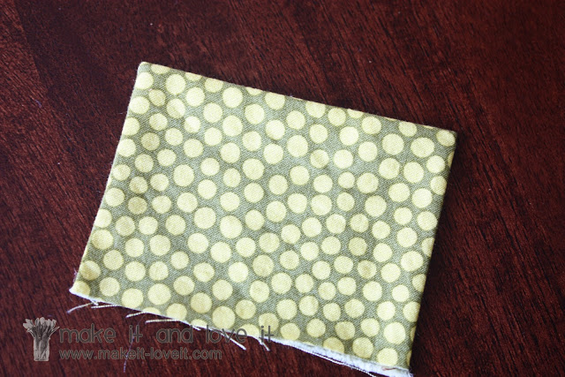
You will have nice and sharp looking corners.

Slide 10
THIS NOT THIS

Slide 11
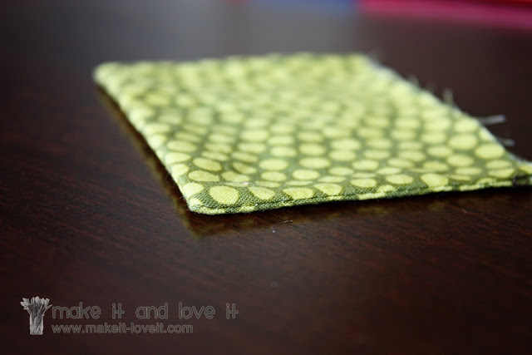
it will lay perfectly flat!!!

Slide 12
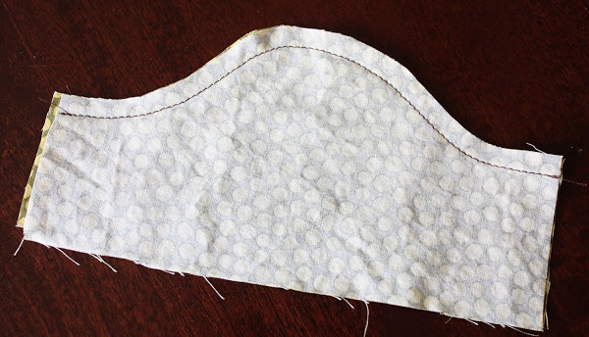
CURVES
REMEMBER:
CLIP valleys, NOTCH mountains
When you have a curve that looks like a mountain…

Slide 13
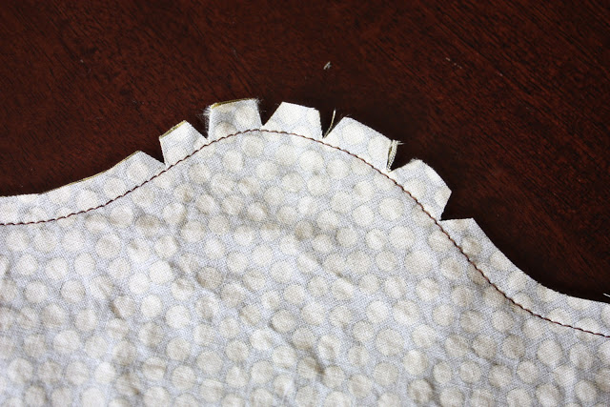
Notch the mountains like this:
about 1/16” to 1/8” from the seam.
you are trying to take away some of the bulk so it will lay flat..

Slide 14
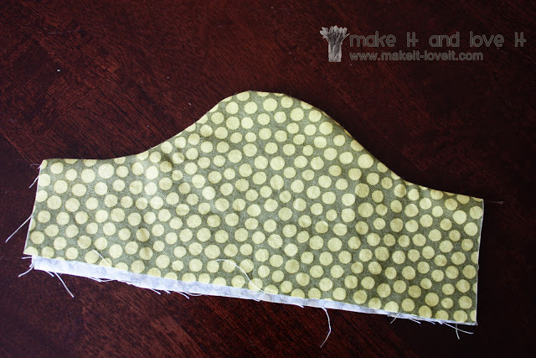
So, when you turn it right side out, it will look nice and smooth.

Slide 15
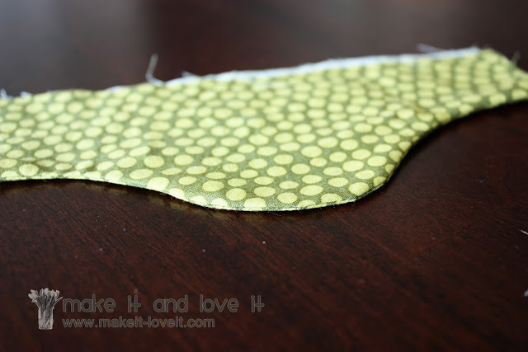

Slide 16
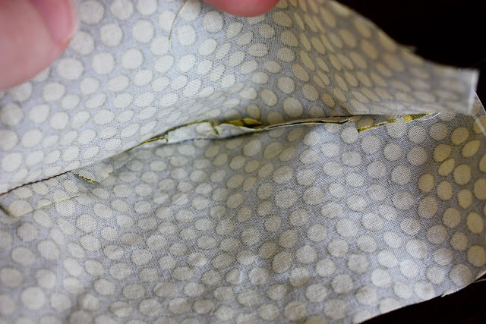
From the inside, you can see the notches are closed up and are almost lay next to each other now because the curve forced them that way.

Slide 17
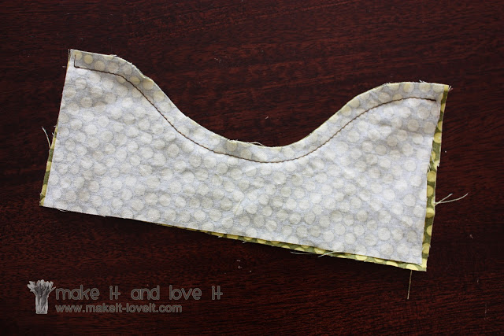
Now on to valleys, which look something like this.

Slide 18
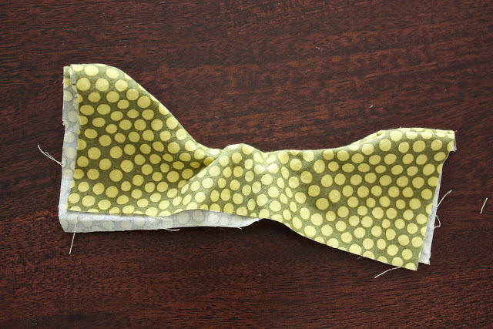
If you tried to turn a “valley curve” right side out, it will not lay flat for you. It will just bunch up and pucker.

Slide 19
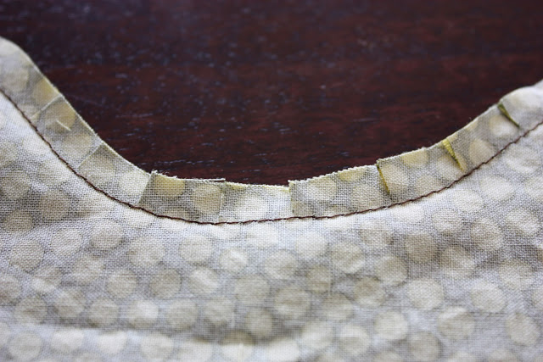
So, clip the valley like this: about 1/16” to 1/8” from the seam.

Slide 20
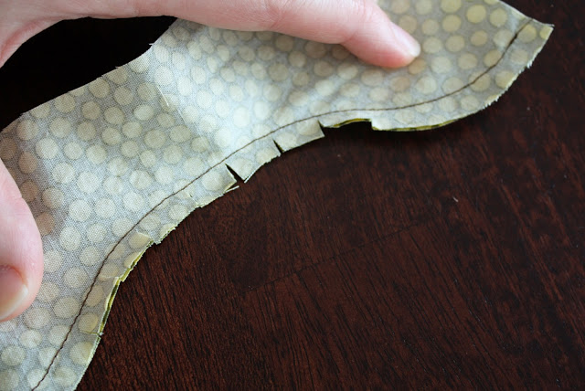
When the curve stretches open a bit, the sips allow it to move.

Slide 21
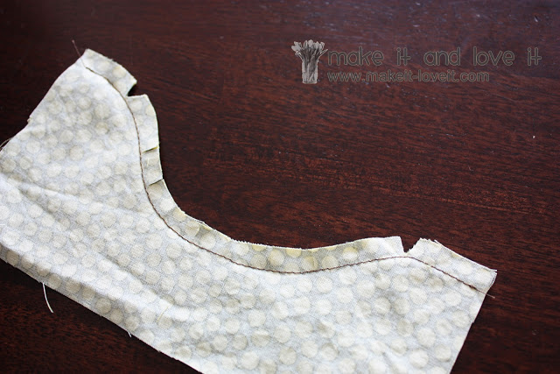
Here you also need to add a little notch at the top where there are slight mountains.

Slide 22
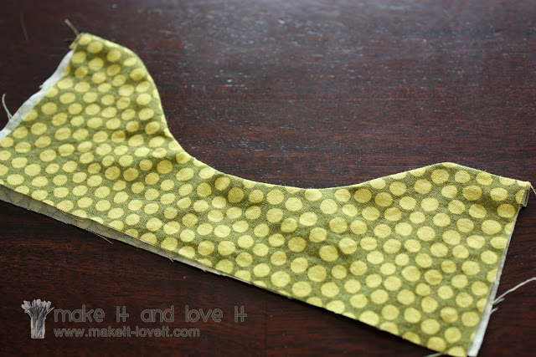
Then turn it right side out and the valley lays nice and flat.

Slide 23
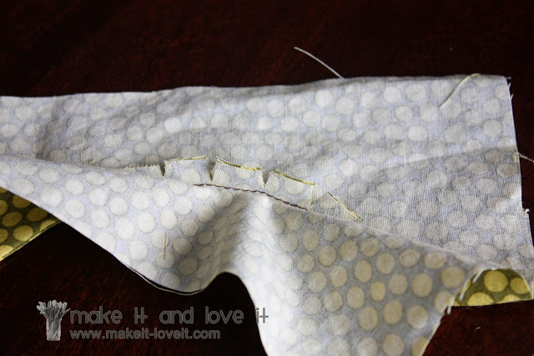
If you open it up, you can see the “clips” are being opened up allowing for the nice curve of fabric from the outside.

Slide 24
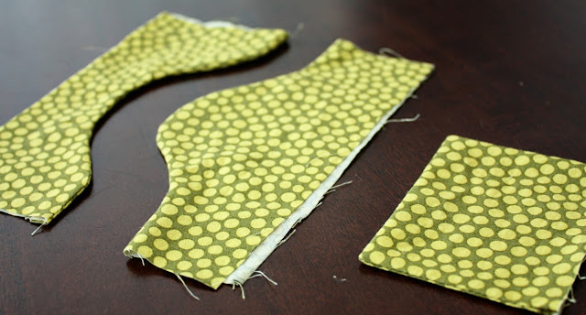
So, use these techniques on your projects and you will notice a huge difference in how your fabric lays and how much better the end product looks.
You will have nice flat crisp edges.

Slide 25
To trimming your seam to various levels making each layer of fabric a different width. Doing this reduces bulk within the seam area.

Slide 26
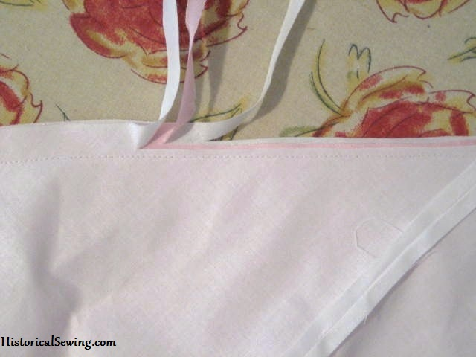
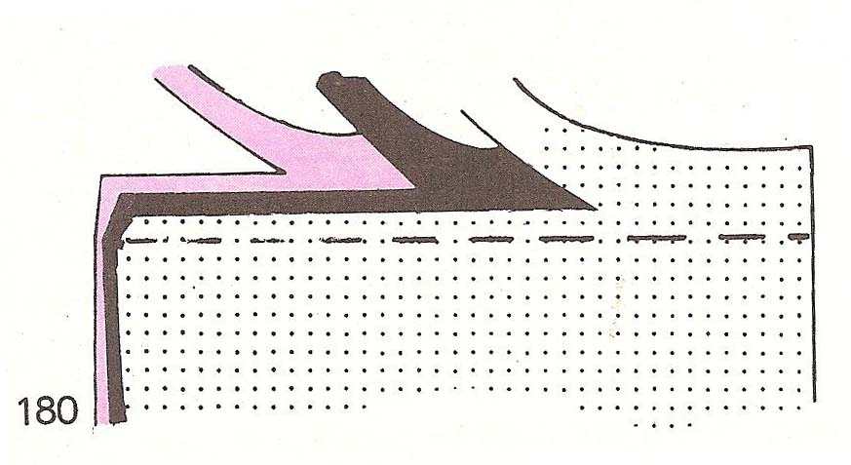
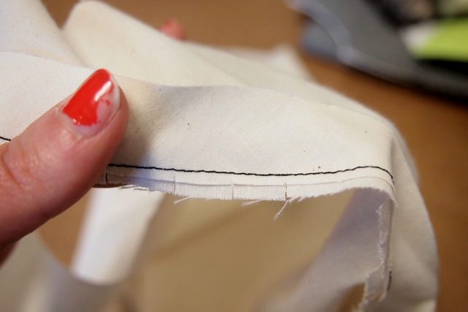
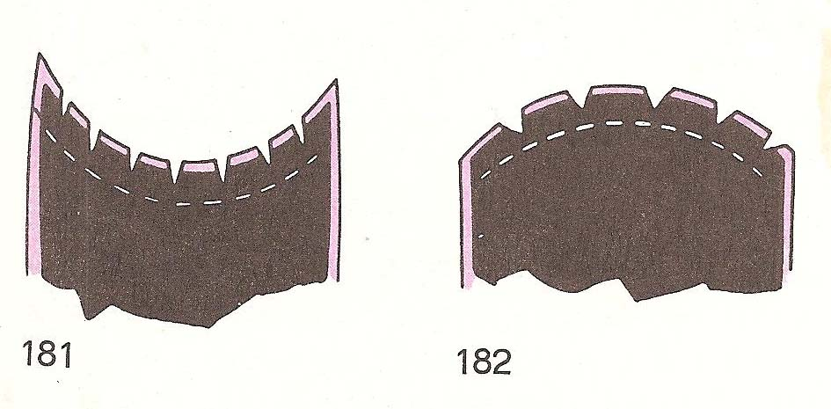
Trimming mean to cut the seam allowances to a smaller width. Usually from 5/8 inch to 3/8 inch or ¼ inch

Slide 27
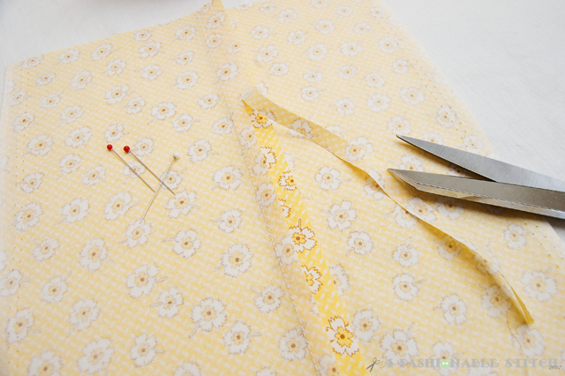
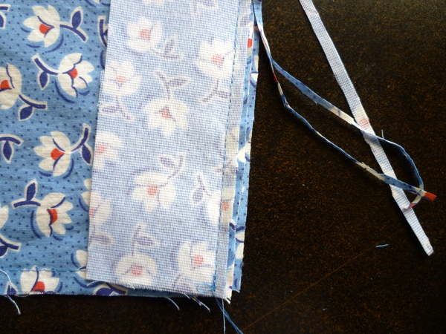
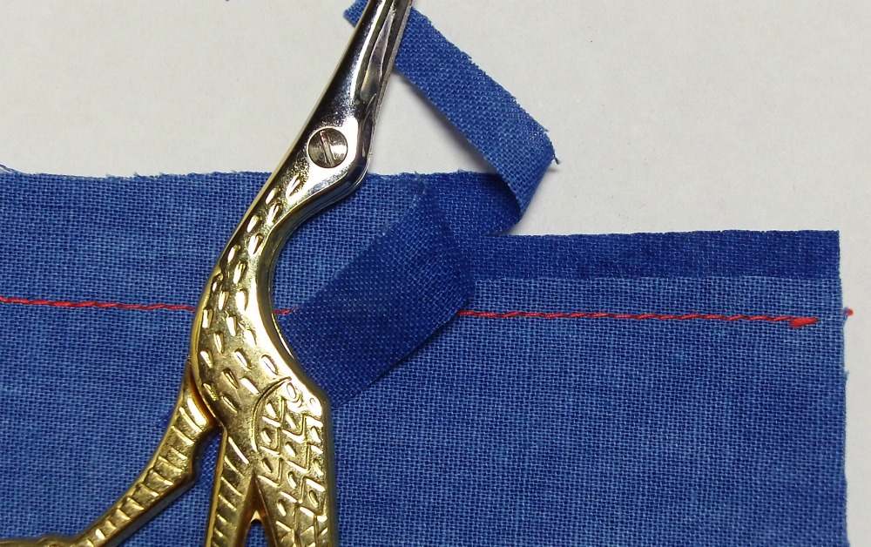
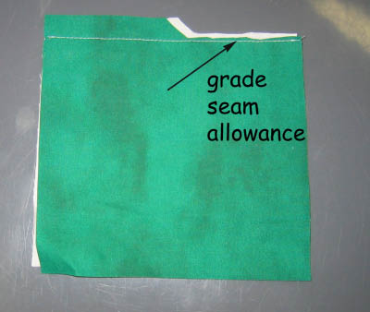
Grading means to layer the seam allowances

