Slide 1
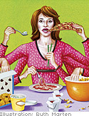
Mindless Eating
Heidi Wengreen, R.D., Ph.D.
Associate Professor of Nutrition
Utah State University
Notes:
http://smarterlunchrooms.org/resource/nut-rep-port-0 – introduction to Mindless eating

Slide 2
Learning Objectives
Recognize the impact of the food environment on food intake.
Define concepts and principles of mindless and mindful eating and list examples.
Browse resources available to teachers at the Cornell University Food and Brand Lab.
Develop one personal and one classroom goal that will promote more mindful and less mindless eating.
Notes:
Learner Educational Objectives
Recognize the impact of the food environment on food intake.
Explore at least three common eating myths about food and weight gain.
Identify small, practical strategies to use to change food intake behaviors at home and in communities.
Describe how the external environment changes internal perception of hunger and fullness and list techniques that can promote changes in portion size.
Define concepts and principles of mindful eating and list examples.
Discuss rationale for using a mindful eating approach instead of traditional dieting.
List tips for becoming a more mindful and less mindless eater.

Slide 3
What is behavioral economics?
“Behavioral economics, or behavioral science more generally, is the study of how we don't behave according to logic. In other words, how we ignore our education and choose whatever is convenient, seems most normal, or seems most instantaneously rewarding. “
Wansink B. Nutrition education and behavioral economics. JNEB. 2012; 44(4):281.
Notes:
Have you every eaten the last piece of crusty dried out chocolate cake even though it tasted like chocolate scented cardboard?
Your childs left over kids meal… soggy hamburger and limp fries and all?
We make over 200 decisions about food everyday… most of them are NOT driven by what we know about nutrition or health…

Slide 4
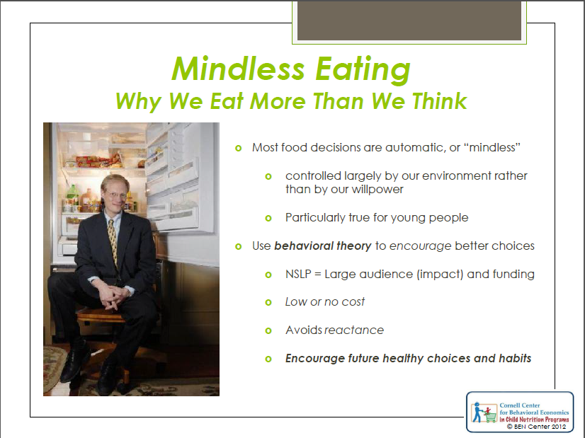
Notes:
I’d like to introduce you to Dr. Brian Wansink –
John S. Dyson Professor of Marketing in the Charles H. Dyson School of Applied Economics & Management at Cornell University
Director of the Cornell Food and Brand Lab in the Department of Applied Economics and Management at Cornell University
Director of USDA’s Center for Nutrition Policy and Promotion from 2007-2009
Author of bestseller: Mindless Eating Why We Eat More Than We Think
Dr. Wansink is known for his work on consumer behavior and food and coined the term and theory of mindless eating. He has been known as the "Sherlock Holmes of Food"^{[2]} and the "Wizard of Why“ we eat what we do.
Dr. Wansink’s theories are based on his and others scientific experiements that provide
Let’s see if we can list a few of these factors that affect of food chocies …
How does our immediate environment (supermarkets, packaging, homes, pantries, and tablescapes) influences eating habits

Slide 5
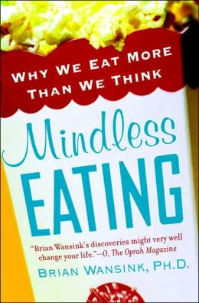
“The best diet is the one you don’t know that you are on”

Slide 6
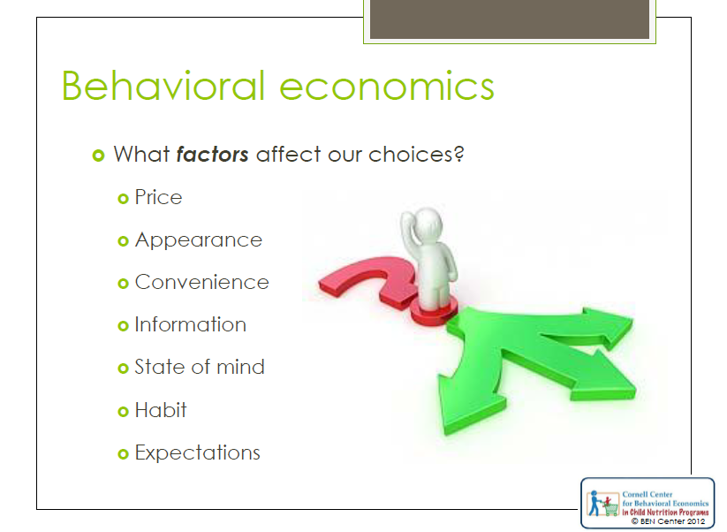
Notes:
Let’s see if we can list a few of the factors that affect of our food choices.
List these on the board.

Slide 7
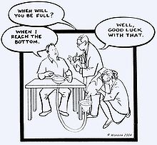
Notes:
Dr. Wansinks cleaver experiments provide valuable insight into why we eat the food we do and how we might use these hidden factors to influence our decision and behavior for good.

Slide 8
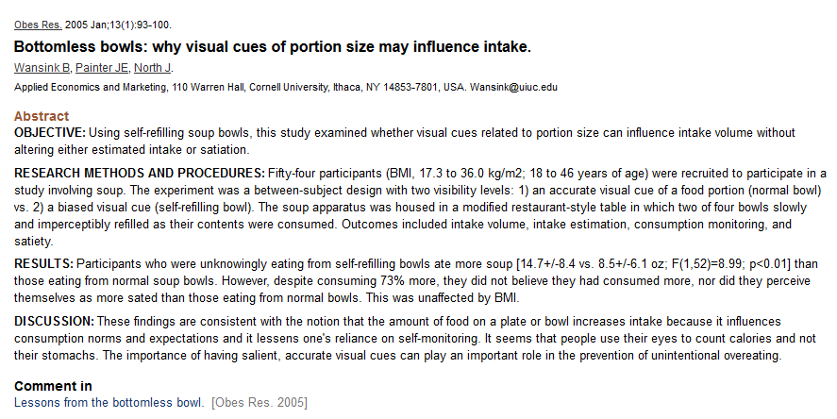

Slide 9
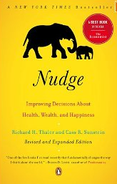
How can mindless eating work to influence people to eat healthier?
Notes:
Designing the environment or social situation to lead NOT FORCE an individual to make a particular choice – nudging….
By a nudge we mean anything that influences our choices. A school cafeteria might try to nudge kids toward good diets by putting the healthiest foods at front. We think that it's time for institutions, including government, to become much more user-friendly by enlisting the science of choice to make life easier for people and by gentling nudging them in directions that will make their lives better.

Slide 10
Proof that “nudging” works – applied to NSLP?
Moving and highlighting fruit increased sales by up to 102%
Naming vegetable and displaying the new names with the foods increased selection of vegetables from 40-70%
Placing white milk first in the coolers increased white milk sales by 46%
http://smarterlunchrooms.org/ideas
Notes:
Smarter Lunchrooms movement
Moving and highlighting fruit increased sales of fruit by up to 102%
Naming vegetables and displaying the new names with the foods increased selection of vegetables from between 40% - 70%
Placing white milk first in the lunchroom coolers has resulted in an increase of up to 46% in white milk sales

Slide 11
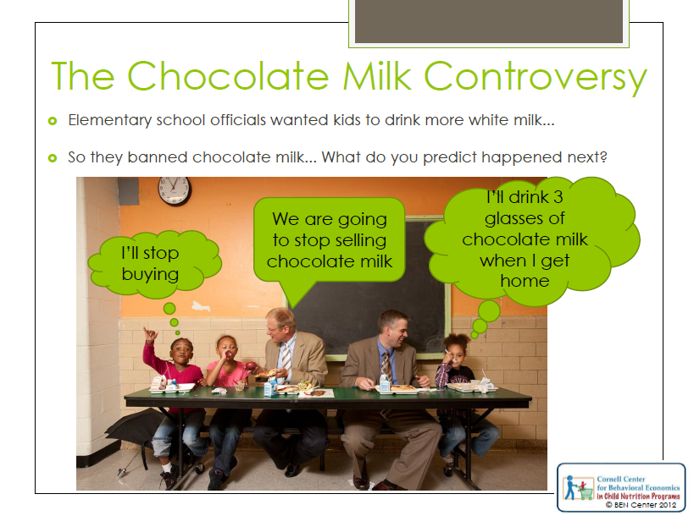
Notes:
Choice is important!
Last fall, Los Angeles took a hard line on school nutrition. In an attempt to mold better eating habits in kids, the Los Angeles Unified School District eliminated flavored milk, chicken nuggets and other longtime childhood favorites. But instead of making kids healthier, the changes sent students fleeing from school cafeterias. There have been reports of a thriving trade in black-market junk food, of pizzas delivered to side doors and of family-sized bags of chips being brought from home. Garbage cans are filling up with the more nutritious food, even if kids aren't.
Choice is important to children, and having the ability to choose can have profound effects on behavior. For example, our research at Cornell shows that when given the choice of either carrots or celery, 89% of children will choose and eat carrots. But if kids are instead given only carrots without a choice, just 69% will eat them. Instead of taking away choice, a better solution is to guide a child's choice.

Slide 12
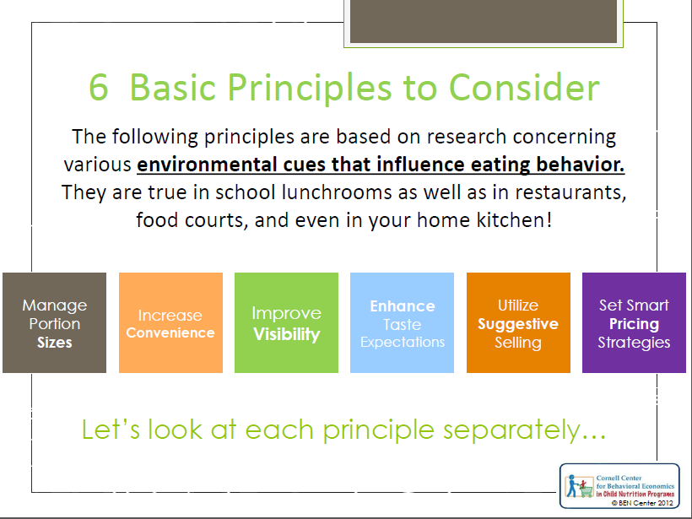
Notes:
We are going to talk through the first 4

Slide 13
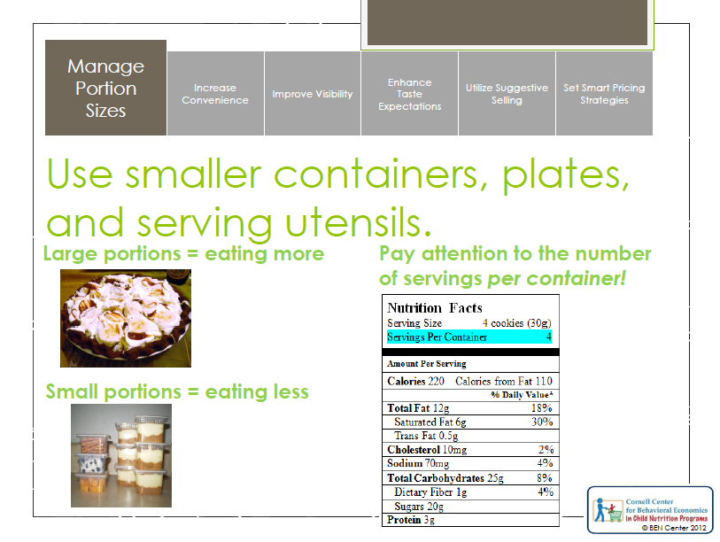
Notes:
Serve smart – serve yourself only what you want to eat – then put the rest away and out of sight.
Why it works: people will clean their plate even after they are full – even when they don’t really like what they are eating – people eat 92% of what they serve themselves.
Stale popcorn – people in a movie theater were given large or medium sizes of popcorn – free. The popcorn was 5 days old. After the movie the people were told that some where given a large bucket of popcorn and others a small. Do you think you ate more because you had the larger sized bucket? Most said no way… I know when I am full.
Big bucket people ate 53% more.
Dish out 20% than you think you may want before you start eating…. You won’t miss 20%, but these kcalories can add up. With FV, dish out 20% more than what you think you’d usually eat. A person will eat an average of 92% of any food they serve themselves.^{[5]}
Buy items in smaller serving sizes.
-If purchasing items bargain-sized, re-portion food items into serving sizes
-At a restaurant ask for half your order to be placed to-go.
-At home replace large dishware with smaller dishware.
-Keep large food containers and packages off the counter

Slide 14
Group share
Each person: List two examples of how you think portions of food have influenced the amount of food that you have eaten (2 minutes).
Share and discuss with your group (4-5 people; 3-5 minutes)
Discuss with the class

Slide 15
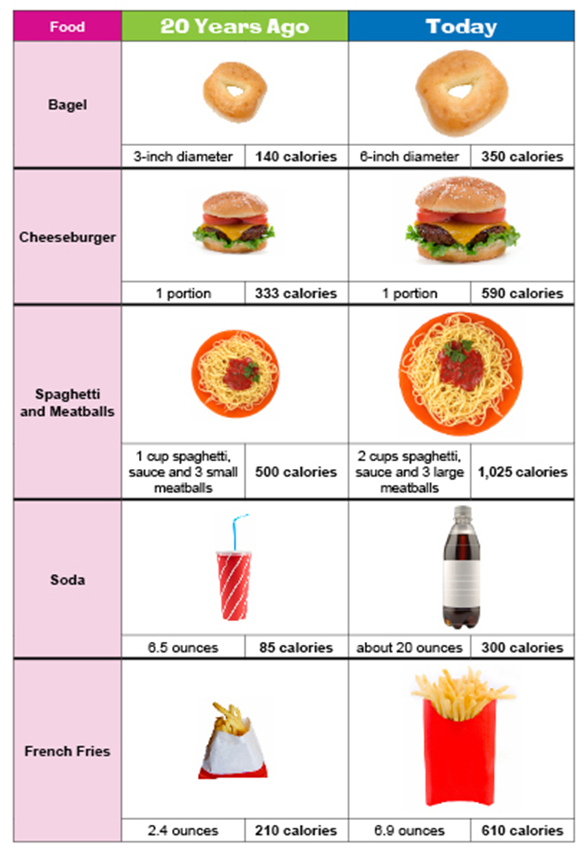
people will generally clean their plate even after they are full – even when they don’t really like what they are eating – most people eat 92% of what they are served!
What affect has “Supersizing” of portions had on consumption?

Slide 16
Supersizing of the “last supper”
http://abcnews.go.com/GMA/Recipes/video/supersizing-supper-10187307

Slide 17
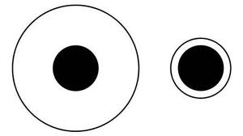
Which black dot is bigger?

Slide 18
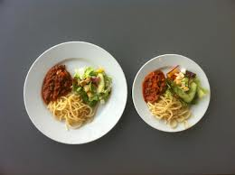
Which looks like more food?
Notes:
People generally eat about 25% more food when they eat on bigger plates

Slide 19
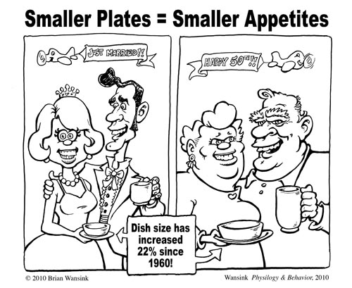
Notes:
85 graduate students and professors were invited to an ice cream social. Those who were given larger serving bowl served themselves 31% more then those with the smaller bowl. Those who were given a larger bowl and serving utensil served themselves 53% ice cream then those who were given a small bowl and spoon.

Slide 20
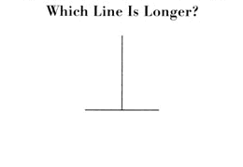

Slide 21
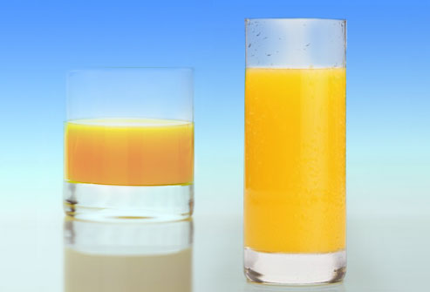
Notes:
Even bartenders pour more liquid into short fat glasses compared to tall skinny glasses.

Slide 22
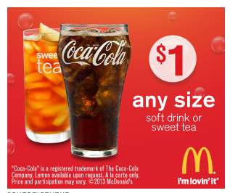
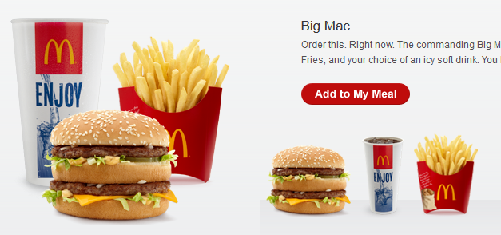
Food costs – quality vs. quantity?

Slide 23
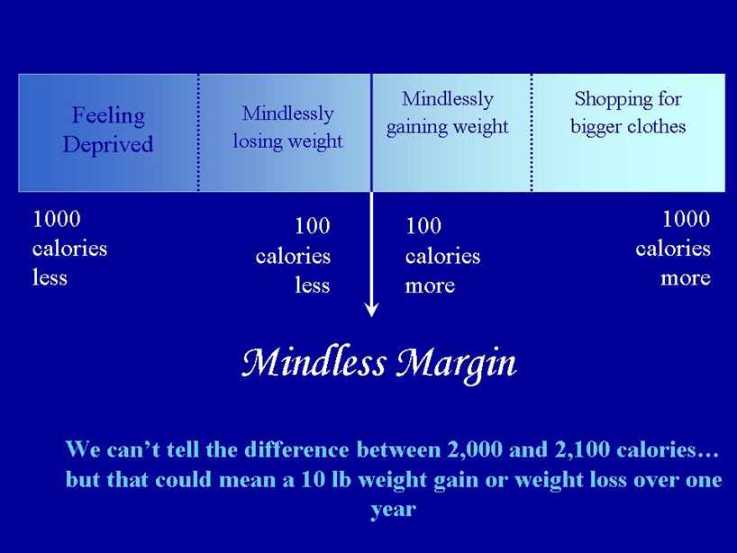

Slide 24
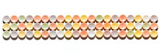
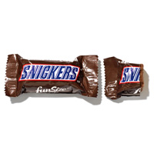
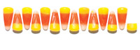
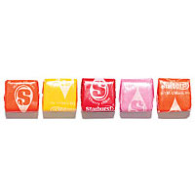
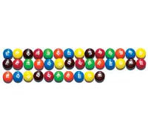
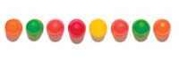
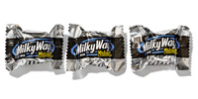
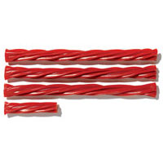
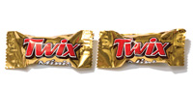
Which is the highest kcalorie candy snack?
Notes:
3 1/3 snack size twissler, 5 starburst, 8 dots, 13 1/3 candy corns, 28 M&Ms, 2 Twix minis

Slide 25
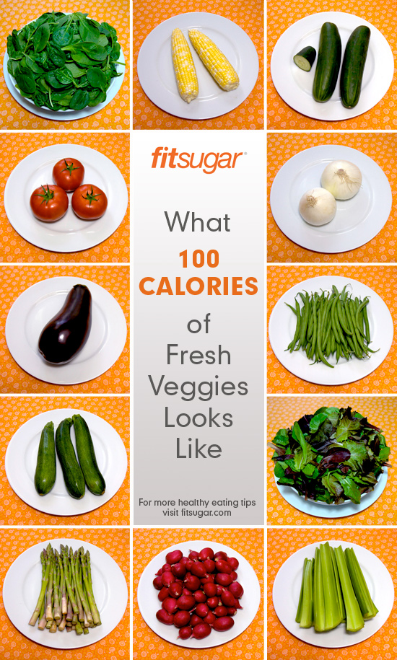


Slide 26
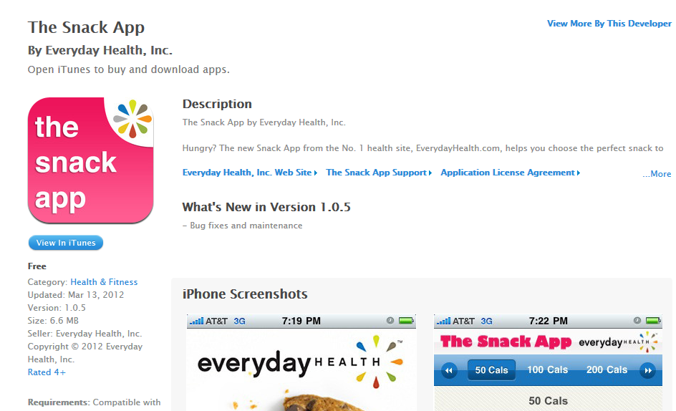

Slide 27
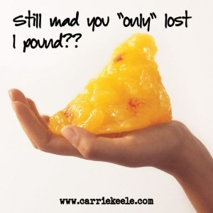
3500 calories = 1 pound of fat

Slide 28
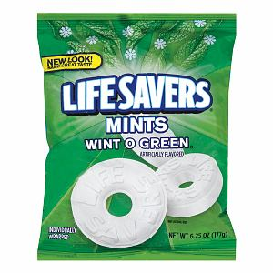
1 life saver mint = 15 kcalories
How many mints would you have to eat to gain 1 lb?
If you eat 1 “extra” mint per day, how many days would it take you to gain 1 extra pound?
Notes:
3500/15 = 233
If you eat just one “extra” mint per day how many days would it take to gain 1 extra pound – just by consuming 1 lifesaver mint per day.
There’s 308 mints in a big samsclub bag.
1 stick of doublemint gum or 3 small jelly beans every day for a year will = 3500 kcalories = 3500 lbs.

Slide 29
1 life saver mint = 15 kcalories
How many mints would you have to eat to gain 1 lb? (3500/15 = 233 mints = 1 lb)
If you eat 1 “extra” mint per day, how many days would it take you to gain 1 extra pound?
Notes:
3500/15 = 233
If you eat just one “extra” mint per day how many days would it take to gain 1 extra pound – just by consuming 1 lifesaver mint per day.
There’s 308 mints in a big samsclub bag.
1 stick of doublemint gum or 3 small jelly beans every day for a year will = 3500 kcalories = 3500 lbs.

Slide 30
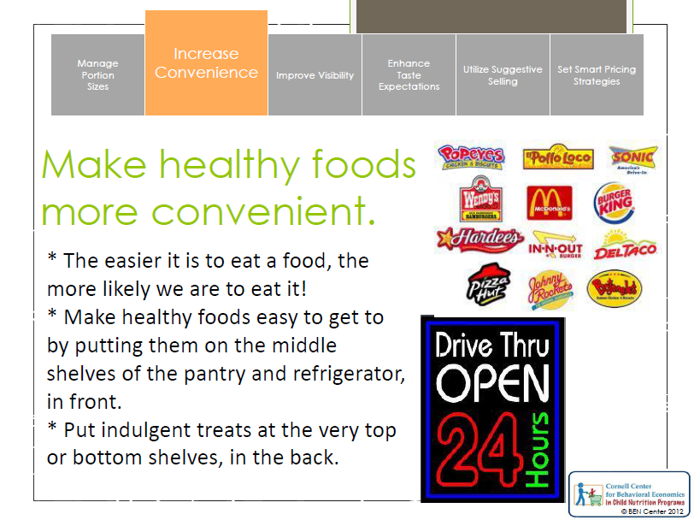
Notes:
Secretaries given candy in clear desktop candy dishes ate 71 percent more candy than did secretaries given candy in white dishes.
We eat more food when we see more food.
If we see candy in a candy jar every 5 minutes, every time we see it we have to decide whether or not to eat it. This means having to say “no” 12 times per hour… if we don’t see the candy, we don’t have to say no.
Make healthy foods the easy and convenient choice and unhealthy foods the harder less convenient choice.

Slide 31
Group share (skip if short on time)
Each person: List two examples of the convenience of food influences your food behavior – either what you eat or how much you eat. (2 minutes)
Share and discuss with your small group (4-5 people; 3-5 minutes)
Discuss with the class

Slide 32
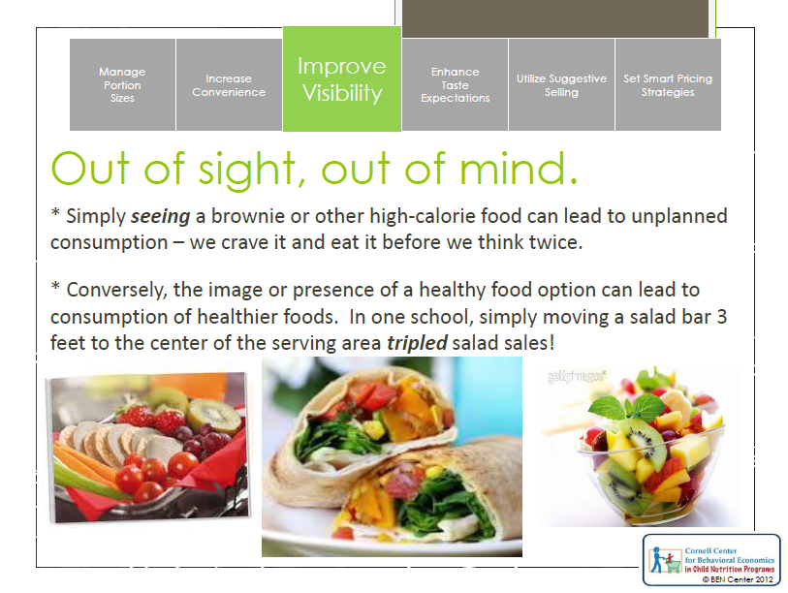
Notes:
Repackage jumbo sizes (like you get at Samsclub and Costco) into smaller bags , then hide the extras. If we see lots of something available, our consumption of whatever that something is will go up. If it is a jumbo bag of jelly bellies, consumption goes up. It is a jumbo bag of spring greens, consumption goes up. 50% of the snack food bought in bulk (such as at a warehouse club store) is eaten within six days of purchase.^{[10]}

Slide 33
Group share
Each person: List two examples of how the “out of sight, out of mind” principle has influenced your food behavior - either what you eat or how much you eat.
Share with your small group (4-5 people)
Discuss with your group (4-5 people)
Discuss with the class

Slide 34
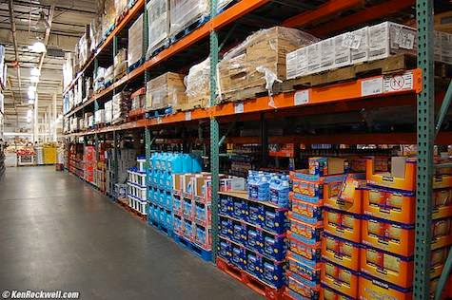
The curse of the warehouse stores
Notes:
Repackage jumbo sizes (like you get at Samsclub and Costco) into smaller bags , then hide the extras. If we see lots of something available, our consumption of whatever that something is will go up. If it is a jumbo bag of jelly bellies, consumption goes up. It is a jumbo bag of spring greens, consumption goes up. 50% of the snack food bought in bulk (such as at a warehouse club store) is eaten within six days of purchase.^{[10]}
Overspending? Yes, but also over-eating.
Huge containers … you’ll eat more because there is more food available.
Having 48 containers of chocolate pudding affects consumption in two ways.
First is something called the salience principle – you see these puddings everywhere , they fall out of the cupboard, they are on the counter, and they hide other food. As a result of their salience you end up eating them more frequently than you normally would.
The idea of norms – say you usually have 2 to 3 boxes of breakfast cereal in your cupboard – if you have only one box it is a signal to get to the store and buy another box before the kids revolt. But if one day you have 12 boxes you will tend to eat them faster to get to the “right” number of boxes or the “normal” number of boxes.
The warehouse curse occurs in the first week after shopping. For the first week people eat the stockfiled foods at almost twice the normal rate.

Slide 35
Get a better deal
Repackage jumbo sizes into smaller bags or containers
Hide the extras – make them inconvenient to track down.
Reseal packages – make them inconvenient to get in to – using tape to close a bag of chips is more of a deterrent to an impulse splurge than an easy-to-open clip.

Slide 36
Get a better deal
Repackage jumbo sizes into smaller bags or containers
Hide the extras – make them inconvenient to track down.
Reseal packages – make them inconvenient to get in to – using tape to close a bag of chips is more of a deterrent to an impulse splurge than an easy-to-open clip.
“De-convenience” tempting foods
Notes:
Leaving serving dishes of tempting foods in the kitchen, but serve vegetables family style …
Secretaries ate more candy when it was on their desk vs. when it was 6 feet away.

Slide 37
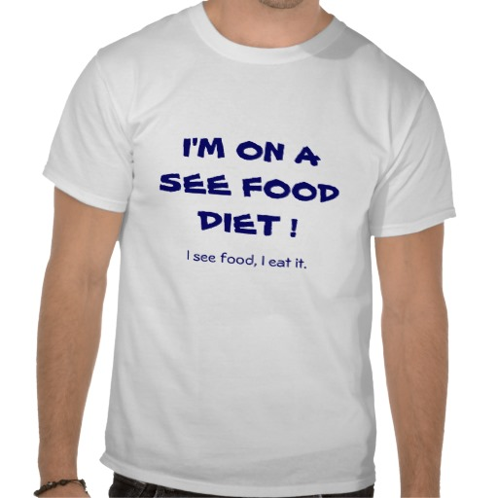
Notes:
Secretaries who had a clear bowl full of Hershey’s kisses on their desk ate 77% more HK than did secretaries in a class bowl that was white instead of clear.

Slide 38
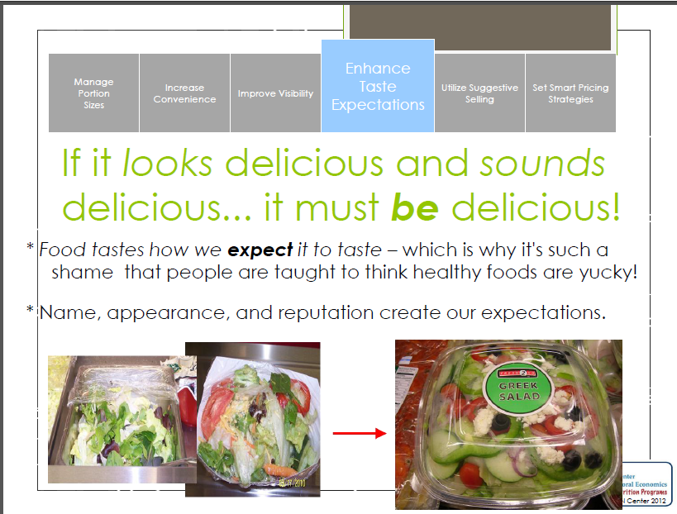
Notes:
Buy a cheap wine and dress it in an expensive looking label and most people will say it tastes expensive… works with other foods as well. Fresh ginger carrots vs. cooked carrots.
People think food eaten on pretty plates, with dim lighting, and soft music tastes better than that eaten in a loud room with bright colors and harsh lighting.
Cinnabon effect.
Lemon jello, colored red, tasted like cherry jello to angry sailors who wanted cherry jello.

Slide 39
Group share (skip if short on time)
Each person: List two examples of how food expectations influence your food behavior - either what you eat or how much you eat.
Share with your small group (4-5 people)
Discuss with your group (4-5 people)
Discuss with the class

Slide 40
Which menu has better food?
Menu A
Menu B
Red beans with rice
Sea food filet
Grilled chicken
Chocolate pudding
Zucchini cookies
Traditional Cajun Red Beans with Rice
Succulent Italian Seafood Filet
Tender Grilled Chicken
Satin Chocolate Pudding
Grandma’s Zucchini Cookies

Slide 41
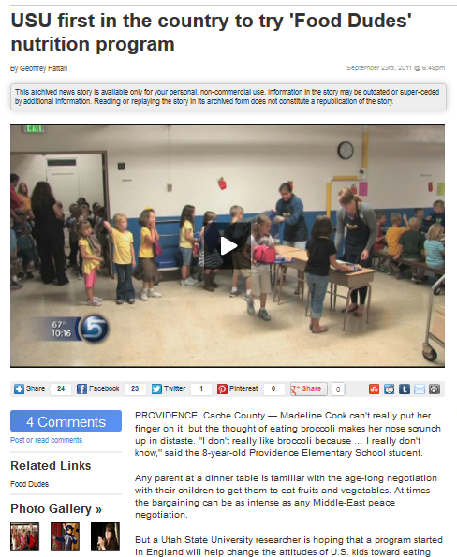
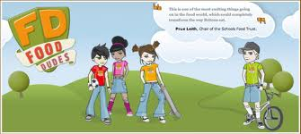
Role models
Repeated tasting exposures
Rewards
= Increased Fruit and Vegetable consumption

Slide 42
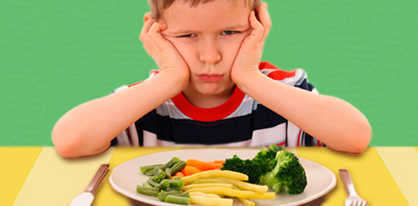

Slide 43
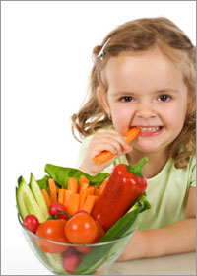

Slide 44
Who are the gatekeepers?
The Nutritional Gatekeeper of a home influences an estimated 72% of all of the food their family eats.
Notes:
Children eat what tastes good, what’s convenient and what portion size they see as appropriate. You can help train nutrition gatekeepers of the future… help create positive lifetime food patterns.

Slide 45
Resources for your classroom
http://foodpsychology.cornell.edu/toolbox/toolbox.html

Slide 46
How can you bring mindful eating into your classrooms?
Browse resources in small groups
Discuss as a group
List your top 3
Group demo of one classroom activity
http://foodpsychology.cornell.edu/index.html

Slide 47
Take action – set a s.m.a.r.t “mindless eating” goal
Personal goal
Classroom goal
Notes:
SMART – specific, measurable, attainable, realistic, and timely

Slide 48
End

