Slide 1
Marlene Israelsen, MS, RD
Utah State University
FACS Nutrition Conference, June 2013

Slide 2
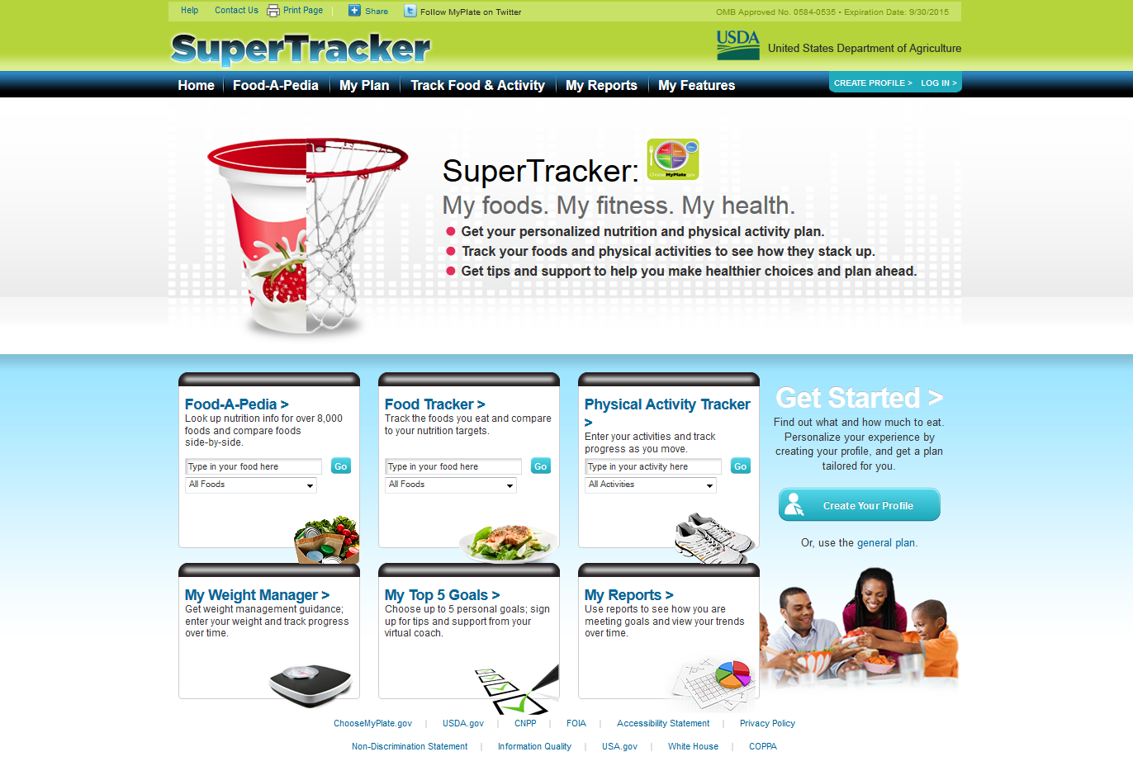
www.supertracker.usda.gov OR choosemyplate.gov

Slide 3
CREATE A PROFILE

Slide 4
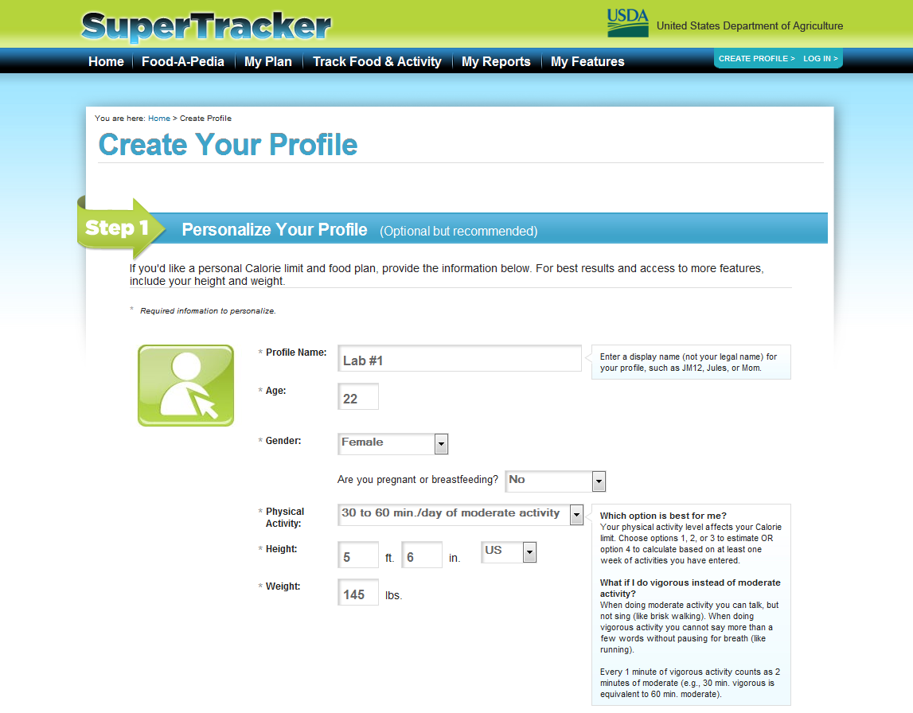

Slide 5
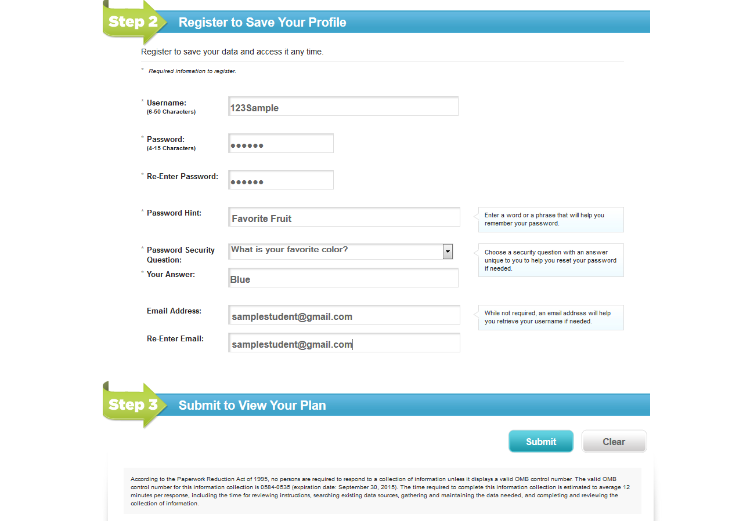
CREATE A PROFILE

Slide 7
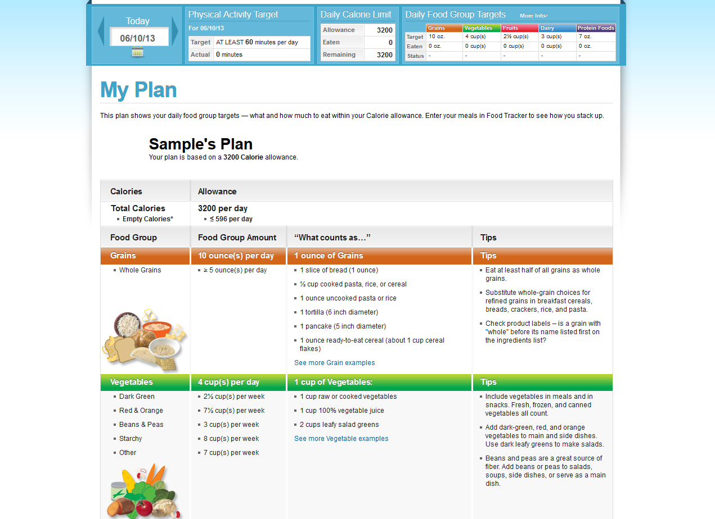
MY PLAN

Slide 8
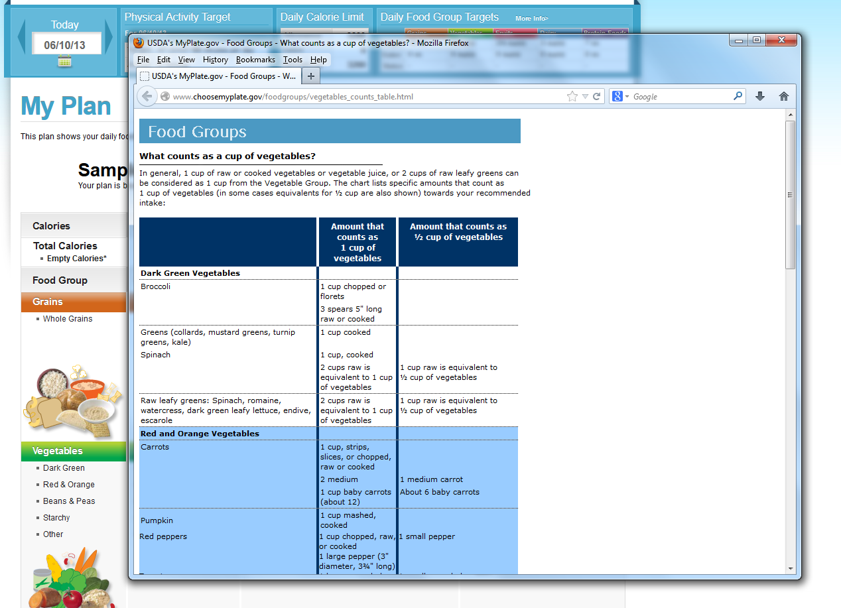
MY PLAN

Slide 9
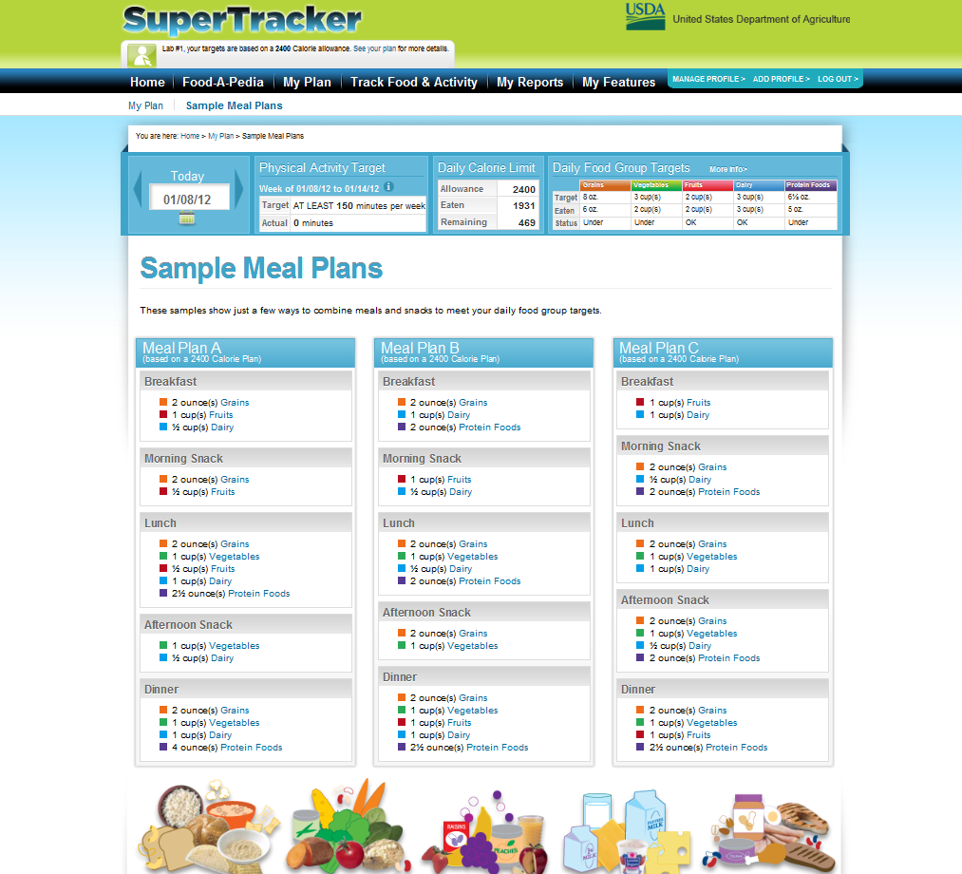

Slide 10
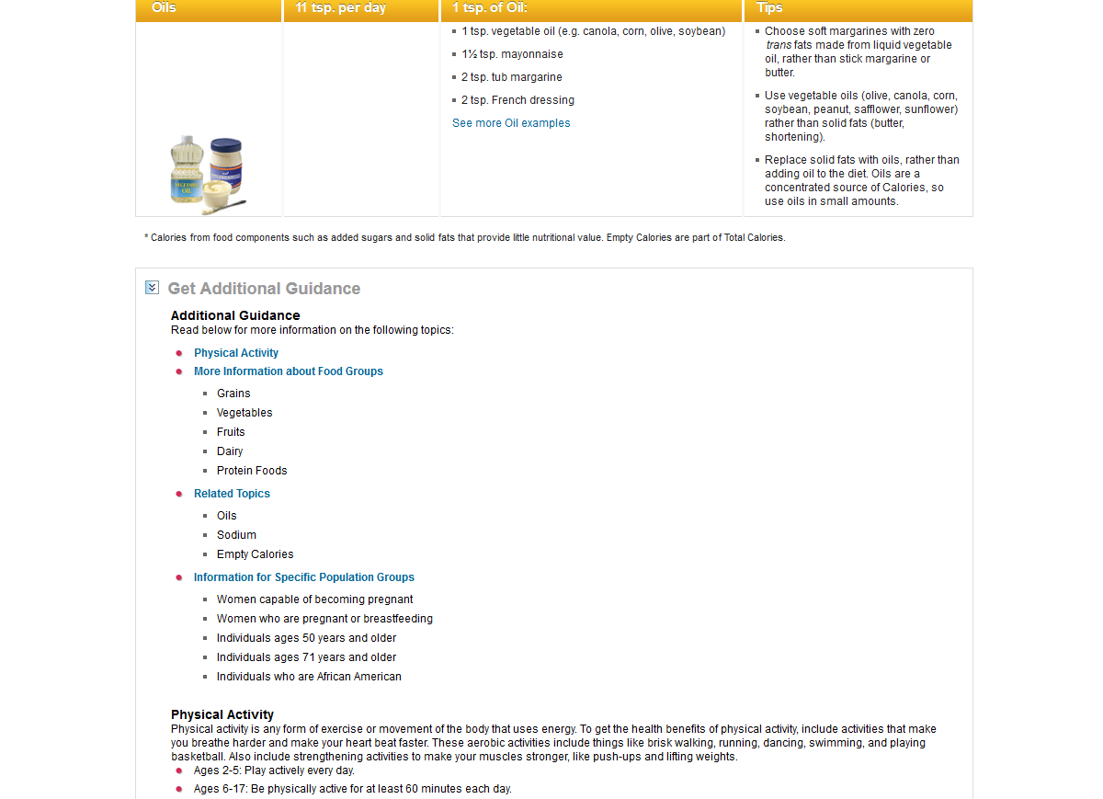
MY PLAN

Slide 11
www.supertracker.usda.gov OR choosemyplate.gov

Slide 12
FOOD-A-PEDIA

Slide 13
FOOD-A-PEDIA

Slide 14
FOOD-A-PEDIA

Slide 15
FOOD-A-PEDIA

Slide 16
FOOD-A-PEDIA

Slide 17
www.supertracker.usda.gov OR choosemyplate.gov

Slide 18
FOOD TRACKER

Slide 19
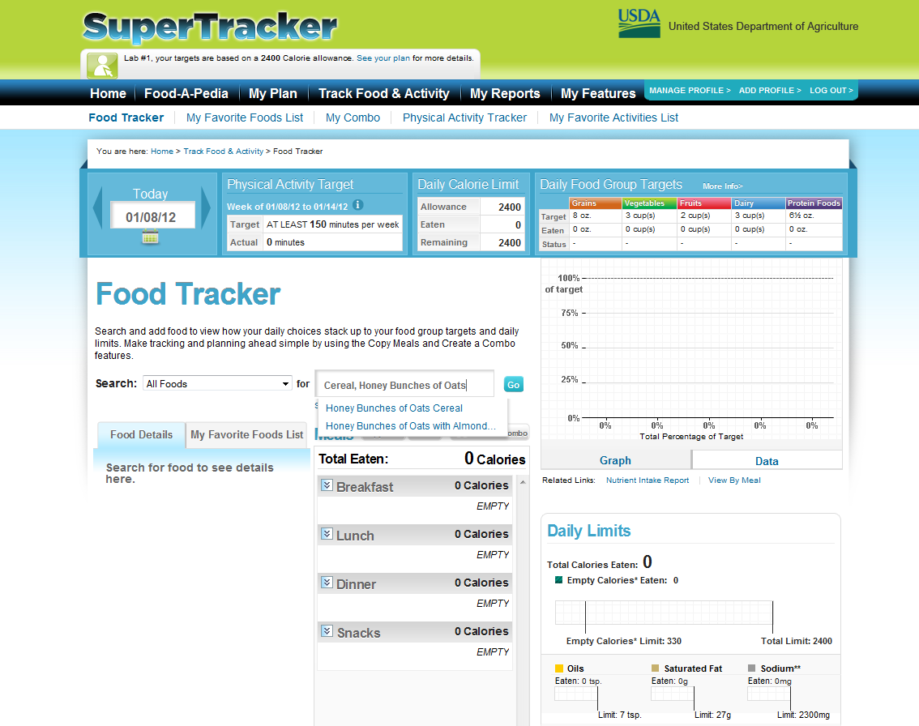

Slide 20
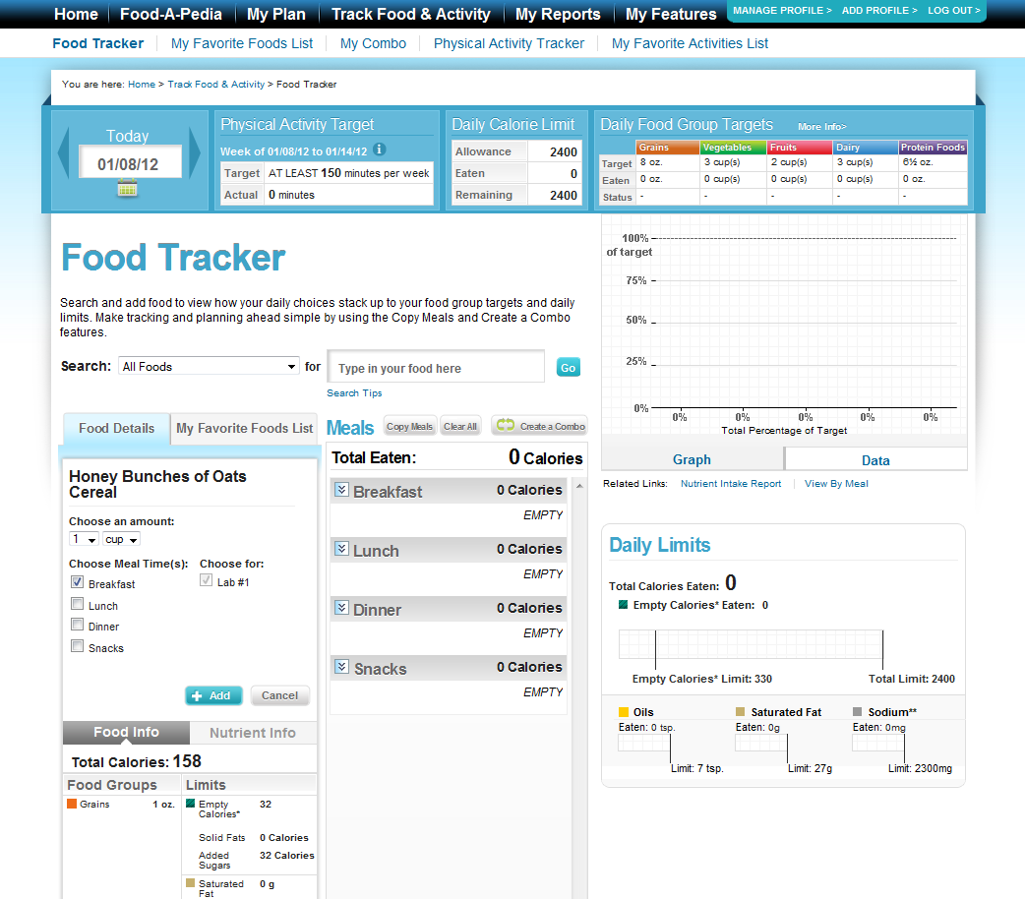

Slide 21
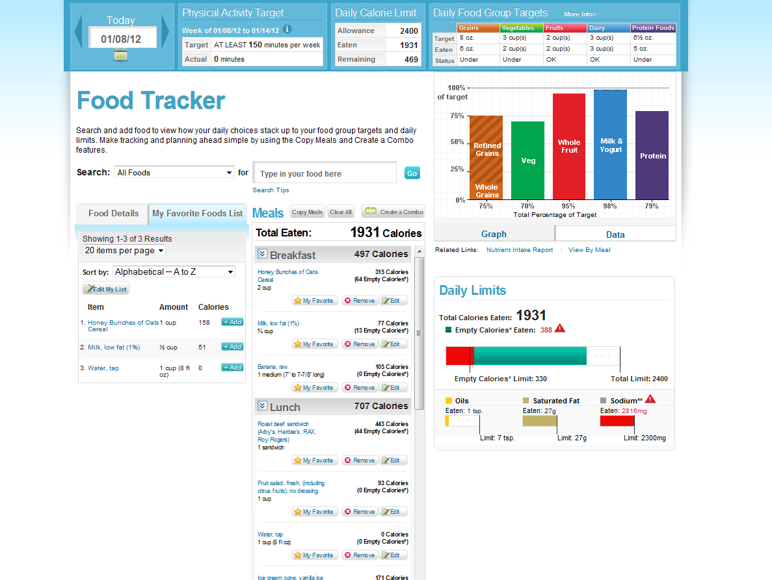

Slide 22
www.supertracker.usda.gov OR choosemyplate.gov

Slide 23
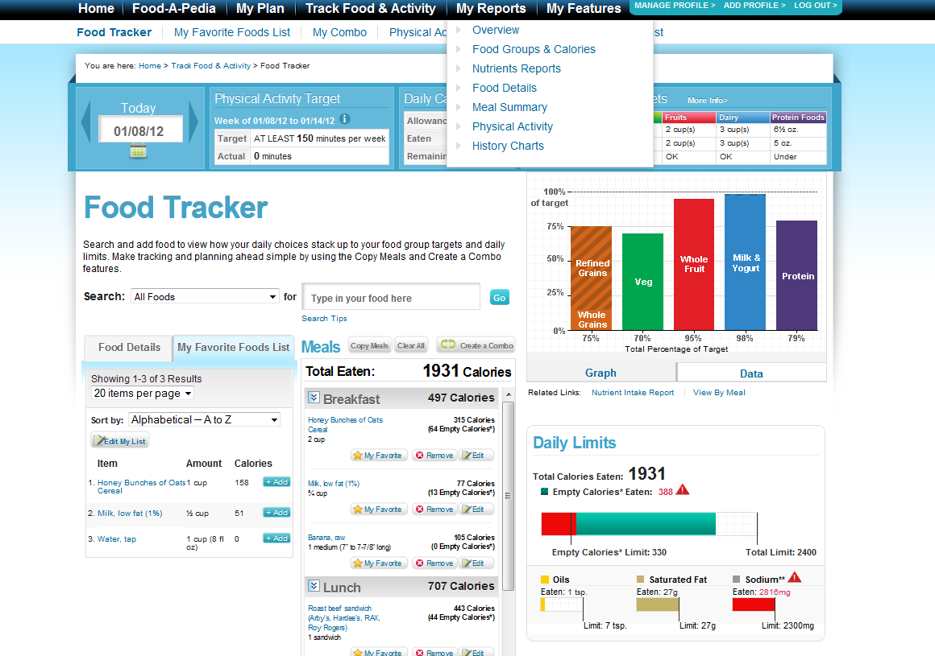

Slide 25
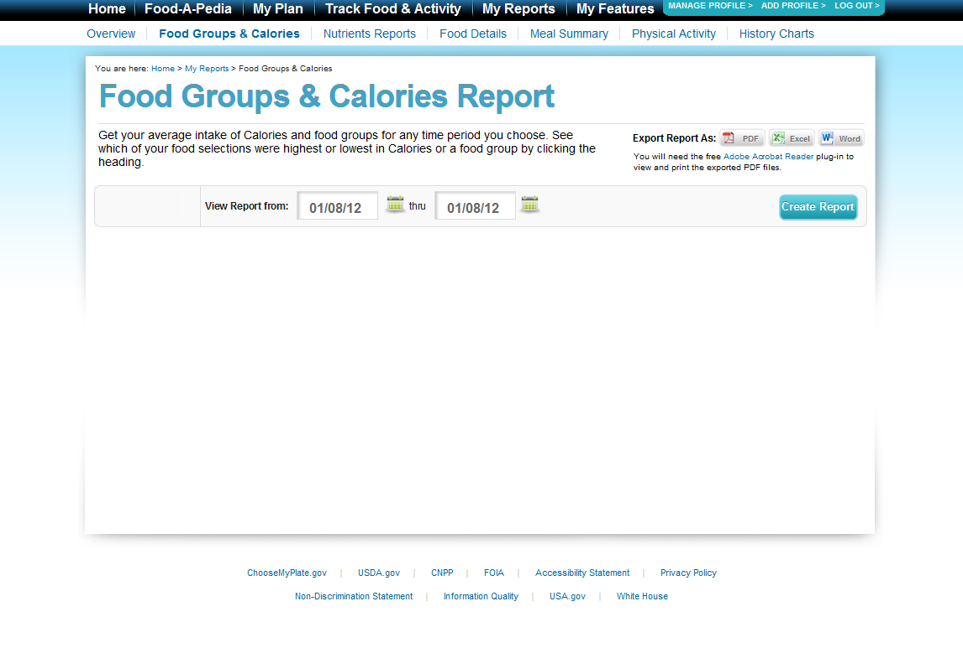

Slide 31
www.supertracker.usda.gov OR choosemyplate.gov

