Slide 1
Daily Food Calorie Needs

Slide 2
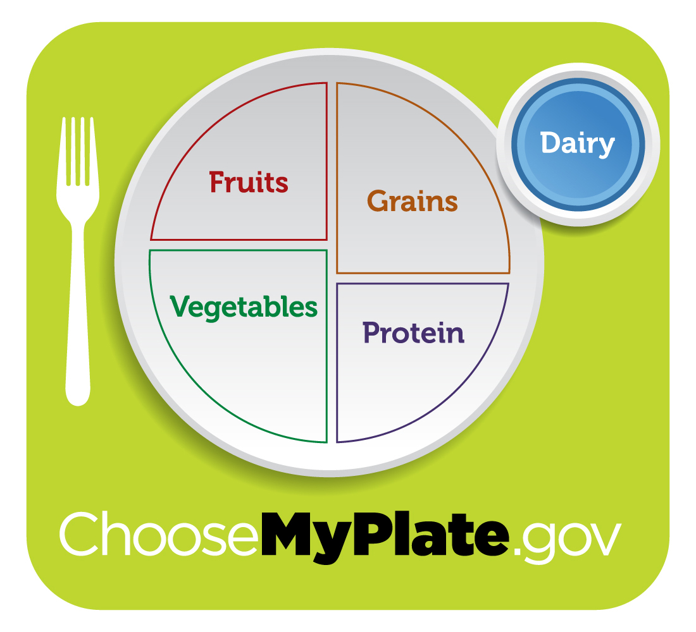

Slide 3
Estimated Calorie Needs
Calorie | 1600 | 1800 | 2000 | 2200 | 2400 | 2600 | 2800 | 3000 | 3200
Female
9-13 | Sed. | High-Sed | Low-Active | Active
14-18 |  | Sed. | High-Sed | Low-Active | Active
Male
9-13 |  | Sed. | High-Sed | Average | Low-Active | Active
14-18 |  |  |  | Sed. | High-Sed | Average | Average | Low-Active | Active

Slide 4
Daily Amount of Food From Each Group
Cal. | 1000 | 1200 | 1400 | 1600 | 1800 | 2000 | 2200 | 2400 | 2600 | 2800 | 3000 | 3200
Fruits | 1 cup | 1 cup | 1.5 cups | 1.5 cups | 1.5 cups | 2 cups | 2 cups | 2 cups | 2 cups | 2.5 cups | 2.5 cups | 2.5 cups
Vege | 1 cup | 1.5 cups | 1.5 cups | 2 cups | 2.5 cups | 2.5 cups | 3 cups | 3 cups | 3.5 cups | 3.5 cups | 4 cups | 4 cups
Grain | 3 oz | 4 oz | 5 oz | 5 oz | 6 oz | 6 oz | 7 oz | 8 oz | 9 oz | 10 oz | 10 oz | 10 oz
Meat | 2 oz | 3 oz | 4 oz | 5 oz | 5 oz | 5.5 oz | 6 oz | 6.5 oz | 6.5 oz | 7 oz | 7 oz | 7 oz
Milk | 2 cups | 2 cups | 2 cups | 3 cups | 3 cups | 3 cups | 3 cups | 3 cups | 3 cups | 3 cups | 3 cups | 3 cups
Oil | 3 tsp | 4 tsp | 4 tsp | 5 tsp | 5 tsp | 6 tsp | 6 tsp | 7 tsp | 8 tsp | 8 tsp | 10 tsp | 11 tsp
D.C. | 165 | 171 | 171 | 132 | 195 | 267 | 290 | 362 | 410 | 426 | 512 | 648

Slide 5

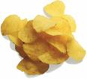

Write what you ate!
Talley Food and Calorie Intake
Food | How Much | Calories/ Serving | Total Calories
Cheeseburger | 1 | 564 | 564
Chips | 2 | 152 | 304
Jello | 1 | 80 | 80
 |  |  | 948

Slide 6
What you ate!
Talley Food Servings
Vegetables- 1 serving (tomato, onion, pickles and lettuce)
Grain- 2 servings (top of bun and bottom of bun)
Meat/Bean- 5 oz.
Milk- 1 serving (slice of cheese)
Oils- 2 tsp (ketchup and mustard)

Slide 7
On a 2000 Calorie Diet
Yours
Recommended
Fruits _____
Vegetables _I___
Grains _II__
Meat & Beans _IIIII__
Milk _I___
Oils _II__
D.C. _____
Fruits- 2 C
Vegetables- 2.5 C
Grains- 6 oz
Meat & Beans- 5.5 oz
Milk- 3 C
Oils- 6 tsp
D.C.- 267
Compare the two. Analyze. Did you meet what your daily needs are in each category? Did you eat too much in some categories? Reflect.

