Slide 1




If I am All Grown Up- How Do I Manage My Money?
Presented by
Marilyn K. Albertson, M.S., CFCS
Extension Associate Professor
Family & Consumer Sciences
Utah State University is an affirmative action/equal opportunity institution.”

Slide 2

Talking to Teens and Young Adults
What do they need to know if they are launching out on their own, going to college, entering the job market or getting ready for marriage?

Slide 3
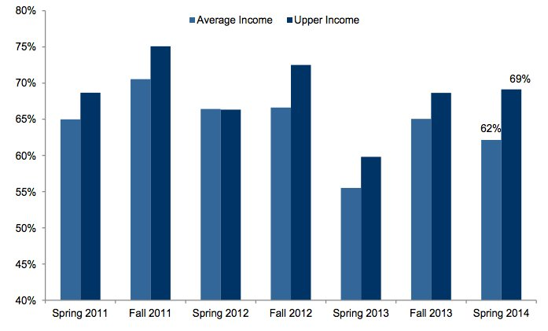
Teens get most money from parents (average or upper-income teens)

Slide 4
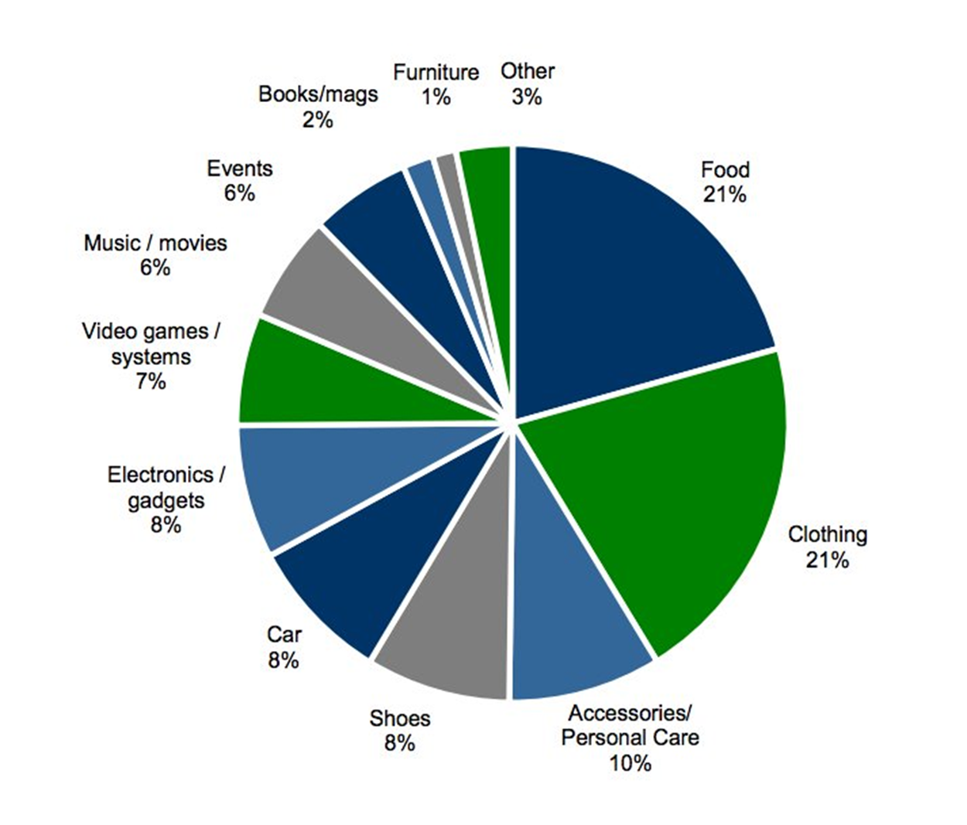
2014 First time Teens spend as much on food as on clothing
Piper Jaffery Semiannual Report April 2014

Slide 5
Teen Income and Savings
Average Income of a 12-14 year old $2,767
Average Income of a 15-17 year old $4,923
38% percent of teens say they are currently saving
22% say they are saving more than last year
57 % of those saving – saving for clothes
51 % of those saving – saving for college
36% of those saving – saving for a car
http://www.statisticbrain.com/teenage-consumer-spending-statistics/

Slide 6
What Are Teens Spending their money on?
More that two-thirds of teenage girls said they shopped at low-budget stores and outlets along with 55 % of boys.
When eating out, about 41% said they prefer quick service dining options and 15% like fast casual options best.
70% own an iPad or tablet.
Nearly half are iPhone users.
They still play video games.
For movies they use Netflix subscriptions over Redbox.
Megan Durisin April 16, 2013 Business Insider
http://www.businessinsider.com/heres-where-teens-spend-their-money-2013-4?op=1#ixzz3d5rGzChk

Slide 7


They Need to Know the Basics about money Management
Teens
Young Adults
Marrying Adults
Notes:
We all need money! It’s great to have, fun to spend, and hard to keep. But why is it so important?
Most teens will spend about $100 per week. Where does this go? Where does this come from?
How do we get it?
Allowance
Gifts
Work
Investments

Slide 8


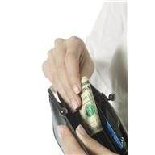


How do teens feel about money? What Are Their Habits?
Notes:
Some of us need to have money for a positive image, some of us need it to fee safe and secure, some of us want to help others with our money, some of us just want to live and enjoy it. That is our money style.

Slide 9

Notes:
How will teens learn to value and manage money? What patterns of behavior have they already learned?

Slide 10
Pair – Share Activity
Pair up. Each partner think of a goal you would like to accomplish in the future.
Take a card from the stack and read it to the person next to you. Look only at the white side with writing on it.
Will this habitude help you or hinder you in achieving that goal? Share your answer with your partner.
Turn card over to see what “Habitude” it is.

Slide 11
Know Your Cash Flow What Are Your Habits?
Write down your habits:
What did you buy in the last month?
Put a + by the items that were needed for a good purpose
Put a – if it was impulsive or a want
How much did you spend for needs?
How much did you spend for wants?

Slide 12
Four Elements of Financial Well-being
Financial Well-Being | Present | Future
Security | Control over day-to-day, month-to-month finances | Capacity to absorb a financial shock
Freedom of Choice | Financial freedom to make choices to enjoy life | On track to meet your financial goals
Source: Consumer Finance Protection Bureau

Slide 13

They need to know how to:
Balance: live within their means
Ask: gather information and evaluate the results
Plan: focus on the future
Act: set themselves up for success

Slide 14

Balance – live within their means
Practice cutting down on mindless spending
Stay out of debt and use credit responsibly
Act like an entrepreneur in generating income and avoiding interruptions in paid work

Slide 15
Activities to teach balance - Cut mindless spending
Track their spending to help them see how they are spending their money now.
Evaluate how much of their spending is for various categories and how much is mindless impulsive spending.
Address needs and wants
Have them identify their spending habits with the “Habitude Cards” or other Financial Personality activities or questionnaires

Slide 16
Activities to Teach Balance
Class Activity – Groups of 4
Share with your group what is the most recent impulsive purchase have you made? As you look back, was it a good or poor decision? What did you learn from it?
Brainstorm ways you could earn extra money to take care of an expense that might come up ….like a doctor bill, car repair.

Slide 17

What Types of Budgets do Teens Have
Holiday Spending Budget
Back to School Budget
Clothing Budget
Transportation Budget

Slide 18
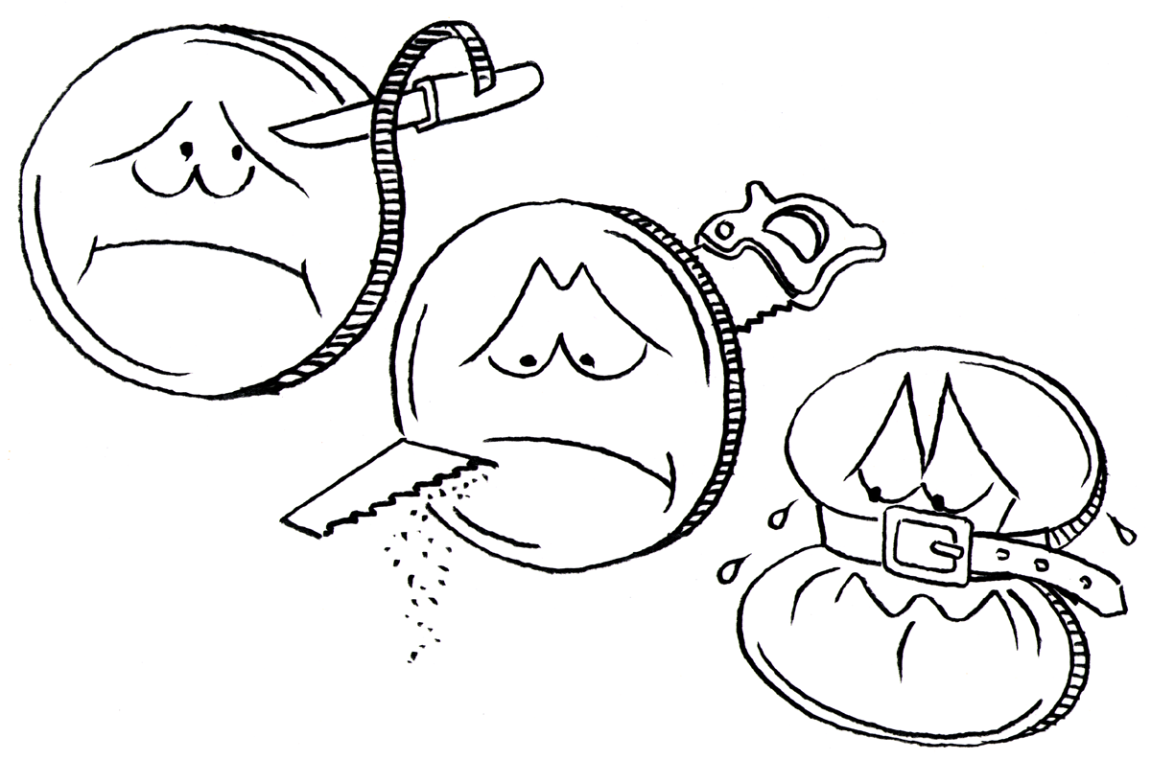
Using a Spending Plan Try It Out
TRIM
CUT
SQUEEZE

Slide 19
Sample Budget

Slide 20
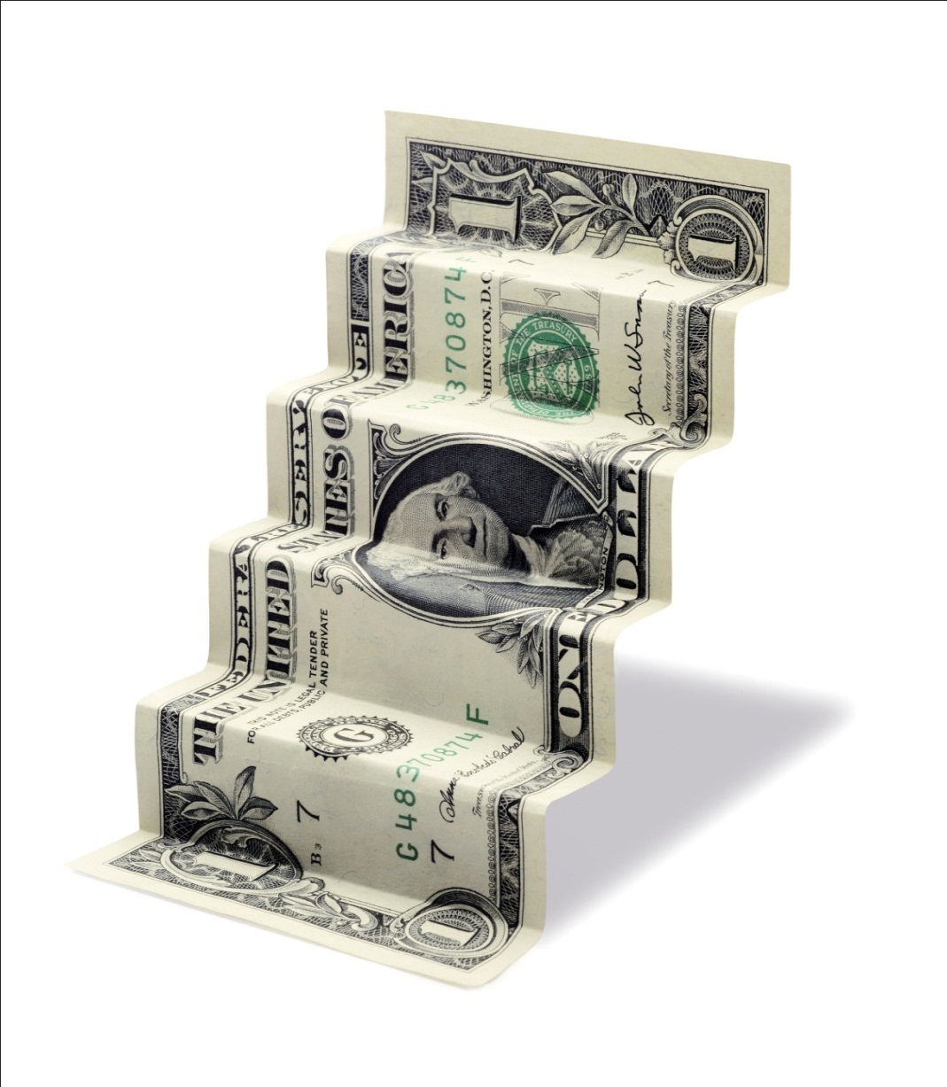
Stepping Down Expenses
Buying Pancakes
RESTAURANT
FAST FOOD
FROZEN
PANCAKE MIX

Slide 21
Step Down Principle
Save a LITTLE to reach your BIG goals
1 Day $3.57
1 Week $25.00
1 Month $100.00
3 Months $300.00
6 Months $600.00
1 Year $1200.00
Out to lunch $5.00
Make own lunch $1.43
Save $3.57
Notes:
If you are wondering how you will ever be able to establish a savings, there are some exercises you can do to review your spending habits and make adjustments.
The step down principle is one of these exercises.* It is a way to reduce expenses by looking at different ways to make a purchase and allows you to choose a less expensive option. It is like a staircase. The most expensive way to make the purchase is on the top step, the next most expensive is on the second step and so-on until the least expensive purchase method is on the bottom step. See if you can step down one or two steps and save the difference from what you normally do. For example if you made your own lunch which costs approximately $1.43 instead of the $5.00 it costs to go out to lunch, you would save $3.57. If your goal was to purchase a sofa for $1200.00, you could reach this goal by simply preparing your lunch every day. In one year you would have $1200.00. You can use this theory on many other items such as clothing. Starting at a high end store, then stepping down to a department store then to a discount store and finally, to a thrift store. Use this principle when you think that you don’t have any extra money to put towards savings. Just remember that little things add up. Do you really need to go to the movies? Could you play a game outside instead for free? Or even rent a movie instead. Ask yourself would you rather have a sofa or french fries every day?
*Alena C. Johnson, Financial Remedies, 2002, Watkins Printing, Providence, UT

Slide 22
Activities Balance – Use Credit Responsibly
Discuss the use of Credit
5 C’s of credit
Character, Capacity, Collateral, Capital, Conditions
Video clip: http://www.investopedia.com/terms/f/five-c-credit.asp
Tips for being wise with credit and comparing credit cards
Credit card simulator, http://www.channelone.com/interact_post/credit-card-simulator/
/

Slide 23
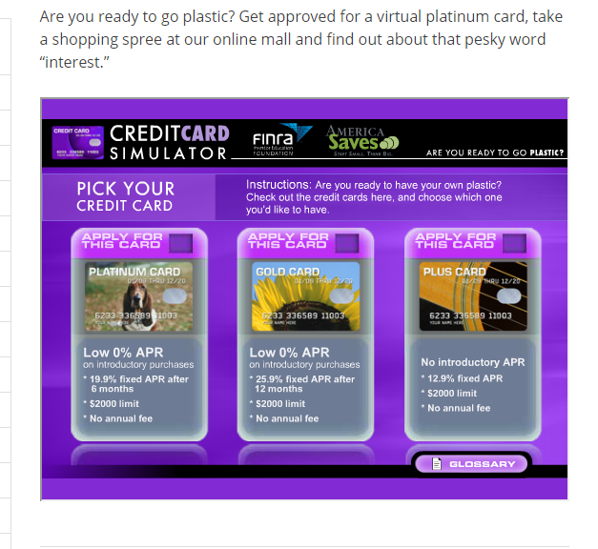
Channelone.com

Slide 24
Forms and Sources of Credit
Comparing Interest Rates with Different Types of Credit
Secured credit – car loans, home loans
Unsecured credit - credit cards
Sources for Credit
Bank or Credit Union Loans, Point of Purchase Loans
Personal Loans
Alternative Forms of Credit – Payday Lenders, Vehicle Title Loans, Pawn Shops, etc.

Slide 25
Alternative forms of Credit and their costs
Videos:
FTC.gov
Payday lenders www.consumer.ftc.gov/media/video-0078-payday-lending
Vehicle Title Loans http://www.consumer.ftc.gov/media/video-0101-car-title-loans

Slide 26

How Can You Be Wise With Credit?
Pay your bill in full each month
If you can’t pay minimum payment on time
Pay extra if you can
Watch how much credit you take out
Be very wise with student loans

Slide 27

Ask – Gather and evaluate information
Identify situations when they need to search for information
Explore how to find trustworthy information
Decide what choices make the most sense

Slide 28
Activities to teach Ask - Shopping for A Car
Hands on Banking – Young Adult Version
Topic 3 – Spending Smart
Lesson 4: Smart Car Buying
Case Study
Federal trade Commission -Focus on Finances Booklet

Slide 29
Activities that Teach Ask – Paying for College
Consider the cost of college
Have students fill out a
College costs Worksheet from http://collegecost.ed.gov/shopping_sheet.pdf
Teach them about the different forms of student aid and loans
FAFSA APPLICATION FRO FEDERAL STUDENT AID
GRANTS, LOANS, WORK STUDY
Loans – government and private
Understand the repayment plan , when you have to pay, interest rate, and loan forgiveness

Slide 30
Activity : Satellite Decisions
Paper
Software
Printer
Internet
Computer
Mouse
Flash drive
Toner

Slide 31

Plan – Focus on the future
Identify specific realistic goals
Make step-by-step plans to reach those goals
Feel confident about their ability to make a difference in their own lives

Slide 32
Activities to teach Plan: Focus on the Future
Measuring Tape activity

Slide 33

Money Goals
Short Term Goals
Long Term Goals
Notes:
Without written down goals-it is only a wish! Take the time to write them down.

Slide 34
Review WHAT ARE YOUR GOALS?
Identify Goals – What you want out of life.
Goal | Need, Want or Hope | Date to accomplish | $$ Needed

Slide 35
What are the steps to reaching Your Goals
Goal: Buy a car | What is needed
Step 1- Figure out how much can afford | Check budget
Step 2 – Read Consumer Reports records on repairs | Go to library to read
Step 3-Check out different used cars, test drive | Ask friends, maybe drive theirs to see how cars handle, features
Step 4 – Find out cost of insurance for various models | Call insurance companies and price different years and models
Step 5- Figure out where to get financing | Check out bank or credit union
Step 6- Find out what the monthly payments will be | Read contract before signing

Slide 36
Activity to teach Plan: Saving your money Always Pay Yourself First(PYF)
Develop a habit of REGULAR savings. THREE types of savings:
Emergency – the unexpected
Short term – car, school, vacation
Long term – retirement, college, etc.

Slide 37
Save Some of Your Dough For expenses you can’t predict...
Establish an Emergency Savings Fund
3 months living expenses
(2 earners)
6 months living expenses
(1 earner)
It is self-insurance for an unexpected job loss or reduction in income

Slide 38
Plan for Periodic Expenses
January Birthdays $10 | February Car insurance $400 | March Oil Change $30 | April Birthday $10
May Prom $75 | June Car registration $150 Birthday $10 | July Concert $50 | August School fees/clothes $350
September Car maintenance $30 | October | November | December Holidays $200
$ 1,315divided by 12 months =
$109.50 to save each month

Slide 39
Planning for the Future-Managing Money In Marriage
Video Clip How not to fall for a jerk https://www.youtube.com/watch?v=SXxypc5AYMs Utah State University Extension youtube. 2013.
Tips for talking about Money before Marriage
Questions to Ask Before You Get Married

Slide 40
What Do You Wish You Knew
If you are married:
What do you wish you had known about your spouse’s financial habits, behavior or attitudes about money before you were married?
David Bach – Story of His First Conversation about Money Management with his wife

Slide 41
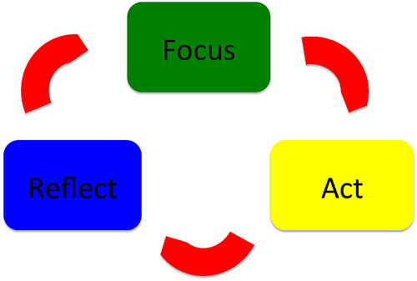
Act – Set themselves up for success
Figure out how to take the steps to put their decisions into action
Determine how to motivate themselves to take the actions
Take advantage of existing ways to stay on track

Slide 42

Activities to teach Act: Take Steps to act
Ask yourself these questions:
Do I really need this?
Is this purchase really helping me reach my goals?
What will happen if I don’t buy it?
Can I use something else instead?

Slide 43
Activities to teach Act: Ways to Stay on Track
Auto deposit to savings account
Calendar Method of tracking Expenses and Payments
Use PowerPay.org to calculate and create a plan for debt repayment

Slide 44
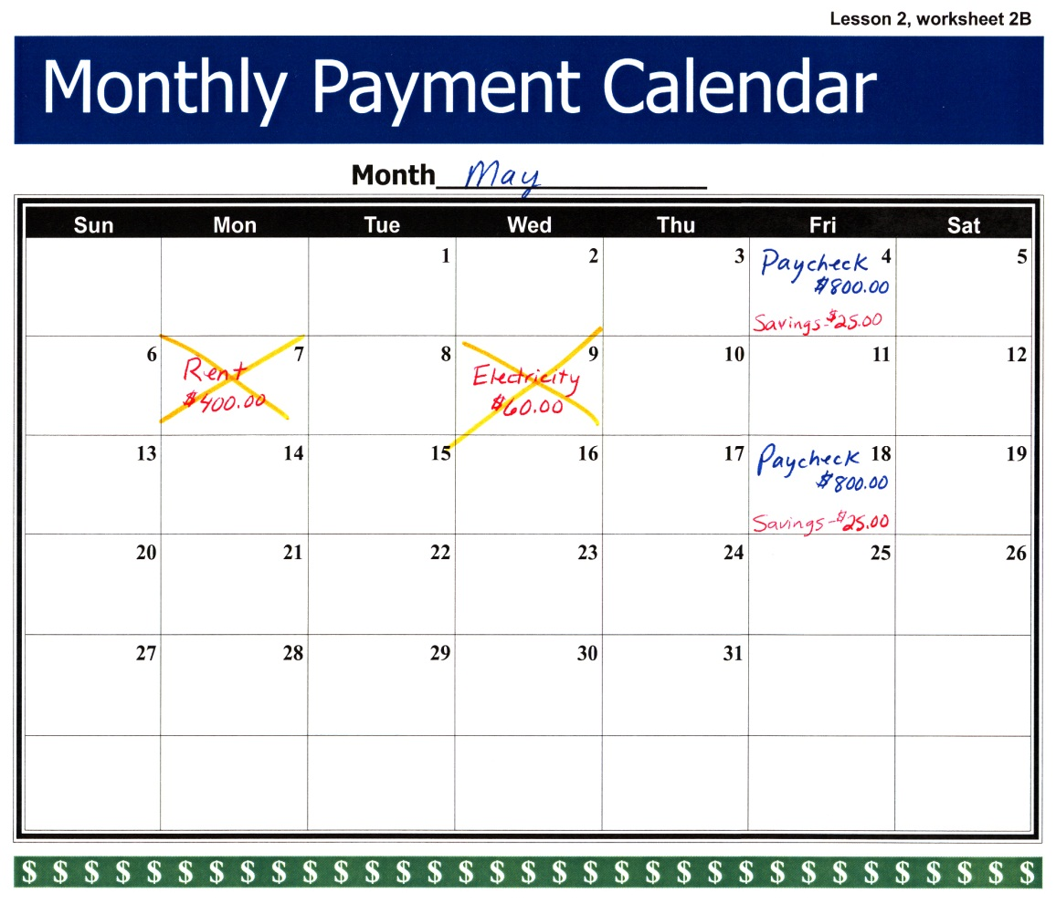
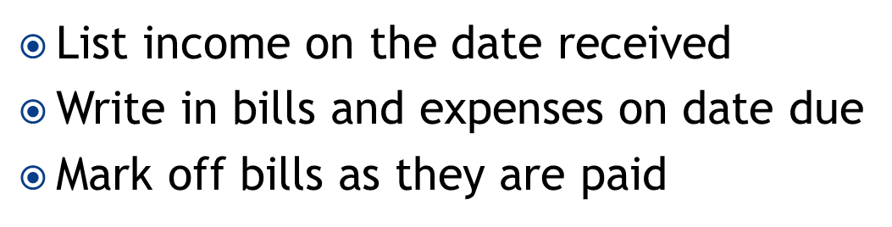
Calendar or Notebook Method
List income on the date received
Write in bills and expenses on date due
Mark off bills as they are paid
Notes:
Calendar or Notebook Method
Some families use a calendar or notebook to track income and expenses. They list income on the date they receive it, write in bills and expenses when they are due, and as they are paid, they mark that bill off. The calendar or notebook also provides a spending record at tax time. The notebook can also be used as a place to store bills so they are easy to find.
Worksheet 1B Tracking Tools, from the Tracking Income and Expenses CIS 1112 publication may be used to help you set up the notebook, if you choose to track expenses with this method.

Slide 45
Road to Financial Success
Four Rules for Financial Success:
Balance - Know your cash flow and know what you owe
Ask - Know what questions to ask and where to get reliable information
Plan – Set goals, and invest some of your money for the future
Act – Work your plan and celebrate your successes

Slide 46


Slide 47
Questions?
Thank You

