Slide 1
SPORTS NUTRITION
NUTRITION FOR THE ATHLETE

Slide 2
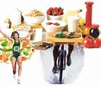



Sports Nutrition Depends on the following
Additional Energy Expenditures that are Needed
Sport Specific Needs for:
  Team Sports, Power Sports, Aesthetic Sports, Endurance Sports, Winter Sports, Water Sports, Mixed Sports, Individual Sports
Food Function with Type of Sport
Training Tools to Improve & Prepare Athletes

Slide 3
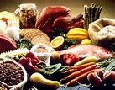
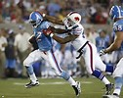

Food & Functionality
Energy =
  High & Low-fiber Carbohydrates
  Animal & Vegetable Lean Proteins
  Low-fat Fats
Food Choices that Impact Performance =
  Eat a Variety of Foods
  Eat Nutrient Dense Foods
  Eat High Vitamin & Mineral Foods

Slide 4
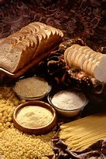
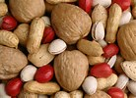

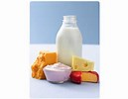
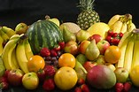
Carbohydrates
Carbohydrates are the body’s primary source of energy.
Dietary carbohydrates include: Grains, Fruits, Vegetables, Beans, Nuts & Dairy.
These foods can be stored in the liver & in the muscles as glycogen to be used later for energy.
Glycogen is a polysaccharide that forms into a glucose when it is hydrated.

Slide 5
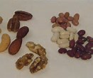
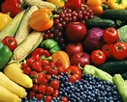
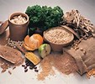
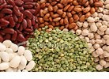
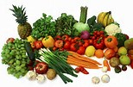
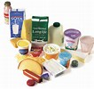
Carbohydrate Recommendations . . .
Minimum Amounts
  5-7 oz. per day
  Athletes need to get 55 – 60% of their daily calories from Carbohydrates the same as non-athletes
Considerations
  Size, Gender, Sport & Diet
  Caloric Density: Carbs are 4 cal/gram
Carbohydrate Loading requires 8-10 oz.
During Training use 30-60 grams of carbs/hr

Slide 6
Student Goal
Tina is a 16 year-old Soccer Player, she is 5’6” & weighs 135 lbs. Her Carbohydrate Goal is: 305-365 grams/day
Food | Carbohydrate Grams
1.5 C Dry Cereal, 1 C Skim Milk, 1 Banana, 8 fl. oz. Orange Juice | Breakfast 100 grams
Turkey Sandwich (2 sl. Bread, 2 sl. Turkey, 1 sl. Tomato, 1 sl. Lettuce, Mayo & Mustard), 1 Apple, 2 Whole Grain Crackers, 1 C Yogurt | Lunch 130 grams
1 C. Chicken Stir-fry w/Vegetables, ½ C Brown Rice, 1 C Yogurt w/½ C Berries | Dinner 125 grams
Total | 355 grams

Slide 7

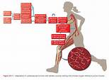
Carbs help the body by?
If excessive Carbs are eaten they are stored as fat by the body but can be called upon later for energy to improve your performance.
Carbs reduce the risk of hypoglycemia or low blood sugars.
Carbs provide fuel for active working muscles.
Carbs prevent “bonking” or “hitting the wall” & forcing you to slow down or stop during an event.

Slide 8

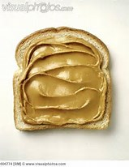
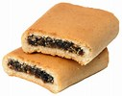
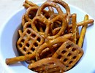

Carbs During Exercise
Research shows that 40-60 grams of carbs/hr will help delay glycogen depletion & keep the body feeling stronger.
Foods to eat during an event to keep the body strong:
  1 medium Banana – 25 g
  1 slice Bread w/Peanut Butter - 20 g
  2 Fig Newton Cookies – 14 g
  1 oz. Pretzels – 20 g
  Roll w/1 Tbsp Jam – 50 g

Slide 9
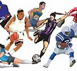
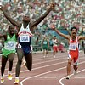
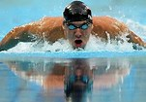
Tips to limit stomach distress
Stay hydrated & practice drinking during training
Avoid “over nutrition” both before & during events
Keep pre-race meal moderate in lean protein & low in fat
Eat a high energy, high carb diet regularly
Avoid high fiber foods before exercise
Limit anti-inflammatory meds, alcohol, caffeine, antibiotics & supplements before events
Visit the Port– A–Potty before your event

Slide 10
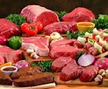
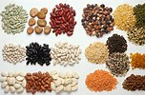
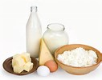
Proteins
Use Animal + Vegetable Sources
Athletes need 15-20% of their daily calories from protein, which is a higher protein content than non-athletes.
Caloric Density: Proteins are 4 cal/gram
Build & Repair Body Tissue, Bone & Muscle
Provide Immune Functions, Enzymes, Hormones & Antibodies
Provide Vitamins & Minerals
Help w/Transportation & Balance of Fluids

Slide 11
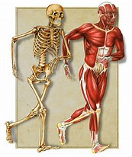
Protein Recommendations
Girls need 5.5 oz/day & Boys need 6.5 oz/day
Athlete Girls & Boys need 6.5 – 8.5 oz/day or 95 grams
Protein-Rich Foods | Protein grams
1.5 C Skim Milk | 12 grams
¾ C Oatmeal | 7 grams
1 String Cheese | 8 grams
¼ C Almonds | 8 grams
1 C Plain Yogurt | 10 grams
2 Slices Deli Turkey | 7 grams
2 Tbsp Peanut Butter | 7 grams
1 Chicken Breast | 25 grams
1 Sports Bar | 10 grams
Total | 94 grams

Slide 12
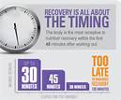
Recovery Nutrition
Well-balanced eating after a workout helps the body replenish lost nutrient stores, repairs damaged tissue & prepares for the next workout.
When you eat matters it is very important.
The body is primed to replenish lost glycogen stores within 4 hrs. Start refueling within 15-60 min after an event.
Recovery is in 3 stages.
  Stage 1 - Snack + Fluids (15-60 min after an event)
    Carb drink (chocolate milk, Gatorade or smoothie w/fruit)
    Protein 10-15 grams (peanut butter sandwich, fruit yogurt or sports bar)

Slide 13
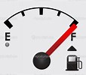
Recovery Nutrition Cont.
  Stage 2 – Meal + Fluid (within 2 hrs after event)
    Balance mostly carbs, some lean proteins, few low-fat)
    Pasta w/tomato sauce, veggies & chicken; Turkey sandwich, whole wheat crackers & fruit; or Chicken stir-fry with brown rice & veggies.
  Stage 3 – Snack + Fluid (within 4 hrs after event)
    Carb drink (chocolate milk, sports drinks, fruit waters, or smoothies)
    Protein 10-15 grams (crackers & string cheese; graham crackers w/peanut butter; or cereal w/low-fat milk)
Certain types of training or competition require greater detail.
  2 or more training sessions/day
  Less than 8 hrs between sessions
  Endurance training more than 90 min.
  Multi-Day competitions

Slide 14

Fats
Sources include Animal Products (full fat dairy, meats – beef, chicken, pork, fatty fish & egg yolks)
Vegetable Products (nuts, seeds, avocados & olives)
Processed Foods (cookies, crackers, baked goods & salad dressings)
Vegetable Oils (olive, canola, peanut, sesame, walnut, safflower, etc.)
Caloric Density: Fats are 9 cal/gram
Athletes need to get 20-25% of their calories from fat. Athletes need a leaner fat content than non-athletes.

Slide 15
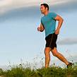
Fats help the body by?
Providing lasting energy that can be used for walking, jogging & easy cycling
Providing heat, insulation, protect our vital organs, start chemical reactions, aid metabolism, can improve heart health, & help with immune functions.
Transporting fat soluble vitamins A, D, E, & K to the body to be used.
Providing Omega-3 Fatty acids (flax seeds, walnuts, salmon), which are valuable nutrients & reduce body inflammation

Slide 16
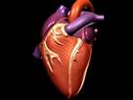
Fats help the body by? Cont.
When excessive fats are eaten they lead to:
  Heart Disease
  Obesity
  Diabetes
  Clogged Arteries
  Stroke
Athletes should use healthy fats & limit their fatty meats, high fat Dairy products, Fried foods & Solid Fats

Slide 17
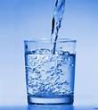
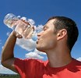
Hydration
All individuals need water, a minimum of 64 fl. oz. a day.
Fluids are found in most foods which helps the body to consume 64 fl. oz.
Fluids help to regulate the body’s temperature, regulate blood pressure, provide structure & lubricants for the body, maintain electrolyte balances, help with nutrient transport & aid in a quicker body recovery (dehydration delays recovery)
As exercise increases, weight loss due to dehydration increases. A 2% weight loss can impair body performance.

Slide 18

Hydration cont.
Allowing the body to become dehydrated can cause muscles to cramp, alter blood pressure & causes weight loss.
Drinking too much water can alter electrolytes & cause hyponatremia – low levels of sodium in the body which causes low blood levels.
A good rule of thumb is to get 16 oz. of water with each meal.
Carry a water bottle with you whether you are working out, working, at school, or doing whatever.
Start to hydrate 4 hrs before any event. Drinking about 10-16 fl. oz during this time.

Slide 19

Hydration cont.
Urine color darkens as dehydration increases, monitor urine color & lack of frequency.
Fluid intake is influenced by: gender, age, body mass, outside temperature, sweat rate, altitude & type of sport involved in.
How much should I drink?
  Always drink a glass of water, milk, or 100% juice at each meal.
  Drink more when adapting to a new environment (altitude, temperatures & humidity)

Slide 20

Hydration cont.
Determine Sweat Rate:
  Step 1 – Weigh yourself (minimal clothing, no shoes) before event.
  Step 2 – Keep track of all fluids consumed during event
  Step 3 – Weigh yourself after event (same clothing)
  Step 4 – Find the difference & convert to oz. (1 lb. = 16 oz or 2 cups of fluid)
  Step 5 – Add to the oz you consumed during the event
  Step 6 – Determine hourly sweat rate: divide total oz lost by hrs of event

Slide 21
Sweat Rate Example
Tim practices for 2 hrs & drinks 20 oz (2.5 cups)
Steps | Action | Results
1 | Weigh self before event | 175 lbs
2 | Keep track of fluids consumed | 20 oz
3 | Weigh self after event (same clothing) | 172 lbs
4 | Find the difference & convert to oz | Lost 3 lbs = 48 oz
5 | Add the oz consumed to oz lost | 20 oz + 48 oz = 68 oz (8.5 cups)
6 | Determine hourly sweat rate: divide oz lost by hrs in event | 68 oz/2 hrs = 34 oz or 4 cups/hr lost

Slide 22

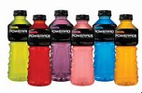
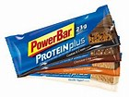
Supplements
Athletes who eat a varied, nutrient dense diet, following the dietary guidelines & get 8 glasses of water a day do not need sports bars, dietary supplements, or sports drinks.
Supplements include the following risks: Drug tests at events, Financial Burdens, Caffeine, FDA Non-tested ingredients, Health Risks, Quality Research, & Can Effect a Good Performance.

Slide 23

Pre-Game Meals
Before the Pre-Game Meal, usually the night before:
  Have a meal that is high in carb-rich foods, moderate in lean protein & low in fat.
Pre-Game Meal should:
  Be 2-4 hrs before the event
  Contain 8-16 oz of water
  Contain low-fiber foods
  Be familiar, not a new food & is easily digested
  Contain 1-3 grams of carbs/lb of weight
  Be Carb-rich: (rice, cereals, pasta, bread, fruits, potatoes, corn, peas, & squash), Lean-proteins (chicken, turkey or fish) & Low-fat (skim milk, low-fat yogurt, avocados, nuts & seeds)
  Should take into account: duration of event, gender, body mass, age, sport & energy needs

Slide 24
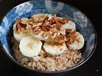
Pre-Game Meal Examples
Breakfast
  1-2 cups Rice Chex Cereal w/1 cup skim milk
    Low fiber Carbohydrate
    Vegetable Protein
  1 cup sliced Strawberries
    Low fiber Carbohydrate
  1/3 cups Almonds
    Vegetable Protein
    Low-fat Fats
  8 oz glass of water
    Hydration
Write 2 more Different Breakfasts – Use the following format for a Pre-Game Meal & plan 2 breakfasts using the following grid.

Slide 25
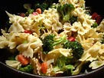
Pre-Game Meal Examples
Lunch
  Pasta Salad (1 ½ cups cooked pasta; 1 cup vegetables (carrots, tomatoes, celery, olives, broccoli & peas); ¼ cup meat (tuna, chicken, or salmon); 1.5 Tbsp vinaigrette dressing)
    Low-fiber Carbohydrate
    Lean Animal Protein
    Low-fat Fats
  Dinner Roll
    Low-fiber Carbohydrate
  Slice of Watermelon
    Low-fiber Carbohydrate
  8 oz glass of Water
    Hydration
Write 2 more Different Lunches – Use the following format for a Pre-Game Meal & plan 2 breakfasts using the following grid.

Slide 26

Pre-Game Meal Examples
Dinner
  Turkey wrap (2 slices of lean turkey, romaine lettuce, tomatoes, avocados, olives, cucumbers, celery, tortilla, mozzarella cheese)
    Low-fiber Carbohydrate
    Lean Animal Protein
    Low-fat Fats
  1 cup low-fat yogurt w/ ½ cup fruit
    Lean Protein
    Low-fiber Carbohydrate
  ½ cup snap peas
    Low-fiber Carbohydrate
  8 oz glass of Water
    Hydration
  Write 2 more Different Dinners – Use the following format for a Pre-Game Meal & plan 2 breakfasts using the following grid.

