Slide 1
Video Clips for FHS 1500 Human Development
By Brandi Fausett
Spanish Fork High School

Slide 2
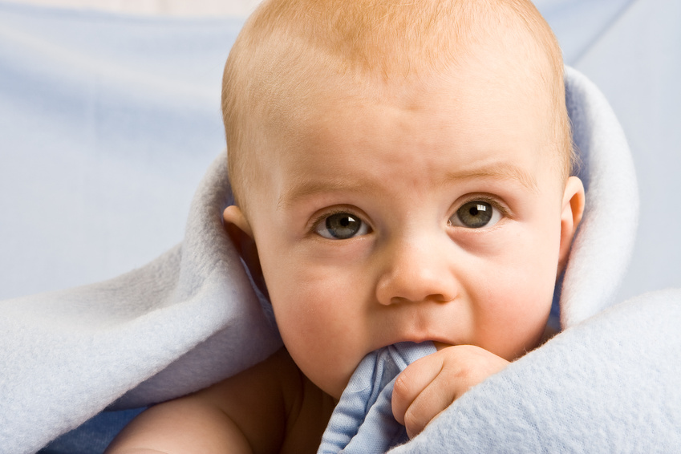
Digital Handout – Email
Chapter 3 REFLEX VIDEOS –
Grasp Reflex
http://www.youtube.com/watch?v=TidY4XPnFUM
Babinski Reflex
http://www.youtube.com/watch?v=oI_ONptx2Ns
Swimming Baby Reflex
http://www.youtube.com/watch?v=QW5p2G4EtP0
Stepping Reflex
http://www.youtube.com/watch?v=CkGjOwPXsvo
Palmar Grasp Reflex
http://www.youtube.com/watch?v=TidY4XPnFUM
Moro Reflex
http://www.youtube.com/watch?v=ur0UcdJ8sR0

Slide 3
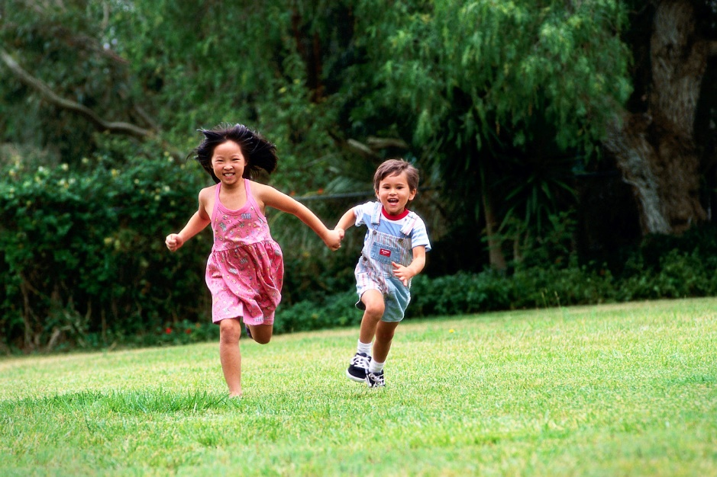
Types of play – Ch.6
Parallel Play
https://www.youtube.com/watch?v=PiuDefOzXU4
Rough and Tumble Play
https://www.youtube.com/watch?v=m6rguNVbK24
Sociodramatic Play
https://www.youtube.com/watch?v=pdOwvZwiYwk
Solitary Play
https://www.youtube.com/watch?v=wnbjtdAnJvI
Stages of Play
https://www.youtube.com/watch?v=nhF6E7zHqWI
Children Speaking about the Importance of Play
https://www.youtube.com/watch?v=sby38BbLZuY

Slide 4
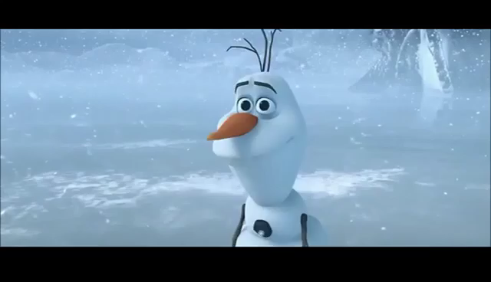
When Talking About Love

Slide 5
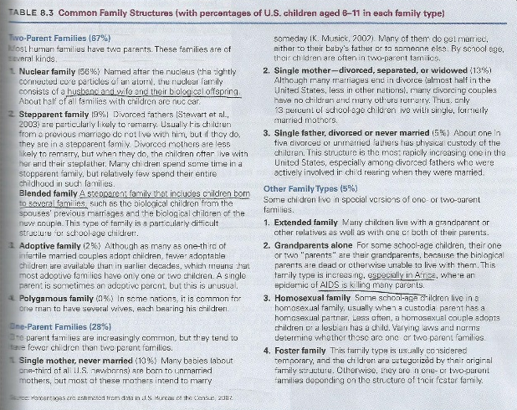
Family Structures
Adopted Families – Matilda, the scene where her teacher adopts her.
https://www.youtube.com/watch?v=-jP2qGjxZGs
Extended Family – Charlie and the Chocolate Factory –
the scene showing the grandparents living with them.
https://www.youtube.com/watch?v=3sKngQ8Gsmc
Nuclear Family – Cheaper by the Dozen
https://www.youtube.com/watch?v=Hsd1tCmeYBc
Blended Family – Yours, Mine and Ours clip
https://www.youtube.com/watch?v=t0R7IRtvvFA
Foster Family – The Blind Side
https://www.youtube.com/watch?v=pPjYhPGkhGA
Single and Divorced Mother & Father – The Parent Trap
https://www.youtube.com/watch?v=DJEKLIpc5qI

Slide 6
Other Fun Activities I have done in this class
Ch. 9 Adolescents/Sleep – After learning about sleep, I let them take about a 20 minute nap with relaxing music on. They love it!!
Nutrition – Make a healthy breakfast meal in class.
Exercise – Have the lesson outside or take a walk around the school.
Strong Bones – We have a arm wrestling competition.
I have the Teacher Instruction Book that has a lot of activities and handouts to use for each chapter in class. A lot of them are good and fun for the class.
  Memory activities
  Sterotyping
  Intelligences

Slide 7
Contact Info
If you would like any of my PowerPoints or Activities I use, please email me at
brandi.fausett@nebo.edu

