Slide 1
Dessert Plating and Presentation

Slide 2
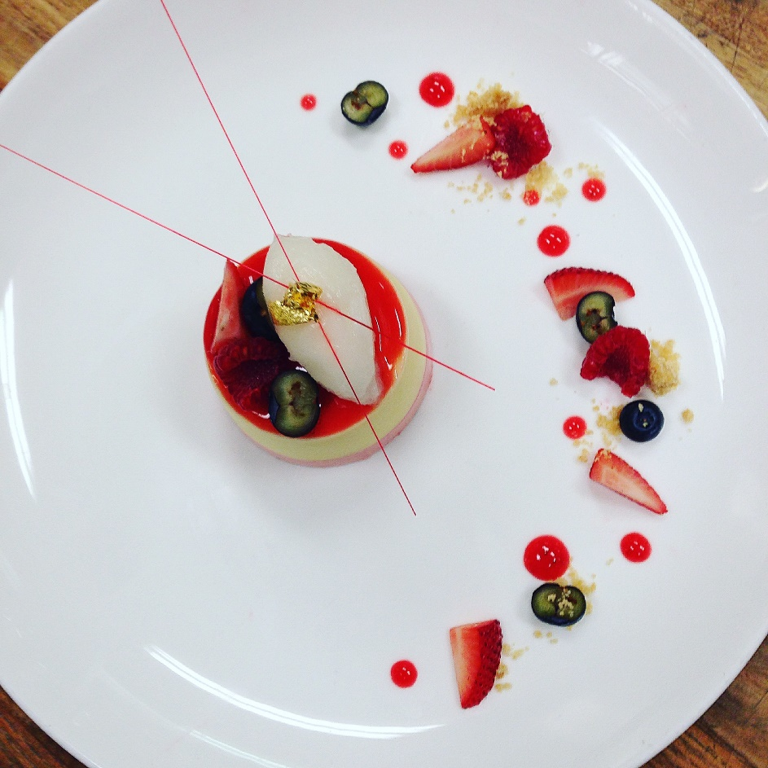
How Fun is This?!!

Slide 3
Learning Goal
Today you will learn how to correctly and creatively plate a dessert so you can charge twice as much or get more ohhhs and ahhhhs.

Slide 4
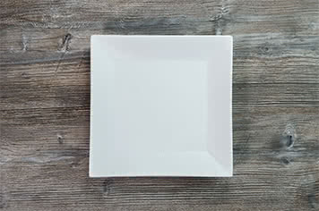
Choose the Perfect Plate
Choose the right plate. Choose the right size plate. Big enough to allow your food to stand out, small enough that your portions don't look too small.
Choose a complementary plate color.
White plates are popular because they create high contrast and provide a neutral background for your colorful creations. Utilize white space by thinking of the rim as your frame.

Slide 5
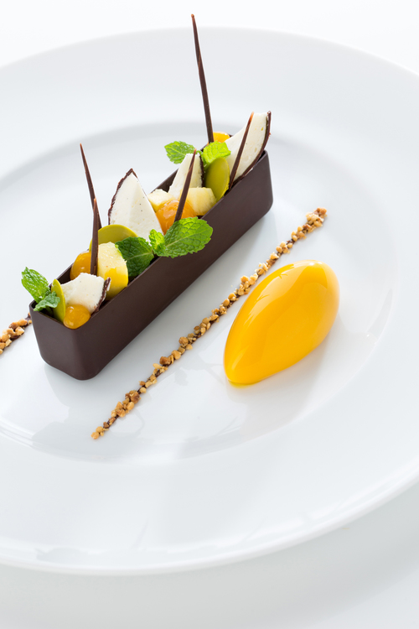
Placing your Ingredients
Use moist ingredients as your base. Another rule of thumb is to plate moist or runny ingredients first, as they tend to move during delivery if they aren't held down by other foods.
Serve odd amounts of food. If you're serving small foods like shrimp, scallops, or bite-sized appetizers, always give guests odd quantities. Serving 7 Brussel sprouts instead of 6 creates more visual appeal, and diners will also perceive that they're getting more food.
Place food to create flavor bites. Essentially, flavor bites are forkfuls of food that combine all of the ingredients in your dish into one bite. Creating flavor bites is the perfect accompaniment to creative plating as it pleases both the eye and the taste buds.
Don't overcrowd your plate. Be sure to never overcrowd your canvas, and keep it simple by focusing on one ingredient - usually the protein for an entrée. Finding a focal point also ensures that the accompanying ingredients will play a complementary, supporting role.

Slide 6
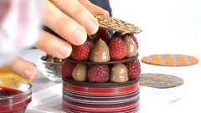
Pay Attention the Details
Think about color and contrast. One of the best-kept secrets to beautiful plating is paying close attention to the details. Try to pair ingredients with complementary colors as this will further enhance your dish's visual appeal.
Create height on your plate. Another way to catch your guests' eyes is to utilize the power of height.
Use texture to enhance your dish. Finally, don't forget about texture. Contrasting a smooth panna cotta with a crunchy tuile cookie creates appealing texture combinations that are classic in high-end cuisine.

Slide 7
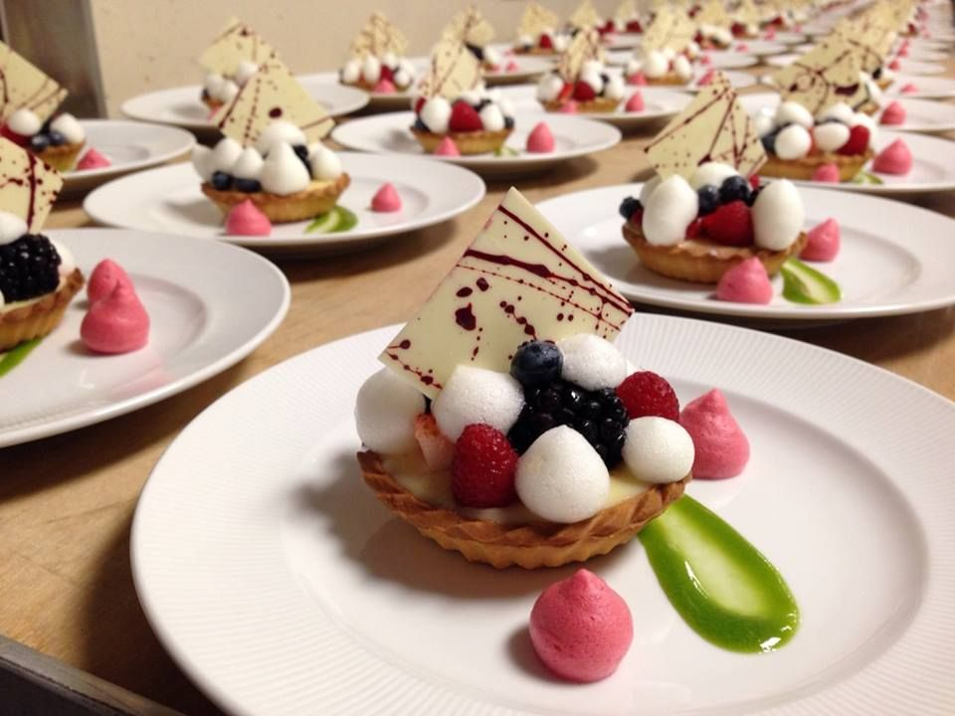
Use Garnishes Purposefully
In the past, chefs casually threw a piece of kale and an orange slice onto every plate as it left their kitchen. However, these garnishes didn't add anything exciting to the dish, and few guests ever ate them. Here are a few examples of smart garnishes and how to incorporate them:
Choose edible garnishes. As you finish plating, remember that garnishes must be related to the dish and should always be edible.
Place garnishes purposefully. Disperse them thoughtfully in order to add color or texture. Also, avoid using unappetizing garnishes like large mint leaves, large chunks of citrus, and anything with a strong odor.

Slide 8
Just a few ideas
Video

Slide 9
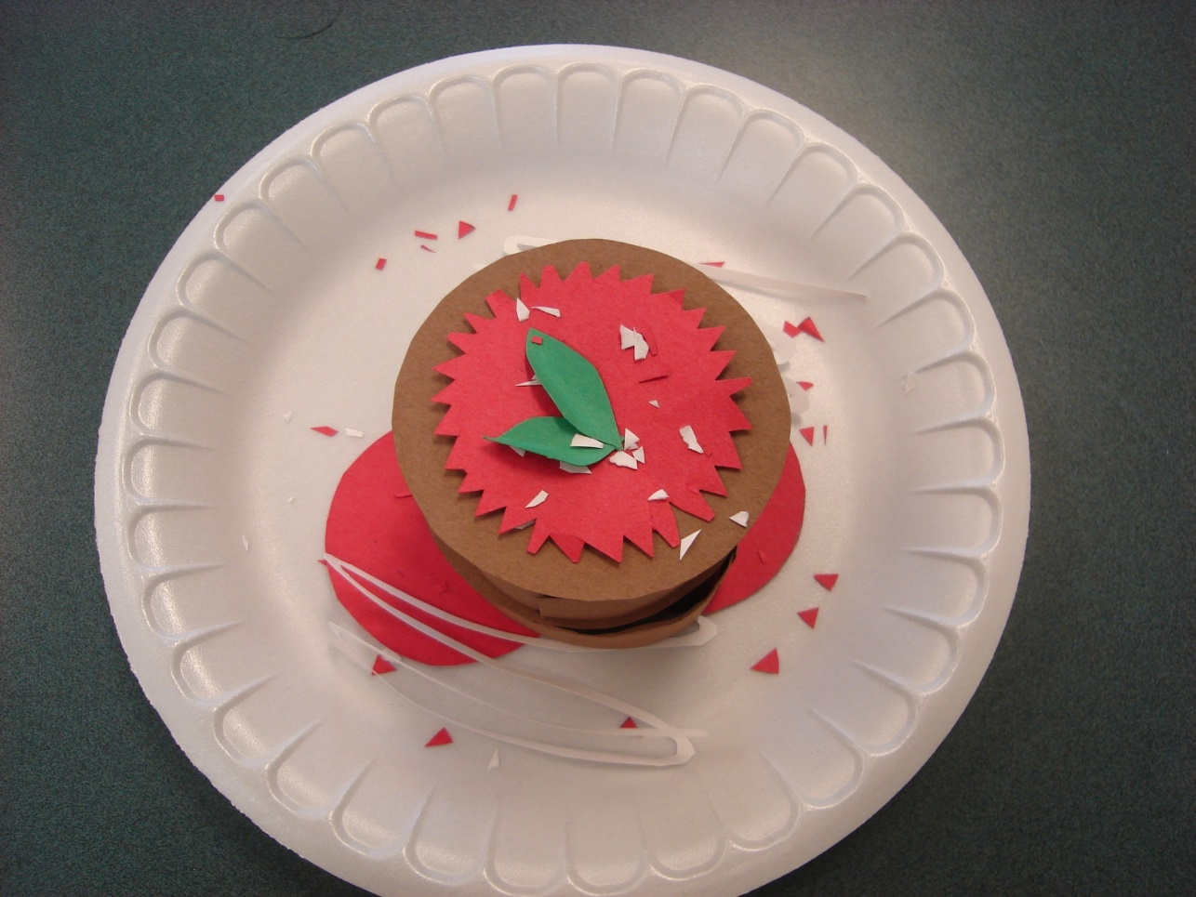
Now you create it in paper.

Slide 10
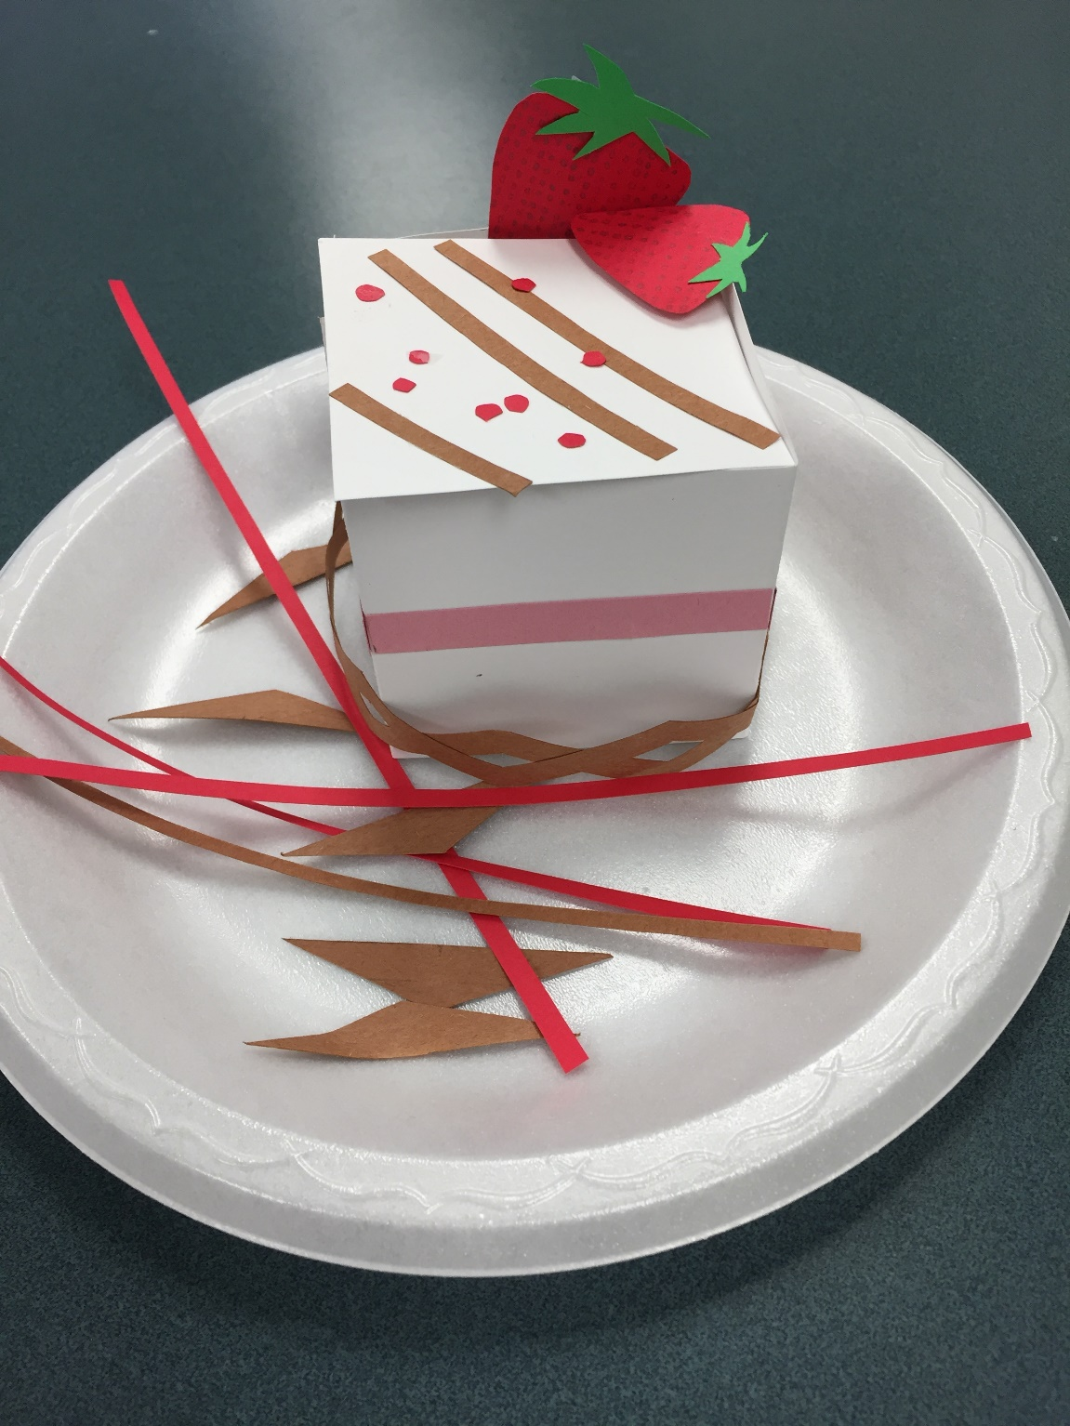

Slide 11
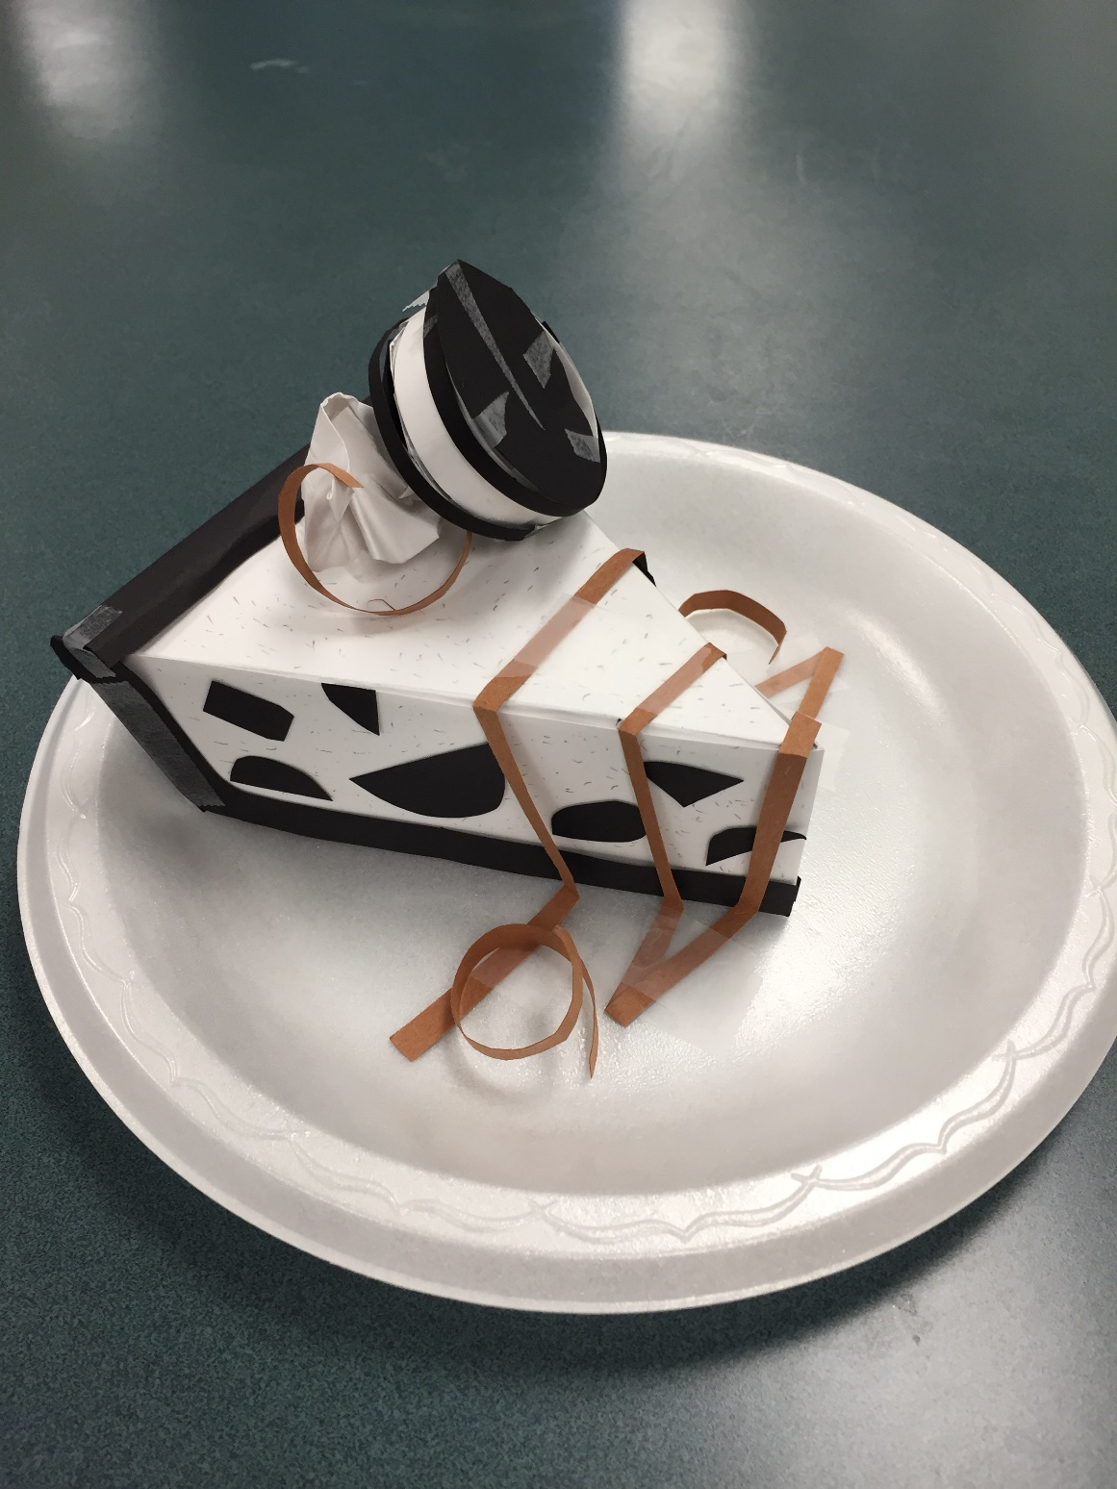

Slide 12
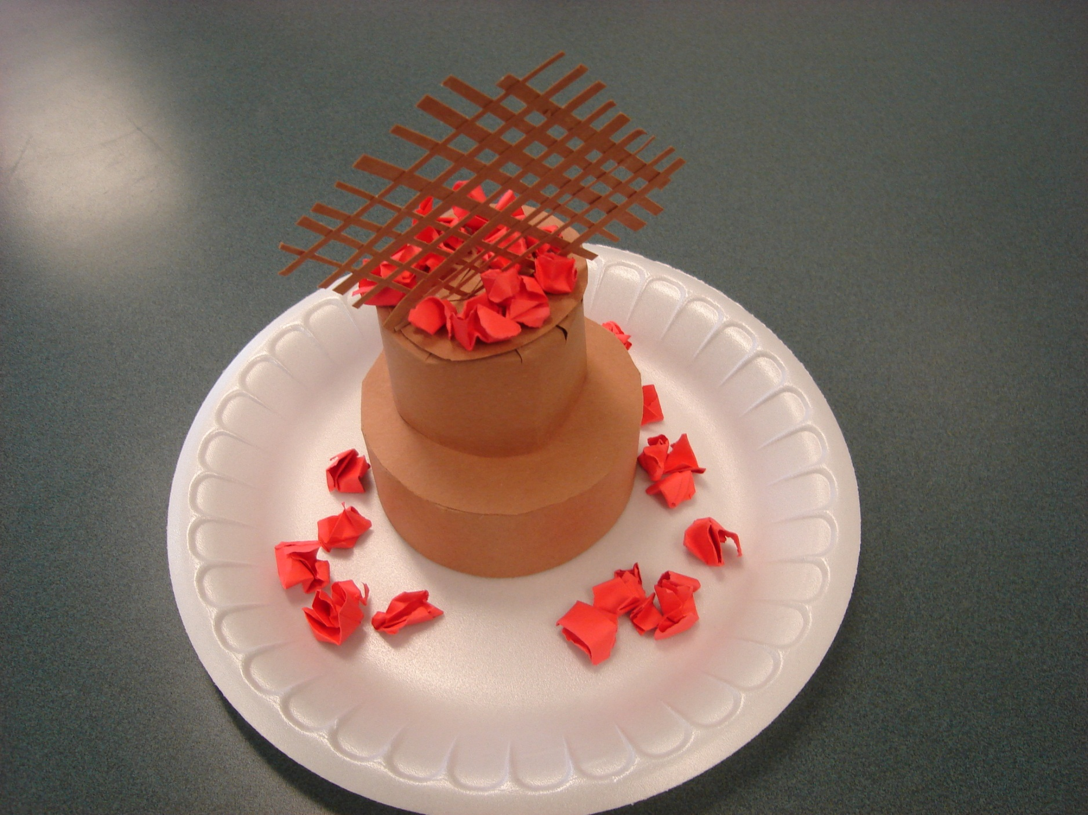

Slide 13
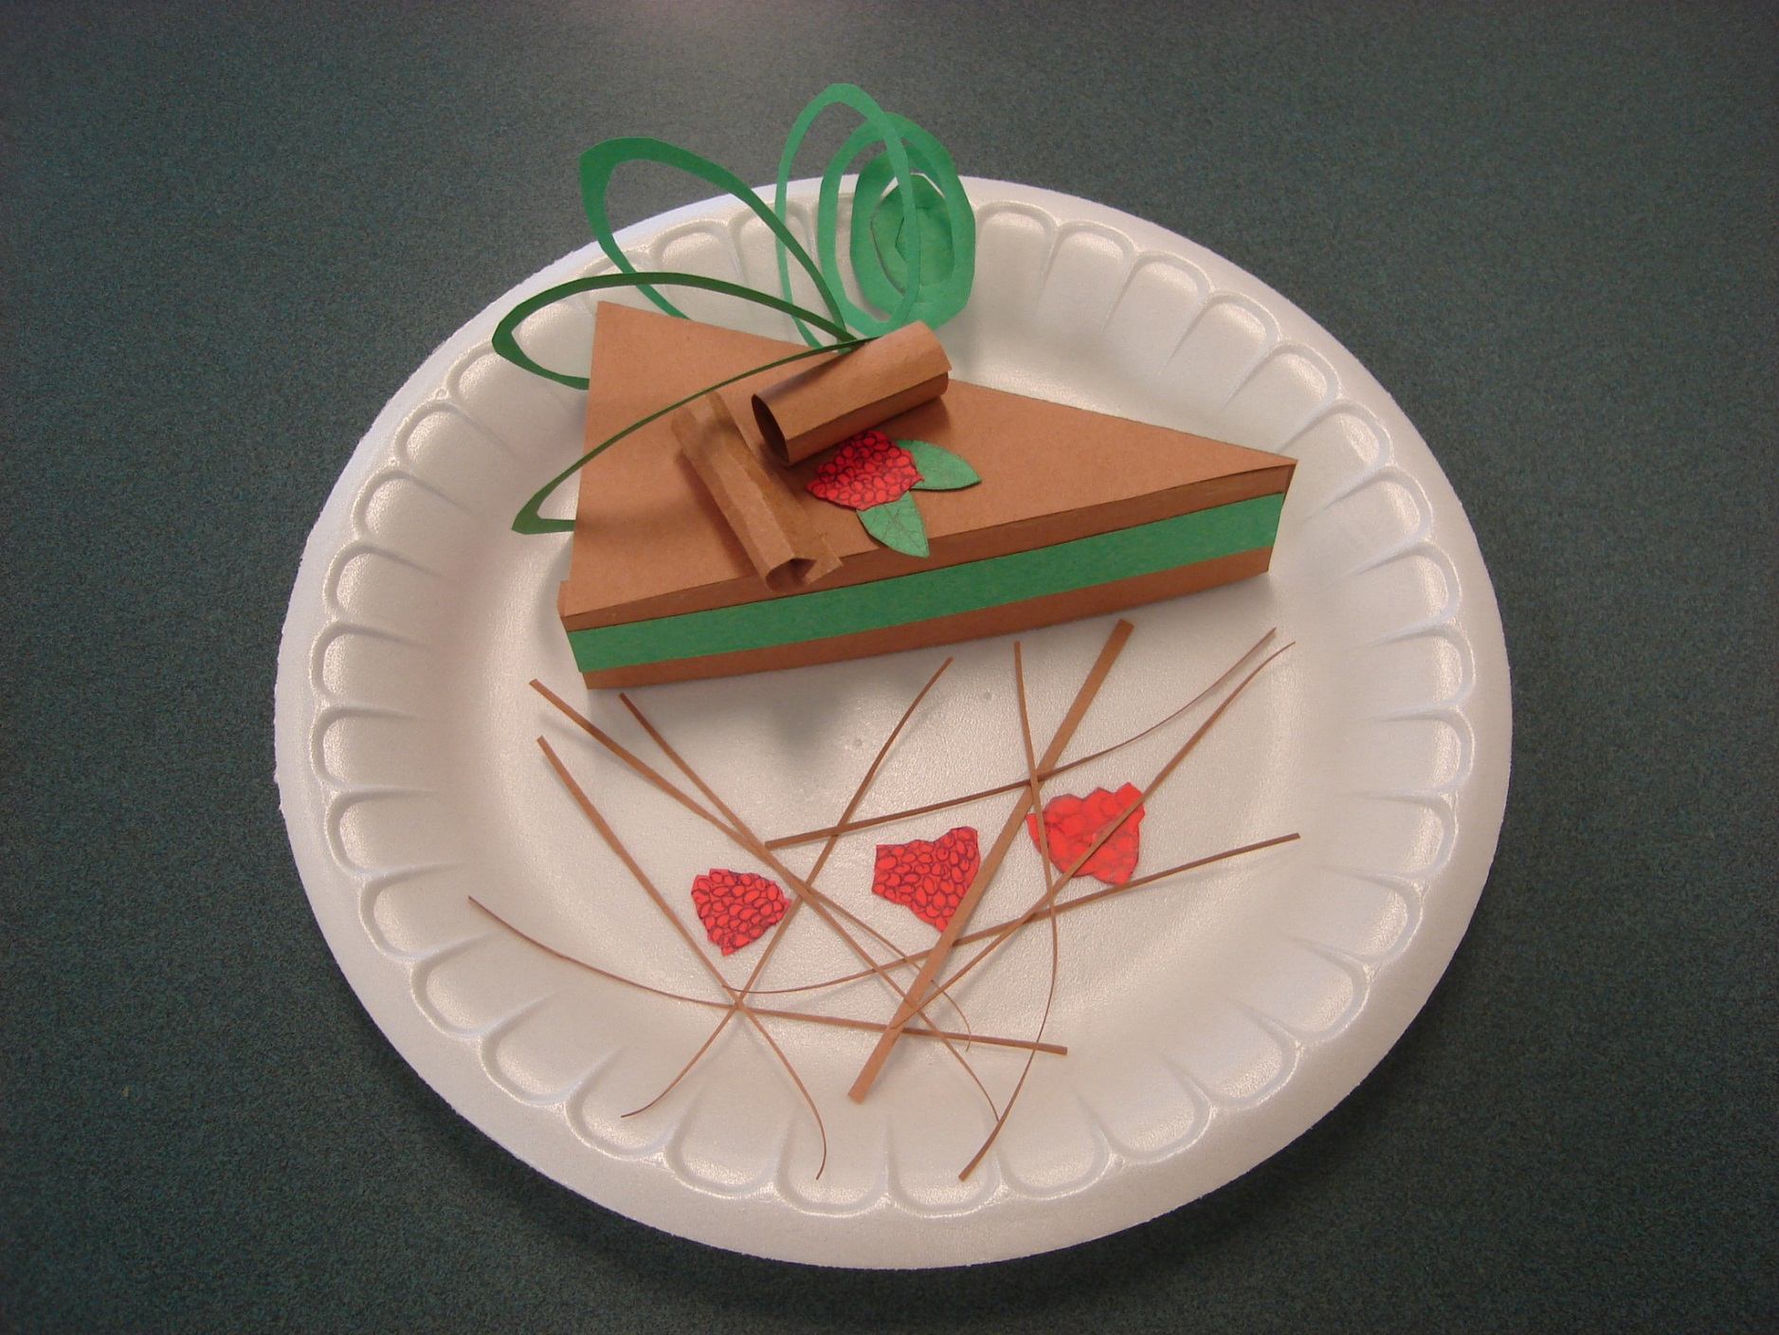

Slide 14
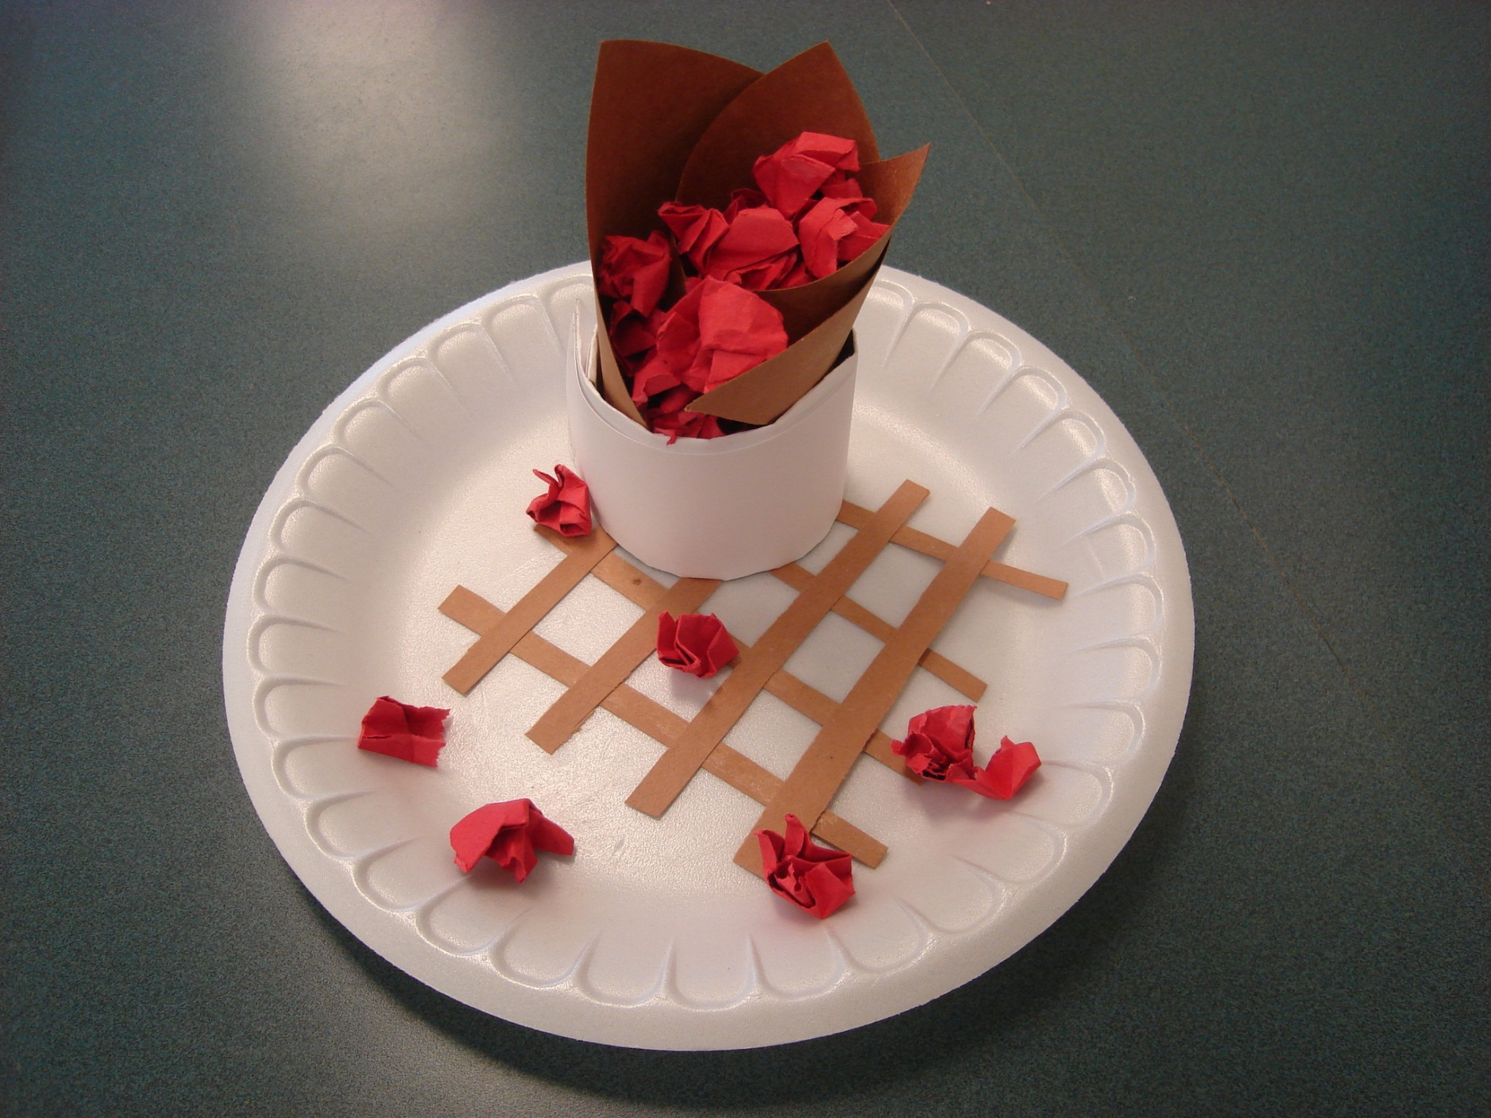

Slide 15
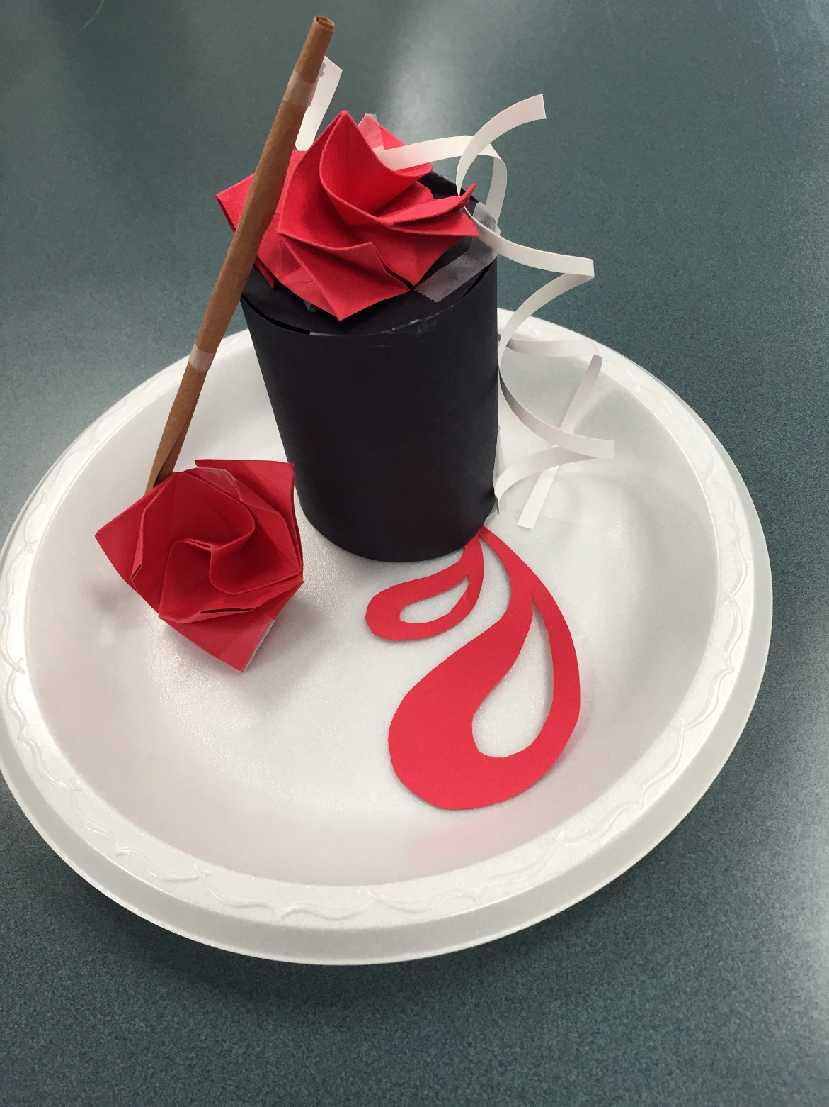

Slide 16
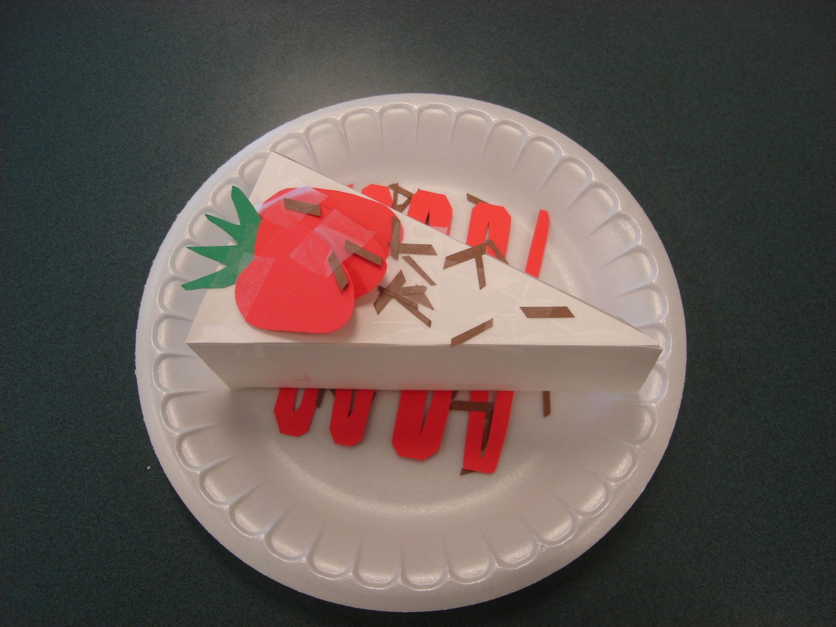

Slide 17
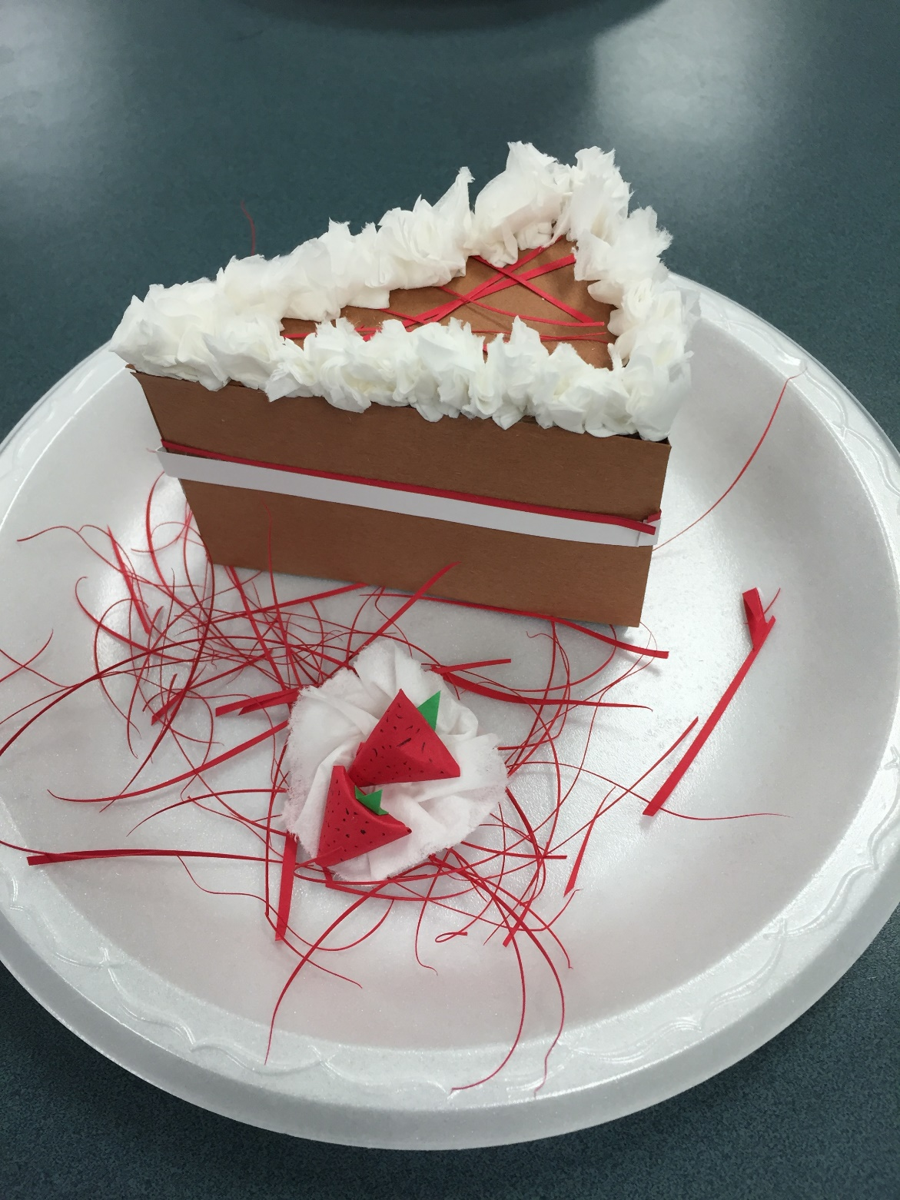

Slide 18
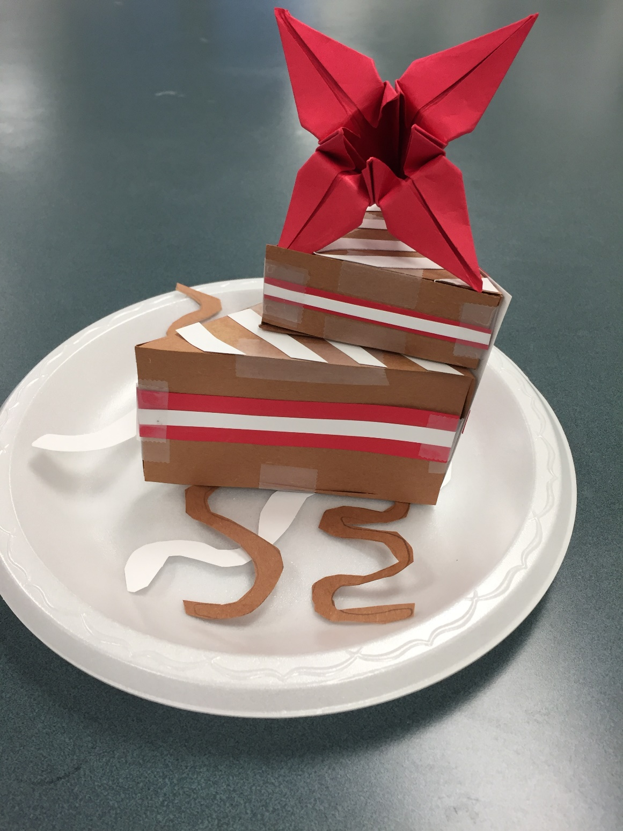

Slide 19
