Slide 1
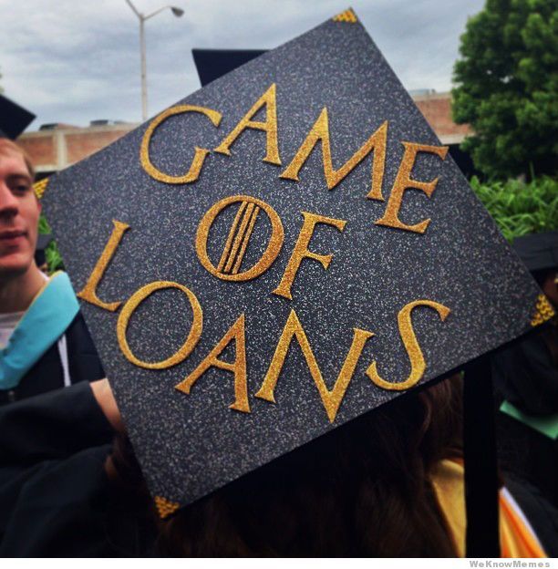
The pros and cons of consumer loans.
Notes:
Image: https://www.google.com/url?sa=i&rct=j&q=&esrc=s&source=images&cd=&cad=rja&uact=8&ved=0ahUKEwiAyOnr2pXSAhUm0YMKHUrTD6IQjB0IBg&url=http%3A%2F%2Fweknowmemes.com%2F2013%2F05%2Fgame-of-loans%2F&bvm=bv.147448319,d.cGw&psig=AFQjCNGETFMd89NJq_RFQ5GHTfh91JDUDg&ust=1487372051116162

Slide 2
Adult Roles & Financial Literacy
Strand 7
  Students will practice family financial planning as it pertains to saving, investing and risk management
Standard 2
  Describe and discuss the impact of credit and debit on personal money management

Slide 3
Objective
This presentation is intended to teach students how loans operate and the risks that can come with them. Today, we will look at four different types of loans: car loans, student loans, personal loans, and payday loans. In addition, we will talk about vocabulary often associated with loans and how interest is calculated. We have included an interactive board game that will help students apply what they have learned in a fun and engaging way.

Slide 4
Contact Information
Jessica Percival
  Jessica.Percival@usu.edu
Marilyn Albertson
  Marilyn.Albertson@usu.edu
USU Extension Office
  (385) 468-4820
  For game instructions and game cards, contact Jessica or Marilyn.

Slide 5

Disclaimer
LOANS ARE NOT ALWAYS A BAD OPTION!
If loans are handled in the proper way, and paid back in the allotted amount of time, they can be a beneficial financial decision.

Slide 6
Loan Vocabulary
What is a loan?
  A thing that is borrowed, in this case a sum of money, that is expected to be paid back with interest within a certain amount of time.
Interest
The amount it cost to borrow money.
Finance
The amount of money that is borrowed.
Loan Term
Unsecured Loan
How long you have to repay the loan.
Loan that does not have collateral, such as property, tied to it.
Secured Loan
Loan that does have collateral, such as property tied to it.

Slide 7

Loan Interest
Interest is calculated as an annual percentage rate (APR) of the amount you borrowed.
You borrow $100 at 6.8% interest.
At the end of the year, you will owe $6.80 in interest.
Your estimated daily interest is around $.02 per day.
Notes:
http://services.vsac.org/wps/wcm/connect/vsac/vsac/loan+repayment/repaying+your+loans/how+interest+works/vsac+-+repayment+-+repaying+your+loans+-+how+interest+works

Slide 8
Types of Loans
Car Loans
Student Loans
Personal Loans
Payday Loans

Slide 9

Car Loans

Slide 10
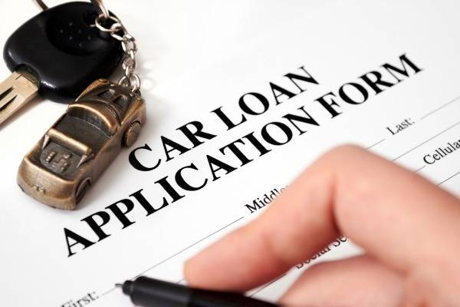
Car Loans
You can receive a car loan through a bank, credit union, or a car dealership.
Visit different banks and credit unions to see where you get the best interest rates.
Don’t be fooled by car dealerships “low interest rates” if you have not checked with a bank or credit union first!
Interest rate is dependent on your credit score. The higher your credit score, the lower your interest rate.
Notes:
Image: https://www.google.com/url?sa=i&rct=j&q=&esrc=s&source=images&cd=&cad=rja&uact=8&ved=0ahUKEwjD15ql7pnQAhUk6YMKHVNMAiUQjB0IBg&url=http%3A%2F%2Fwww.edmunds.com%2Fcar-loan%2F&bvm=bv.138169073,d.cGw&psig=AFQjCNF2dxdFWpxrj2ZzP_wbBSMMJ2az5g&ust=1478718518079248

Slide 11
Length of Car Loans
Long Term Auto Loans
Loans from 36 months (3 years) to 84 months (7 years).
Smaller monthly payments, but you pay more in interest.
Short Term Auto Loans
Loans from 12 months (1 year) to 36 months (3 years).
Pay off the loan quicker.
Higher monthly payment, but you pay less in interest.

Slide 12
Calculating – Long Term Loan
Credit Score: 650
60 Month Loan
Car Price: $15,000
Down Payment: $0
Interest Rate: 4.5%
Monthly Payment: $279.65
Total Amount Paid: $16,779
Total Interest Paid: $1,779.00
72 Month Loan
Car Price: $15,000
Down Payment: $0
Interest Rate: 4.5%
Monthly Payment: $238.11
Total Amount Paid: $17,143.92
Total Interest Paid: $2,143.92

Slide 13
Calculating – Short Term Loan
Credit Score: 650
12 Month Loan
Car Price: $15,000
Down Payment: $0
Interest Rate: 4.5%
Monthly Payment: $1,280.68
Total Amount Paid: $15,368.16
Total Interest Paid: $368.16
36 Month Loan
Car Price: $15,000
Down Payment: $0
Interest Rate: 4.5%
Monthly Payment: $446.20
Total Amount Paid: $16,063.20
Total Interest Paid: $1,063.20

Slide 14

Risk of Car Loans
Make sure your monthly payments are something you can afford.
Low credit score mean higher interest rate. Higher credit score mean lower interest rate.
The car is used as collateral, so if you stop making payment on the loan, the car will be repossessed.
Make payments on time to avoid higher interest rates and added fees.
Make sure you keep insurance on your car to avoid additional fees added to your monthly payment.

Slide 15

Student Loans

Slide 16
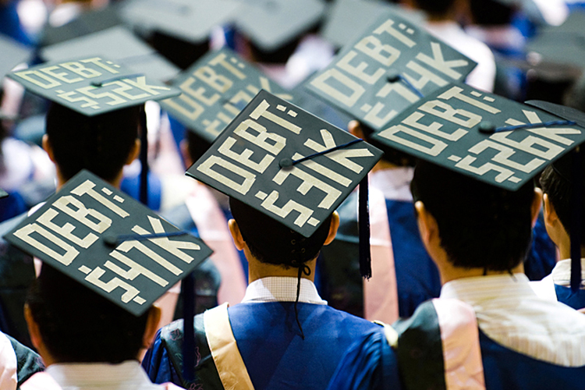
Student Loans
Student loans can be obtained from the federal government or private institutions.
  Federal loans can be obtained through FAFSA.
  Private loans will be offered by banks, credit unions, and other financial institutions.
Only borrow what you need for tuition!
Read all the fine print.
Notes:
Image: https://www.google.com/url?sa=i&rct=j&q=&esrc=s&source=images&cd=&cad=rja&uact=8&ved=0ahUKEwi_uqOH7pnQAhUJxoMKHbndD94QjB0IBg&url=http%3A%2F%2Fwww.salon.com%2F2013%2F02%2F04%2Fstudent_loans_the_next_housing_bubble%2F&bvm=bv.138169073,d.cGw&psig=AFQjCNGIliBk7JjMmHf1ZQVt3p_JViTncA&ust=1478718559405550

Slide 17
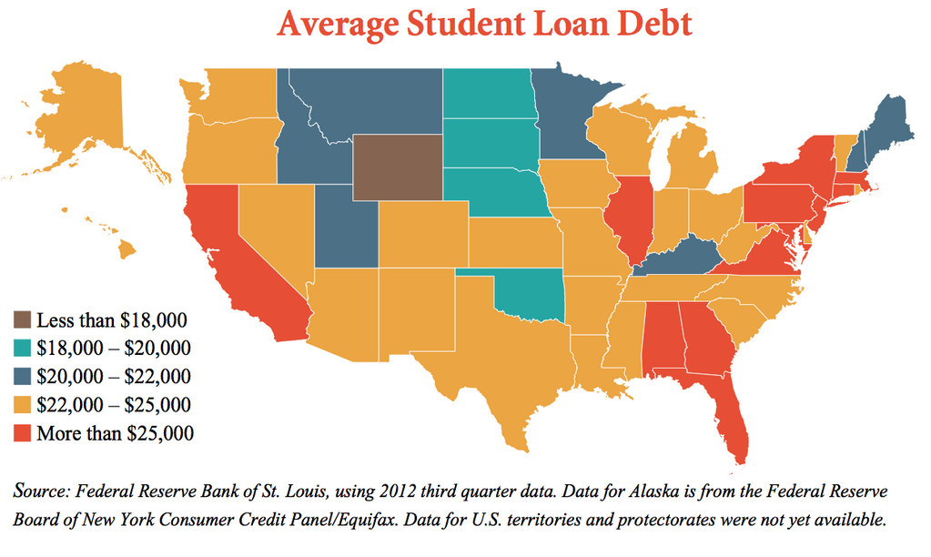
Student Loan Statistics
$45.5 million is lost each year in Utah alone because people turn to loans before applying for FAFSA.
$1.4 trillion in student debt in the United States for 2017 graduates.
Average student loan debt is $37,172.00
Notes:
Image: http://www.politifact.com/texas/statements/2014/jun/09/pete-gallego/pete-gallego-equates-average-student-loan-debt-pri/

Slide 18
Types of Student Loans
Subsidized
For undergraduate students.
Government will pay the interest while you are in school.
Unsubsidized
For undergraduates, graduate or professional students.
Loan accumulates interest while you are in school.

Slide 19
Risks of Student Loans
If you don’t finish the degree program, you leave school with no degree, and student loan debt.
If you don’t get a job right out of school, you will not be able to pay the loan down which means you will be paying more in interest.
You take out more money in loans than you need to pay for tuition, books, and fees.
If interest is building on your loan while you study, you will be paying interest on interest.

Slide 20
Alternatives to Student Loans
Work part time or get tuition reimbursement.
Open an Individual Development Account.
Fill out the FAFSA to see what grants you qualify for.
Apply for as many scholarships as you can.
www.fastweb.com
Apply for work study when you fill out the FAFSA.

Slide 21

Personal Loans

Slide 22
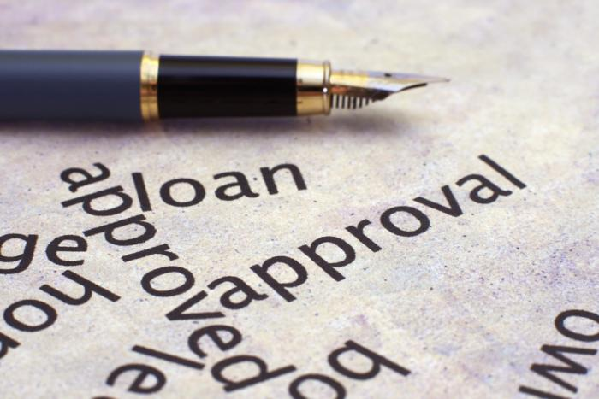
Personal Loans
Used for general purposes such as family
emergencies, purchasing home furnishings,
repairs, etc.
Most difficult to receive and have strict requirements.
May be secured or unsecured.
Interest rates will be based on your credit score.
Never borrow more than you need!
May have a lower interest rate than a credit card.
Notes:
https://www.google.com/url?sa=i&rct=j&q=&esrc=s&source=images&cd=&cad=rja&uact=8&ved=0ahUKEwiZqpXE7pnQAhWmv1QKHf_KAkUQjB0IBg&url=http%3A%2F%2Fwww.consumerfu.com%2Fcheap-personal-loans&bvm=bv.138169073,d.cGw&psig=AFQjCNGtF1OJPs7VTJQ5X7GEsqmY70vv3Q&ust=1478718646509043

Slide 23
Types of Personal Loans
Unsecured
Loans that are not backed by assets.
Lender does not have collateral they can seize if you do not repay your loan.
Secured
Loan backed by assets or collateral.
Ensure you will be able to repay the loan or your assets will be taken from you.
Higher interest rates.
Usually have lower interest rates.
Notes:
https://www.creditkarma.com/article/important-information-about-personal-loans

Slide 24
Credit Scores and Interest Rates
Score Range | What does that mean?
300-629 | Poor Credit → Hard to get a loan, may have to pay high interest rates.
630-689 | Average Credit → Easier to qualify for a loan; may have a higher interest rate.
690-719 | Good Credit → Can qualify for credit, but not the best rates.
720-850 | Excellent Credit → Qualify for lower interest rates and rewards cards.
Notes:
Score division is from: Nerd Wallet: https://www.nerdwallet.com/blog/credit-cards/apply-for-a-credit-card/

Slide 25
Risks of Personal Loans
Must be paid off in a fixed amount of time.
If you don’t pay the loan back, the lender could take you to court and sue you.
Some personal loans include prepayment penalties if you pay off your loan before a certain date.
Be wary of scammers who use false advertising to lure you into a fake loan agreement.
Hidden or additional fees may be associated with these types of loans.
Notes:
http://blog.equifax.com/credit/what-you-need-to-know-before-taking-out-a-personal-loan-2/
Image: https://www.google.com/url?sa=i&rct=j&q=&esrc=s&source=images&cd=&cad=rja&uact=8&ved=0ahUKEwi7rL3d7pnQAhWrh1QKHYikCMAQjB0IBg&url=http%3A%2F%2Fnewproductvisions.com%2Fblog%2F%3Fp%3D625&bvm=bv.138169073,d.cGw&psig=AFQjCNEf-x4a4uzIPui4dAgpX5WvIa6URQ&ust=1478718737659455

Slide 26
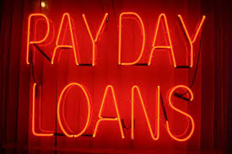
Payday Loans

Slide 27
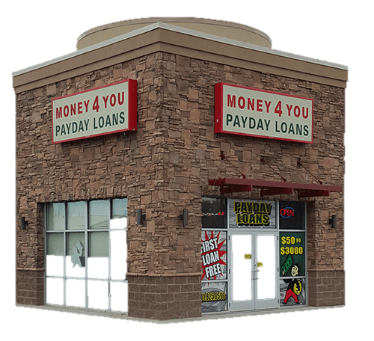
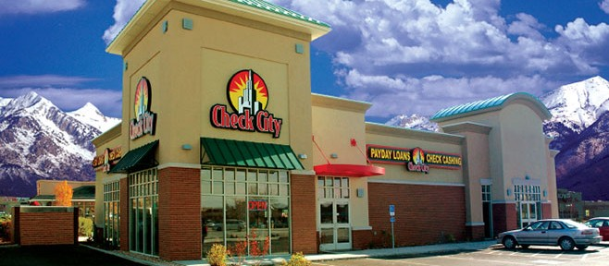
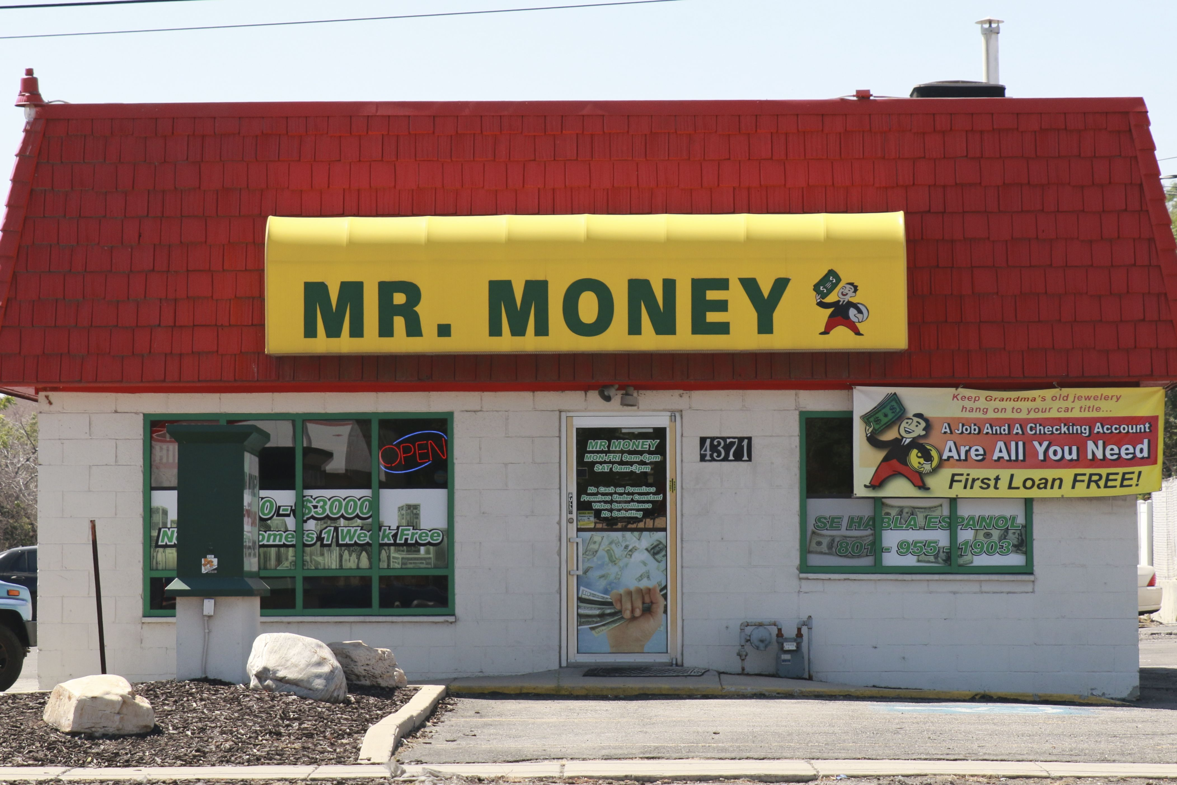
Payday Loans
Also known as Cash Advanced Loans, Check Advanced Loans, Deferred Deposit Loans, or Post-Dated Check Loans.
Typical Payday Loans have a repayment term of two-weeks and an interest rate of nearly 400%. In Utah, the average interest rate is 466%.
Notes:
https://www.credit.com/loans/loan-articles/the-truth-about-payday-loans/
Mr. Money: https://www.google.com/url?sa=i&rct=j&q=&esrc=s&source=images&cd=&cad=rja&uact=8&ved=0ahUKEwiv6cDMpbrQAhUMwYMKHY7jB1wQjB0IBg&url=https%3A%2F%2Fmoney4youpaydayloans.com%2Flocations%2Fmr-money-4371-w-3500-s-wvc-ut84120%2F&psig=AFQjCNEGiPOguVRn4WVAE9Kldc7Aw3rf0g&ust=1479832832189282
Check city: https://www.google.com/url?sa=i&rct=j&q=&esrc=s&source=images&cd=&cad=rja&uact=8&ved=0ahUKEwi294yFprrQAhXqslQKHXDIApYQjB0IBg&url=http%3A%2F%2Fwww.checkcity.com%2Fcompany%2Fonline-rates-and-fees%2F&psig=AFQjCNEGiPOguVRn4WVAE9Kldc7Aw3rf0g&ust=1479832832189282
Money 4 You: https://www.google.com/url?sa=i&rct=j&q=&esrc=s&source=images&cd=&cad=rja&uact=8&ved=0ahUKEwinus-KprrQAhXmllQKHZEXDFoQjB0IBg&url=https%3A%2F%2Fmoney4youpaydayloans.com%2F&psig=AFQjCNEGiPOguVRn4WVAE9Kldc7Aw3rf0g&ust=1479832832189282

Slide 28
Payday Loan Statistics
The average borrower is in debt for 5 months of the year, spending an average of $520 in fees to repeatedly borrow $375.
Typical payday loans have a repayment term of two-weeks and an average annual percentage rate of nearly 400%.
7-10 borrowers use payday loans for regular, recurring expenses such as rent and utilities.
Payday lenders have access to checking accounts to ensure they can collect money owed from the borrower before other lenders or bills are paid.
Notes:
http://www.pewtrusts.org/en/research-and-analysis/fact-sheets/2016/01/payday-loan-facts-and-the-cfpbs-impact

Slide 29
How Payday Loans Work
Provide some personal and financial information.
Request a loan for a certain dollar amount.
Pay a fee for the loan and receive the cash.

Slide 30
Example of a Payday Loan
You need to borrow $300 to repair your car.
You go to a payday lender and write a check for $340 and post-date it for two weeks ($300 for the repair and $40 for the payday loan fee).
When the two weeks are up, the payday lender will cash your check.
If you are able to pay that $340 loan, you will no longer owe anything to that lender.
If you are unable to pay the $340 loan, you will have to take out another loan on top of the $340 and be charged additional fees.
Notes:
Car: https://www.google.com/url?sa=i&rct=j&q=&esrc=s&source=images&cd=&cad=rja&uact=8&ved=0ahUKEwiqitOQqbrQAhUprFQKHSoOCIsQjB0IBg&url=http%3A%2F%2Fwww.clipartkid.com%2Fmechanic-car-repair-cliparts%2F&psig=AFQjCNFi7IWlYQey6cgol4NYCrsUDHcBlA&ust=1479833929132609
Loan: https://www.google.com/url?sa=i&rct=j&q=&esrc=s&source=images&cd=&cad=rja&uact=8&ved=0ahUKEwjqprXVqLrQAhXJg1QKHcy5BfkQjB0IBg&url=http%3A%2F%2Fwww.bankers-anonymous.com%2Fblog%2Fi-took-out-payday-loans%2F&bvm=bv.139250283,d.cGw&psig=AFQjCNFe-dHZhSTOvhT3vPWuBHlcPwZ3Tw&ust=1479833773665514
Money: https://www.google.com/url?sa=i&rct=j&q=&esrc=s&source=images&cd=&cad=rja&uact=8&ved=0ahUKEwi9utuzqbrQAhXmxFQKHUODBQ0QjB0IBg&url=http%3A%2F%2Femojidictionary.emojifoundation.com%2Fhome.php%3Femoji%3Demoji542.jpg&psig=AFQjCNHRCRCWzK7HO5EzuY9QjHjxkn--gA&ust=1479833844234472

Slide 31
The Cost Of Payday Loans
You need to borrow $500. You will repay the money in one year.
Bank or Credit Union has a loan with an APR of 7.5%
A credit card has an APR of 20%
A payday lender has an APR of 390%
$21 in interest = you pay $521 total.
$56 in interest = you pay $556 total.
$1,518 in interest = you pay $2,018 total.
Notes:
Source: https://www.consumer.gov/articles/1011-payday-loans-and-cash-advances#!what-to-know
Bank: https://www.google.com/url?sa=i&rct=j&q=&esrc=s&source=images&cd=&cad=rja&uact=8&ved=0ahUKEwjhopmdiOvTAhURHGMKHY47DEQQjB0IBg&url=http%3A%2F%2Fwww.panama-offshore-services.com%2Fblog%2F5_steps_to_open_a_bank_account_in_panama.htm&psig=AFQjCNEmNkJnuL9MQw0fVc9uh9xJn6-xsA&ust=1494702829857291
Credit Cards: https://www.google.com/url?sa=i&rct=j&q=&esrc=s&source=images&cd=&cad=rja&uact=8&ved=0ahUKEwjIkYS_iOvTAhUBEGMKHRCYA9oQjB0IBg&url=https%3A%2F%2Fen.wikipedia.org%2Fwiki%2FCredit_card&psig=AFQjCNERahieulRnMof40y46Pg0rdNU_zg&ust=1494702921410693
Payday Loans: https://www.google.com/url?sa=i&rct=j&q=&esrc=s&source=images&cd=&cad=rja&uact=8&ved=0ahUKEwiF5KPOiOvTAhVJ3WMKHUmPBNQQjB0IBg&url=http%3A%2F%2Fwww.avoidpaydayloans.com%2F&psig=AFQjCNH8OGXUDzid7bugmCWyGEBcF3GFsQ&ust=1494702962559178

Slide 32
Risks of Payday Loans
If you are unable to quickly repay the debt you will be charged high interest and expensive additional fees.
Many people get trapped in the payday loan cycle and can never get out of debt.
They are a much more expensive method of borrowing money.
Some APRs can reach as high as 5,000%.
  To compare, APRs for credit cards range from 9% - 30%.
  Personal loans have even lower APRs than credit cards.
Very convenient and easy to get.
Notes:
https://www.credit.com/loans/loan-articles/the-truth-about-payday-loans/

Slide 33
Alternatives to Payday Loans
Negotiate a payment plan with the creditor.
Charge the amount to your credit card.
Borrow money from your savings account.
Ask a relative to lend you the money.
Apply for a small traditional loan.
Ask your creditor for more time to pay a bill
Use your bank’s overdraft protections.
Obtain a line of credit from an FDIC-approved lender.
Notes:
https://www.credit.com/loans/loan-articles/the-truth-about-payday-loans/

Slide 34

Questions?
Notes:
https://www.google.com/url?sa=i&rct=j&q=&esrc=s&source=images&cd=&cad=rja&uact=8&ved=0ahUKEwjIssL6sbrQAhUnxlQKHeOJDq8QjB0IBg&url=http%3A%2F%2Foncologynews.com.au%2Fqa-breast-cancer-in-young-women%2F&bvm=bv.139250283,d.cGw&psig=AFQjCNFF1F0iQxoUqzHe56MXXf--8lgpMA&ust=1479836298483477

