Slide 1
Customer Service and Management
Culinary Arts STRAND 10

Slide 2
Importance of Customer Service
Make or break an establishment
Increases customer satisfaction, loyalty and employee moral.

Slide 3
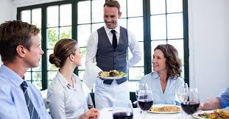
Importance of Customer Service
Understand customer needs
Age
Families with children first timers
Special occasions
Dietary needs
Language barriers
Dining alone

Slide 4
Identify front of the house job and duties.
STRAND 10 Standard 2

Slide 5
Host/Hostess
Responsible to the customer, greets and seats customers, takes reservations, supervises service to customers, handles customer complaints.

Slide 6
Server
Handles customer needs, knows menu items, checks tables, checks on food/drinks/water, corrects problems, presents the check, often acts as cashier, knows appropriate table settings, handles table service, maintains appropriate personal hygiene and sanitation, serves from the right, removes plates from the left, quickly cleans up spills, uses a tray properly, handles side work and filling table supplies

Slide 7
Bus Person
Clears and resets table covers and assists the server

Slide 8
Cashier
Responsible for cash drawer, counts back change, knows procedure to follow if there is a discrepancy

Slide 9
Dining room manager or maître d’hôtel
Controls overall food production, handles complaints, resolves problems, monitors customer service

Slide 10
characteristics needed to be a skilled employee
STRAND 10 Standard 3

Slide 11
Characteristics
Positive ATTITUDE
Personal Appeal
Pride in your job, friendly, problem solving, courtesy
Clean uniform, nails clean and trimmed, minimal jewelry, clean and appropriate shoes, well groomed, well rested, hair tied back, breath is fresh, no heavy colognes or perfumes

Slide 12
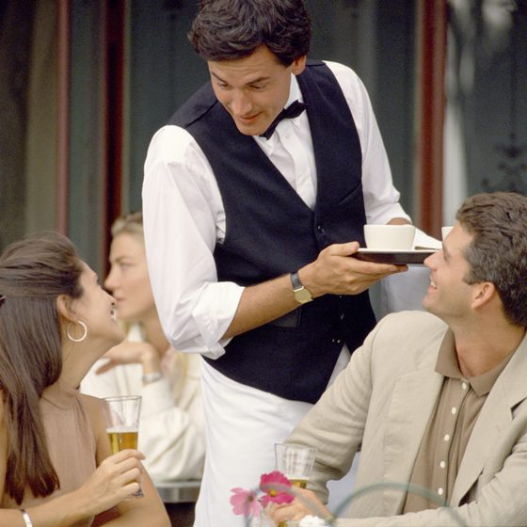
Communication skills
Verbal
Non-Verbal
Speaking
Listening
How you look (no gum, posture, no touching face or hair)
Written communication (write clearly and understandably)

Slide 13
Understand the order of front of the house service.
STRAND 10 Standard 4

Slide 14
Greet customers
Make sure that the cover is clean and all the proper equipment Is present. A cover is an individual place setting including all required equipment for the meal.

Slide 15
Take Beverage Order
Place beverage to the customer’s right
Keep fingers away from the rim of the glass
Keep beverages refilled

Slide 16
Sell the Menu
Understand ingredients, dietary restrictions and allergies
Be prepared to recommend menu items
Ask open ended questions
Upsell – offer a larger size or better quality
Smile, maintain eye contact
Listen carefully, confirm order

Slide 17
Serve the Order
Watch hand placement on plate, stay away from food
Serve on customer’s left side
Check during the meal for additional assistance
Clear from the right

Slide 18
Alcohol Service
Be familiar with state and local liquor laws.

Slide 19
Processing Payment
Gather customer feedback

Slide 20
Categorize the main types of dining environments
STRAND 10 Standard 5

Slide 21
Quick service
Fast food. Limited menu, low prices and fast service.

Slide 22
Casual Dining
Includes family style, neighborhood establishments, buffets and themed restaurants.

Slide 23
Traditional or Fine Dining
Expensive, great locations, fine food

Slide 24
American Service
Plated in the kitchen

Slide 25
French Service
Tableside preparation, food is prepared in the kitchen and finished tableside. Requires skilled servers.

Slide 26
Russian Service
Food is prepared in kitchen and placed on platters. Servers serve food off the tray to the guest’s plate.

Slide 27
English Service
Is referred to as family style. Food is prepared in the kitchen and served in bowls or platters. Guest serve themselves from the bowls or platters.

Slide 28
Identify various pieces of dining equipment and how they are used
STRAND 10 Standard 6

Slide 29
Knives
Dinner, butter, steak

Slide 30
Forks
Dinner, salad or dessert, fish,

Slide 31
Spoons
Soup, coffee or teaspoon, iced tea spoon

Slide 32
Drinking Glasses
Water goblet, wine goblet, champagne flute, coffee cup, teacup, beverage glass

Slide 33
Dinnerware
Charger, Dinner plate, salad plate, bread plate, soup bowl

Slide 34
Table setting
Center of table: center piece, salt and pepper, condiment holders
Napkin in the center of the place setting or to the left
Forks on the left, knives and spoons on the right
All knife blades turn in to plate
Flatware 1” from edge of table
Dessert forks and spoons at the top of the place setting spoon above the fork
Bread plate on the left above the fork, butter knife on the top of the bread plate, blade facing down toward the plate
Water glass above the tip of the knife
Coffee cups to the right of the knives and spoons

Slide 35
qualities and duties of an effective manager
STRAND 10 Standard 7

Slide 36
Communication

Slide 37
Time Management

Slide 38
Resource management

Slide 39
Employee Selection
Job descriptions, applications and interviewing skills
use open ended questions
no illegal questions (race, gender, religion, national origin, birthplace, age, disability or marital status)

Slide 40
Employee Training

Slide 41
Orientation
learning about policies and procedures

Slide 42
Cross Training
learning others jobs so you can cover for them

Slide 43
On the Job Training
learning while you work

Slide 44
Employee Supervision
Hold staff meetings, make sure employees follow all workplace rules and laws, resolve problems between employees

Slide 45
Employee Evaluation
Identify strengths and weaknesses.
Self-evaluations may be used.

Slide 46
Leadership

Slide 47
Working Together

Slide 48
Help employees to understand diversity, stereotypes and prejudice.
Build a team that works well together by understanding and valuing differences and individual strengths.
Manager needs to set example to employees.

Slide 49
Motivate Others
Internal motivation or intrinsic personal drive
External motivation reward or recognition

Slide 50
Problem Solving
Define the problem, analyze the causes, develop and choose solutions, plan action steps, implement the plan, evaluate the results.

