Slide 1
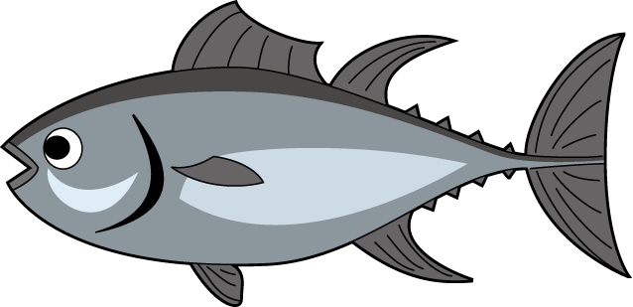
Meat, Poultry, Seafood

Slide 2
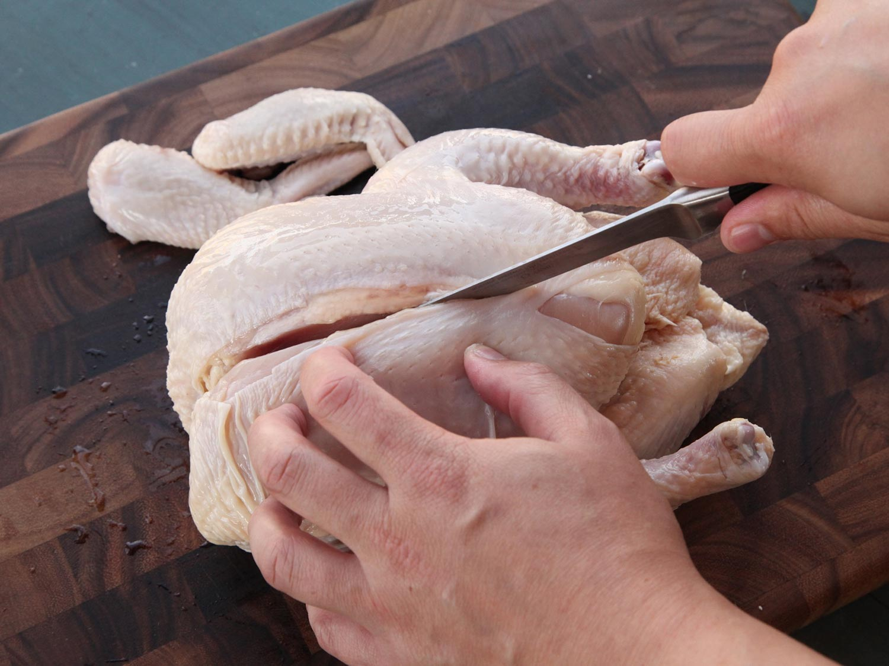
Fabrication
The process of cutting or breaking down the meat/poultry into its usable parts.

Slide 3
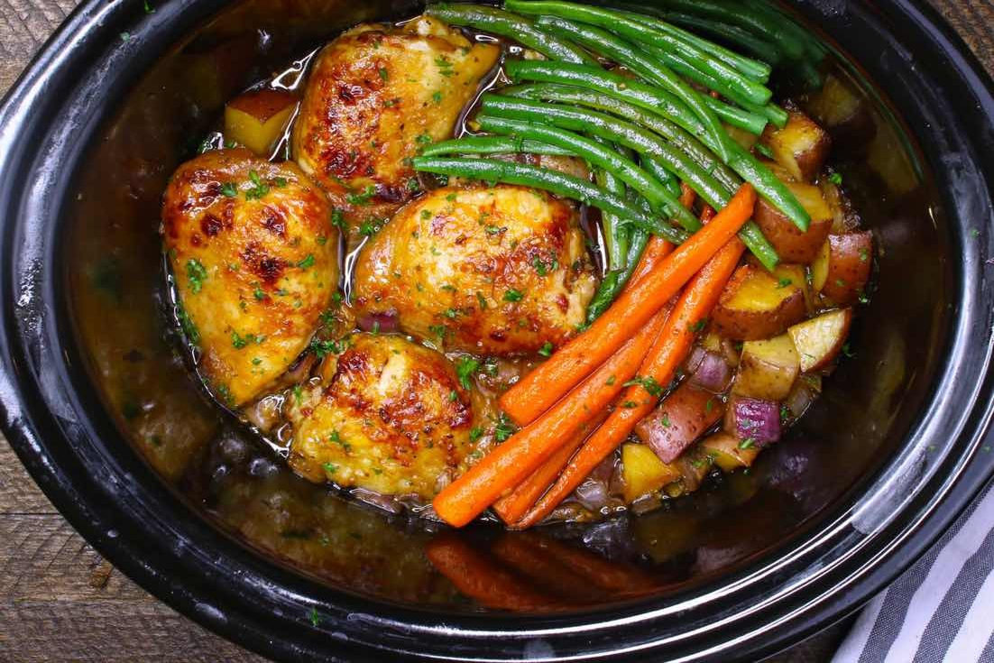
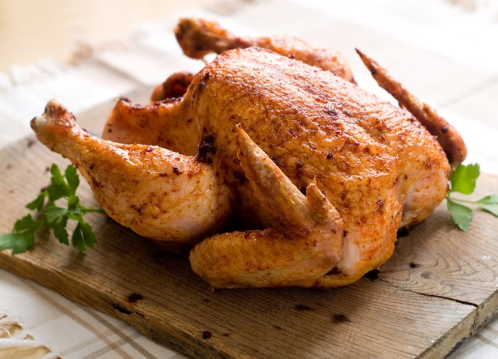
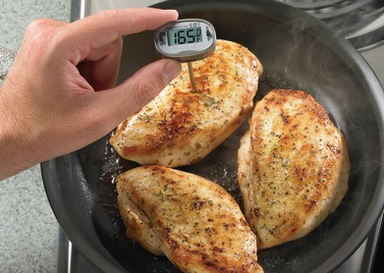
Poultry Preparation
Types of poultry include turkey, chicken, duck, goose, pheasant, quail and other birds.
Poultry works good with dry or moist heat methods although more mature birds are best cooked with moist methods to help with tenderness.
All poultry (whole, ground or stuffed) must be cooked to a minimum temperature of 165 F.

Slide 4
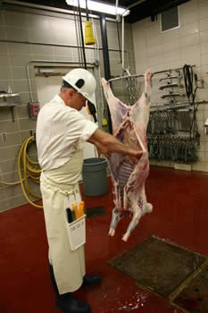
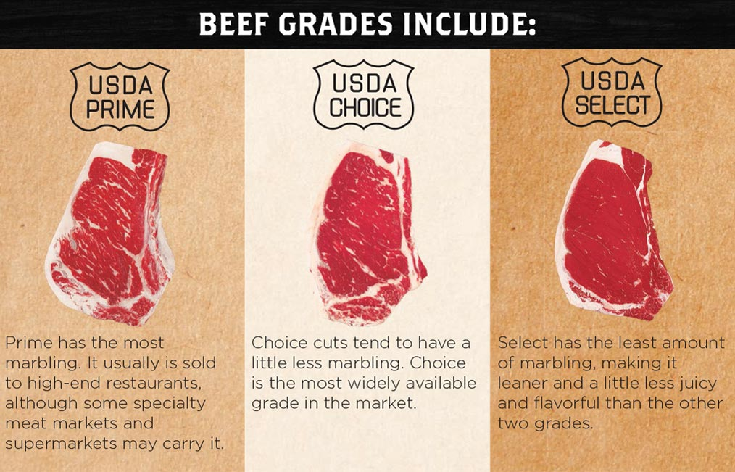
Meat – Beef, Veal, Lamb, Pork
All meat is inspected for safety
Quality grading is optional
  Beef
    Prime – restaurants
    Choice – restaurants and stores
    Select – stores and used in processed food

Slide 5
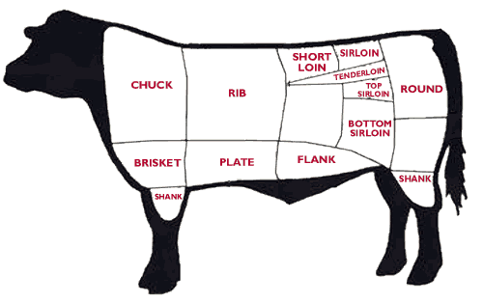
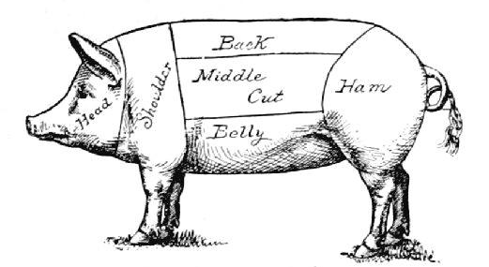
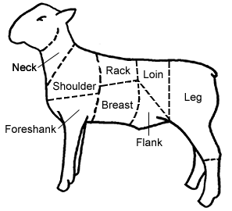
Cuts of Meat
Wholesale
  More tender comes from support muscles
    Beef: rib, short loin, sirloin and tenderloin
    Veal: rack and loin
    Pork: loin
    Lamb: loin and rib
  Less tender comes from movement muscles
    Beef: chuck, brisket, shank, plate, flank and round
    Veal: chuck, breast, leg
    Pork: shoulder, butt, leg
    Lamb: fore and hind shank, leg, breast, shoulder, neck
Retail Cuts: examples include roast, steak, chops, stew meat and ground

Slide 6
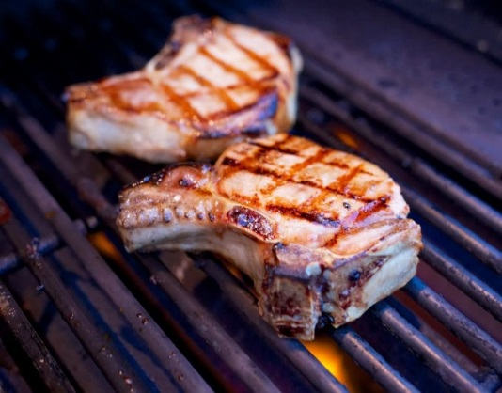
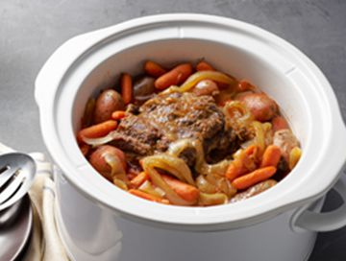
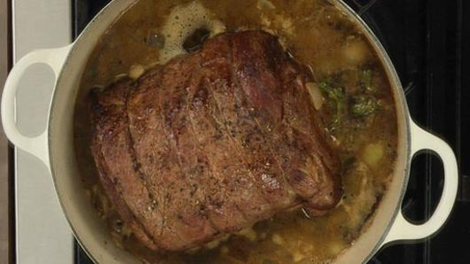
Cooking Methods
Dry Heat – More tender
  Roasting/baking, grilling, broiling, sautéing, pan-frying, deep frying
Moist Heat – Less tender or tender
  Stewing, steaming, simmering, boiling
Combination – works for less tender or tender
  Braising – seared first then liquid added and cooked covered.

Slide 7
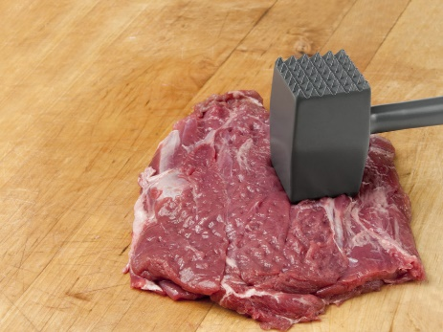
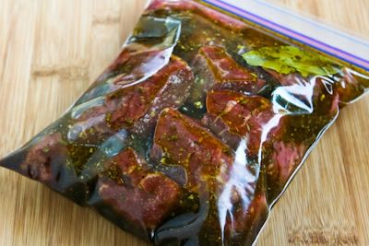
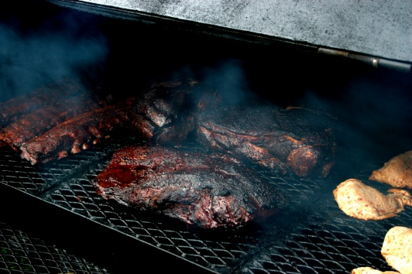
Tenderizing Methods
Mechanical
  Grinding, needling, pounding, cutting thin
Chemical
  Marinating, meat tenderizers
Cooking
  Slow and dry like smoking, slow and moist like stewing, braising or cooking in a crock pot

Slide 8
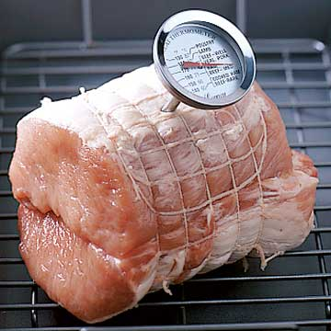
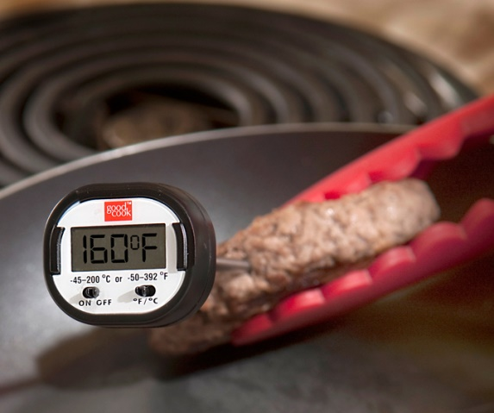
Cooking Temperatures
Ground Pork, Beef, Veal or Lamb – 155 degrees
Whole Pork, Beef, Veal or Lamb – 145 degrees
  (Steak and roasts)
In the center of the meat away from bone and fat.

Slide 9
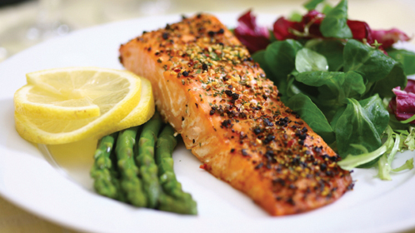
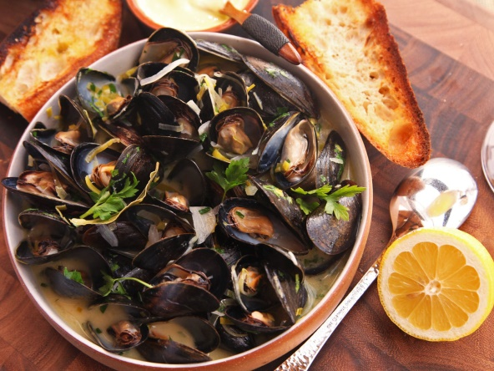
Seafood
Finfish or Fish
Shellfish
Two categories – fresh water or salt water
Wild or farmed raised
Round: Trout, salmon
Flat: Halibut, flounder
Crustaceans
  Shrimp, lobster, crab
Mollusks
  Cephalopods: Squid, octopus
  Bivalves: Clams, mussels, oyster, scallops
  Gastropods: conch, abalone

Slide 10
How is fish caught?
Hand Line - tuna, snapper and grouper
Mid-water Trawl - krill, rockfish and smelt
Bottom Trawl - cod, halibut, lobster, rockfish, shrimp and other bottom-dwellers
Pots - lobsters, crabs and Pacific cod
Fish farming – or aquaculture

Slide 11
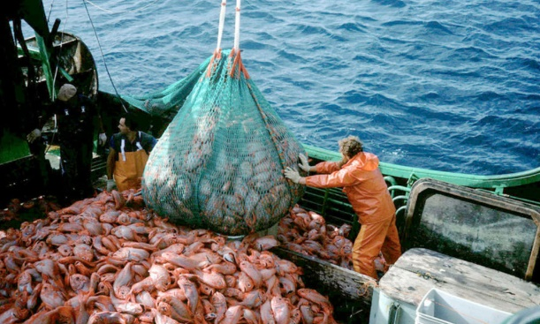
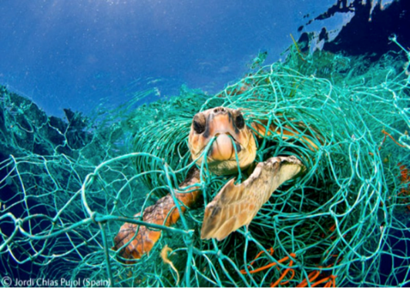
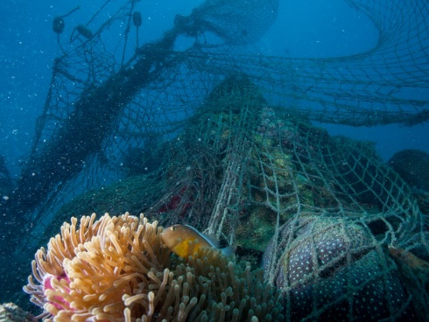
Impact of Fishing
Unsustainable fishing
  Overfishing: removing more too many fish so there is nothing left to replenish the population. Currently endangered: Orange roughy, eel, haddock, halibut, Atlantic cod, skate, Atlantic salmon.
  Bycatch: other species (dolphins, turtles, birds) caught in addition to what is intended to catch.
  Habitat destruction: some fishing methods destroy sensitive habitats like coral reefs & pollution

Slide 12
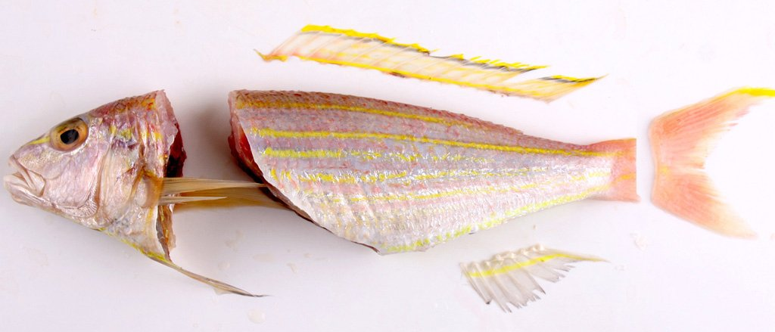
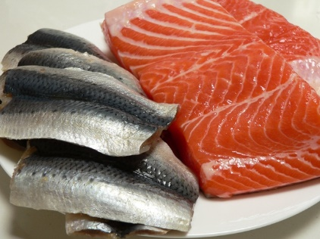
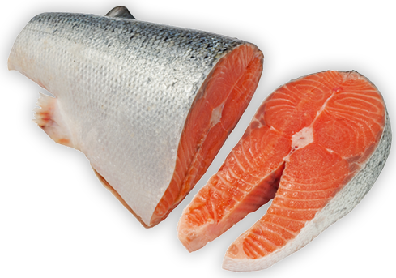
Cuts and Fabrication for Fin Fish
Drawn: Gutted and viscera removed
Dressed: Viscera and fins removed
Pan Dressed: Dressed and scales removed, head and tail optional
Filet: Boneless side of fish (cut parallel to spine)
Steaks: Cut perpendicular to the spine, may include bone and/or skin – usually larger fish

Slide 13
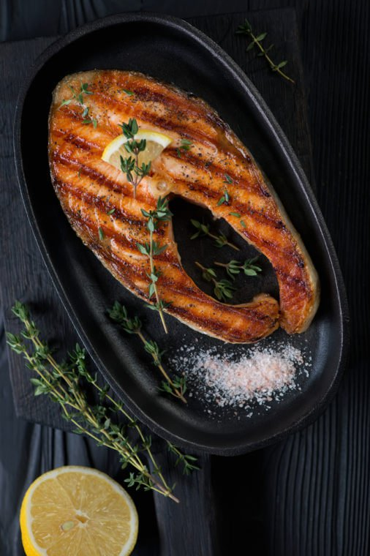
Cooking Fish
Fin fish: broil, grill, pan fry, poach, steam, deep fry, bake
Shellfish
  Shrimp 3-5 minutes, turns pink and firm. Can boil, grill, pan fry, poach, deep fry, bake.
  Lobster and crab boil 18-20 minutes per lb. Turns red when cooked.
  Clams, mussels, oysters open when cooked. Takes 3-4 minutes if in a single layer. Steam. Clams can also be fried.

Slide 14
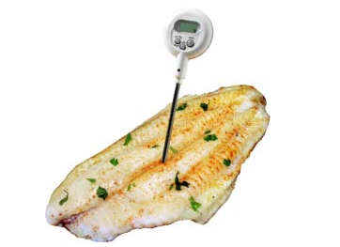
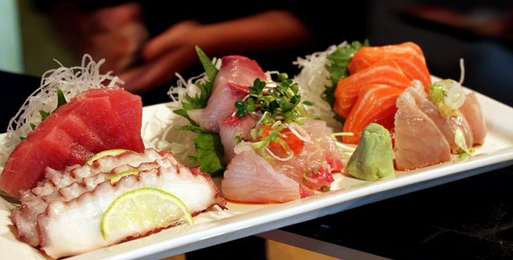
Cooking Temperature
Seafood – 145 degrees
Shellfish over cooked becomes tough and rubbery
Sashimi – is raw thinly sliced fish – fish must be sashimi grade

Slide 15
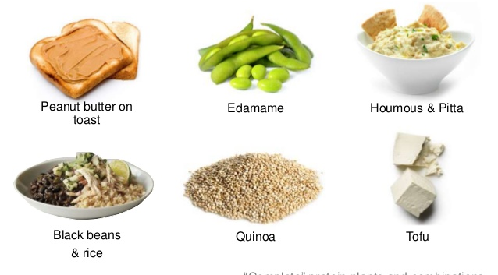
Vegetarian Protein Options
Complementary proteins: Combine incomplete protein foods such as beans and rice for a complete protein – all necessary amino acids.
Most complete proteins are of animal source but soy and quinoa are complete plant sourced proteins.

