Slide 1
Cuisines of Europe, Asia, Middle East and Mediterranean
Strand 11 – Culinary Management

Slide 2
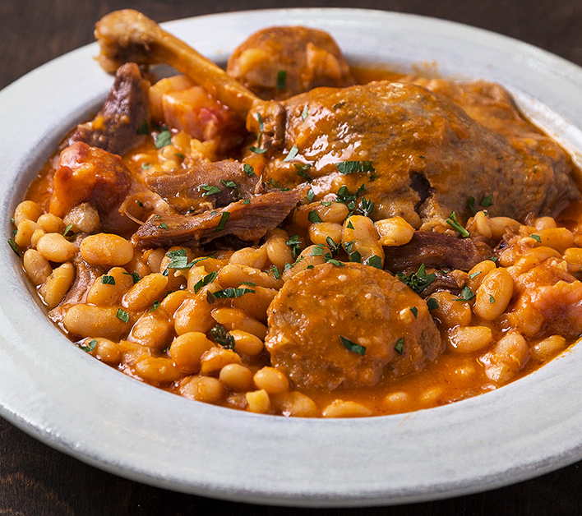
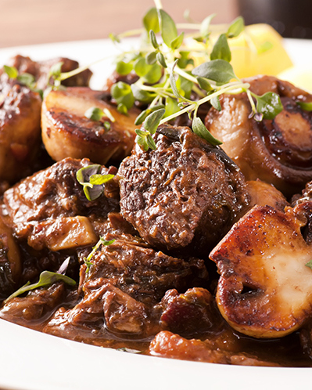
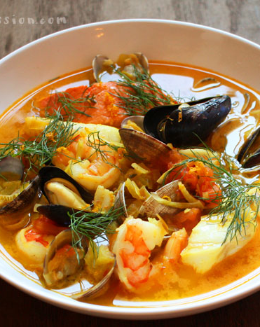
Flavors and Techniques of France
Fleur de sel, Herbes de Provence, Garlic, Olive Oil, Butter, Wine, Cheeses, Olives, Lemons, Artisan Bread
Cassoulet: Stew made with meat and beans
Bouillabaisse: Rich, Spicy stew or soup made with various kinds of fish
Quiche: Savory, open-faced pastry crust with a filling of savory custard with cheese, meat, seafood or vegetables
Boeuf Bourguignon: beef braised in red wine with mushrooms and onions

Slide 3
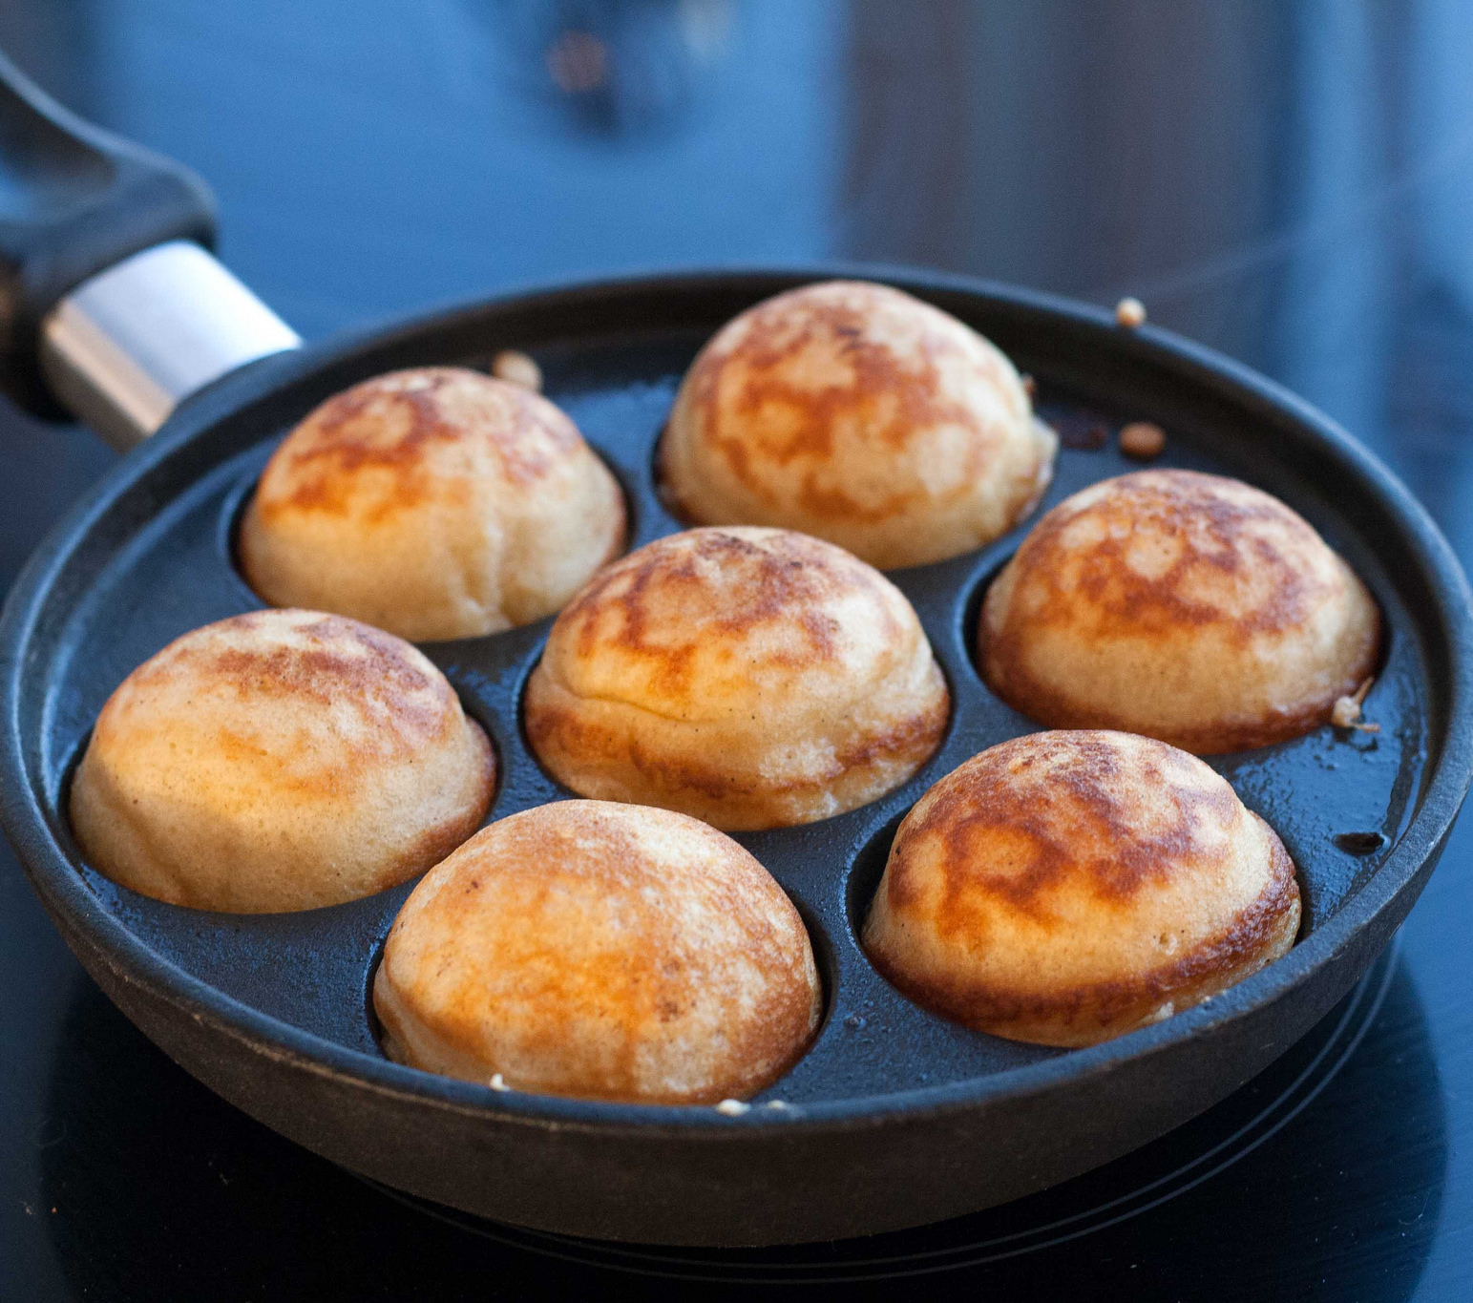
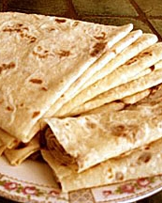
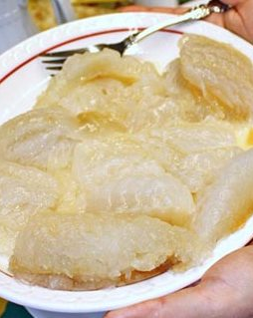
Flavors and Techniques of Scandinavia
Dill, onions, mustard, juniper berries, gravlax, meatballs, fish, vinegar
Lefsa: traditional Norwegian flatbread made with potatoes, flour, butter and milk. Cooked on a griddle
Lukefisk: lyed fish, dried cod steeped in lye for preservation
AEbleskiver: pancake puffs

Slide 4
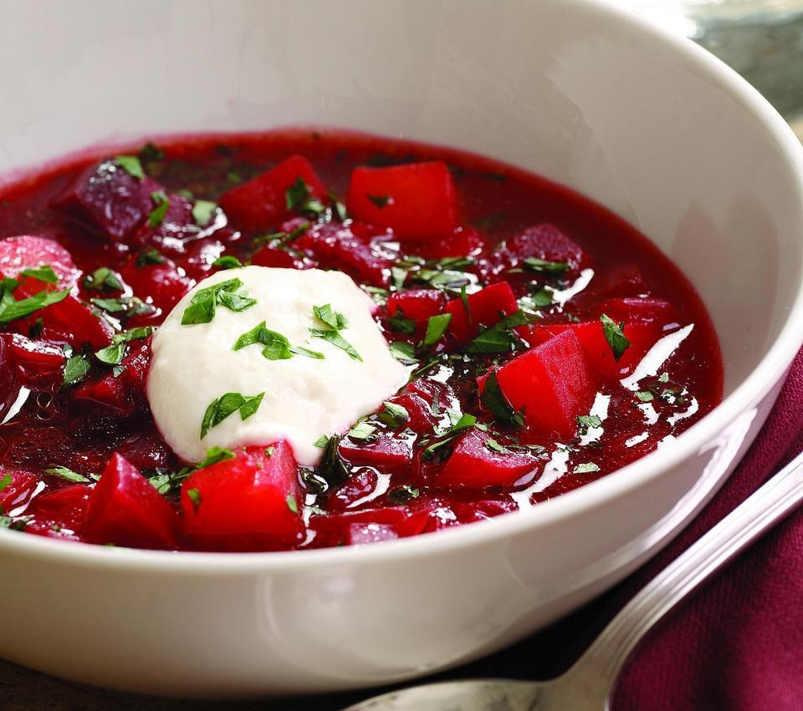
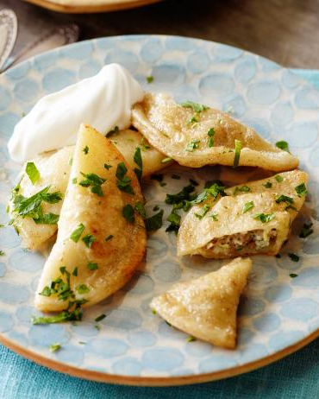
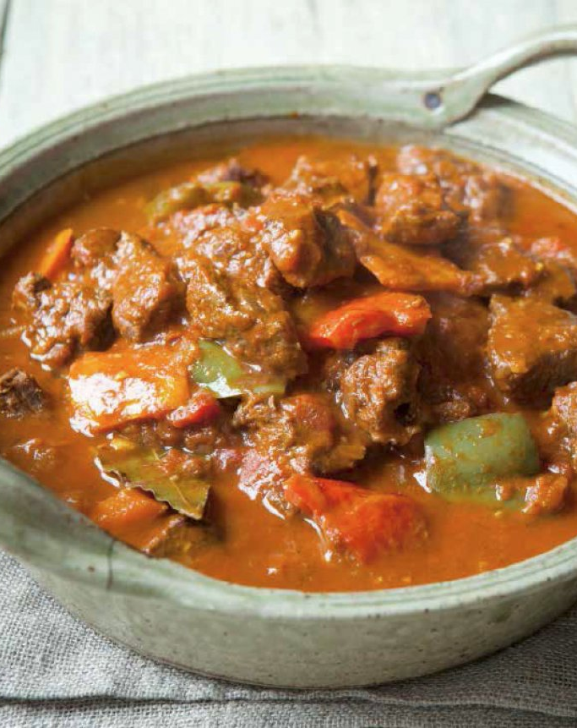
Flavors and Techniques of Eastern Europe
Paprika, onion, dill, sour cream, pickled vegetables, caraway, mustard seed.
Borscht: Soup made with beets and served with sour cream
Pierogis: dough dumping filled with potatoes or cheese
Goulash: Hungarian soup or stew of meat and vegetables flavored with paprika

Slide 5

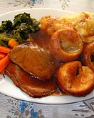
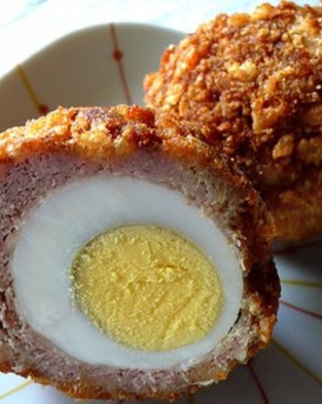
Flavors and techniques of the United Kingdom
Onions, Brussel sprouts, potatoes, cabbage
Yorkshire pudding: popover made of baking egg batter, typically eaten with roast beef.
Scotch eggs: hard boiled egg encased in sausage meat, rolled in breadcrumbs and fried
Trifle: multi layered dessert including cake, custard and cream.

Slide 6
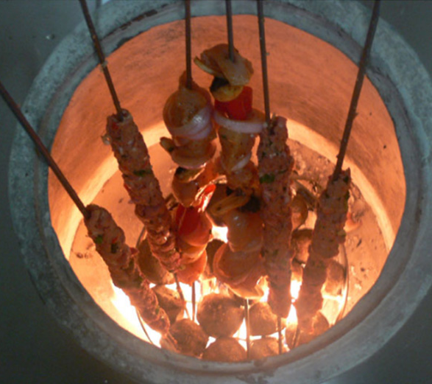
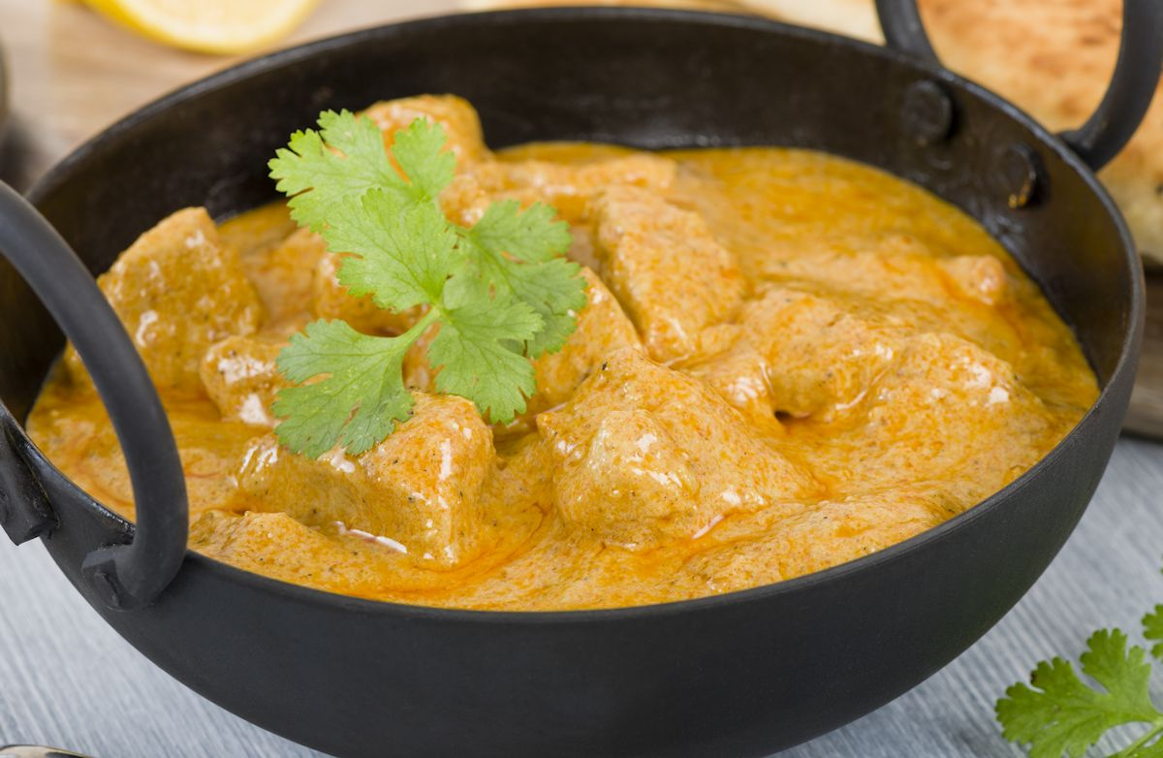
Flavors and Techniques of India
Garlic, onion, potatoes, peas, basmati rice, lentils, ghee, yogurt, lamb, goat, naan, cardamom, cloves
Curry: spiced vegetables and or meat dish with a hearty sauce
Tandoori: cooking in a cylindric clay or metal oven - tandoor

Slide 7
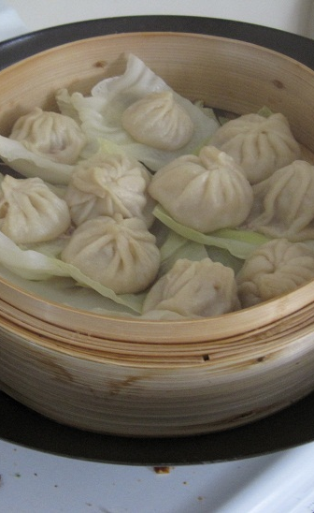
Flavors and Techniques of Northeast Asia
Rice, ginger, garlic, sesame seeds, bok choy, seafood, soy, tofu, dashi, cilantro, peanuts, cabbage, rice noodles
Steaming: in a bamboo steamer over a wok

Slide 8
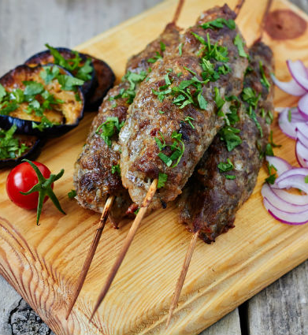
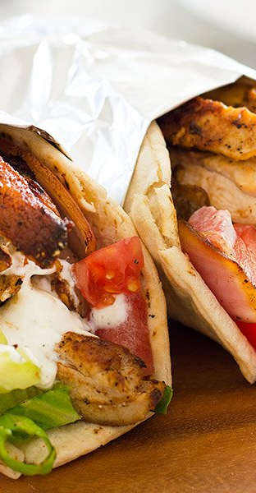
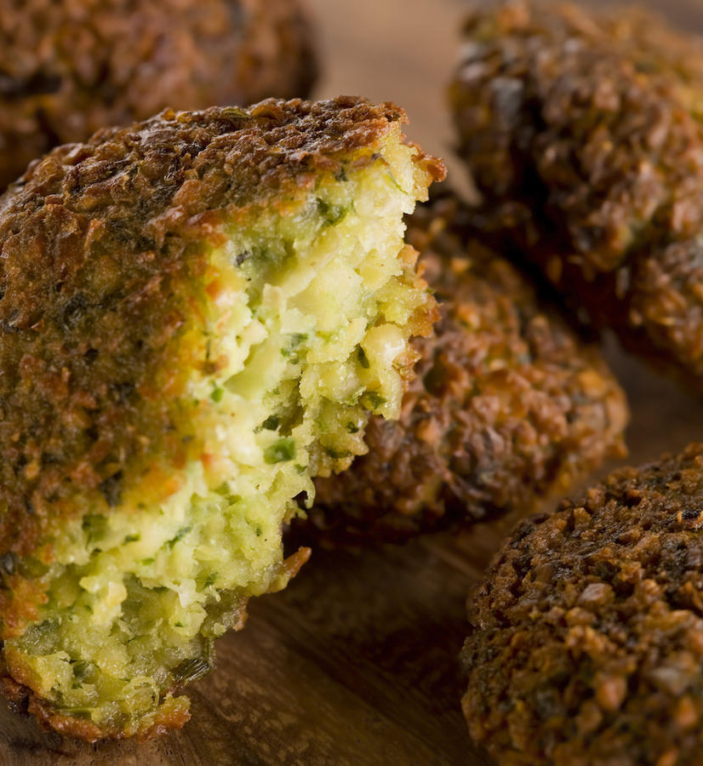
Flavors and Techniques of the Middle East
Citrus, ghee, olive oil, lentils, chickpeas, olives, pitas, honey, sesame, pine nuts, lamb
Kebabs: food threaded on a skewer and roasted
Shawarma: pita filled with seasoned roasted meat
Falafel: Spiced mashed chickpeas formed into fritters and deep fried

Slide 9
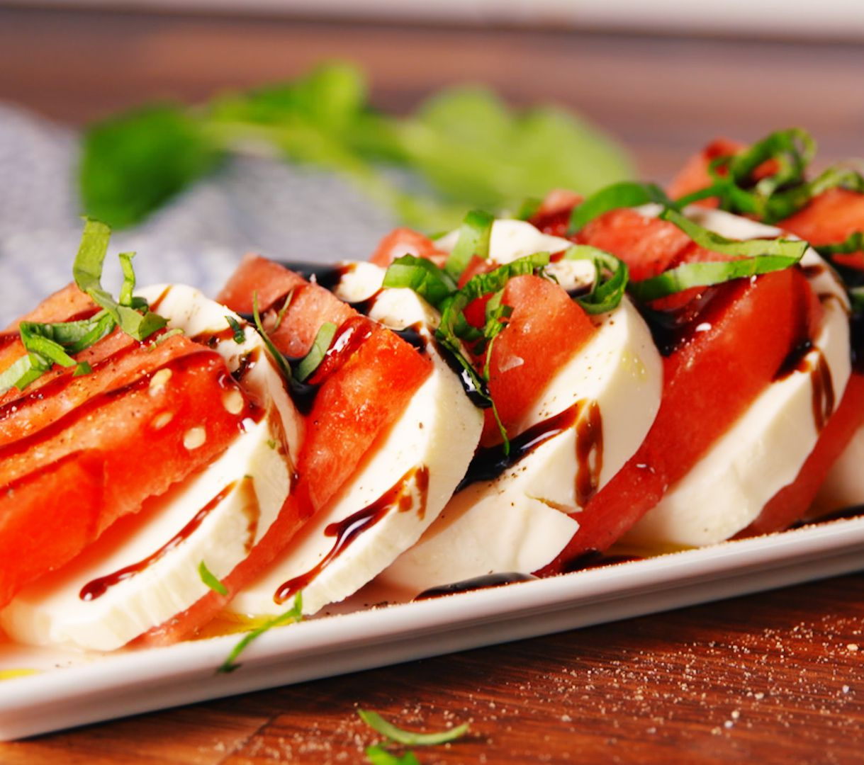
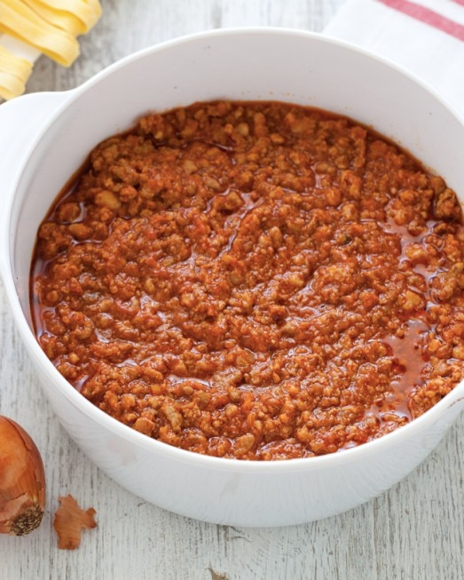
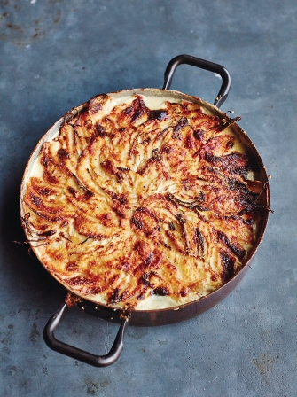
Flavors and Techniques of Italy
Anchovies, balsamic vinegar, capers, garlic, sweet peppers, olives, olive oil, basil, oregano
Al Forno: in the oven
Bolognese: meat sauce with vegetable and tomato base cooked several hours
Caprese: olive oil, basil, tomato and fresh mozzarella dish

Slide 10
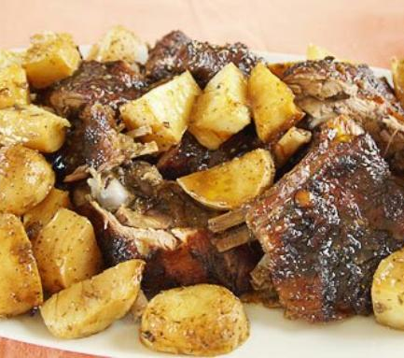
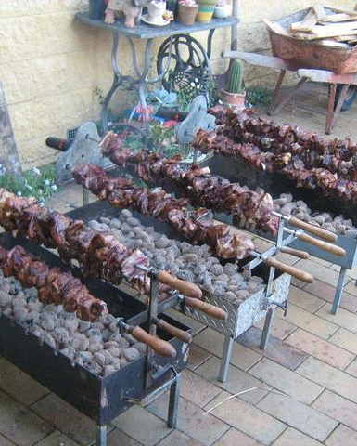
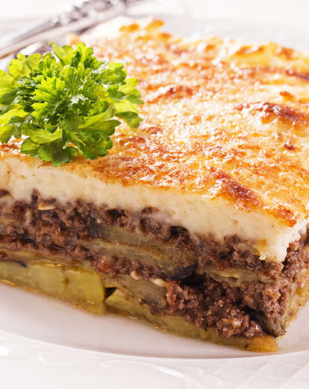
Flavors and Techniques of Greece
Cucumber, feta, garlic, honey, lemon, olive oil, yogurt, lamb, oregano
Souvla: cooking meat or fish on skewers over direct source of heat
Psito: method of roasting meat, chicken or fish in the oven
Moussaka: ground lamb and eggplant layered in a dish

Slide 11
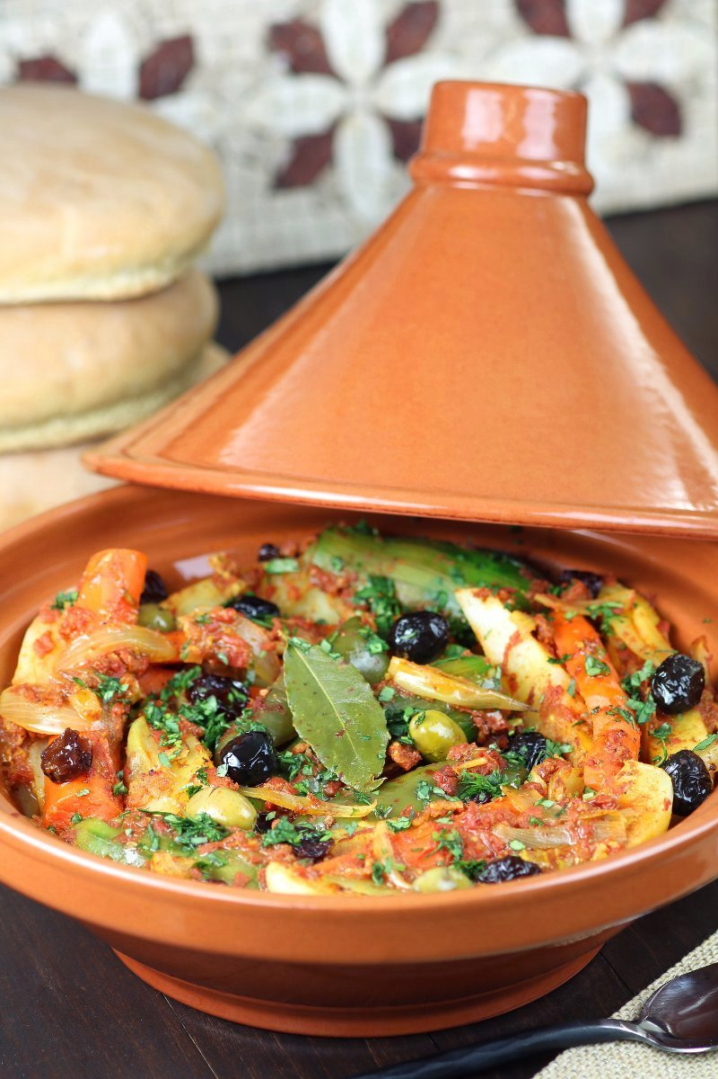
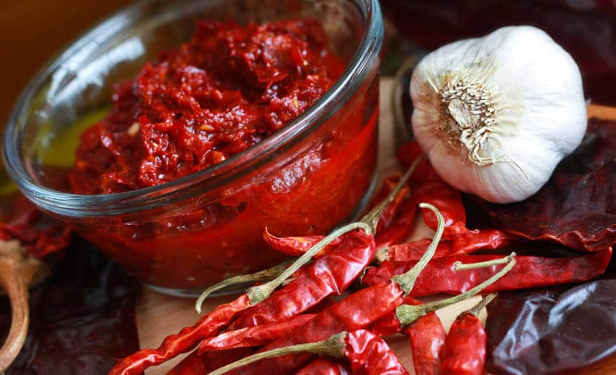
Flavors and Techniques of Morocco
Dried fruits, ginger, lemon, couscous, almonds
Haissa: Moroccan red sauce made of chilies, garlic and olive oil
Tagine: spicy stew cooked in shallow earthenware cooking dish with a tall conical lid

Slide 12
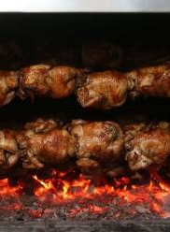
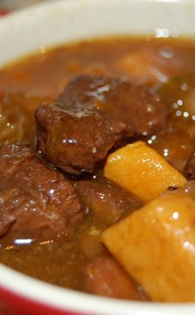
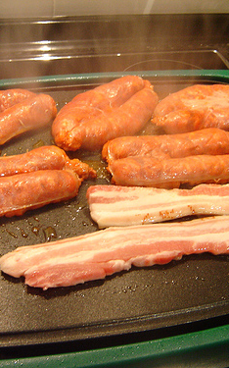
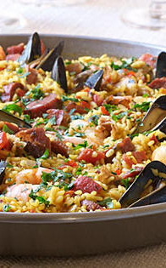
Flavors and Techniques of Spain
Anchovies, cheese, garlic, ham, honey, olive oil, onions, nuts, saffron
A la brasa: Cook using a charcoal grill
Cocida: To stew or stewed
A la plancha: To grill on a metal plate
Paella: Shellfish, rice and saffron

