Slide 1
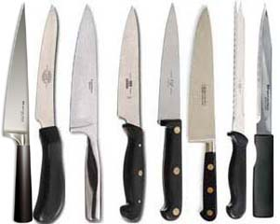
Know Your Knives
ProStart

Slide 2
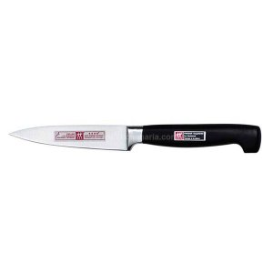
What is this?

Slide 3
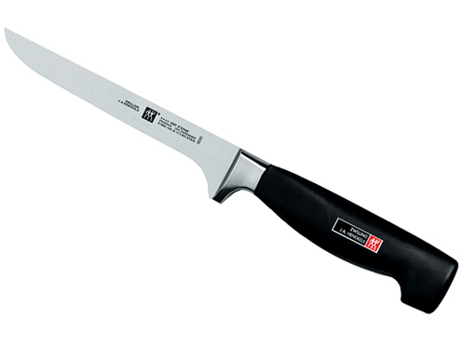
What is this?

Slide 4
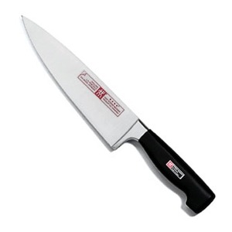
What is this?

Slide 5
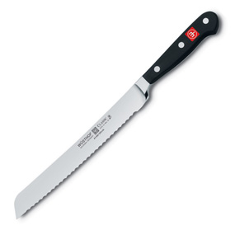
What is this?

Slide 6
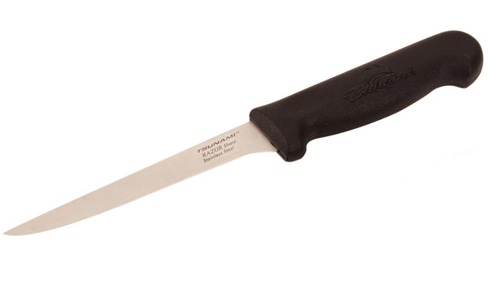
What is this?

Slide 7
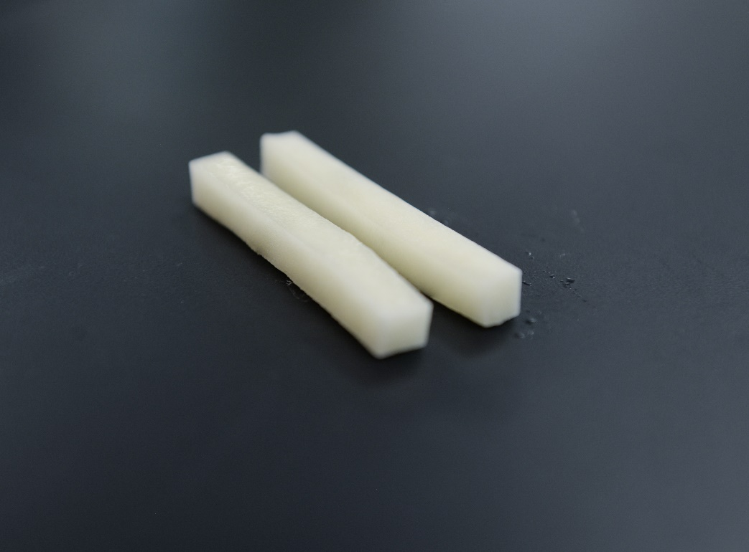
Describe the following cut:
Batonnet: 2 x 1/4 x 1/4

Slide 8
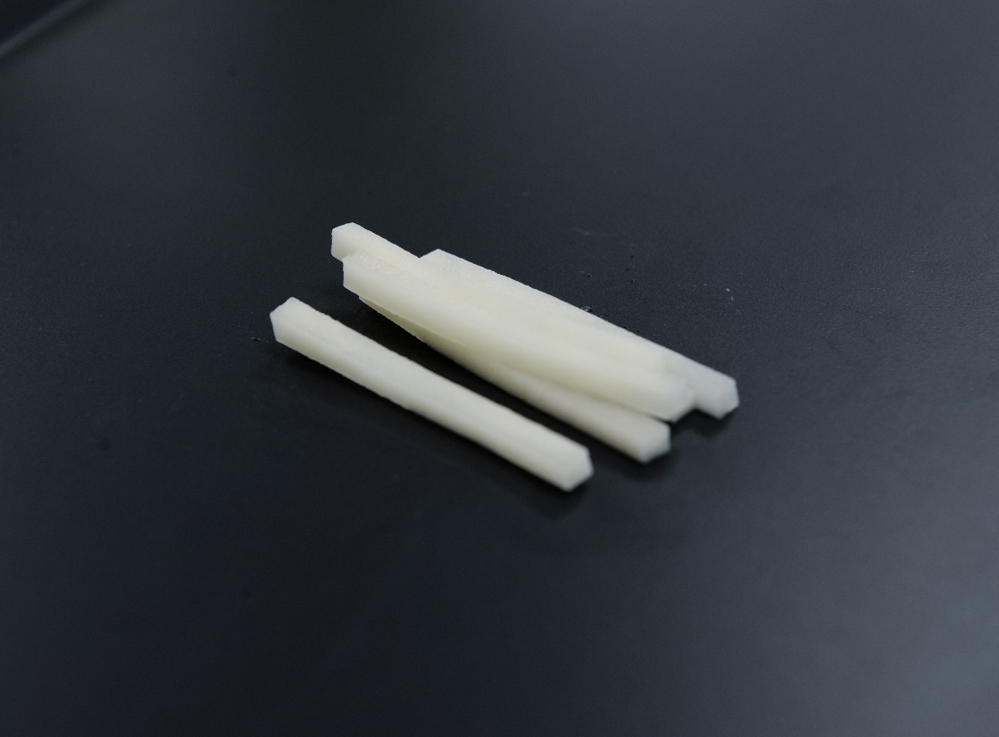
Describe the following cut:
Julienne: 2 x 1/8 x 1/8

Slide 9
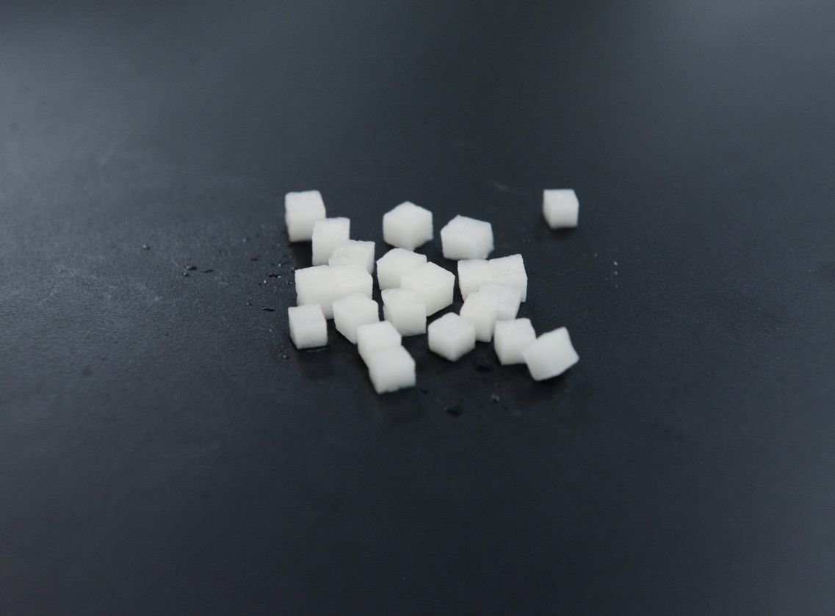
Describe the following cut:
Brunoise: 1/8 x 1/8 x 1/8

Slide 10
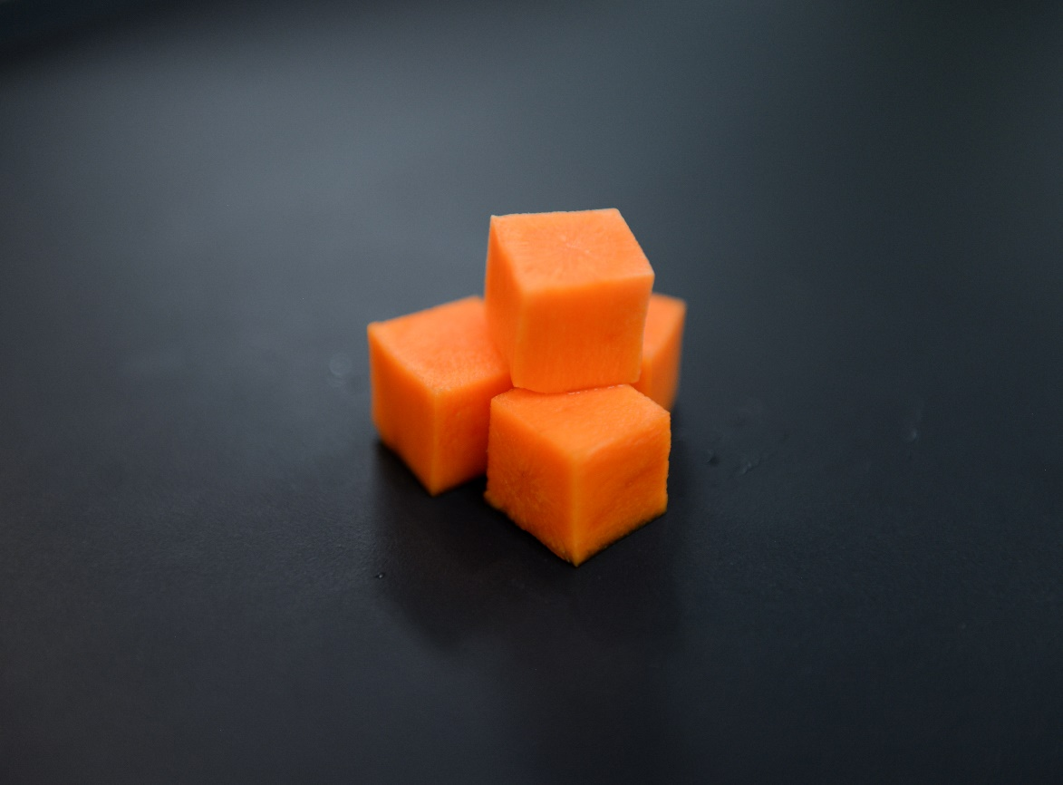
Describe the following cut:
Dice: ¼ x ¼ x ¼ or ½ x ½ x ½

Slide 11
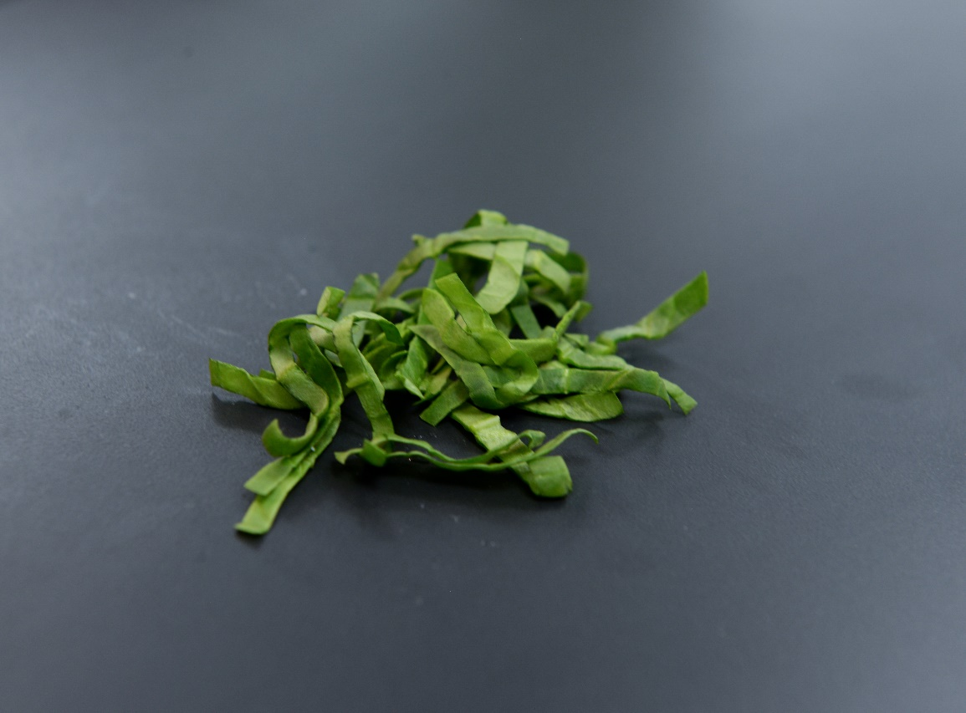
Describe the following cut:
Chiffonade: Roll leaf such as basil or spinach and thinly cut into strips.

Slide 12
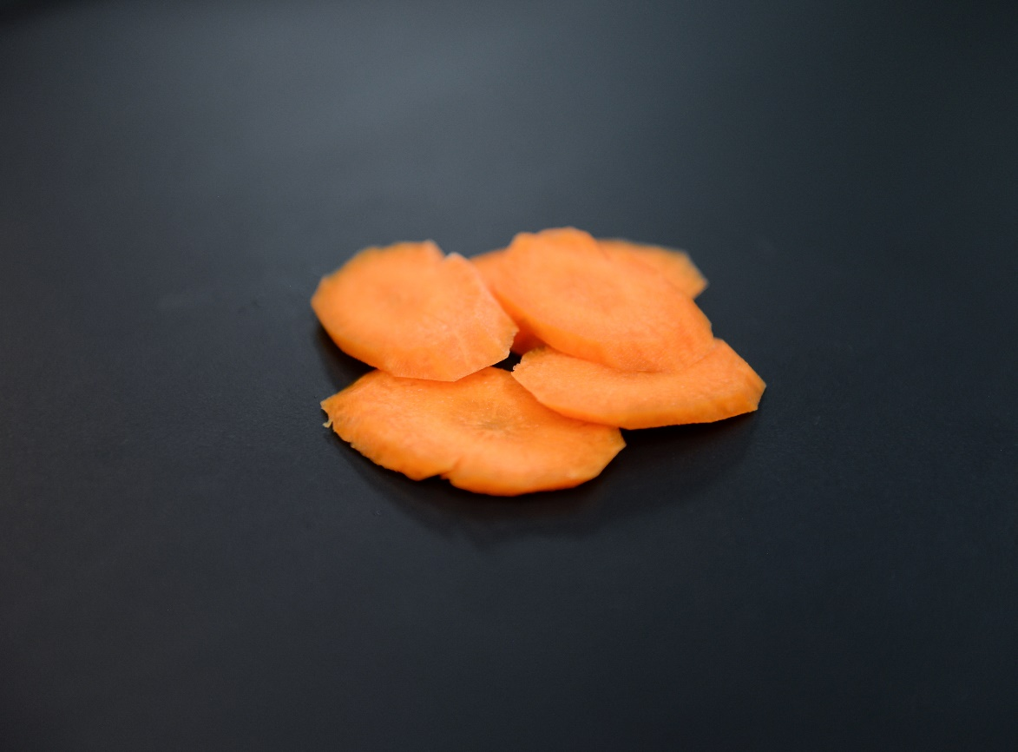
Describe the following cut:
Diagonal: Cut on a 45 degree angle

Slide 13
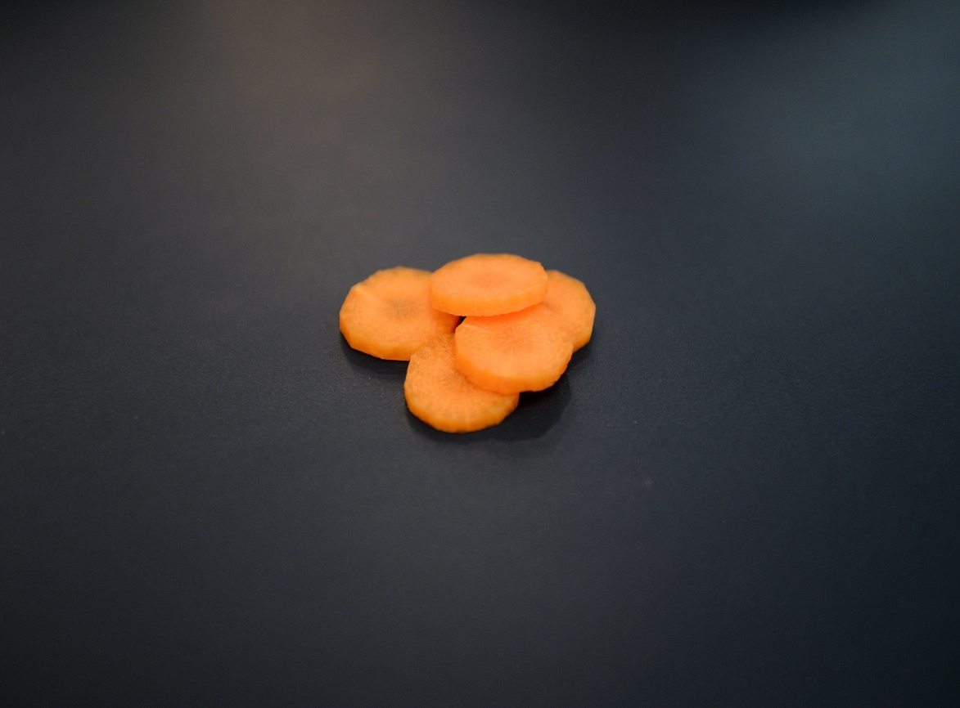
Describe the following cut:
Rondelle: Circle cut like a coin

Slide 14
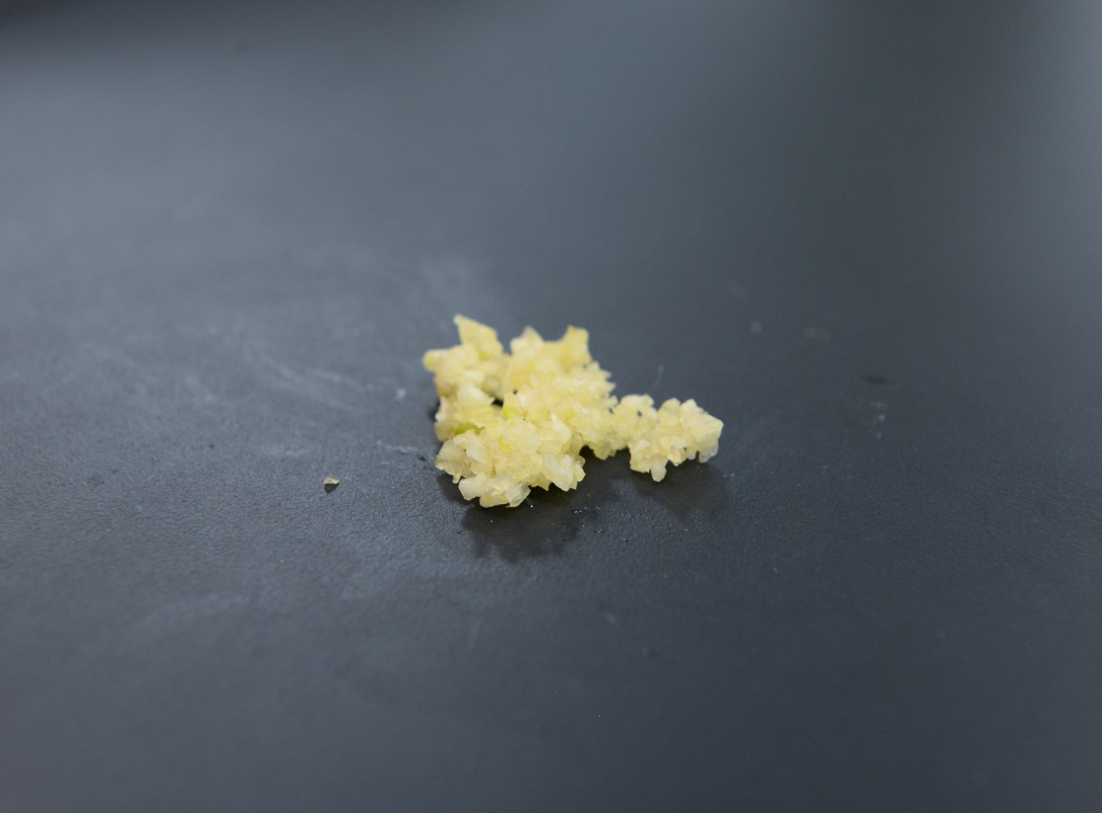
Describe the following cut:
Mince: Very small pieces – rocking motion

Slide 15
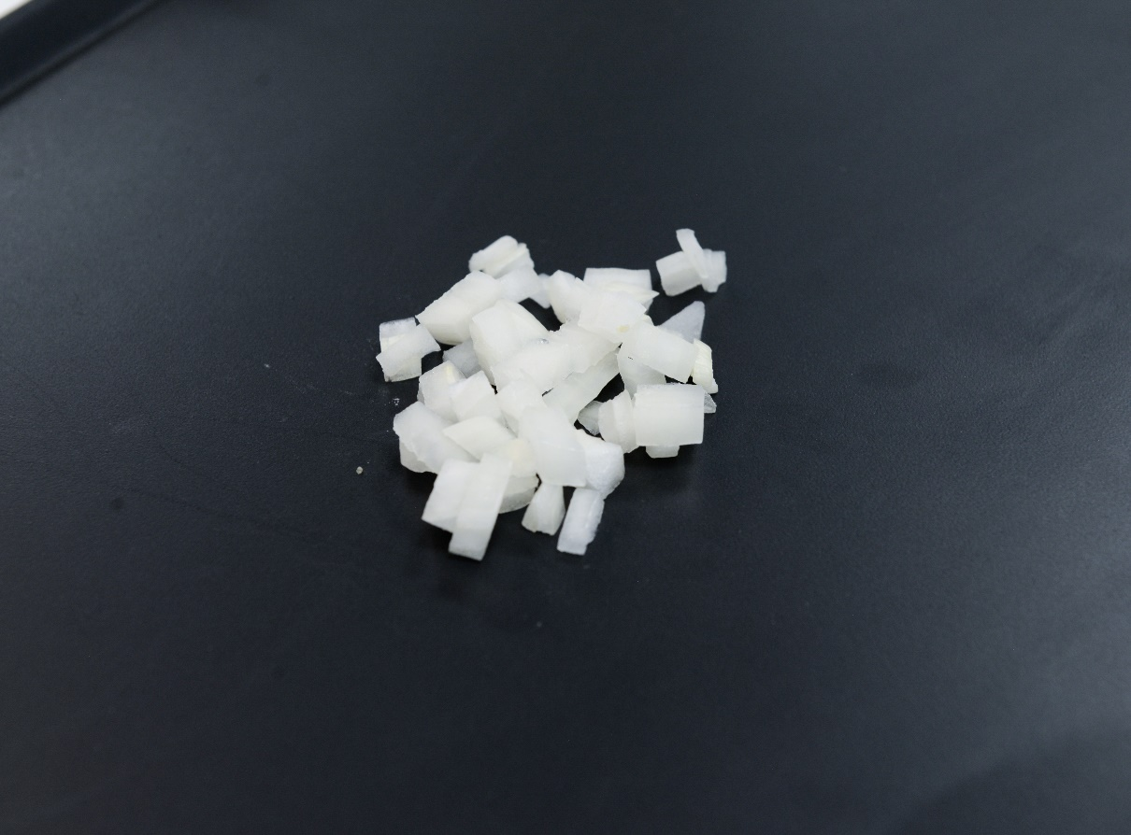
Describe the following cut:
Coarse Chop: Like dice, but not as precise – uniform in size so it cooks evenly.

Slide 16
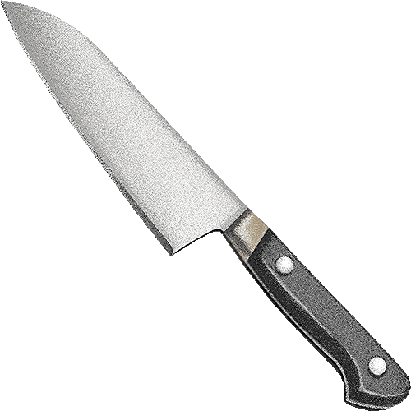
Parts of a knife
A: Tip
B: Cutting Edge
C: Spine
D: Blade
E: Heel
F: Bolster
G: Handle
H: Tang
I: Butt

Slide 17
Guidelines for knives:
Keep knives sharpened – cuts more evenly with less force, it’s safer
Use a knife only for it’s intended purpose
Keep the handle clean and dry
Never leave knives soaking under water
Never talk or point with a knife
Never distract others who are using knives
If a knife is dropped, jump back and let it fall
Store knives in knife kits, racks or sheaths
Never hand someone a knife, put it on the counter and let them pick it up

