Slide 1
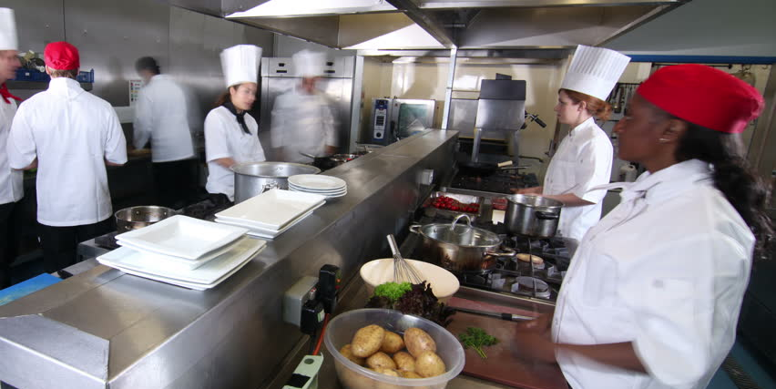
Kitchen Basics
Strand 1

Slide 2
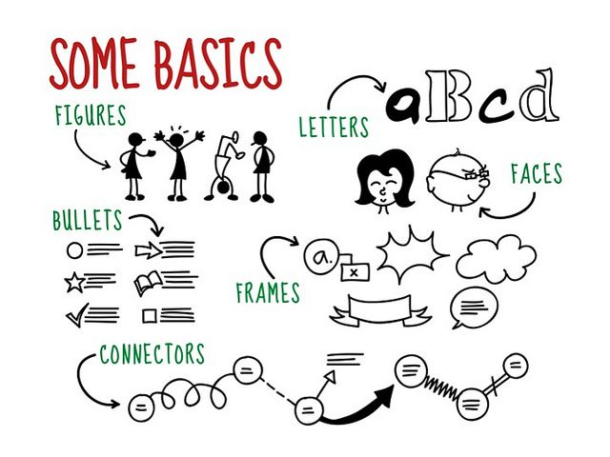
Visual Note Taking

Slide 3
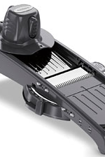
Small Ware
Mandoline
Use: Slicing
Safety: Use the hand guard
Cleaning: Clean like a knife

Slide 4
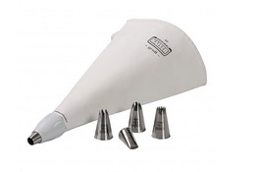
Small ware
Piping Tools
Use: Decoration or filling
Safety: None
Cleaning: Use brush with hot soapy water

Slide 5
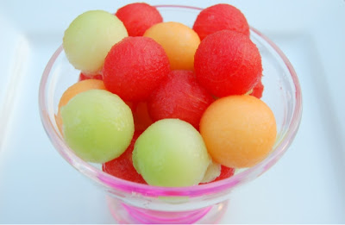
Small ware
Parisian Scoop
Use: Creating spheres
Safety: Watch for sharp edges
Cleaning: Hot soapy water

Slide 6
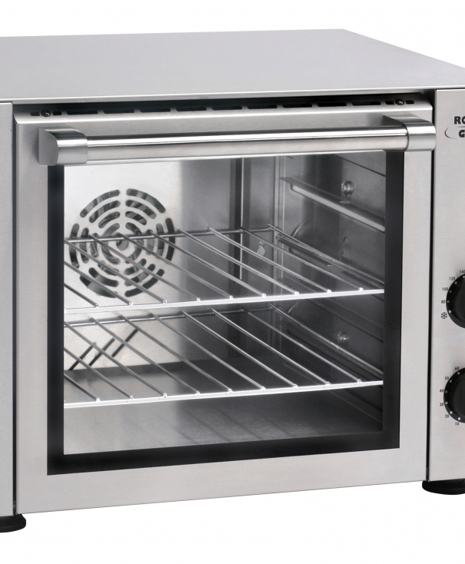
Food Prep & Service Equipment
Convection Oven
Use: Cooking with forced air
Safety: Hot pads
Cleaning: Follow manufacturer’s instructions

Slide 7
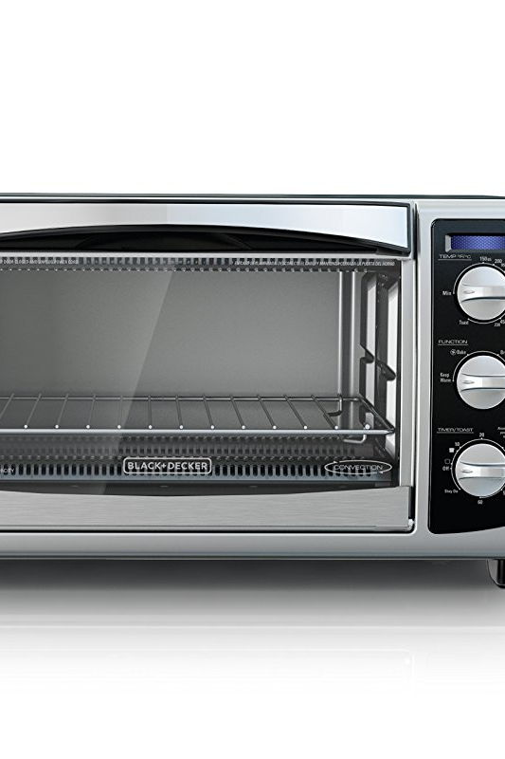
Food Prep & Service Equipment
Conventional Oven
Use: Cooking with radiant heat
Safety: Hot Pads
Cleaning: Follow manufacturer’s instructions

Slide 8
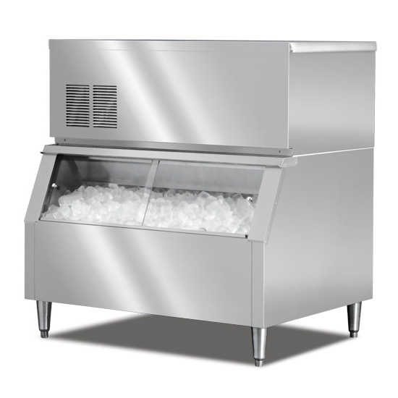
Food Prep & Service Equipment
Ice Machine
Use: Making ice
Safety: Use a metal scoop
Cleaning: Follow manufacturer’s instructions

Slide 9
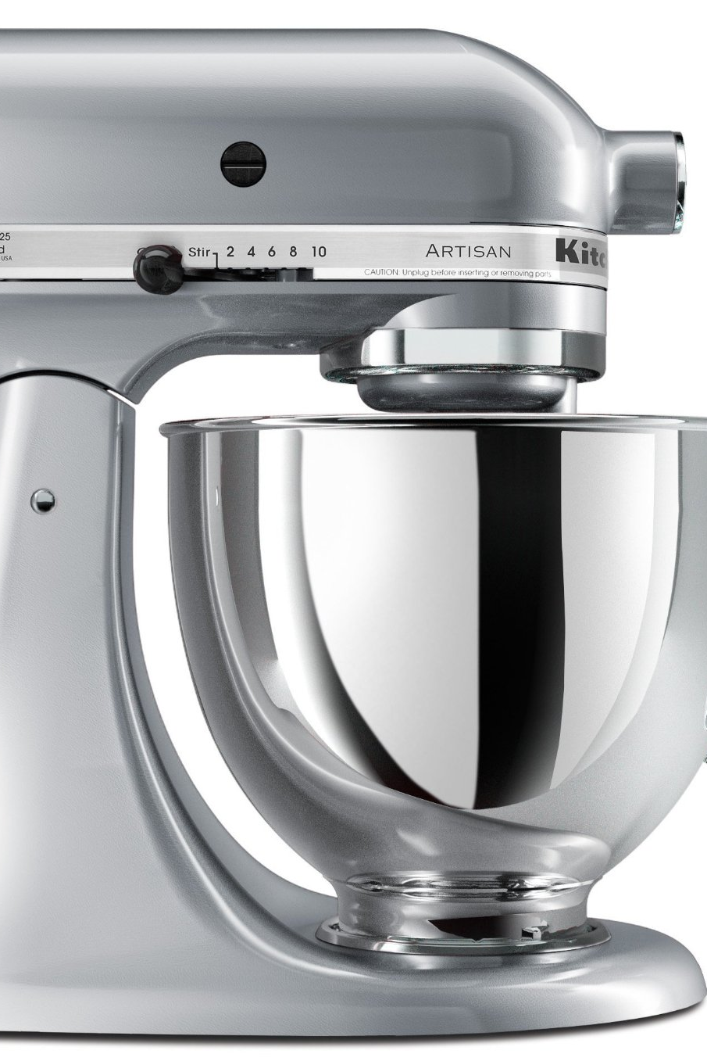
Food Prep & Service Equipment
Stand Mixer
Use: Mixing and whipping
Safety: Keep all objects away from bowl while mixer is in motion
Cleaning: Wash bowl and attachments, wipe down mixer

Slide 10
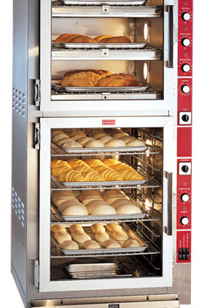
Food Prep & Service Equipment
Proofer
Use: Warming chamber
Safety: Monitor temperature, use hot pads if necessary
Cleaning: Follow manufacturer’s instructions

Slide 11
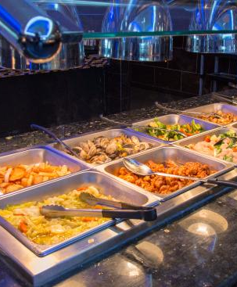
Food Prep & Service Equipment
Steam Table
Use: Stationary table to hold hot food using steam
Safety: Lift lid away from you
Cleaning: Follow manufacturer’s instructions

Slide 12
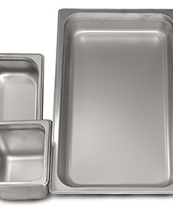
Food Prep & Service Equipment
Hotel Pans
Use: Cooking and serving food
Safety: Watch for sharp edges and lift cover away from you
Cleaning: Hot soapy water

Slide 13
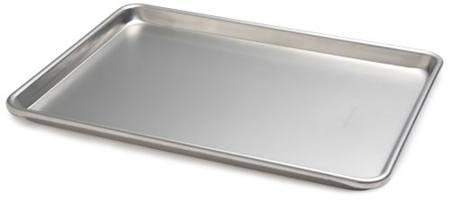
Food Prep & Service Equipment
Sheet Pans
Use: Baking and cooking
Safety: Use hot pad
Cleaning: Hot soapy water

Slide 14
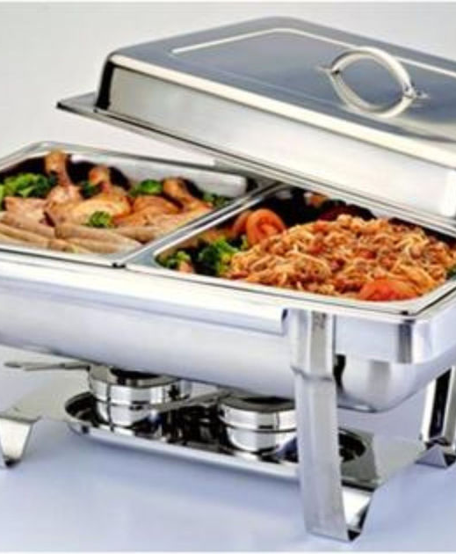
Food Prep & Service Equipment
Chafing Dishes
Use: Portable dish to hold hot food using steam
Safety: Watch for sharp edges, lift cover away from you and monitor open flames
Cleaning: Hot soapy water

Slide 15
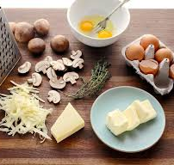
Mise en place
Put in place
Organizing equipment and preparing ingredients (measuring, doing knife cuts) before you begin cooking. (Like on a cooking show)

