Slide 1
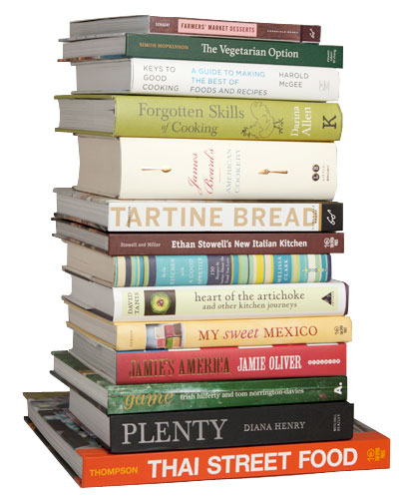
Standardized Recipes
ProStart Year 1 Chapter 4

Slide 2

What does it mean to standardize something?

Slide 3
Standardized Recipe
A standardized recipe has been found to produce the same good results and yield every time using a standardized format.

Slide 4

Why would it be important for restaurants to standardize recipes?

Slide 5
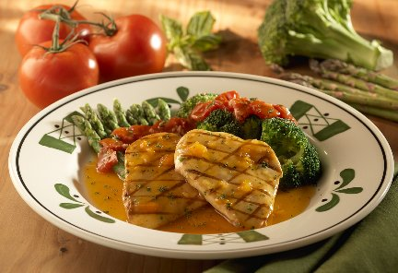
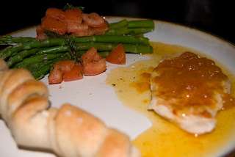
Customer Satisfaction
Olive Garden Venetian Apricot Chicken
OR
Consistency in every detail including preparation, nutritional content and presentation

Slide 6
What if we owned a bakery and these were the cookies we sold?
What if we opened a second store?

Slide 7
Cost control
What if you didn’t measure accurately and used .04 in extra ingredients each time you made something (like extra craisins). Let’s say you sold 160 oatmeal craisin cookies every day and you were open 6 days a week and closed major holidays – so let’s say you’re open 300 days a year. How much money will you lose? .04 x 160 x 300 = $1920 a year!!

Slide 8
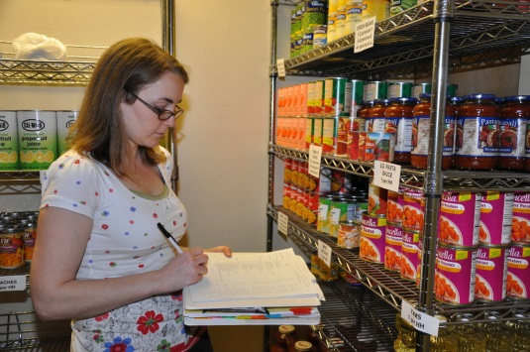
Purchasing Procedures and Inventory Control
You know what to purchase, how much to purchase and how much should be stored.

Slide 9
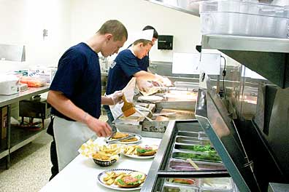
Labor Cost Control & Employee Confidence
Less training required.
Creating the same recipe decreases preparation problems and food shortages.

Slide 10
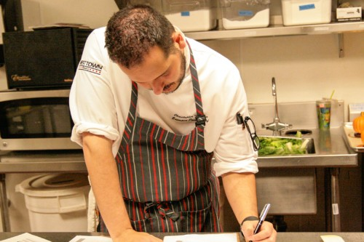
Reduced Record Keeping
Keeps everything streamlined. Food production records are always the same.

Slide 11
Parts of a Standardized Recipe
Name of the recipe
Yield – how much will this make?
Portion Size – what is one serving?
Ingredients – be specific in what is needed and how much, use weight if possible
Step by step directions
Temperature, Time and Equipment
Nutrition information – federal law requires chains with 20 or more restaurants to have nutritional information available online or in the restaurant

Slide 12
Grandma J’s Oatmeal Cookie-1
½ cup shortening
1/3 cup sugar
½ cup brown sugar
1 egg
1 tsp. vanilla
1 C + 2 tbsp. flour
1/4 tsp. salt
½ tsp. baking soda
½ tsp. baking powder
1 cup oatmeal
¼ cup raisins or craisins - optional
Preheat the oven to 350.
Cream shortening, sugar and brown sugar. Add eggs and vanilla and mix well. Add flour, salt, baking powder and baking soda and mix about 30 seconds. Add oatmeal and fully mix all ingredients. Stir in raisins or craisins. Using a cookie scoop, place on ungreased cookie sheet. Flatten with a fork or hand. Bake at 350 for 8-10 minutes. Makes 8-12 cookies
Which one is a standardized recipe?
Grandma J’s Oatmeal Cookie-3
Cream ½ cup shortening, 1/3 cup sugar, and ½ cup brown sugar in a mixer. Beat in 1 egg and 1 tsp vanilla. Mix in 1 cup + 2 tbsp flour, ¼ tsp salt, ½ tsp baking soda, ½ tsp baking powder. Stir in 1 cup oatmeal and ¼ cup of raisins or craisins. Roll in balls, flatten with a fork or hand. Bake at 350 8-10 minutes on an ungreased cookie sheet.
Grandma J’s Oatmeal Cookie – Yields 12 cookies-4
½ cup shortening
1/3 cup sugar
½ cup brown sugar
1 egg
1 tsp. vanilla
1 C + 2 tbsp. flour
1/4 tsp. salt
½ tsp. baking soda
½ tsp. baking powder
1 cup oatmeal
¼ cup craisins
1. Preheat the oven to 350.
2. Cream shortening, sugar and brown sugar.
3. Add eggs and vanilla and mix well.
4. Add flour, salt, baking powder and baking soda and mix
about 30 seconds.
5. Add oatmeal and fully mix all ingredients.
6. Stir in raisins or craisins.
7. Using a ¾ oz. cookie scoop, scoop dough and place on ungreased
cookie sheet. Flatten with a fork or hand.
8. Bake at 350 for 8-10 minutes.
Grandma J’s Oatmeal Cookie-2
½ cup shortening
1/3 cup sugar
½ cup brown sugar
1 egg
1 tsp. vanilla
1 C + 2 tbsp. flour
1/4 tsp. salt
½ tsp. baking soda
½ tsp. baking powder
1 cup oatmeal
¼ cup raisins or craisins - optional
Bake at 350 for 8-10 minutes.

Slide 13
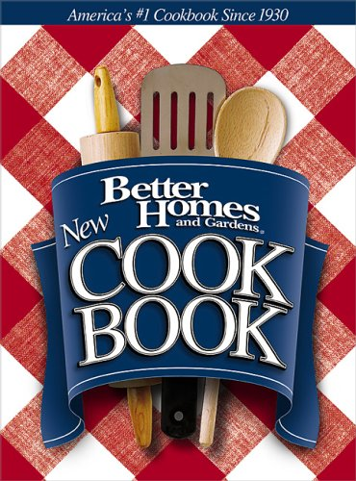
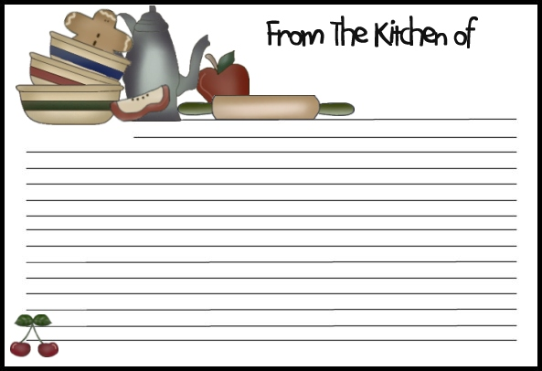
Do standardized recipes matter at home?

Slide 14
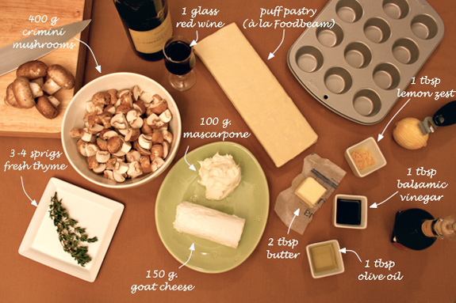
How to use a recipe
READ THE RECIPE COMPLETELY!!!!!
Mise en place – get it all ready
Measure carefully and Follow instructions

