Slide 1
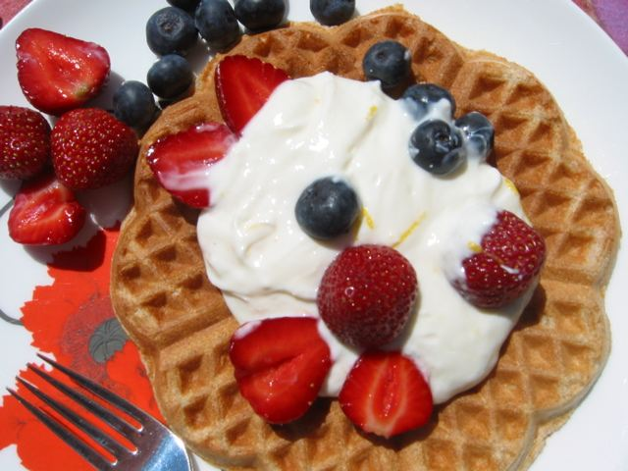
Breakfast Foods

Slide 2
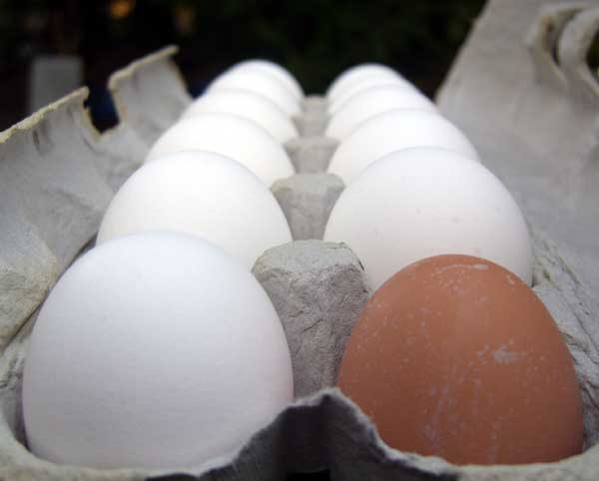
The Versatile Egg
Magic Ingredient!!
Outer shell, white (albumen), yolk, chalazae
White: Protein and water
Yolk: Protein, fat and thickener
Grades AA, A, B
Jumbo, XL, L, M, S, Peewee
Most recipes based on large eggs

Slide 3
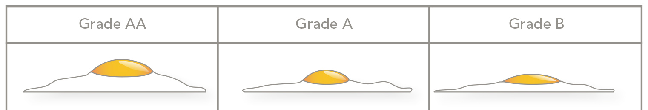
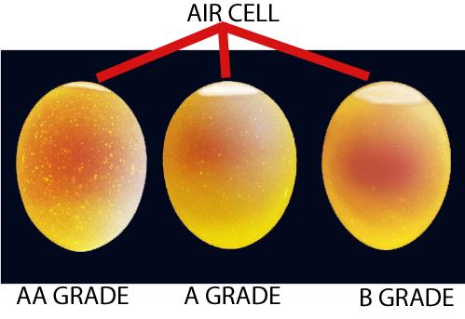
Grades of Eggs

Slide 4
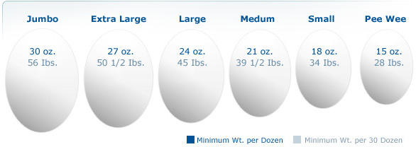
Sizes of Eggs

Slide 5
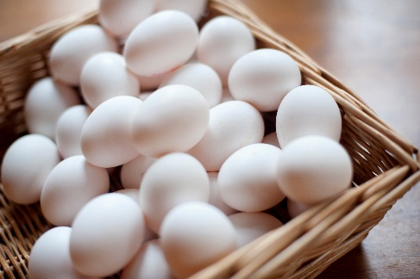
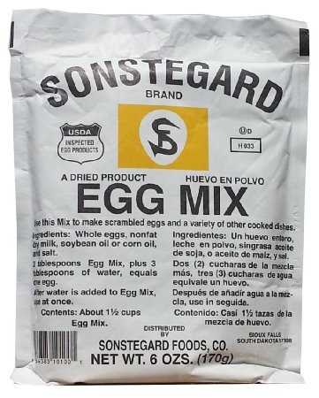
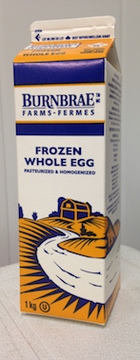
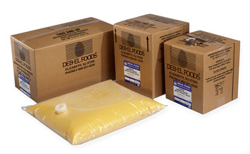
Purchase Form
Fresh in Shell
Dried or Powdered
Fresh Pooled
Frozen

Slide 6
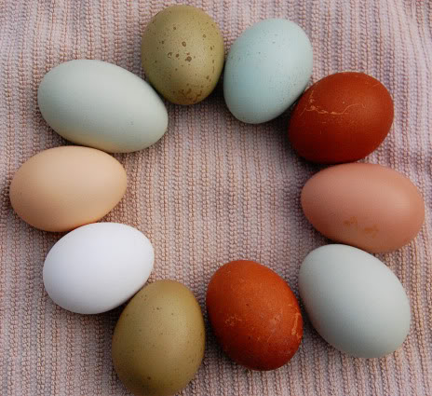
Shell Color
Egg color depends on the breed of chicken. No difference in taste or nutrition.

Slide 7
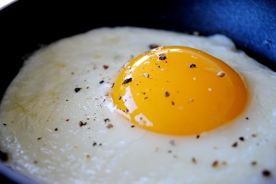
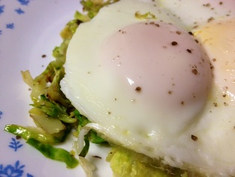
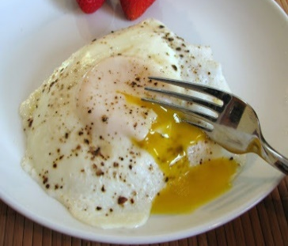

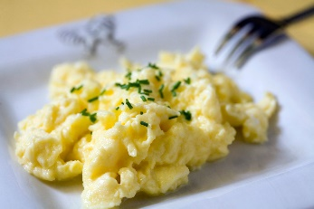
Ways to Cook an Egg
Fried
Sunny Side Up: Yolk is unbroken, not flipped
Basted: Like sunny side up but the white is cooked while spooning hot butter or fat over the egg
Over Easy: Egg is turned while cooking, runny yolk
Over Medium: Egg is turned while cooking, slightly cooked yolk
Over Hard: Egg is turned while cooking, yolk is firm
Scrambled: Egg whisked before cooking

Slide 8
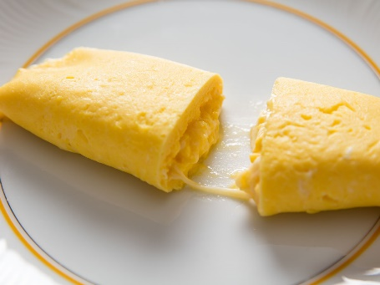
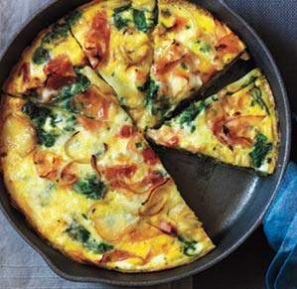
Omelets
French: cooked while in pan then rolled with fillings
Frittata: open faced omelet, fillings mixed into eggs, finished in oven or broiler

Slide 9
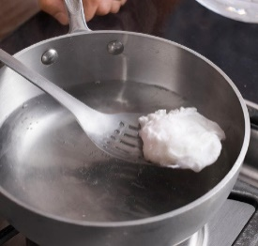
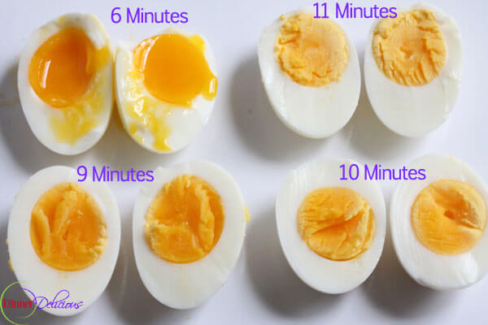
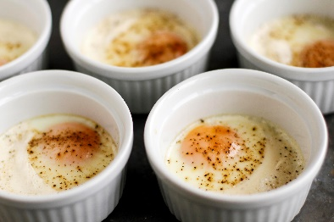
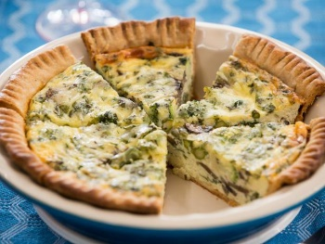
Other Cooked Eggs
Poached Eggs – Removed from shells and cooked in gently simmering water
Soft Boiled Eggs – Cooked in shells with runny yolk (simmer 4-6 minutes)
Hard Boiled Eggs – Cooked in shells with firm yolk (simmer 12-15 minutes)
Shirred – baked in ramekins, yolks soft, whites firm
Quiche – egg and fillings baked in a crust

Slide 10
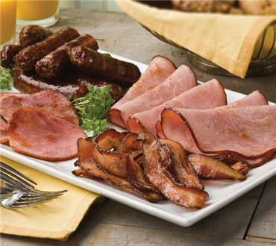
Breakfast Meats
Bacon: Brined and cold smoked pork belly
Ham: Hogs hind leg, cured or brined
Sausage: Ground meat, usually pork, seasoned. Might be put in casing to hold in moisture.
Canadian Bacon: Boneless pork loin, trimmed, brined and smoked
Other Meats: Smoked or cured fish, small steaks, pork chops, corned beef for hash (potatoes & meat)

Slide 11
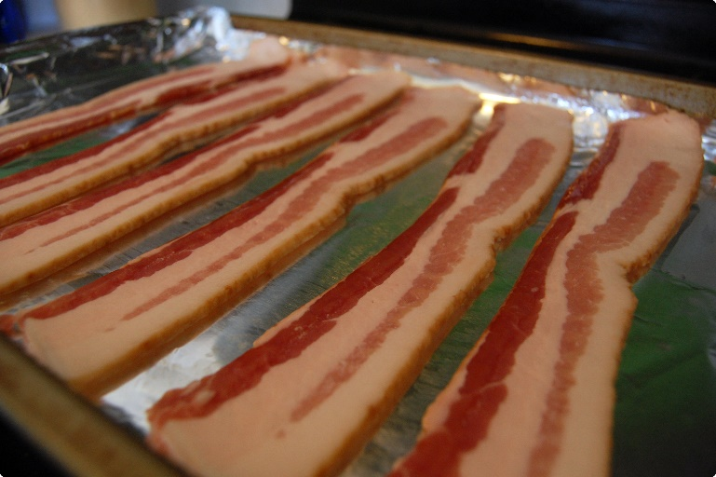
Cooking Breakfast Meat
Low temperature to avoid over cooking
Fry pan or large amounts in oven

Slide 12
Milk terms to know…
Pasteurized
Heated to destroy harmful bacteria
Homogenized
Fat is broken down so that milk fat appears uniformly throughout the product

Slide 13
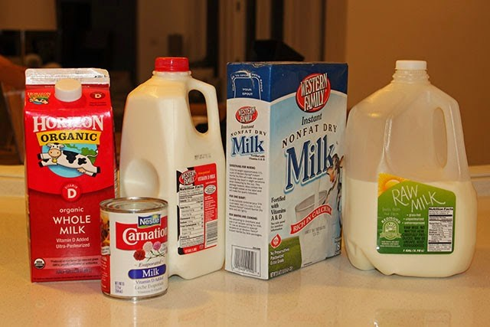
Types of Milk
Fresh Milk
  Whole (4% Fat)
  Low Fat (1-2% Fat)
  Skim (0% Fat)
Cream
  Half & Half (10-18% Fat)
  Light Cream (18-30% Fat)
  Whipping Cream (30-36% Fat)
  Heavy Cream (36% + Fat)
UHT – Ultra Pasteurized for shelf stability
Powdered - dehydrated
Lactose-Free – Lactose removed
Non Dairy Substitutes
  Soy
  Rice
  Almond or other nuts

Slide 14
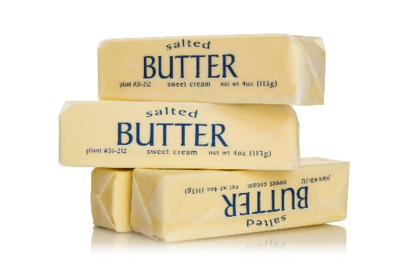
Other Dairy
Cultured Dairy (Bacteria added. Gives tang, body and flavor)
  Buttermilk
  Sour Cream
  Crème Fraiche
  Yogurt
Butter
  80% Fat, 16% Water, 2-4% Solids
  Sweet: No Salt
  Salted: Stores longer, enhanced flavor
  European: More fat, no salt, make with cultured cream
  Whipped: Increases volume
  Clarified: Water and solids removed, increases smoking point

Slide 15
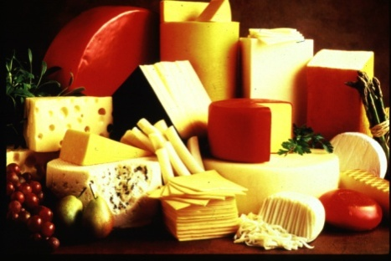
Cheese
Fresh or Unripened Cheese: Soft and White,
Examples: cottage, ricotta, cream, mozzarella, feta
Soft Cheese: Rinds are powdery white or golden orange,
creamy in texture
Examples: Brie, Camembert
Semisoft: Mild with buttery flavor, smooth, sliceable
Examples: Gouda, Munster, Havarti, Jack, Provolone
Blue-veined: Mold is injected or sprayed into cheese, strong flavor
Examples: Blue, Gorgonzola, Roquefort
Firm: Aged, firm texture, mild to sharp flavor
Examples: Cheddar, Gruyere, Manchego
Very Hard: Ripened with bacteria & enzymes,
slow process, at least 2 years. Hard and dry texture
Examples: Asiago, Parmigiano, Pecorino Romano
Processed Cheese: Not really “cheese” but used as cheese
Examples: American Cheese, Cheese Spread, Canned Cheese

Slide 16
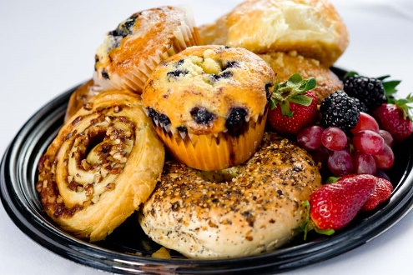
Breakfast Carbs
Breads
  Ready made
    Bagels, scones, donuts, muffins, croissants, English muffins
  Made to Order
    Pancakes, French Toast, Waffles
Cereals
  Hot
    Made on site, served with milk or cream
    Granular: Grits or Farina
    Whole, cracked or flaked: Oatmeal or Cracked Wheat
  Cold
    Purchased ready to eat

