Slide 1
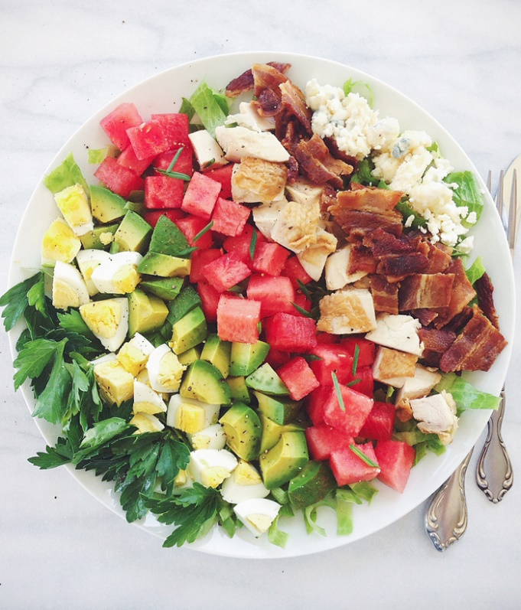
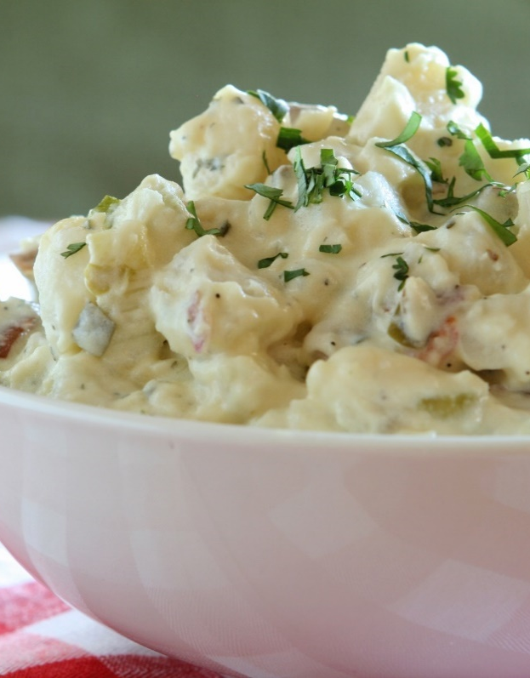
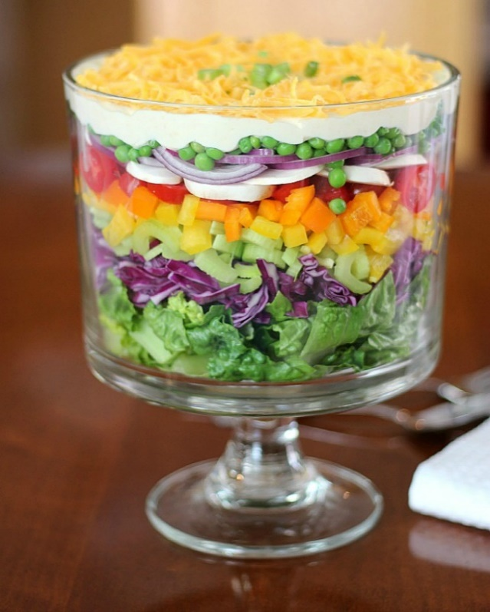
Salads and Dressings
Culinary Management STRAND 7 Standard 2
Notes:
NOTE: To replace a picture, just select and delete it. Then use the Insert Picture icon to replace it with one of your own!

Slide 2
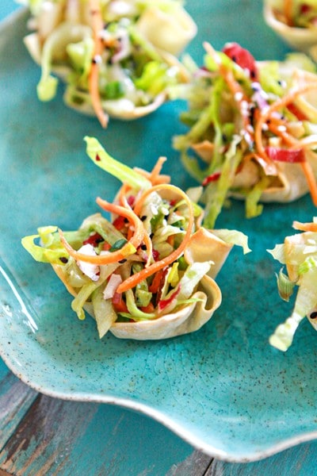
Types and uses of Salads
Appetizer: Served before the meal, this is designed to whet the appetite.

Slide 3
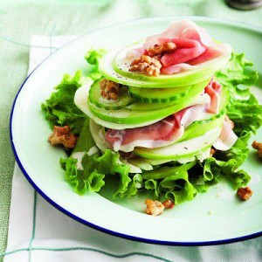
Types and uses of Salads
Accompaniment: Served with and compliments the main dish

Slide 4
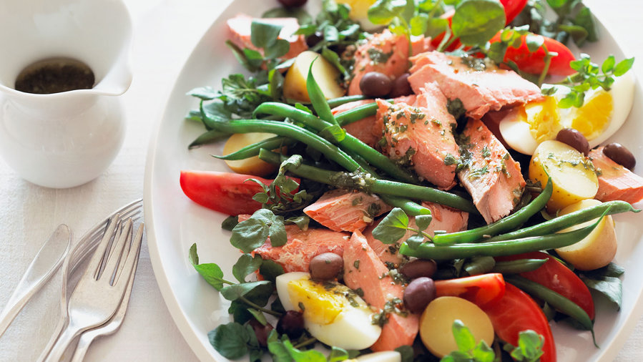
Types and uses of Salads
Main dish: This should have a variety of nutrients.

Slide 5
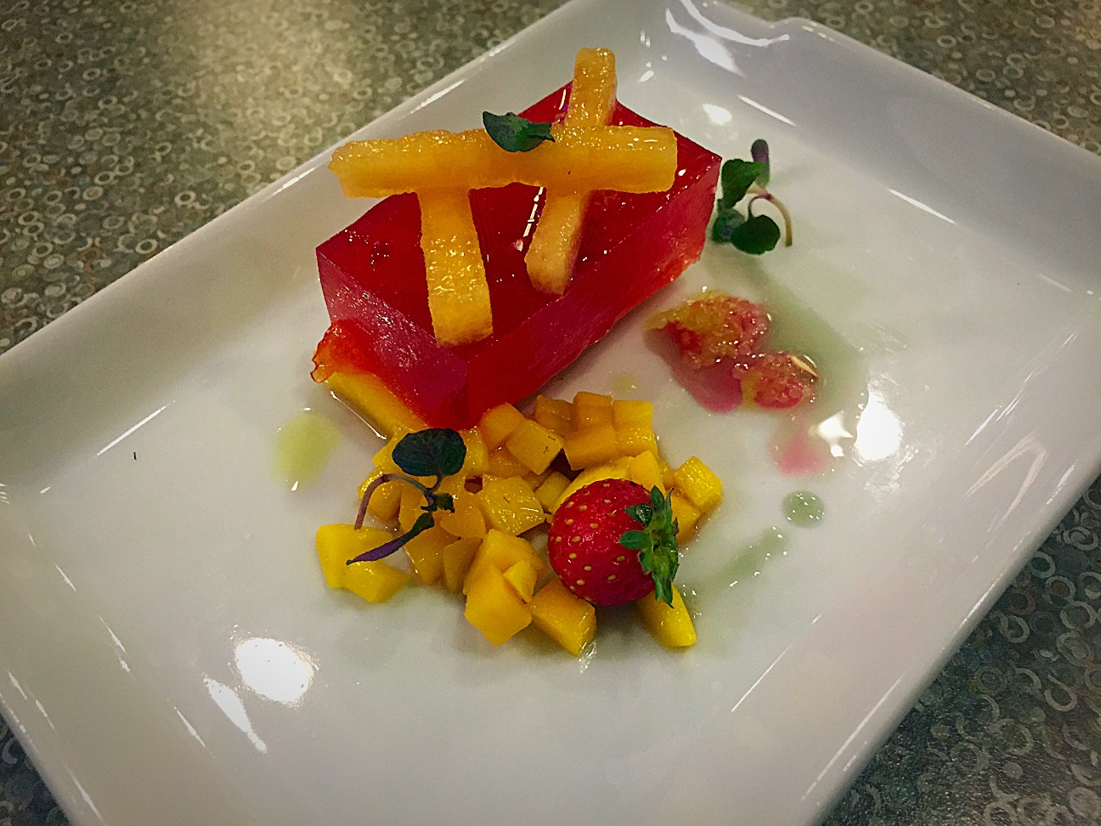
Types and Uses of Salads
Separate-course/intermezzo: A light salad served after the main course to refresh the palate.

Slide 6
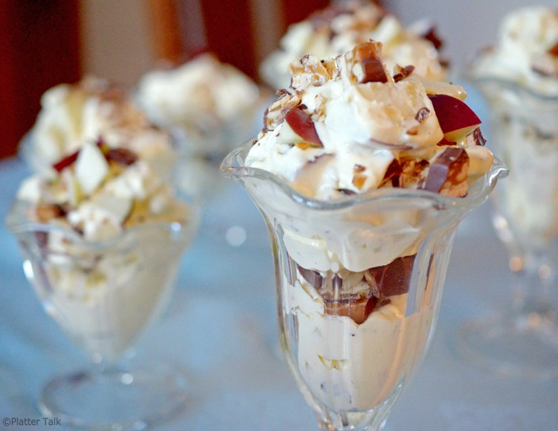
Types and Uses of Salads
Dessert: A salad served at the end of the meal.

Slide 7
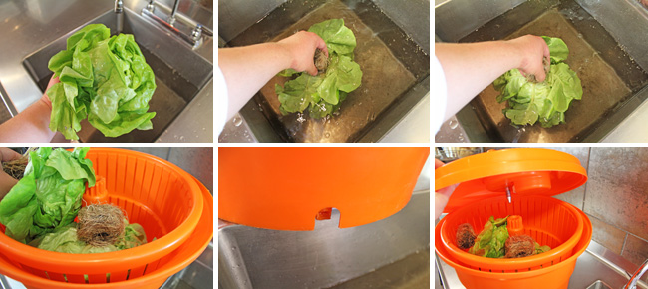
Salad Preparation
When possible, purchase greens daily.
Salad greens should be submerged and rinsed several times in cold water
Dry greens thoroughly.

Slide 8
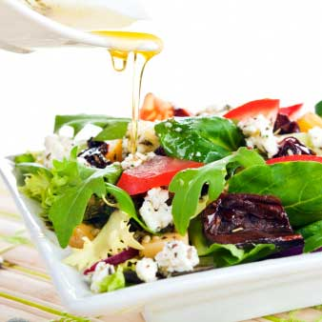
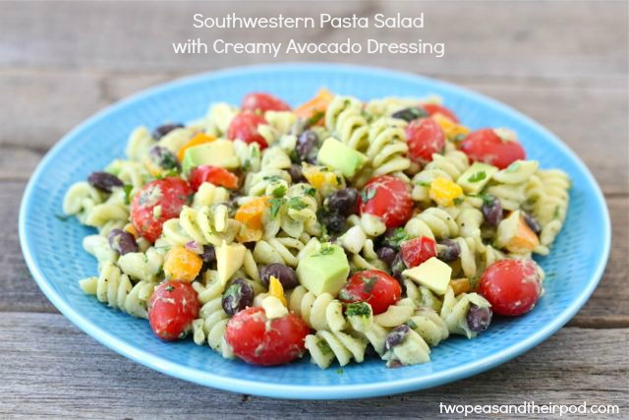
Salad Preparation
Match type of dressing with salad ingredients
  Heavier dressings with more substantial ingredients
Dress greens just before serving
Starch salads should be dressed and refrigerated to allow the flavors to blend and develop.

Slide 9
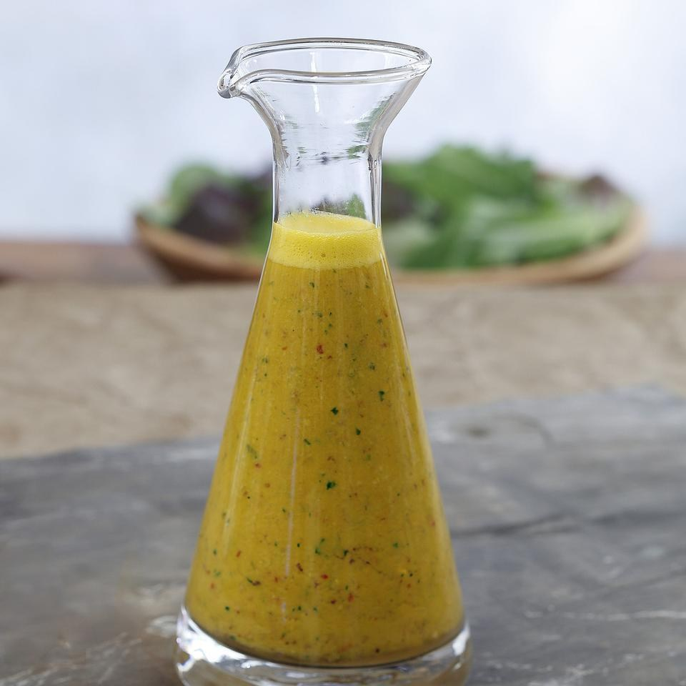
Dressing
Vinaigrette
  Made with oil and vinegar 3:1 ratio
  Vinaigrette quickly separates—Must shake before use

Slide 10
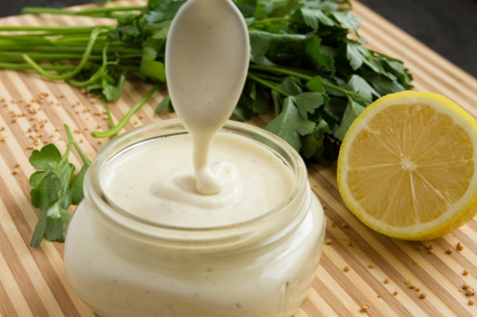
Dressings
Mayonnaise based dressing
  Thick, creamy dressing that is a permanent emulsion of oil, vinegar or lemon juice, egg yolk and seasonings.
  An emulsifier is a substance that keeps the oil and vinegar blended.
    Egg yolk or mustard are effective emulsifiers

Slide 11
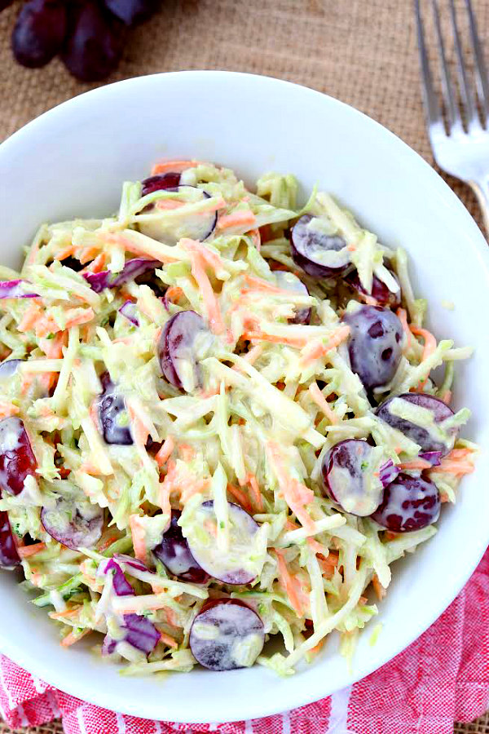
Dressings
Cooked Dressings are usually thickened with a starch, such as flour or cornstarch.
  Examples: Coleslaw dressings, potato salad dressings, frog-eye salad

Slide 12
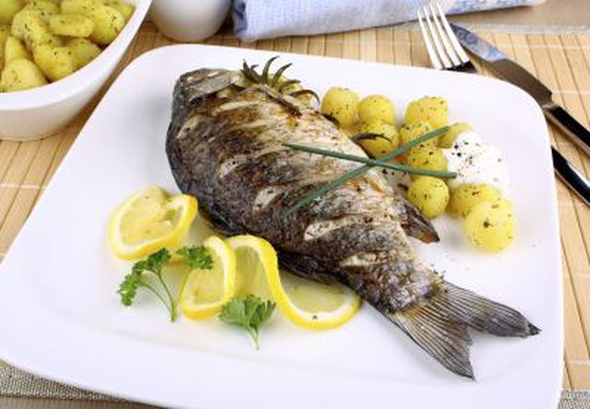
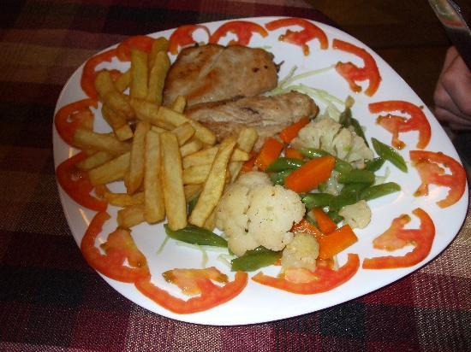
Garnishes
Decorative ingredient used to finish a plate or drink
  Edible
  Variety in color, size, texture and shape
  Enhances the food, doesn’t overpower
  Make food look appetizing
  Planned as part of the plate
  Proportionate to the size of the food being served
YES
NO

