Slide 1
Chocolate

Slide 2

Chocolate History
Mayans believed it was a divine food from the gods.
French thought it to be a dangerous drug
Love, romance

Slide 3
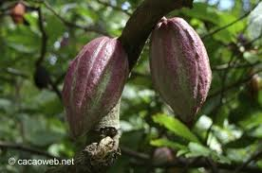
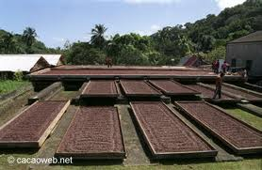
Chocolate preparation
Comes from cocoa beans from
cacao trees.
Roast cocoa beans – dry fermentation

Slide 4
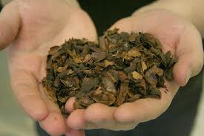
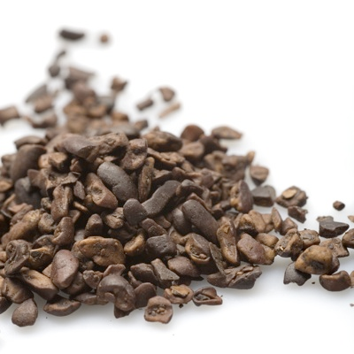
Continued
Loosen outer shell and crack bean
shown: shells, used in gardens
Beans are broken into small pieces
  called nibs

Slide 5
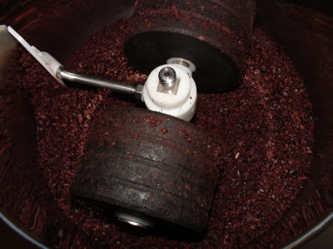
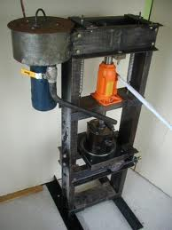
Continued
Crushed into paste – completely
unsweetened, called chocolate
liquour
Pressed to separate the liquid from
the solid. Liquid is cocoa butter.
This can be combined with chocolate
liquour to make eating chocolate.

Slide 6
Types of Chocolate
Type | Description | Form
Unsweetened Chocolate | 90% chocolate liquor, 5% cocoa butter, maybe 5% sugar | Blocks or bars
Semi-sweet Chocolate | Solid chocolate about 45% chocolate liquor, 15% cocoa butter and 40% sugar | Blocks, bars, chunks & chips
Milk Chocolate | chocolate liquor, cocoa butter, sugar, and some type of milk | Blocks or bars, chunks & chips
White Chocolate | Sweetened cocoa butter | Blocks or bars, chunks & chips
Cocoa | Only 10-25% of cocoa butter remains | Powdered
Dutch Cocoa | Cocoa powder treated with alkali to reduce acidity | Powdered

Slide 7
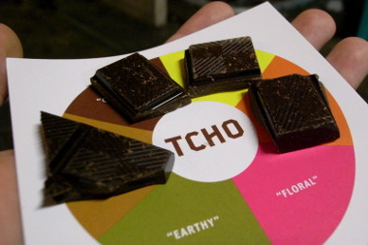
Tasting Chocolate
Cleanse your palate
Chocolate needs to be room temperature
Allow the chocolate to dissolve in your mouth – don’t bite or chew
Describe what you taste at the beginning, during and after

Slide 8
Storage
Cool, dry place.
Wrap carefully
Refrigeration causes moisture to condense. May need to refrigerate in hot humid weather.
Bloom – cocoa butter has melted and recrystallized on the surface. No change in flavor, but looks funny.
Should keep several months.

Slide 9
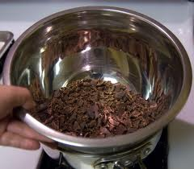
Tempering Chocolate
Why?
  So it will harden evenly and have a good shine
  Can be purchased already tempered
How?
  Finely chop 1 pound of chocolate.
  Combine ¾ of the chocolate and 2 tsp. shortening in a heat proof bowl set over a pan of simmering water. Don’t let the water near the chocolate.
  Melt the chocolate to 105 degrees, stirring. Place the bowl in a larger bowl of cold water, stir in the remaining chocolate until melted. The temperature should drop to 87 degrees. Place back over simmering water. Heat back to 92 over hot water. Re-heat to 92 if it gets too thick.

Slide 10
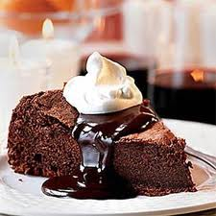
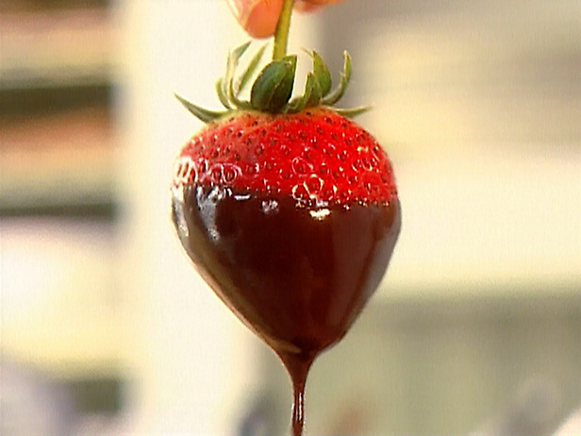
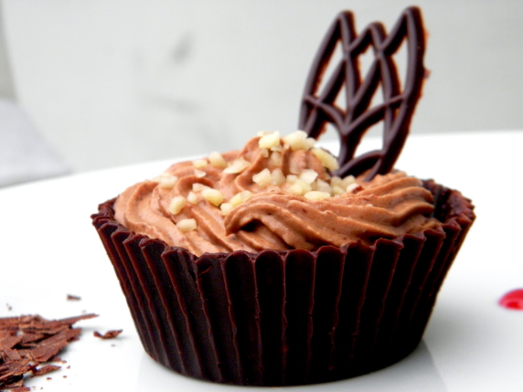
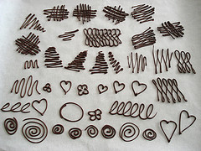
Chocolate uses
Sauces or icing (Ganache)
Dipping
Piping - garnish

