Slide 1
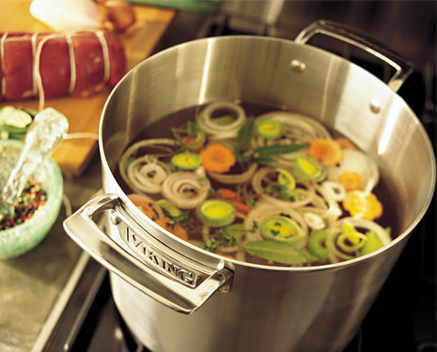
Stocks, Sauces and Soups

Slide 2
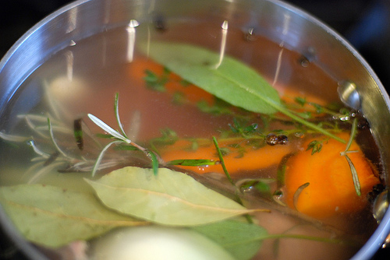
What is Stock?
A flavorful liquid made by gently simmering bones and or vegetables.

Slide 3
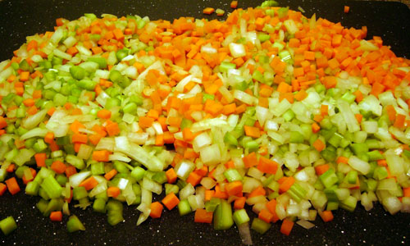
4 Essential Parts to Stock
Mirepoix – 2 parts onion, 1 part carrot, 1 part celery roughly chopped.
Aromatics – herbs and spices, thyme, parsley stems, bay leaf, cracked pepper corn – in a cheesecloth bag or not.
Liquid – most often water
Major flavoring ingredient –
bones or vegetables

Slide 4
Preparing Stock
Combine bones or vegetables in cold water or liquid
Bring to a simmer
Add mirepoix and aromatics at the appropriate time
Simmer different types of stocks until correct flavor and color.
White/Poultry: simmer 2-4 hours
Brown/beef or veal: roast bones first, simmer 6-8 hours
Fish: simmer 20-45 minutes
Vegetable: simmer 30-60 minutes.

Slide 5
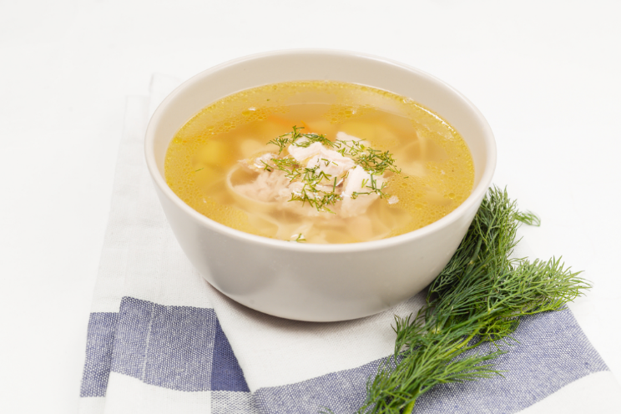
Soup Types
Clear/Stock Soups
Broth, consommé, clear vegetable and noddle soups such as chicken noodle.
Unusual/Regional Soups
Gazpacho, gumbo, borscht etc.
Thick Soups
Creamed, purred, bisque, chowder

Slide 6
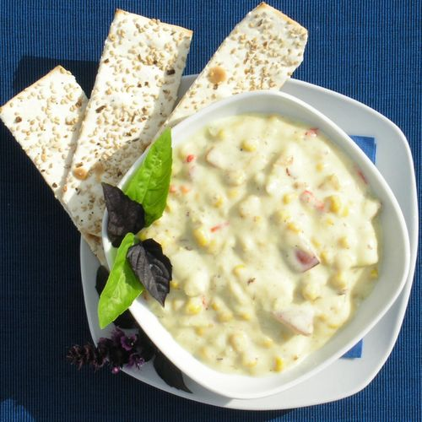
Thick Soups
Cream – made by adding thickeners – smooth texture
Puree – thickened by starch in ingredients such as potatoes
Bisque – smooth cream soup made from shell fish
Chowders – thick cream soup with chunks

Slide 7
Thickeners for sauce and soup
Roux – white, blond or brown - Equal parts of flour and fat, melt butter stir in flour, cook and stir. Color depends on how long you cook it.
Beurre manie – equal parts of solid butter and flour, added in pea sized balls.
Slurry – cornstarch, flour, arrowroot or potato starch mixed with cold liquid
Starchy foods – like potatoes and pasta.

Slide 8

Grand or Mother Sauces
Notes:
https://www.youtube.com/watch?v=gTqT-bkrKTU

Slide 9
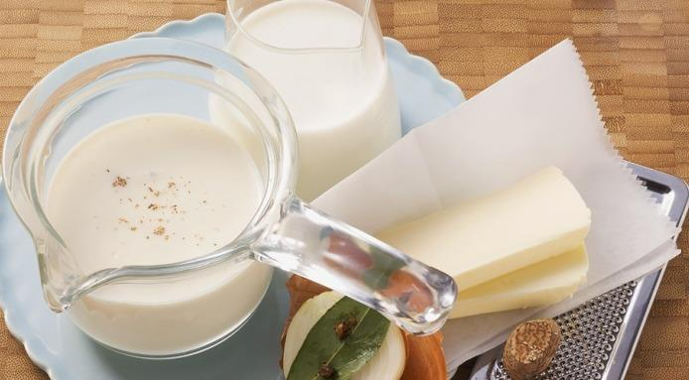
Béchamel
Uses:
Some cream soups
Moussaka
Lasagna
Soufflé
Croquettes
Croque Monsieur (sandwich)
With vegetables and pasta
Derivative Sauces
Mornay/cheese sauce
Crème sauce
Soubise (diced sweated onions added)

Slide 10
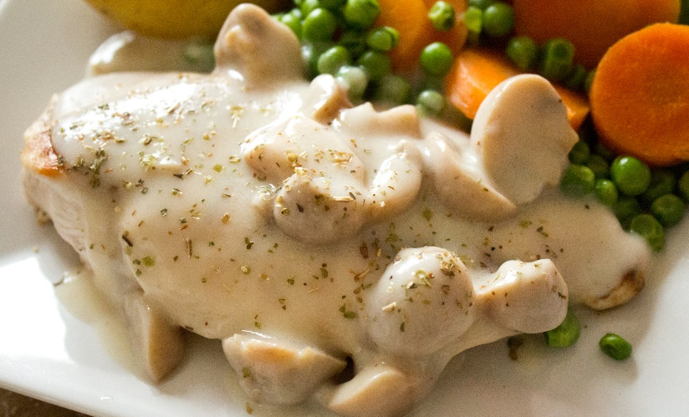
Velouté
Uses:
Fish or chicken, depending on the stock used
Creamed soups
Anytime you would use a fish or poultry gravy
Derivative Sauces
Allemande – add lemon juice, egg yolk and cream
Supreme – Cream and butter to finish
Poulette – mushrooms, chopped parsley and mon juice.

Slide 11
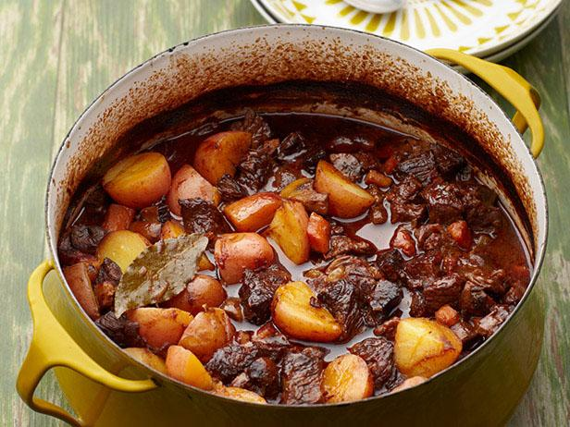
Espagnole
Uses:
Roasted beef or veal dishes
Derivative Sauces
Bourguignonne - red wine and onions/shallots
Demi-glace
Chasseur – mushrooms/shallots or tomato
Bordelasie - red wine and shallots

Slide 12
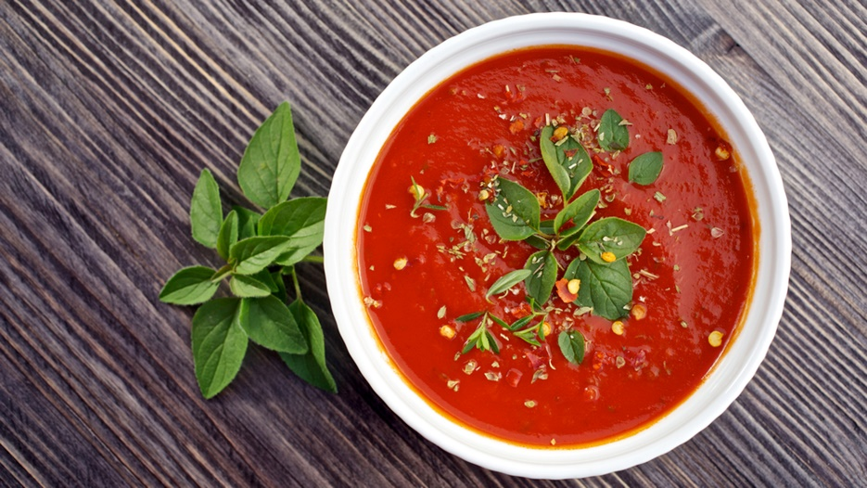
Tomato
Uses:
Pasta
Fish
Vegetables
Poultry
Ground meats and sausages
Breads and dumplings like gnocchi
Derivative Sauces
Marinara,
Creole Sauce – onions, celery and green peppers
Salsa – onions, peppers and cilantro

Slide 13
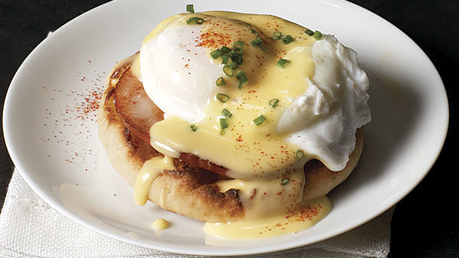
Hollandaise
Uses:
Eggs – such as eggs benedict
Vegetables
Poultry
Fish and beef dishes
Derivative Sauces
Béarnaise – reduced vinegar, shallots and tarragon
Dijon – add Dijon mustard
Chantilly – folded-in whipped cream.

