Slide 1
Vocabulary
Culinary Arts

Slide 2
Strand 1
Equipment

Slide 3
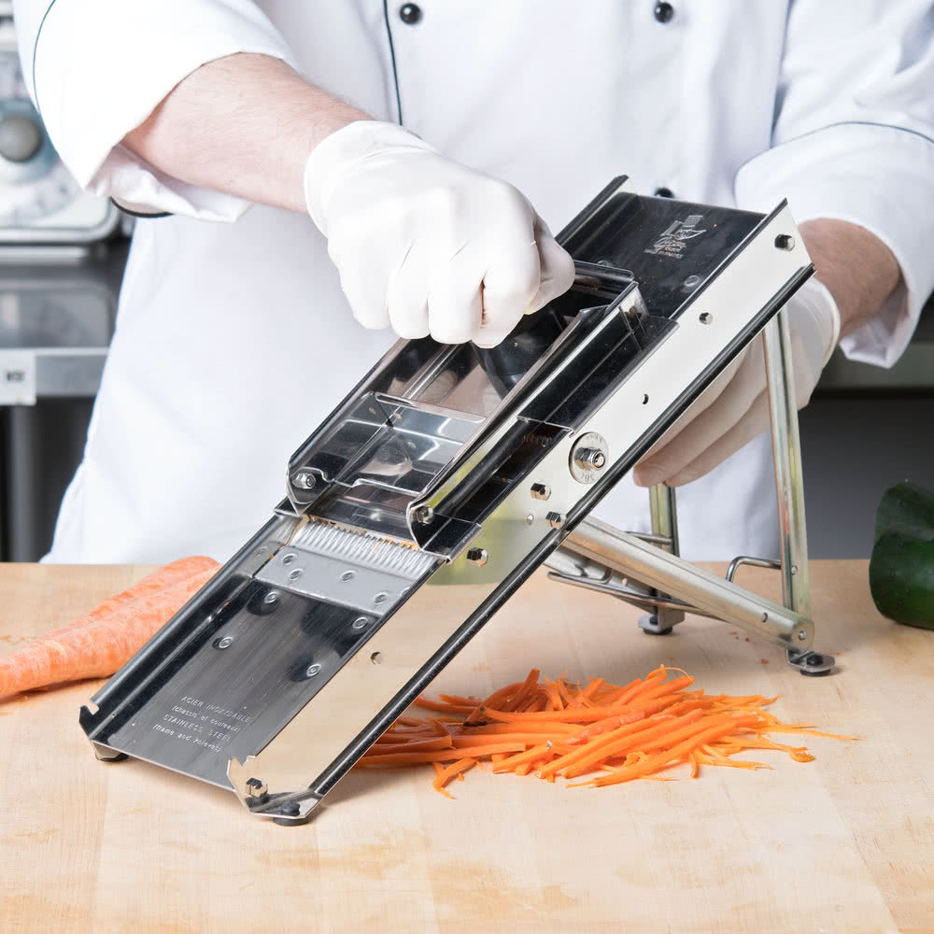
Mandoline
Definition: Used for slicing and for cutting juliennes; with suitable attachments, it can make crinkle-cuts
Tip: Make sure to use the finger guard

Slide 4
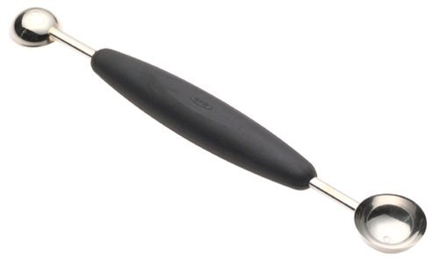
Parisian Scoop
Definition: Used for cutting spheres out of fruit and vegetables.
Tip: Parisian scoops are sometimes called melon ballers.

Slide 5
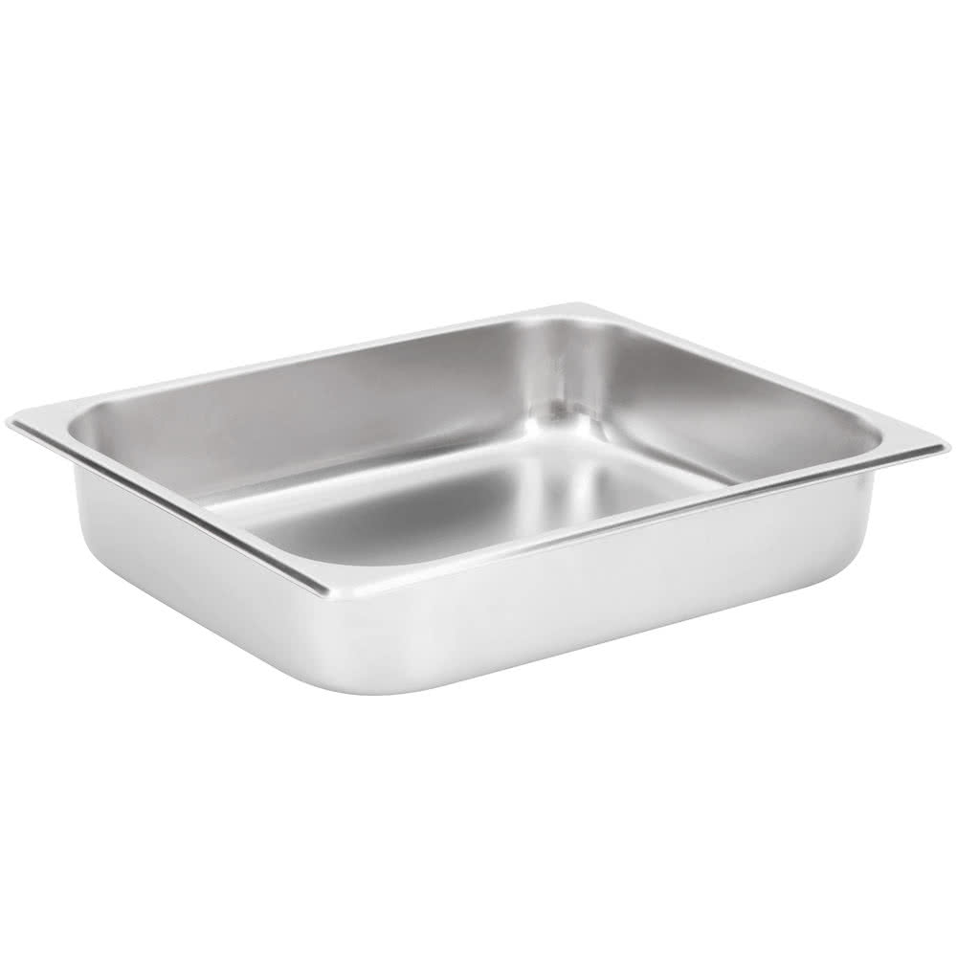
Hotel pan
Definition: Large rectangular pans that food is cooked and served from
Tip: Hotel pans come in large variety of sizes depending on the need.

Slide 6
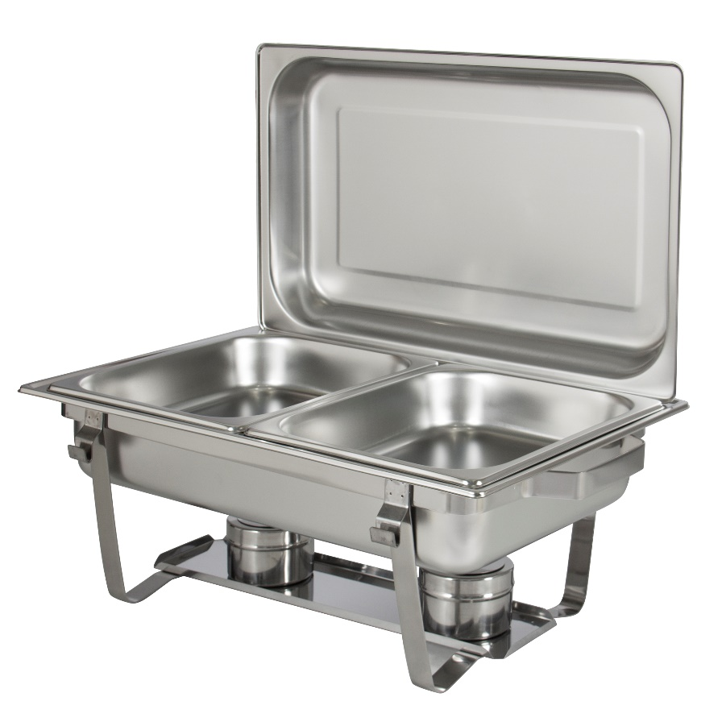
Chafing Dish
Definition: a metal dish with a lamp or heating appliance beneath it, for keeping food hot
Tip: These hold hotel pans to keep food hot at a buffet line.

Slide 7
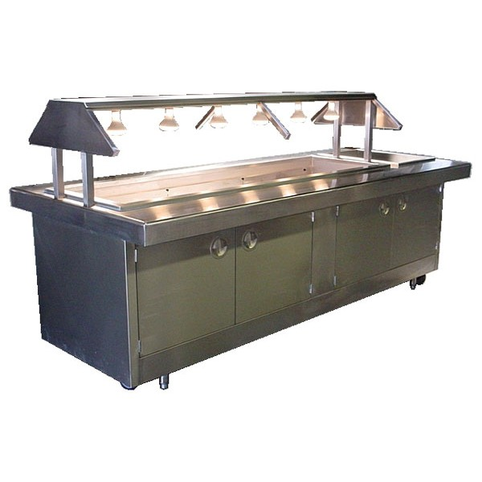
Steam Table
Definition: table with slots to hold food containers which are kept hot by steam circulating beneath them
Tip: This is where you get your hot food from restaurants like Chuck-a-Rama

Slide 8
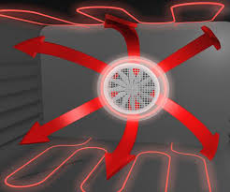
Convection Oven
Definition: a convection oven has a fan and that blows hot oven air over and around the food
Tip: When using a convection oven lower the temperature 25 degrees.
Notes:
http://www.thekitchn.com/whats-a-convection-oven-and-when-do-i-use-it-appliance-guides-from-the-kitchen-216549

Slide 9
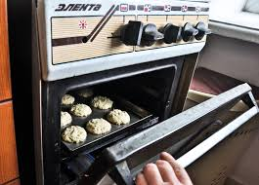
Conventional Oven
Definition: The heat source in a conventional oven is stationary, usually radiating from the bottom
Tip: Conventional ovens are better for baking.
Notes:
https://www.chowhound.com/food-news/176267/whats-the-difference-between-a-conventional-and-a-convection-oven-2/

Slide 10
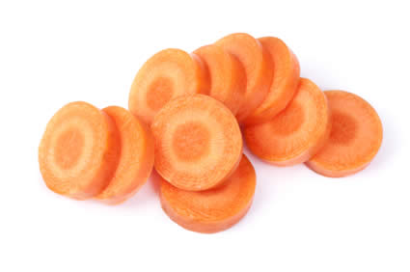
Rondelle
Definition: Round cut, also called a coin cut.
Tip: Keep thickness even to make sure that cooking is even.

Slide 11
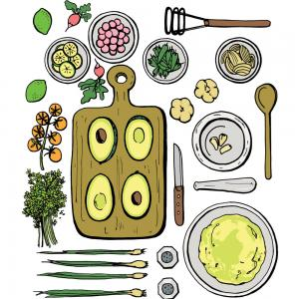
Mise En Place
Definition: a French term for having all your ingredients measured, cut, peeled, sliced, grated, etc. before you start cooking
Tip: Everything in its place

Slide 12
Strand 2
Safety and Sanitation

Slide 13
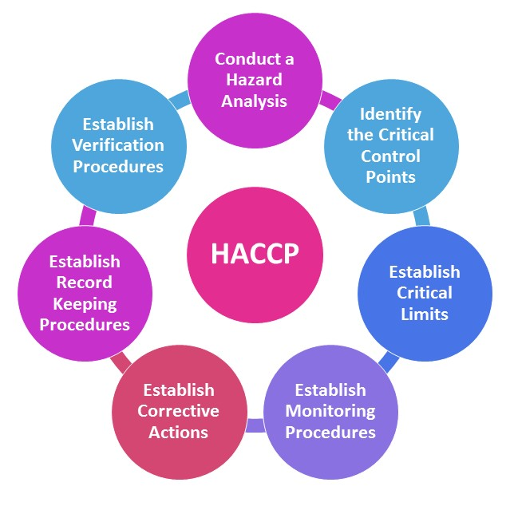
haccp
Definition: Hazard analysis and critical control points or HACCP is a system used to keep food safe.
Tip: Some food service establishments have a HACCP plan in place

Slide 14
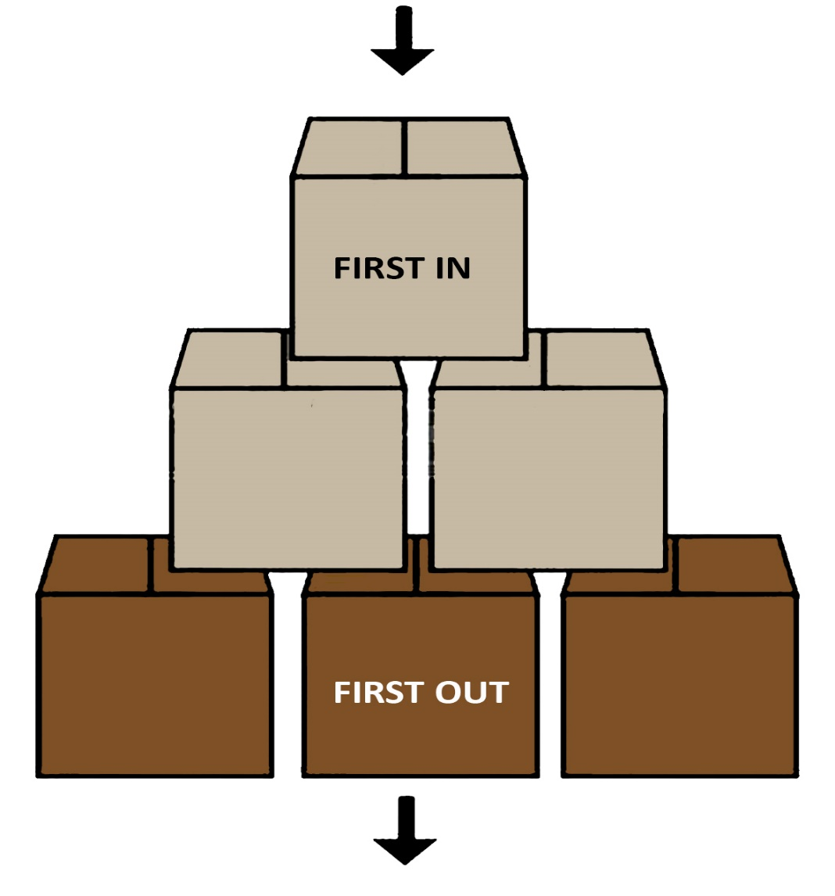
FIFO
Definition: Refers to a method of rotating the oldest stock out before using newer food. First in, First Out
Tip: rotate newer items to the back of the shelf

Slide 15
Cross-contact
Definition: When one food containing allergens comes in contact with a surface or food, thereby posing a hazard for persons having that allergy.
Tip: Food labels remind customers of the possibility of cross contact.

Slide 16
Cross-contamination
Definition: the human transfer of pathogens from one surface or food to another.
Tip: Cross-contamination can be avoiding by washing hands, knife and cutting station between tasks.

Slide 17
FATTOM
Definition: General conditions for bacterial growth include food, acidity, time, temperature, oxygen, moisture.
Tip: Not all of these conditions have to be present for bacteria growth, but combined, they ensure bacteria growth.

Slide 18
Bacteria
Definition: tiny single cell micro-organism.
Tip: Think Salmonella and E-coli

Slide 19
Virus
Definition: simple organism responsible for majority of foodborne illness .
Tip: Think Norovirus and Hepatitis A.

Slide 20
parasite
Definition: organism that must live in or on a host to survive
Tip: Think Giardia.

Slide 21
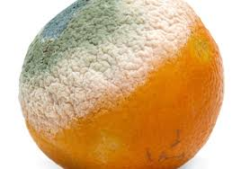
Fungi
Definition: spore producing organism including yeast and mold. Typically, visible on spoiled food.
Tip: some fungi can be eatable like mushrooms. .

Slide 22
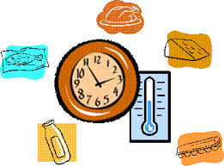
TCS
Definition: Refers to foods that are need time and temperature control for safety.
Tip: These are foods that have to be refrigerated before or after preparation.

Slide 23
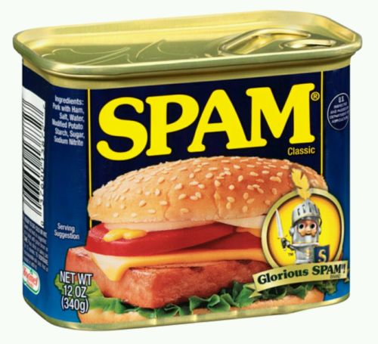
RTE
Definition: Refers to foods that are ready-to-eat.
Tip: These are foods that do not need any preparation to eat, like baby carrots or spam.

Slide 24
Clean
Definition: Free from visible dirt.
Tip: Just because there is no dirt on it does it mean that you would eat food off of it.

Slide 25
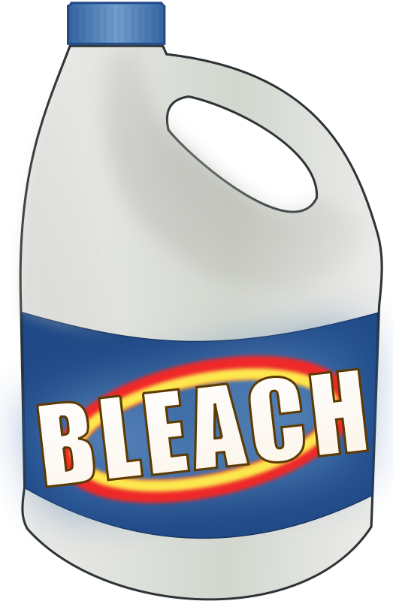
Sanitize
Definition: Free of bacteria.
Tip: You can buy sanitized dirt to eat!

Slide 26
SDS
Definition: Safety Data Sheets (SDSs) are summary documents that provide information about chemicals and advice about safety precautions.
Tip: Every place that has chemicals, will have a binder with SDS sheets for each chemical.

Slide 27
STRAND 3

Slide 28
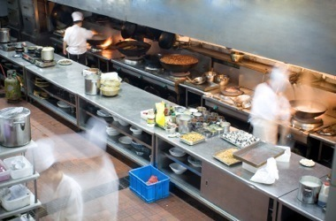
Brigade system
Definition: A system of hierarchy found in restaurants and hotels employing extensive staff, commonly referred to as “kitchen staff”.
Tip: Communication is essential for an efficiently run kitchen.

Slide 29
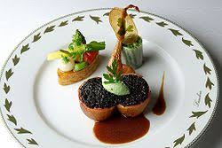
Grande Cuisine
Definition: refers to the cuisine of "high level" establishments, gourmet restaurants and luxury hotels.
Tip: Where all refined skills are shown.

Slide 30
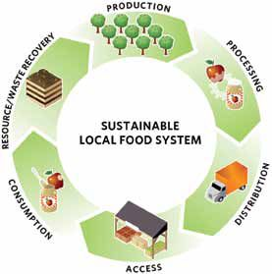
Sustainability
Definition: encompasses everything from how waste is managed, to how employees are treated, to how the food impacts the health and well-being of its patrons.
Tip: Reduce, Reuse, Recycle

Slide 31
Strand 4

Slide 32
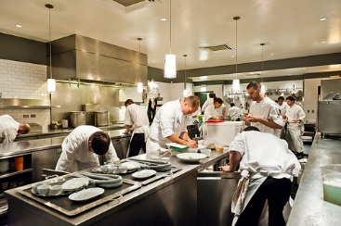
Back of the house
Definition: the kitchen area of a restaurant and staff who work in the kitchen.
Tip: The responsibility in the back of the house is just as hospitality driven as the front of the house.

Slide 33
Critical Thinking
Definition: the objective analysis and evaluation of an issue in order to form a judgment
Tip: Think outside the box.

Slide 34
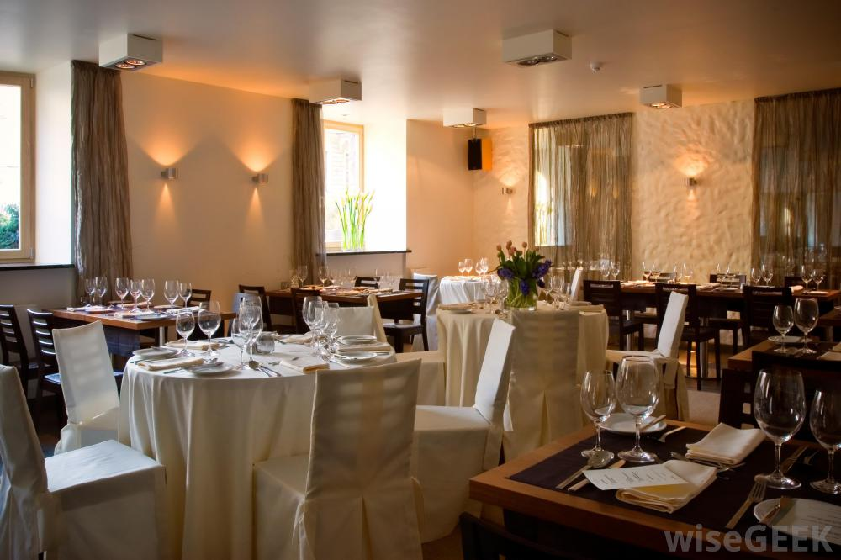
Front of the house
Definition: the areas of a restaurant open to the public or public view, such as the lobby, bar, and dining room.
Tip: It is the “performance” that counts. Without great customer service a restaurant has no chance of survival.

Slide 35
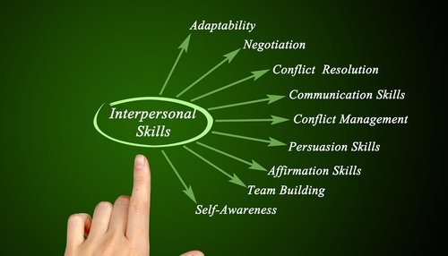
Interpersonal Skills
Definition: skills used by a person to interact with others properly.
Tip: Be tactful.

Slide 36
STRAND 5

Slide 37
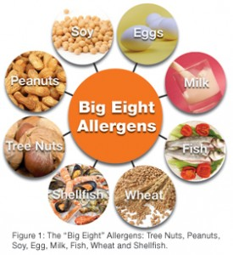
Food allergy
Definition: Food allergies produce histamine when a particular food is eaten.
Tip: Avoid cross-contact through proper food handling.

Slide 38
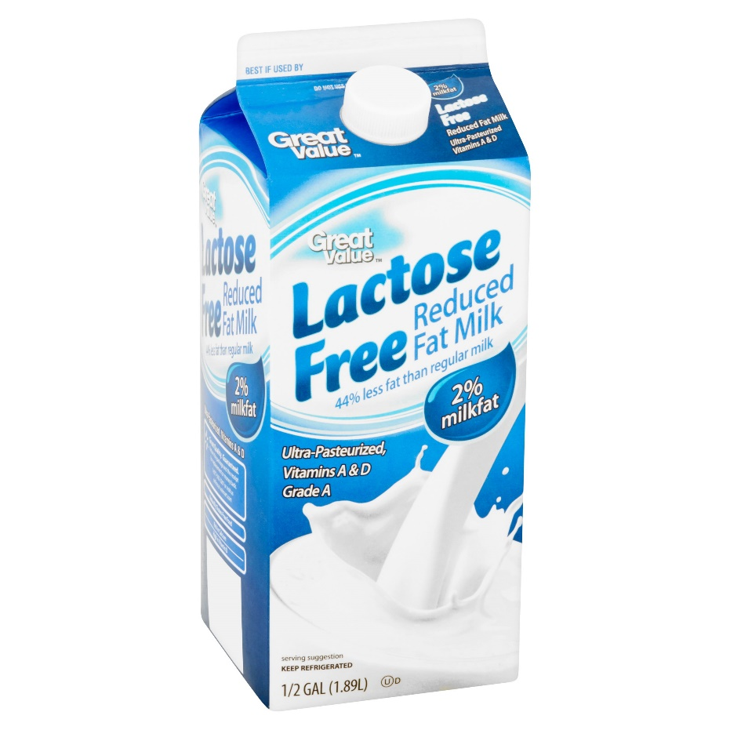
Food intolerance
Definition: A food intolerance is the body’s inability to process or breakdown.
Tip: Lactose intolerance is an example of a food intolerance.

Slide 39
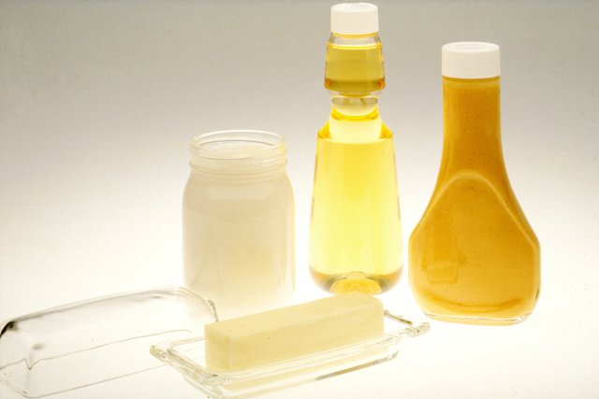
lipid
Definition: The classification of both fats and oils.
Tip: No more than 30% of your calories should come from lipids.

Slide 40
Strand 6

Slide 41
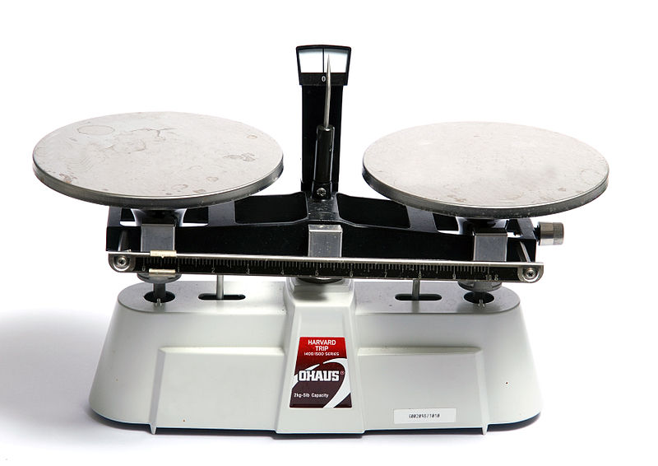
Balance Scale
Definition: A device for weighing. It has a balanced beam and two pans. When the pans contain exactly the same mass the beam is in balance.
Tip: Used to help determine ratios

Slide 42
Digital Scale
Definition: A device for weighing, with a digital weigh out and electronic tare.
Tip: Can be used to measure smaller amount.

Slide 43
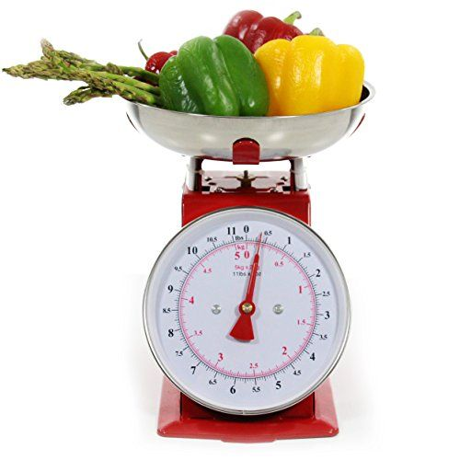
Spring Scale
Definition: A device for weighing, weight is determined based on the tension of the spring.
Tip: These are the kinds of scales in the produce section of the grocery store.

Slide 44
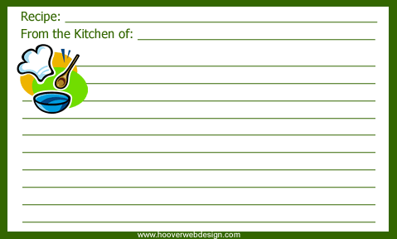
Standardized Recipe
Definition: A recipe found to produce the same good results and yield when the exact procedures followed every time.
Tip: Includes: name, ingredients, directions and yield.

Slide 45
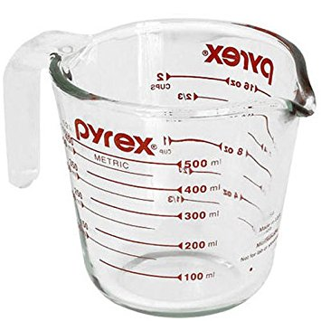
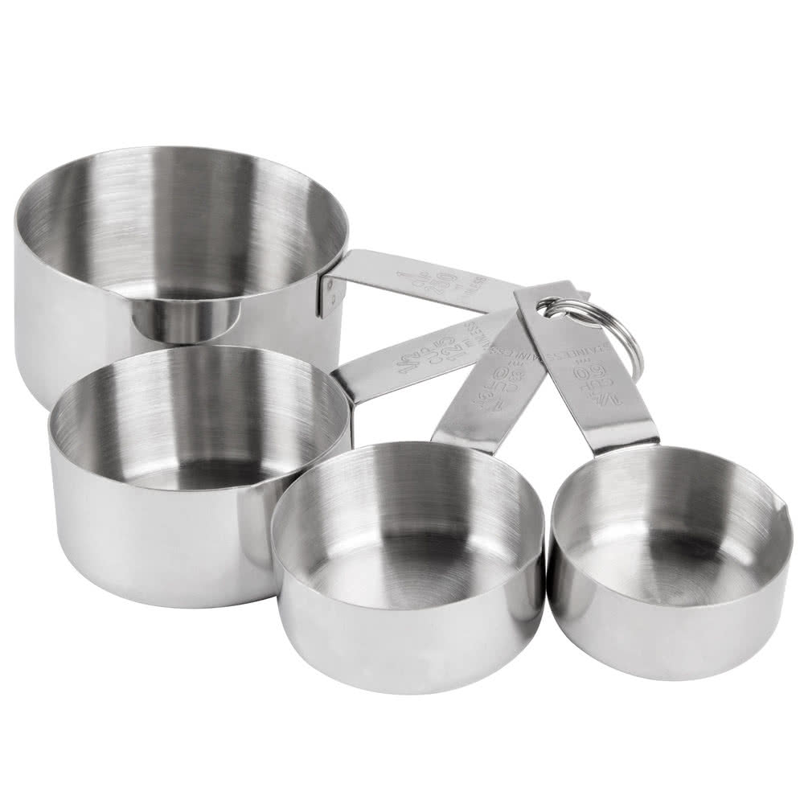
Volume (measurement)
Definition: The amount of space that a substance or object occupies.
Tip: Examples include measuring spoons, measuring cups and liquid measuring cups

Slide 46
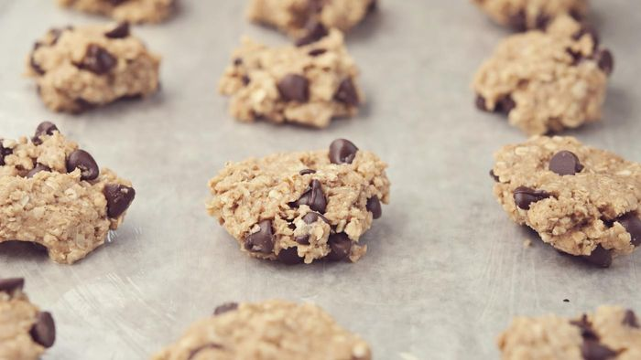
Yield
Definition: How many servings the recipe will make.
Tip: It can help you to know if a recipe needs to be halved, doubled, etc. according to how many you are serving.

Slide 47
Strand 7

Slide 48
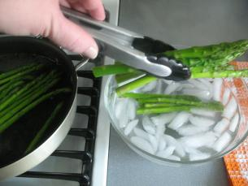
Blanching
Definition: Cooking in boiling water for a short time and immediately cooled in an ice bath.
Tip: It helps preserve nutrients, maintain texture and can help remove skins on vegetables like tomatoes.

Slide 49
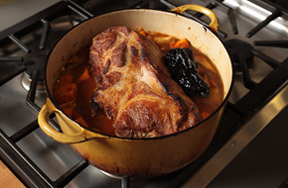
braising
Definition: a long, slow cooking process; meat is first seared and the pan is deglazed before the moist cooking technique is used.
Tip: Braising is an excellent way to tenderize super tough cuts of meat.

Slide 50
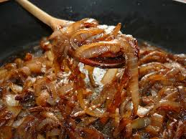
Caramelization
Definition: A cooking process used to draw the sugars out of a food and then cook the food in its sugar.
Tip: Carrots and onions caramelize really well based on their sugar content.

Slide 51
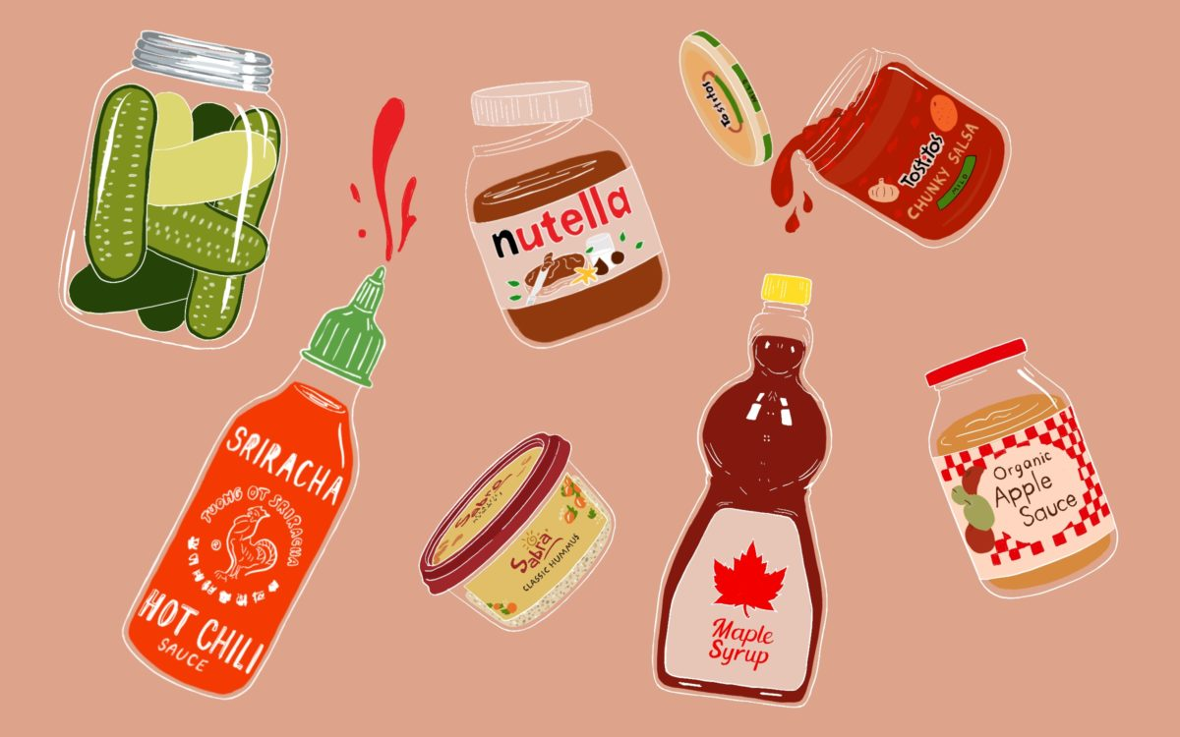
Condiment
Definition: Sauces that are served as an accompaniment to foods. May be used to alter an enhance flavor foods.
Tip: Hot sauce, pickled foods, ketchup, mustard, jams, salsa…

Slide 52
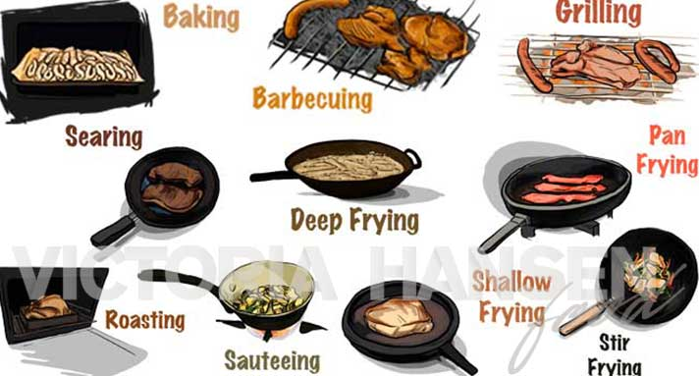
Dry heat
Definition: it uses fats, oils, radiation of hot air or metal to transfer heat.
Tip: This method helps maintain nutrients and flavors

Slide 53
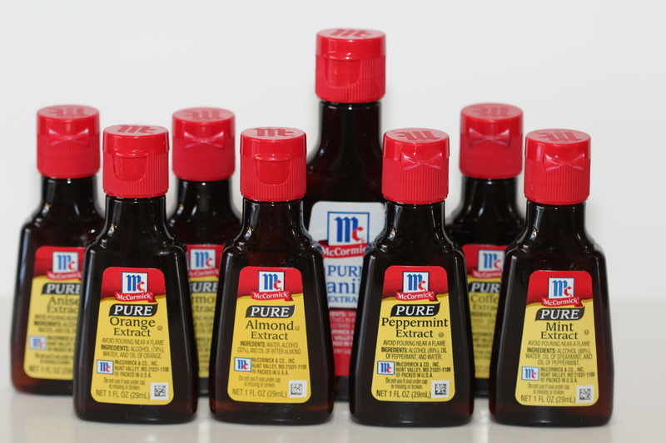
Extract
Definition: concentrated flavors that are used most often in baking.
Tip: Vanilla, almond and lemon. Did you know you can buy pizza extract?!

Slide 54
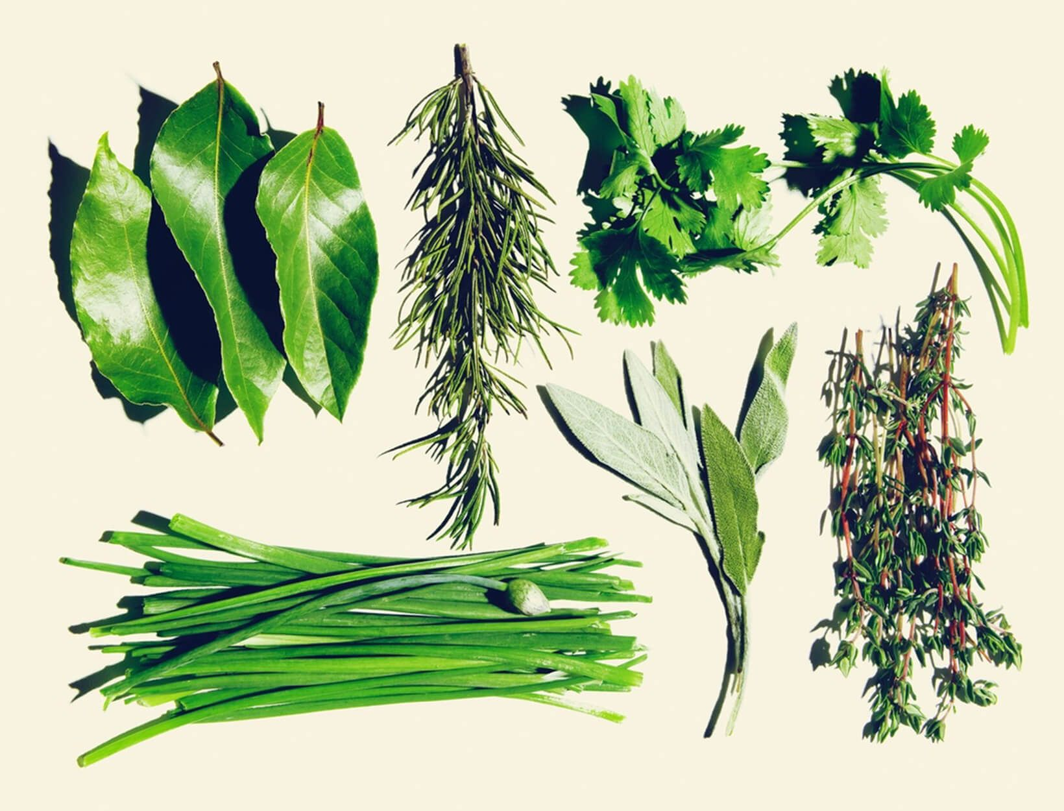
Herb
Definition: The leaves, stems and flowers of aromatic plants. Available fresh and dry
Tip: Add dry herbs at the beginning of cooking and fresh herbs at the end of cooking.

Slide 55
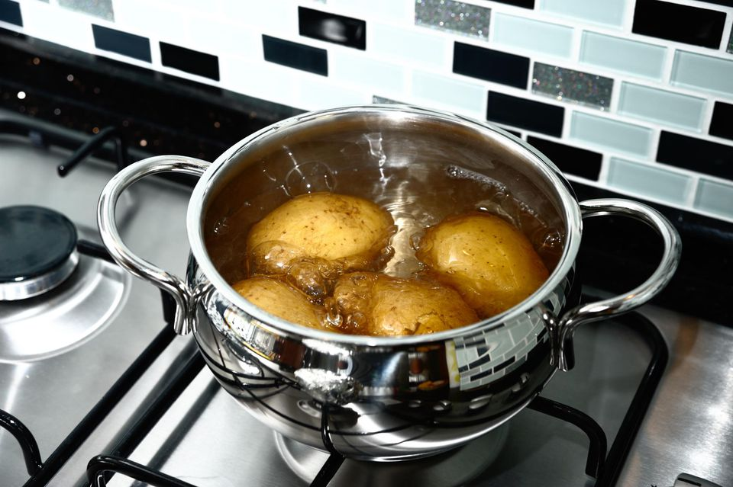
Moist Heat
Definition: To use liquid, (not oil) to cook meats. Typically used on tough cuts of meat.
Tip: Stewing, boiling, blanching, poaching, steaming, pressure cooking and slow cooking.

Slide 56
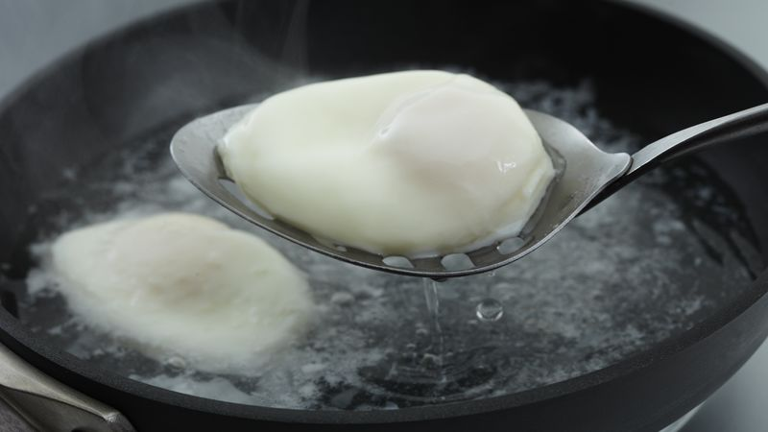
Poaching
Definition: To cook in a small amount of simmering liquid.
Tip: Eggs, fish and fruit can all be poached.

Slide 57
Spice
Definition: Bark, buds, fruit, roots, seeds or berries.
Tip: Usually in dry form, available whole or ground.

Slide 58
STRAND 8

Slide 59
Béchamel
Definition: Milk and white roux
Tip: One of the mother/grand sauces. Found in some cream soups and mac & cheese.

Slide 60
Beurre Manie
Definition: Equal parts flour and butter kneaded to make a paste
Tip: Used as thickener for soups and sauces
Notes:
https://www.youtube.com/watch?v=pC_VFqO_qIs

Slide 61
Espangnole
Definition: Brown stock and a brown roux
Tip: One of the mother/grand sauces. Also called a brown sauce.

Slide 62
Hollandaise
Definition: Egg yolks, acid and butter.
Tip: One of the mother/grand sauces. This is the trickiest sauce to make. Served over eggs.

Slide 63
MirePoix
Definition: One part carrot, one part celery, two parts onion.
Tip: Used to flavor stocks, soups and sauces.

Slide 64
Roux
Definition: Equal parts flour and fat heated to make a paste
Tip: Used as thickener,

Slide 65
Slurry
Definition: Cornstarch or flour and liquid.
Tip: Used as thickener.

Slide 66
Tomato
Definition: Tomatoes and stock
Tip: One of the mother/grand sauces. Is the base for barbeque sauce.

Slide 67
Veloute
Definition: White stock and a white roux
Tip: One of the mother/grand sauces. Is a chicken or turkey gravy.

Slide 68
Strand 9

Slide 69
Appetizer
Definition: Served at the first course of a meal used to stimulate the appetite.
Tip: Usually complements the entrée and dessert.

Slide 70
Brochettes
Definition: Food presented on a skewer.
Tip: This is a fun way to present foods like fruit.

Slide 71
Canape
Definition: Small open face cold sandwich prepared on a variety of breads, crackers or other base with a variety of toppings.
Tip: Garnishing is an important component.

Slide 72
Crudites
Definition: Seasonal vegetables often served with a dip
Tip: Type of hors d’ oeuvres.

Slide 73
Hors d’ oevores
Definition: Small bites served prior to a meal or at a separate reception.
Tip: Typically served separate from the meal.

Slide 74
Rumaki
Definition: Food item wrapped in bacon with or without sauce.
Tip: Traditionally a water chestnut and chicken liver wrapped in bacon and soaked in sauce overnight before cooking.

Slide 75
Strand 10

Slide 76
Charger
Definition: Decorative plate under the eating plate.
Tip: Don’t eat off of it. Can be used to protect the table.

Slide 77
Cover
Definition: Individual place setting with all the proper equipment is needed for the meal.
Tip: Your personal space at a table. Your cover may change each course as foods are served.

Slide 78
Cross Training
Definition: Learning other’s jobs so that you can fill in for that person if needed.
Tip: More cross-training makes you a more valuable employee.

Slide 79
Flatware
Definition: Knife, fork, spoon of any material.
Tip: AKA: silverware

Slide 80
Front of the House
Definition: Those that work where the customers can see and interact with them.
Tip: Hostess, waiter, busser, bar tender, manager.

Slide 81
Strand 11

Slide 82
Biscuit Method
Definition: Cut the fat into the dry ingredients, and then add the liquids.
Tip: This creates the flaky layers.

Slide 83
Blended/Muffin Method
Definition: Combines liquids, in one container and combine dry ingredients in a separate container and then combine the two mixtures.
Tip: Don’t over mix!

Slide 84
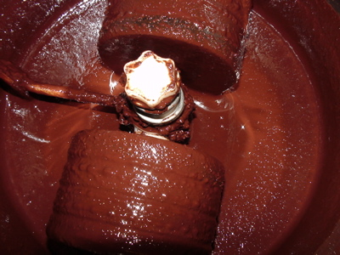
Chocolate liquor
Definition: is a thick, gritty, dark brown paste comprised of roughly half cocoa butter and half cocoa solids.
Tip: This has nothing to do with alcohol.

Slide 85
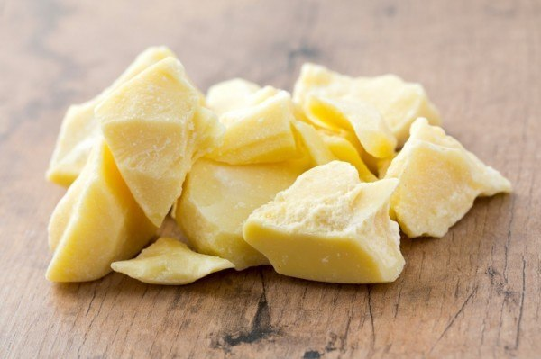
Cocoa butter
Definition: pale-yellow, edible vegetable fat extracted from the cocoa bean. It is used to make chocolate.
Tip: When chocolate blooms, it is the cocoa butter coming to the surface.

Slide 86
Creaming
Definition: Fat and sugar whipped until light and fluffy.
Tip: Often used for making cookies.

Slide 87
Drop Batter
Definition: Two parts flour, one part liquid
Tip: Used to make muffins.

Slide 88
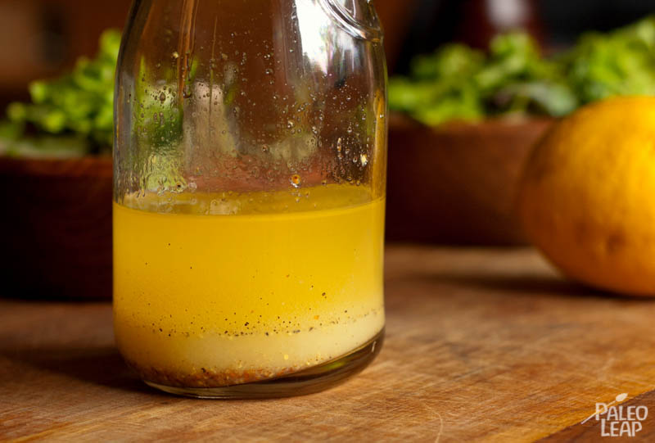
emulsification
Definition: the process of mixing two or more liquids that are unmixable
Tip: Eggs make a great emulsifier

Slide 89
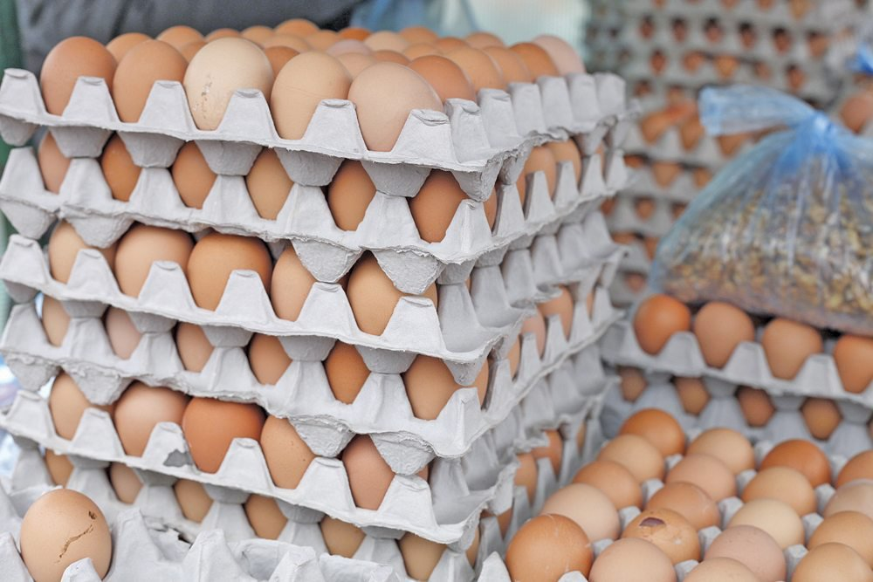
Flats (Egg)
Definition: Usually sold in cardboard carton that hold 30 eggs and in packages of 2 or more.
Tip: when buying check the edges for broken eggs

Slide 90
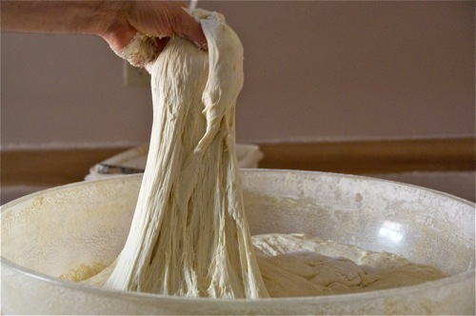
gluten
Definition: an elastic protein that is responsible for giving baked goods structure.
Tip: Needed for proper bread formation
Video

Slide 91
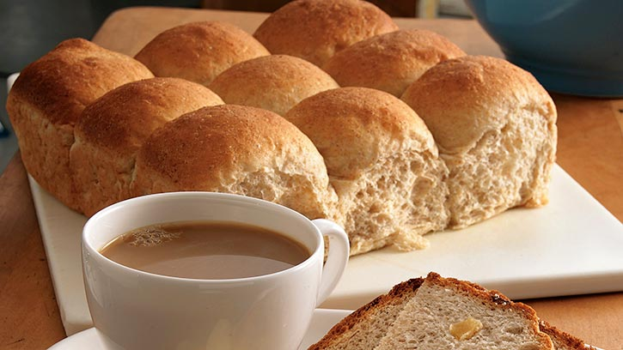
leavening
Definition: gasses trapped in dough, creating small bubbles that give baked goods a light and airy texture.
Tip: Yeast, baking soda, baking powder, steam and eggs are all types of leavening.

Slide 92
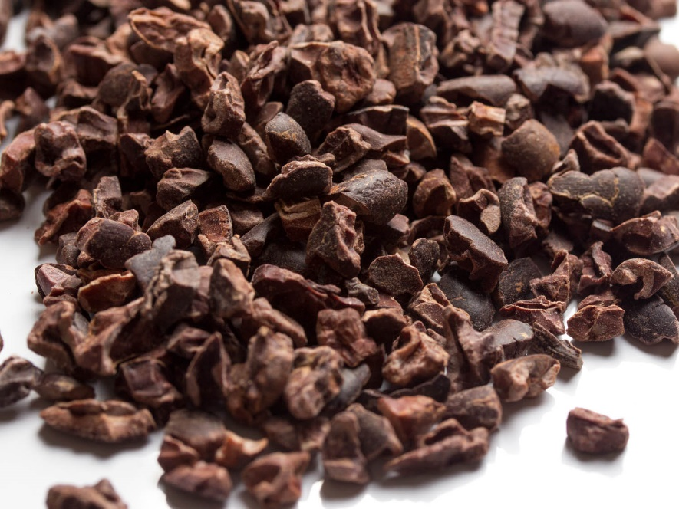
nibs
Definition: bits of fermented, dried, roasted and crushed cacao bean.
Tip: These are bitter, there is no sugar in them

Slide 93
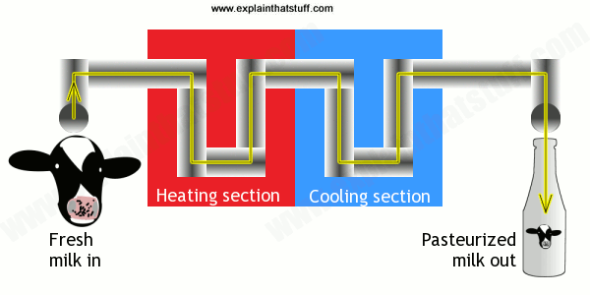
pasteurized
Definition: the process of heating milk to destroy pathogens.
Tip: You can buy unpasteurized or raw milk, but you have to sign waver.

Slide 94
Pour Batter
Definition: Equal parts flour and liquid.
Tip: Used to make crepes, pancakes and waffles.

Slide 95
Rancid
Definition: term generally used to denote unpleasant odors and flavors in foods resulting from deterioration in the fat or oil
Tip: If it smells bad throw it out

Slide 96
Soft Batter
Definition: Three parts flour, one part liquid.
Tip: Used in scones and biscuits.

Slide 97
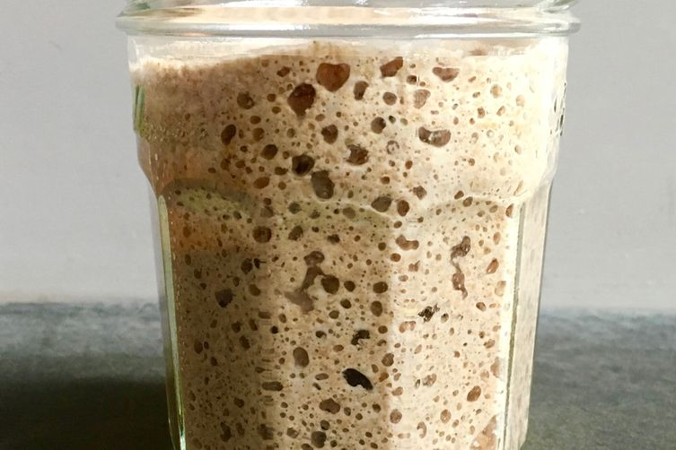
Starter (sour dough)
Definition: a mixture of flour, yeast, sugar and liquid. It gives bread a unique, mildly sour taste
Tip: you have to feed the starter

Slide 98
Strand 12

Slide 99
Ceviche
Definition: Raw fish, marinated in citrus which ”cooks” the fish.
Tip: Dish from Peru. Often includes tomato, onion and green peppers.

Slide 100
Chimicurri
Definition: Thick herb sauce made with olive oil, parsley and other spices.
Tip: From Argentina. Served over grille meat. Think the Argentine version of ketchup.

Slide 101
Churrasco
Definition: Culinary technique for barbequing.
Tip: From Brazil. Think Tucanos.

Slide 102
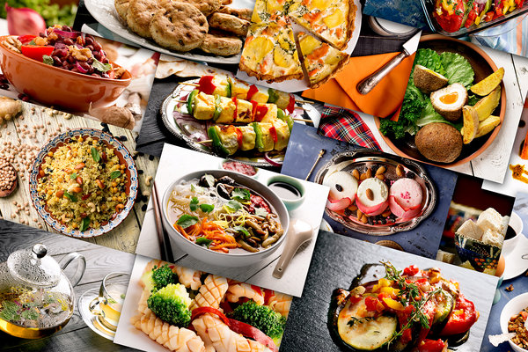
Cuisine
Definition: A style or method of cooking specific to a country, region, or establishment.
Tip: Cuisine is influenced by ingredients available in a particular area.

Slide 103
Empanada
Definition: Latin American hand pie.
Tip: Usually savory, filled with meat and potatoes.

Slide 104
Mole
Definition: Rich, dark, complex sauce.
Tip: From Mexico. Often made with whatever is in the cook’s kitchen

Slide 105
Mortar and Pestle
Definition: Culinary equipment for grinding herbs and spices.
Tip: Harry Potter uses one in potions class.

Slide 106
Plantains
Definition: Large firm variety of cooking banana.
Tip: Looks like a banana but is very starchy and must be cooked.

