Slide 1
Value of Play

Slide 2

Unoccupied Behavior
The child is not involved in any particular activity. He/she just observes what seems interesting at the time.

Slide 3
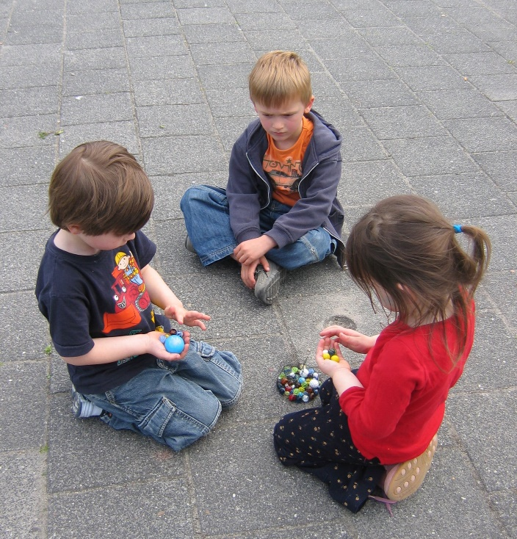
Onlooker Behavior
This behavior involves watching other children play. The child may talk to the children who are playing but does not become actively involved. The onlooker wants to be close enough to interact with the children who are playing. (begins in toddlers)

Slide 4
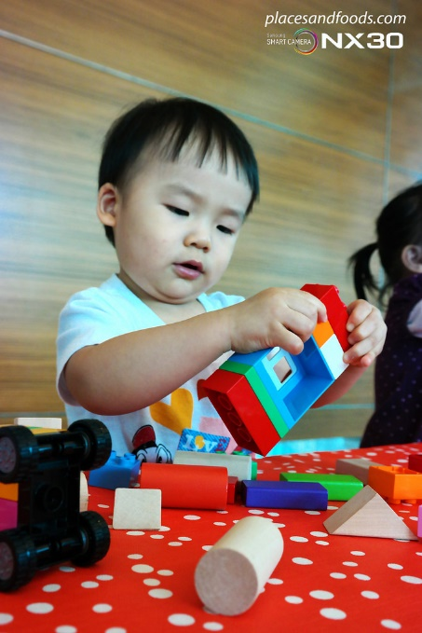
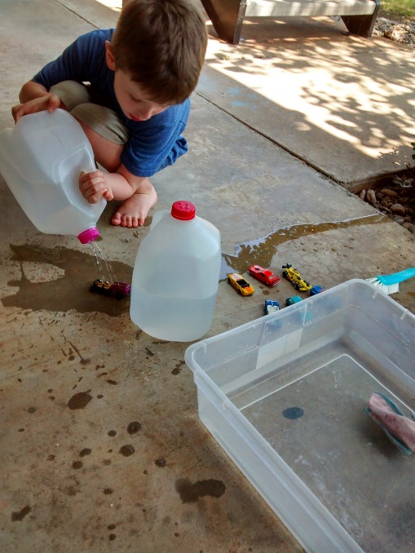
Solitary Play
This type of play involves a child playing alone. He/she has no interest in anyone else or what they are doing. The toys he/she plays with are different from those the other children are playing with. He/she is totally involved in a personal activity. (begins in infants)

Slide 5
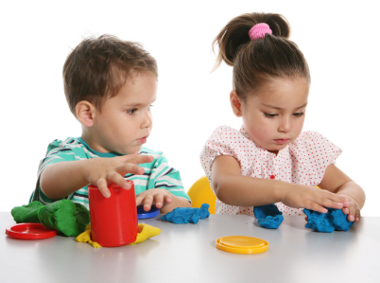
Parallel Play
This type of play involves a child playing beside other children. There is no actual interaction, but the toys are similar. The child is playing beside the other children rather than with them. Toddlers often participate in parallel play because communication with one another is difficult. (begins 2-3 years)

Slide 6
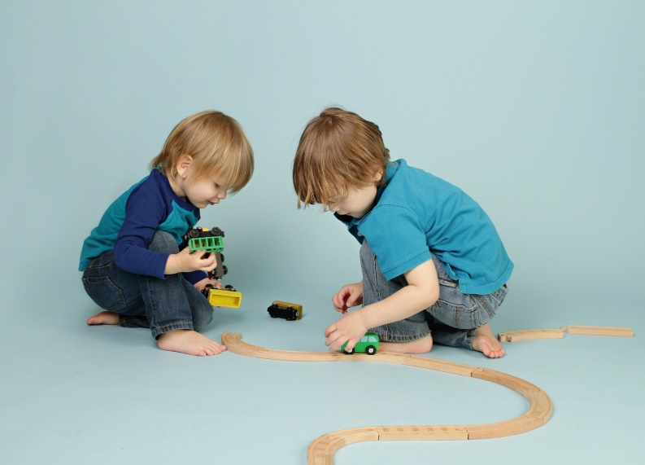
Associative Play
This type of play involves a child playing with other children. The children share toys and interact with one another. Children are involved in similar but not identical activities. There is no specific organization of activities. Each child does what he/she wishes but is a part of a large group. (begins 3 year – school age)

Slide 7
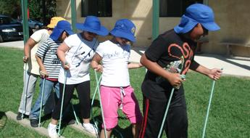
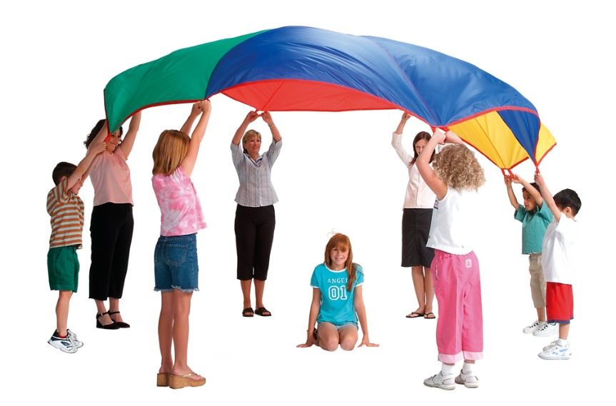
Cooperative Play
This type of play involves organization. The child is a part of a group that has a specific purpose in mind such as making an art project or playing a game. There are usually leaders and followers in this type of play. (begins as preschoolers)

Slide 8
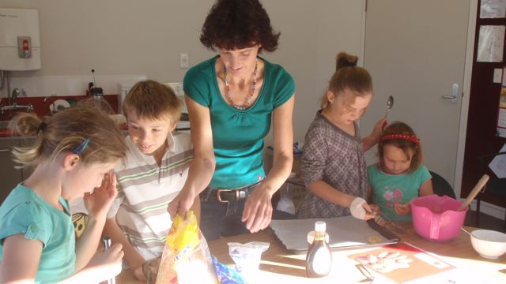
Child Vs Teacher
Child directed learning is where the child decides what to do, the idea, and the materials to use. Adult follows the child’s lead.
Teacher directed learning is teacher deciding what to do and how to do it. Pre-cut and pre-drawn materials with instructions for what to do with them.

Slide 9
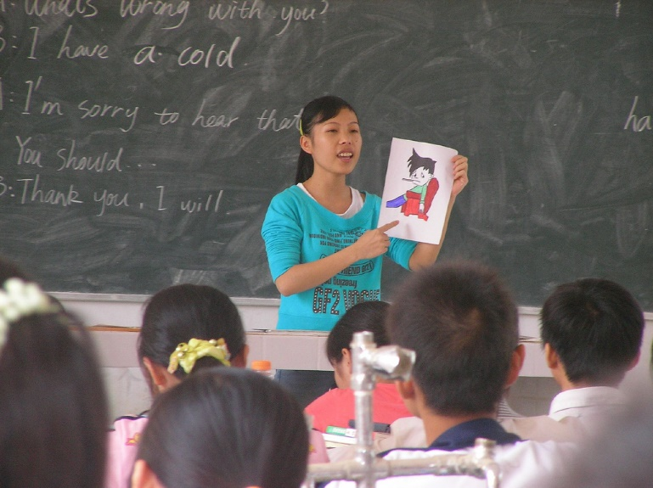
Teachers Role
http://vimeo.com/ncca/review/37958082/d5d9bfe5f8
Classroom design must also be conducive to play
The teacher must also provide stimulating materials to enhance and entice children into play
Play and learning should be integrated throughout the day.

Slide 10
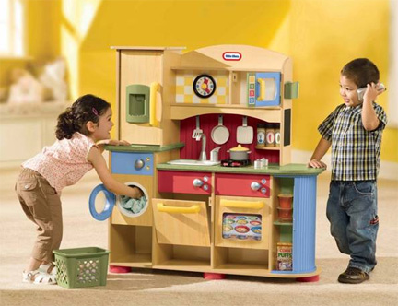
Gender Differences
There are gender differences in play.
Children’s identification of whether they are boys or are girls will result in playing more with other children of their gender (Fagot, 1994; Fagot & Leve, 1998).

Slide 11
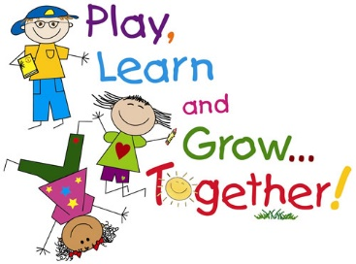
Why is this important?
They learn about themselves, others, and their world that they live in.
Develops and enhances creativity
Builds confidence and self-concept, initiative, and autonomy (independence) = Erikson’s Theory
Releases energy
Provides individual time and down time.
Develops the 5 basic areas of Growth and Development (Physical, emotional, social, cognitive, and moral).

Slide 12
Resources
http://www.ttacnews.vcu.edu/2014/02/what-is-the-teachers-role-in-supporting-play-in-early-childhood-classrooms/
http://www.education.com/reference/article/gender-differences-play/

