Slide 1
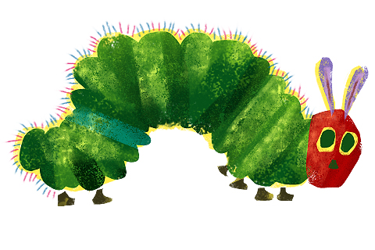
ECE A Unit 2

Slide 2
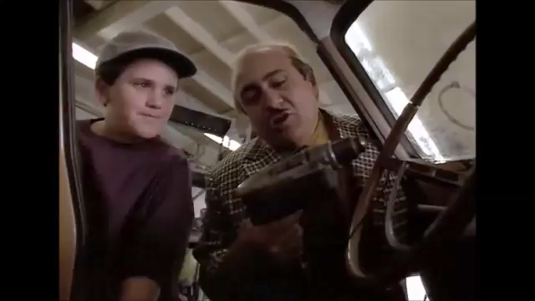
His idea of disciplining
Notes:
You could….

Slide 3
Daily Routines and Schedules
1. Provide a pattern for each day, event, and task.
  The schedule needs to be flexible so children can finish projects and activities or in the event that a parent stops by with a special thing.
2. Allow the child to be independent and feel great satisfaction in doing tasks themselves.
  Activities are designed to develop self esteem and positive feelings about learning.
  Children feel more competent and teachers feel relief because kids can be independent by predicting what comes next.
Notes:
This would be better

Slide 4
DAILY ROUTINES & SCHEDULES
3. Provide consistency & predictability
  Gives children a feeling of power and control because thy know what is going on.
  Gives a feeling of security because they can predict what will happen next.
4. Helps the center to run smoothly.
  If there is resistance, then the schedule needs to be adjusted.

Slide 5
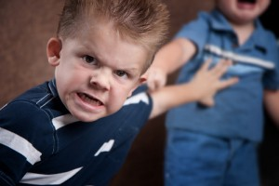
Positive Discipline & Guidance
The keys to well-behaved children.
Notes:
What if…..

Slide 6
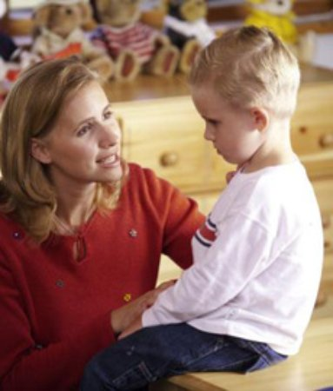
  One mom tried many methods to control her kids when they have one of “those moments” but the one that she found very effective was to just take the child for a car ride and talk.
Notes:
Here is an idea

Slide 7
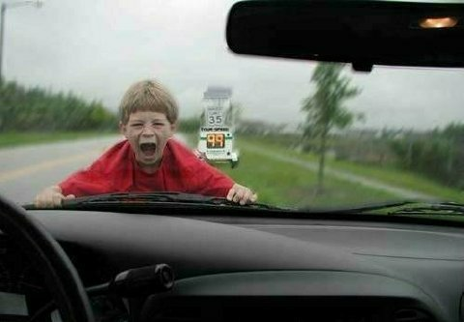
Here is the photo of one of those sessions with my friend’s son in case you would like to try this technique.
  They usually calmed down and stopped misbehaving after their little outing together.

Slide 8
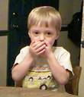
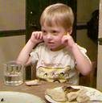

Reasons for Misbehavior
Normal for the age
Natural curiosity
Don’t know better.
Unfulfilled needs
  bored
Environment
For power & control
For revenge
Feel inadequate
Feel discouraged
To feel they belong
And…

Slide 9

The child misbehaves to get attention.
  Positive attention vs. negative attention

Slide 10

Why is this child misbehaving?
  Jane, 3 year old, goes into Mom’s bedroom and uses lipstick to draw on Mom’s bedspread.
Complete the scenario
in your workbook.

Slide 11

  Spank, yell, threaten, ignore, intervene… What would you do?
Identify 3 positive and 3 negative techniques.
Notes:
Show segment of video yelling threatening and putting down

Slide 12
So, what would you have chosen to do?
Depending on what you chose, it fell under the technique of
Punishment or Discipline.

Slide 13

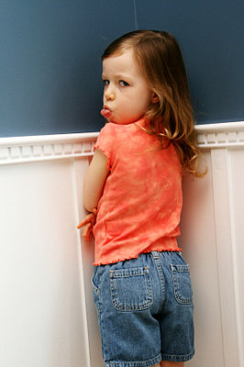


Punishment
Physical of verbal attacks.
Forces children to obey.
  Obey out of fear.
Child Learns:
  RESENTMENT
  REVENGE
  RETREAT
    Low self esteem
    Sneaky

Slide 14

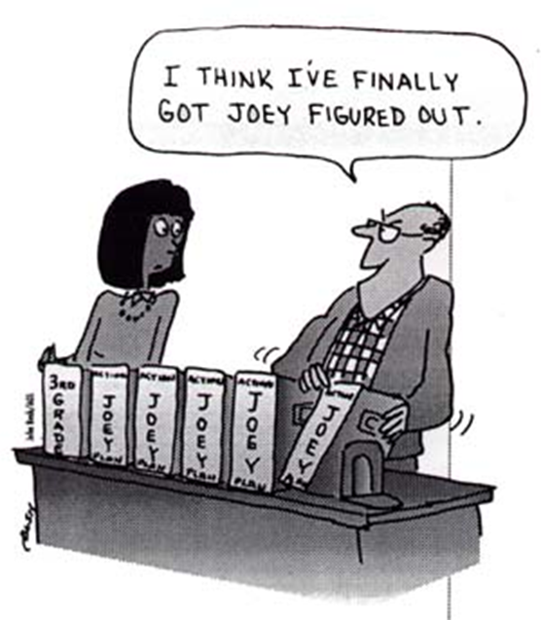
Discipline
Teaching & training.
  When behavior modification is needed.
Fair, firm, & consistent.

Slide 15
WHAT ABOUT SPANKING?
Lets talk about it…. YES or NO???

Slide 16
WHAT ABOUT SPANKING?
It is a poor form of discipline and it does not work.
Spanking does not teach what you want them to do, only what you want them not to do.
It often creates feelings of hatred, revenge, and resentment rather than self-discipline
It teaches that violence and aggression are the ways to deal with life.
It escalates into other forms of physical abuse, even child abuse.

Slide 17


Where did we ever get the crazy idea that in order to make a child do better, first we have to make them feel worse?
Children do better when they feel better!

Slide 18


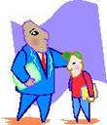
Guidance / Model
To set an example, give advice, counsel, or help.
  Adults model the type of behavior that they desire in the children.
  Teaches children how to deal with experiences based on just watching the people around them.
Continual teaching
  The child learns what is expected of them.
A parent’s daily job!!

Slide 19

SELF-DISCIPLINE
The goal of guidance and discipline:
The ability to control one’s own behavior by personal choice.

Slide 20
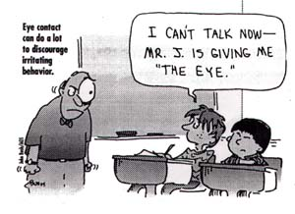
Each child and situation is different and different acts will work for each.

Slide 21
Wiggle your way through the various acts of positive discipline techniques
Complete the study guide section D & E (pgs 21-23)
Work on Assignment #10 Annie’s Terrible Week
Make sure that page is completed up
through page #24.
Work on Child Development Ages and Stages chart.

Slide 22
1. INDIRECT GUIDANCE
Outside factors that influence behavior.
  A well planned facility
  A consistent schedule and routine
  A well planned lesson and activity
  Age appropriate activities
  Realistic Expectations
  Safety guidelines and precautions
  Child centered equipment and plans

Slide 23
2. Direct Guidance
Involves verbal and nonverbal actions
  Body gestures
  Facial expressions
    Nonverbal actions must reinforce what you are saying to the child.
Verbal actions….

Slide 24

3. Positive Statements
Telling a child what they CAN do, rather than what they CAN’T do.
Instructions are more clear.
Builds self-esteem and confidence.
Works for all ages!
“Please walk” instead of
“Don’t run”

Slide 25
Practice – Positive Statements What would you say?
Don’t hit your sister again!
Don’t forget your lunch!
Don’t slam the door!
Don’t climb up the slide!
Don’t listen to that kind of music!

Slide 26
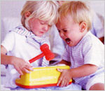
4. Redirection
If a child is doing something you do not want them to do….give them something else to do.
Distract them with another option

Slide 27
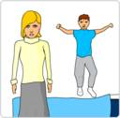
5. Reverse Attention
Ignore inappropriate behavior and deal with problem when child is no longer seeking attention.
Comment on the positive actions being done.
  Children will repeat any behavior that receives attention (positive and negative).

Slide 28

6. Time Out
Gives children an opportunity to re-gain control of their emotions.
One minute for each year.
Quiet spot, tell them why they are there, re-state the rule, have them apologize at end.

Slide 29

Consequences
  7. NATURAL
8. LOGICAL
  Related to misbehavior
  Not done in anger
  Short duration
  Unpleasant
Things that naturally happen without parental interference.

Slide 30
Write a natural and logical consequence for each misbehavior.
2 children fight over whose turn it is to play video games.
A child is not ready for school on time.
A child does not come home on time from a friends house for dinner.

Slide 31
9. If / When….then
Put something that they don’t want to do before actions that they do want to do.
Tell them what can be done instead of what cannot be done.
  As soon as you brush your teeth, we’ll read a story.
  You can go outside once your toys are cleaned.

Slide 32
10. Reinforcement
Encourage behavior through praise, support, and attention.
Letting the child know when they are doing things right and appreciating them for their effort.
Letting them know that you believe in them, their abilities, their choices and decisions, and their actions.

Slide 33
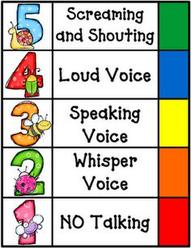
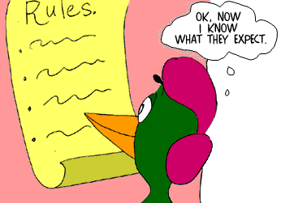
11. Setting Limits
Children need limits on their behavior.
They want to know what is acceptable and allowed.
Rules should be fair, consistently enforced, and help children learn responsibility and self-control

Slide 34

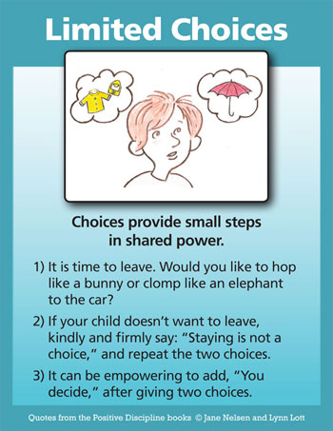
12. Limited Choices
2 or 3 options.
Gives child a sense of power and control.
Offer only real possibilities.
Can help reduce temper tantrums.
  What would you like to drink?
  Would you like Milk or OJ to drink?

Slide 35
TIPS to facilitate positive guidance

Slide 36

1. Active Listening
Listen with your eyes and ears to what the child is saying to you.
  Get down on their level.
  Pay attention to what they are thinking and feeling.
Respond to the child by repeating what they said to you!

Slide 37
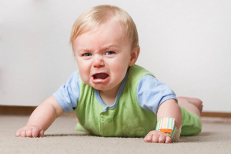




2. Expression of Feelings
Children need to know that their feelings are okay.
  Maybe the way they are expressing it is not okay.
Give children an acceptable way to express these feelings.

Slide 38
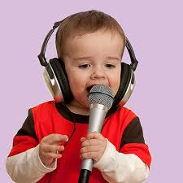
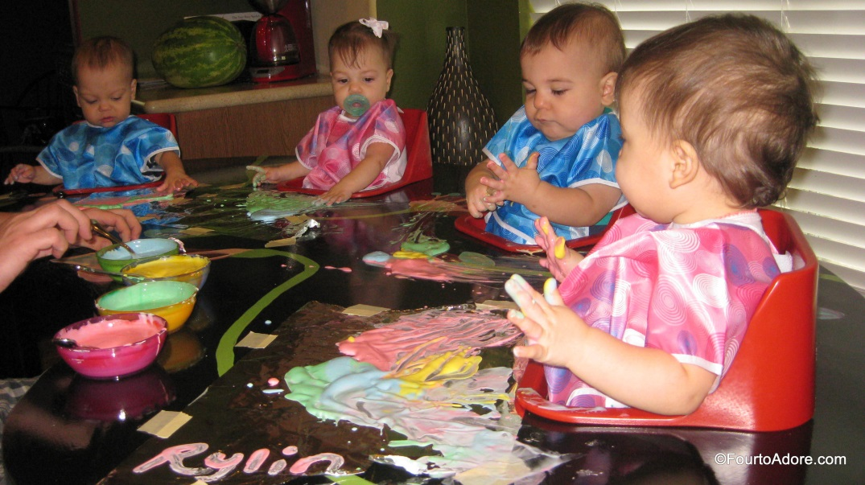
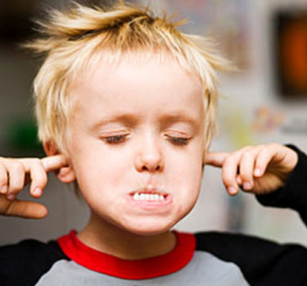
3. Avoid Overstimulation
Too many choices and options overwhelm a child.
  They may act out
Provide only the needed supplies or choices.

Slide 39
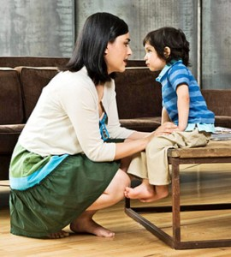
4. Proximity
Be near the child when you are talking with them or making a request.
  Verses talking from across the room
Get down on their level.

Slide 40
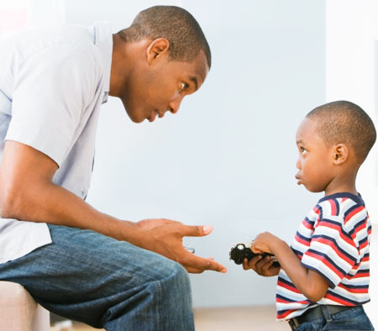
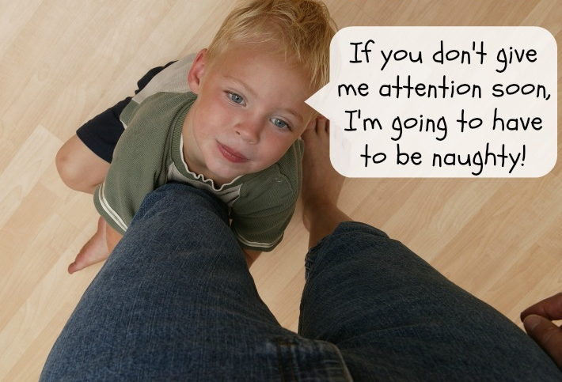
5. Follow Through
If you request that a child do something and you give them a consequence or a warning, follow through with it on the second account.
  You will be a liar if you don’t.
  Your kids won’t believe you.

Slide 41
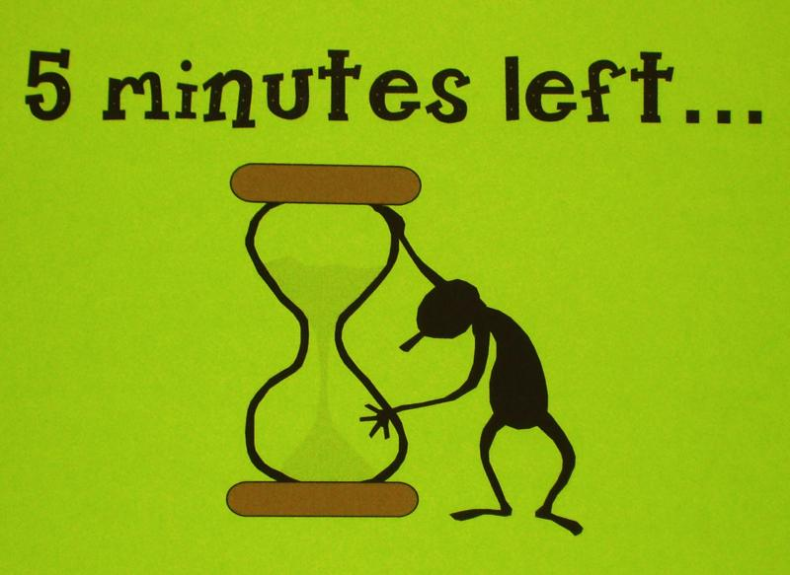
6. Timing
Give the child a warning for what is coming up.
  “In 5 minutes it will be time to clean up”
There is an appropriate time for everything.
  A lesson right before lunch is not the best time

Slide 42
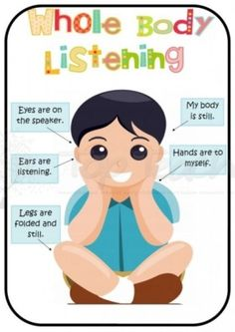
7. Prompt or Remind
Give a reminder to stop an unacceptable behavior or to start an acceptable one.
  Do you remember where we keep the play dough?
  What must we remember when we ride our bikes?

Slide 43

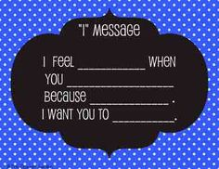
8. I messages
Tell the child how you feel about their behavior or what you need done.
  Does not put blame on the child.
  Does not cause them to be defensive.
I need you to clean up your toys.
When I see you hitting your brother, I feel unhappy because you are hurting him.

Slide 44
9. AGE APPROPRIATE ACTIVITIES DAP:
Activities and equipment that are relevant and safe for the age of the child promote growth and development.

Slide 45

10. AVOID UNREALISTIC EXPECTATIONS:
It is important that the teacher understand the skills and abilities of the children.

Slide 46
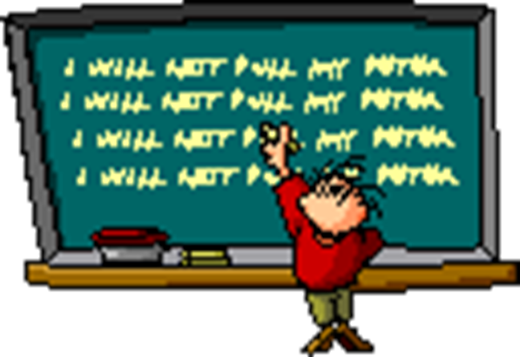
MISTAKES R WUNDERFULL OPPERTUNITEEZ 2 LERN!
  Recognize your mistake
  Reconcile “I’m sorry”
  Resolve: Focus on solutions rather than blame.

Slide 47

11. Make sure the message of LOVE always gets through:
“They may not always remember what you say, but they will always remember how you made them feel!”

Slide 48
12. FORBIDDEN DISCIPLINE ACTIONS:
NO TEASING
NO HUMILIATION
NO INSULTS
NO THREATENING
NO FRIGHTENING
NO LAUGHING AT
NO YELLING
SPANKING
SLAPPING
HITTING
SHAKING
PULLING
PINCHING
Confirmed incidents will be grounds for immediate
dismissal from a childcare job.

Slide 49
DISCIPLINE STEPS: (flowchart)
Redirect
  Involve them
  Resist giving attention to the disruptor
    “Someone is disturbing the class”
Check it out
  Move closer, place hand on shoulder
Speak to the child about the problem
  Sometimes it helps to whisper to the child
  Talk privately
  “What can I do to get your help?”

Slide 50
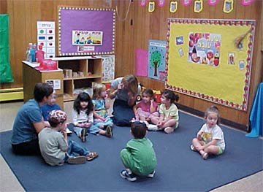
4. Use one of the techniques discussed.
ie: Give choices, use logical or natural
consequences, etc…
5. Use time out (time away) only if still out of control.

Slide 51
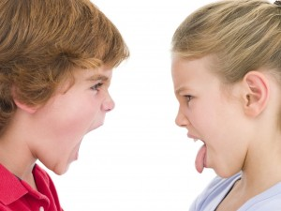
Conflict resolution with Children
Listen to both sides of the conflict.
Restate the problem in a different manner. “So what I am hearing is……”
Say “I know how that would make me feel, but I don’t know how you feel” ask each child. “How do you FEEL about this situation?”
Decide “What could we do to solve this problem?” Listen attentively to each child’s ideas. List or restate all of the solutions.
Ask “Would you be willing to try one of these solutions? Which solution should we try?”
Observe the children. If the solution is not working, go back to step #2.

Slide 52
Appropriate Behavior Child Care
Management Techniques
(as found in the state test guide)
If one area of the classroom creates physical aggression try changing the room arrangement
Locate a child with a short attention span next to the teacher
Invite and gently take the child’s hand and walk when a child will not come out of an area
Give children the opportunity to make limited choices
Give positive reinforcement when a child tells the truth

Slide 53
Explain/how to use toys appropriately and redirect with appropriate items
Call attention to a child that is participating correctly
Give a time limit when they need to change when a child doesn’t want to take turns
Put away the distracting influence and involve him/her in helping with the activity when a child does not seem to be paying attention
Minimize blame, have child clean up, assist as needed when children not cleaning up

Slide 54
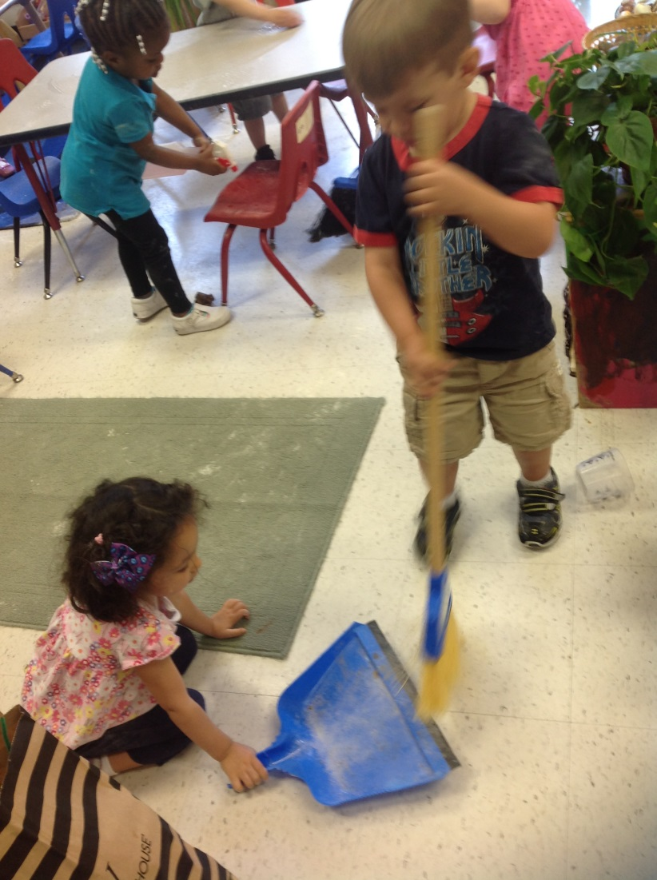
Cleaning up can be made into a game encourages a good attitude toward work by having the children help
Remind them of rules and encourage problem solving when children are arguing
Giving a few minutes warning helps children get ready to come inside

Slide 55
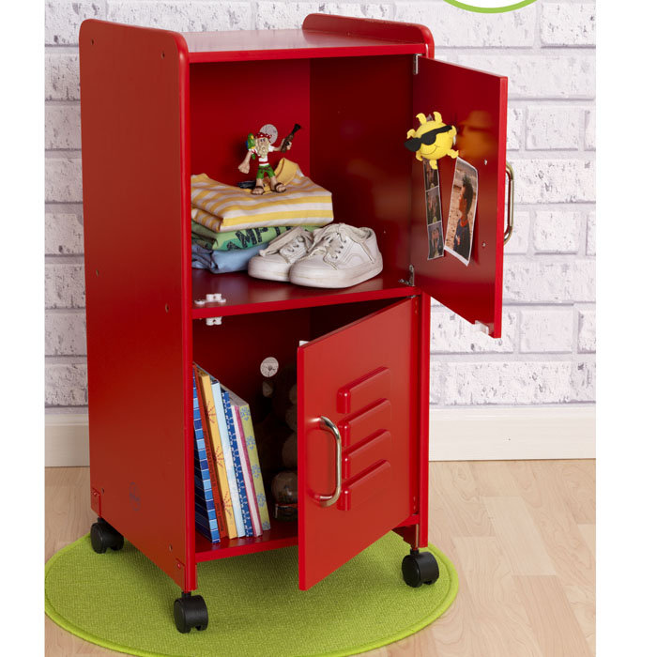
Tell them to use their inside voices (positive statement) when a child is squealing, yelling shouting
Try using a positive statement to correct disruptive behavior (i.e. tell the child “you shared something now you need to listen”)
Have child who has distracting toys put them away
Stop and ask all the children to return to their places; children ease their way from their places

Slide 56

Acknowledge and bring them back to the activity when a child interrupts with personal stories, etc.
Calmly keep the child from running away, hold him/her if the child runs away from you

Slide 57

Tell child you will listen to her when she can talk in a calm voice if they are whining, crying, etc.
Remove the child from the environment if the child is aggressive, fighting, etc.

Slide 58

Ignore temper tantrums if the behavior is for attention and no one is in danger of harm
Explain that tantrums are not acceptable

Slide 59
ASSIGNMENT:
ANNIE AND THE TERRIBLE, NO GOOD, VERY BAD WEEK.

