Slide 1

Coping with Challenging situations
Break me

Slide 2
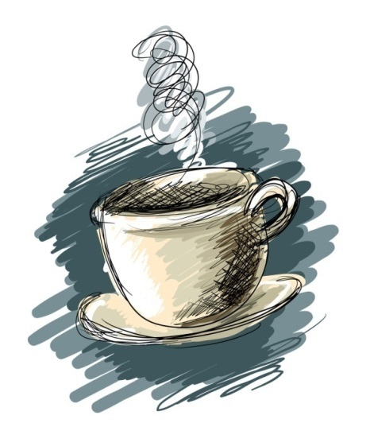
A Cup of Tea (Hope Floats)
Pay attention to the major stressors going on in the life of this family.
  Workbook Question #1
Note how it is affecting them.
Note how it makes you feel and what you are thinking.
  Workbook Question #2

Slide 3
1. Life situations that cause stress? What did you see in the video?
  Death *
  Divorce *
  Moving *
  Illness *
  New school year or a new school
  Abuse
  Family money problems
  Parent Remarriage
  New baby
  Change of any kind to their life or schedule
Top 4 stressors

Slide 4

2- Common reactions to stress?
Feel, think, react, want to do?
Notes:
Squeezed activity – feel, think, react, want to do?

Slide 5
2- Common reactions to stress?
Clinginess
Withdrawal
Headaches
Stomachaches
Aggression
Difficulty Concentrating
Unexplained fears
Lower self-concept
Substance abuse
Nervousness
Drop in academic performance
Baby talk
Accident prone
Eating problems
Mood changes
Restlessness
Changes in Sleep Patterns
Irritability
Loss of energy
Behavior disorder
Ignore it
Sadness
Loss of temper
Bedwetting, nailbiting, thumbsucking
Notes:
Squeezed activity – feel, think, react, want to do?

Slide 6

Help a child get through their challenging situations by giving them coping skills.

Slide 7
3- Support that can be given to help a child when they are dealing with challenging issues.
1- Children need to talk about their feelings.
2- Children need more help and support than adults. You can use the other adults in the child's life to fill this role.
3- Children usually can understand what is going on.
4- Children should be told the truth in a calm and reassuring way.

Slide 8
4- Dealing with the fears that challenging situations can create.
1- Respect their fears and avoid belittling the child.
2- Children tend to be most fearful between the ages of
**2 to 7 because they cannot yet discriminate between
real and unreal dangers.
3- Help a toddler overcome fears by being understanding
and comforting to the child.
** 4- Help the child overcome fears by using make-believe
play to act out the fearful situation.

Slide 9

Never underestimate, for the parent or the child, the power in:
Daily exercise or movement
Eating nutritionally
Having leisure time
Enjoying hobbies
Adequate sleep
Relaxation methods
Talking about feelings
Just do something
to help.

Slide 10

In order to help, you must say and do something.

Slide 11
5 STAGES OF GRIEVING
Have you ever lost an object? You had to grieve for it the same way you would grieve for losing a person.
Denial and feelings of shock
Anger
  Blame someone or something
Guilt
  Blame oneself for something they did in the last few months.
Bargaining
  With other people or with God to not let it happen
Acceptance
  Coming to terms, move on, adjusting to change

Slide 12
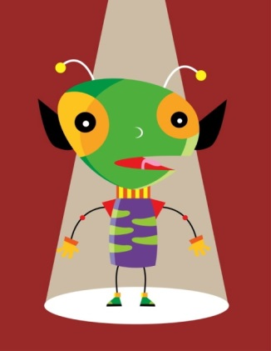







WEIRD Alien name write

Slide 13

divorce

Slide 14
A. Describe coping skills to deal with DIVORCE:
1- Reassure the child that they are still loved by both parents.
2- The child should not be blamed for the divorce.
3- Maintain as much stability in the child’s life as possible.
(same school, same home…)
4- Provide continuity in the child’s daily schedule and situation.
5- Children often believe that their parents will get back
together again.
6- Parents should never belittle/bad mouth one another in
front of the kids.

Slide 15

Specific effects of Divorce on child’s ages:
A. Preschoolers (2-5 years)
  Major theme: Fear of abandonment
  Symptoms: sleep disturbances, clinginess
B. Young childhood (5-9 years)
  Major theme: Fear of being displaced
  Symptoms: School & social Grief
C- Adolescence
  Major theme: Fear of own relationship failure.
  Symptoms: Independence, promiscuous

Slide 16
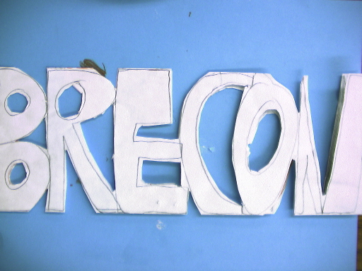

Slide 17
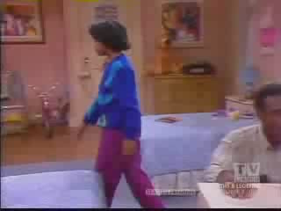
death

Slide 18
B- Coping skills to deal with DEATH
  Review from divorce: Talk about what is happening. Be honest. Kids are stronger than we think.
  Never say “Grandma is only sleeping”
  Remember to listen to them express their feelings.
  One discussion is never enough
1- Children dealing with death feel grief and need to appropriately express it.
- Check children’s interpretation of what they are thinking.
  Help remove unwanted guilt about what caused the death and that it had nothing to do with them.
2- Help Children understand that they will not die just because someone else has.

Slide 19
B- Coping skills to deal with DEATH:
3- Reassure children by being specific about when you will return whenever you leave.
** 4- Under the age of 5, children usually think of death as if the person has gone on a short vacation and that they will be back. Death does not seem permanent to them.
5- Teach a child about death before the child is confronted with the death of a loved one.
  - Death is universal – everything dies Ie: animals, flowers
  - Never force a child to see or touch the body

Slide 20

Specific effects of Death on child’s ages:
Early Childhood (2-5)
  Think it’s reversible. Think little kids’ can’t die. Egocentric and think that they caused the death. Don’t understand the concept of forever. Fear of abandonment.
Middle Childhood (6-12)
  Understand causes of physical death (gun, attack, illness). Know that death is irreversible. Intrigued by details of death.
  Death is only for old, sick, and careless. Still egocentric and think that it won’t happen to them.
Adolescence
  Natural for all people. Death results in bodily deterioration. Develops morals and values about death. Visualizes self sick or dying.
  Still egocentric with feelings of invincibility so they test limits.

Slide 21



Look at the pot
How well is it put together?
  It is taped together, but is it really complete? Why NOT? What do you see?
  No matter how well we help our kids through challenging situations, there will always be scars and memories left to deal with.
  Be careful with what you put your kids through!
    It as confusing as dealing with an alien.

Slide 23
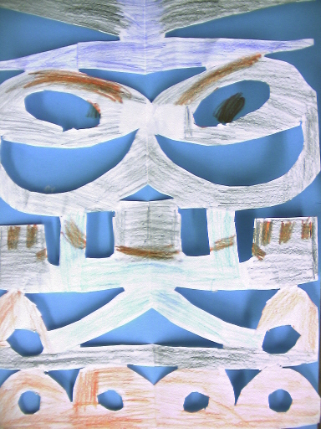


Slide 24
Finish working on past assignments
Discipline scenarios
Guidance observation
Parenting Style Scenario and Essay
Empathy station reactions

