Slide 1
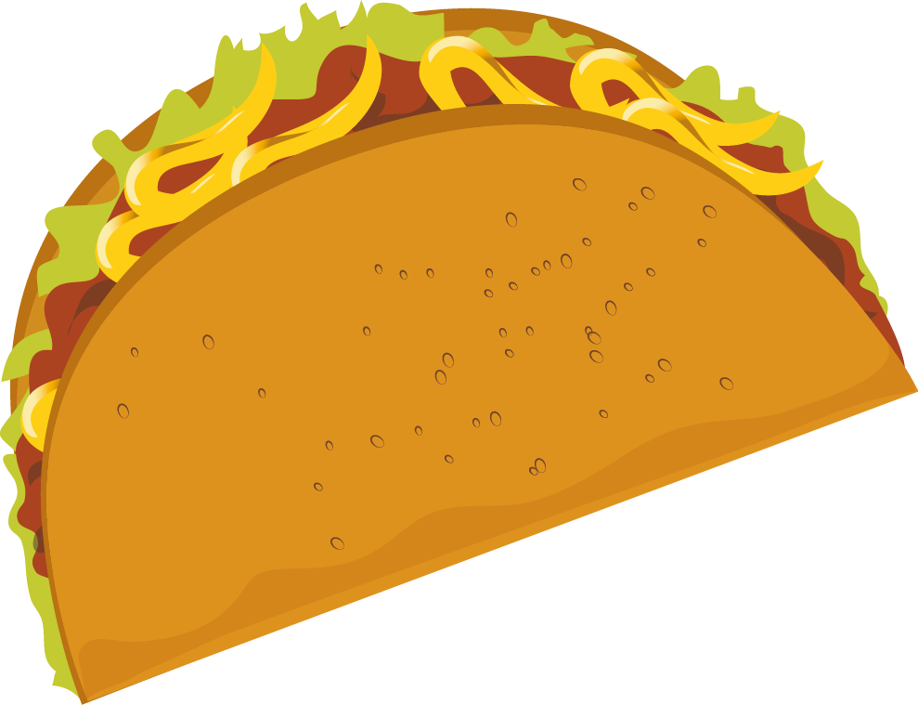
THE TACO TAXI

Slide 2
Menu
Cheesy Taco Flatbread
$3.00
Fiesta Fruit Punch
$1.00

Slide 3
Truck Front
THE TACO TAXI
TCOTXI
Truck Back
THE TACO TAXI
TCOTXI

Slide 4
Truck Top
Cut this part out to create the “bank” for the money you will collect.
Truck Bottom

