Slide 1

Food Truck Face-Off

Slide 2
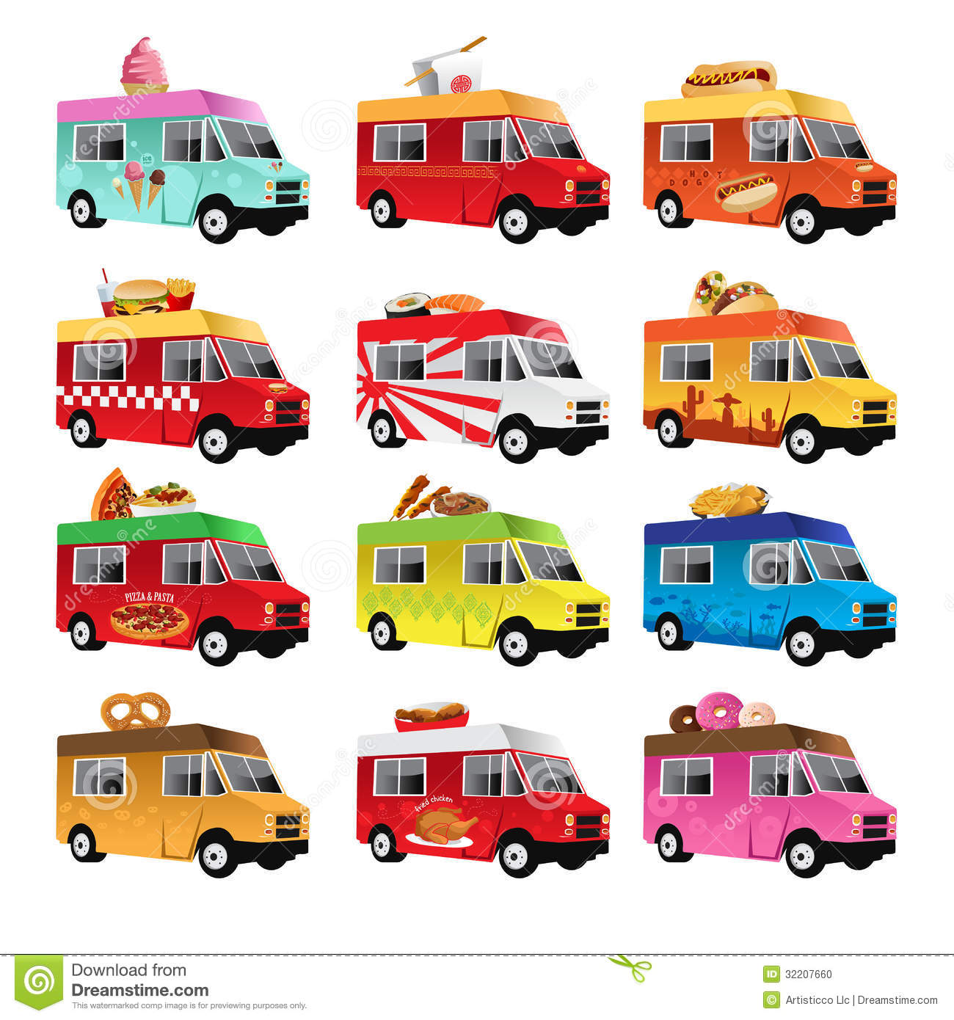
Create a Business Plan
Select the “Employees” You Will Be Working With (Kitchen Groups)
Choose a Recipe
Create a Company Name
Determine the Goals of the Company
Create a Plan of Action
Supplies needed?
Target market?
Employee responsibilities?

Slide 3
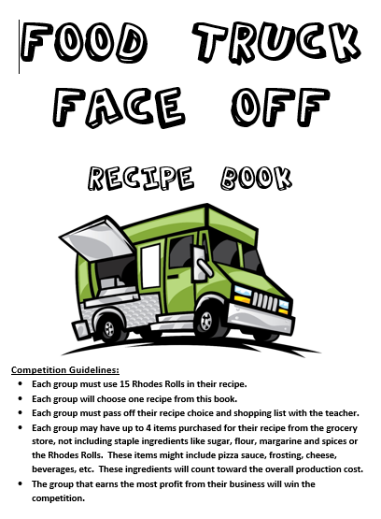
Recipe Selection
Each group must select a recipe from the Food Truck Face-Off Cookbook.
Each group will start with a base of 15 Rhodes Rolls.
Choose your top 4 choices from the book and complete 4 market surveys in class to determine the popularity and demand for your product.

Slide 4




Advertising
Create a logo to advertise your company.
Memorable
Simple
Professional

Slide 5
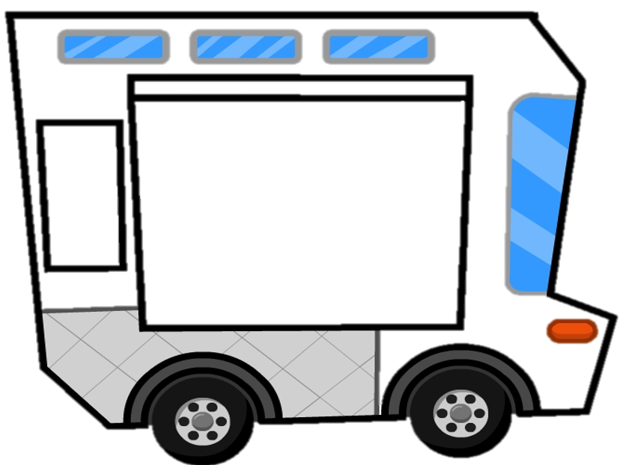
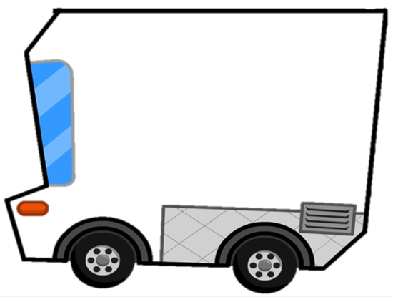
Advertising
Each employee will design their own creative logo/slogan on a practice food truck.
Then, all employees will vote on the best one that will then be used as the template for the final food truck.

Slide 6
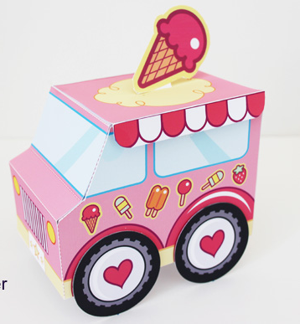
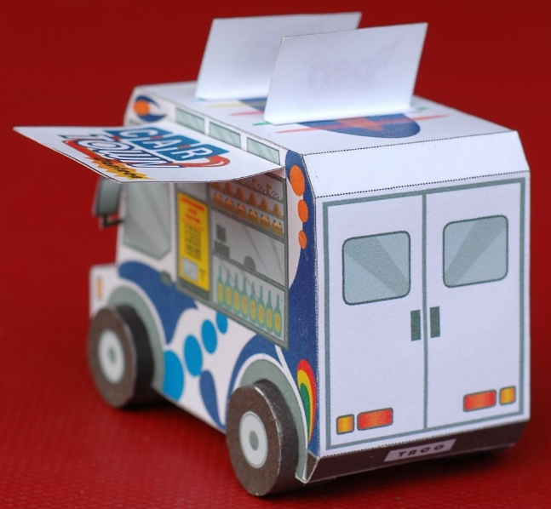
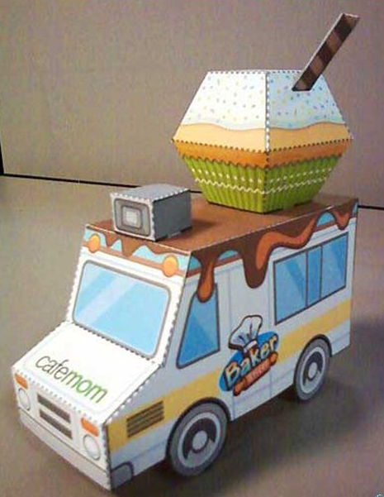
Advertising
Your food truck will double as your advertising and as a “bank” for your revenue.
The food truck must include:
Company Name / Logo / Slogan
Food Products Offered
Price of Food Products
Color and Creativity
Neatness and Good Construction

Slide 7
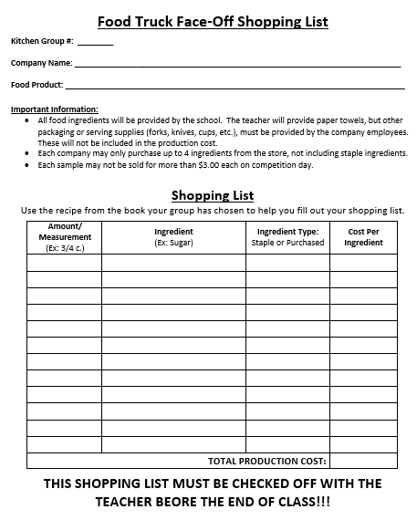
Shopping List
Each company MUST check off their shopping list and recipe with the teacher on planning day. Companies will be ineligible to compete if this is not done.
All food ingredients will be provided by the school.
Packaging and serving supplies (forks, knives, cups, etc.) must be provided by the company employees. (Paper towels are free.)
Each company may only purchase up to 4 ingredients from the store, not including staple ingredients.
Each sample may not be sold for more than $3.00 each on competition day.

Slide 8
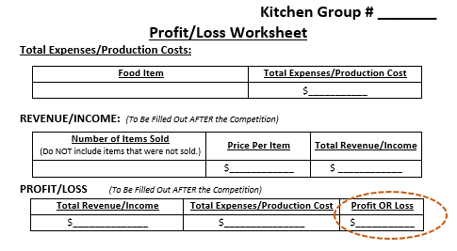
Profit / Loss Worksheet
After the competition, each group will calculate their production costs (total expenses) and their revenue (income) to determine if they made any profit or if they suffered a loss.
The team with the greatest revenue wins!

