Slide 1
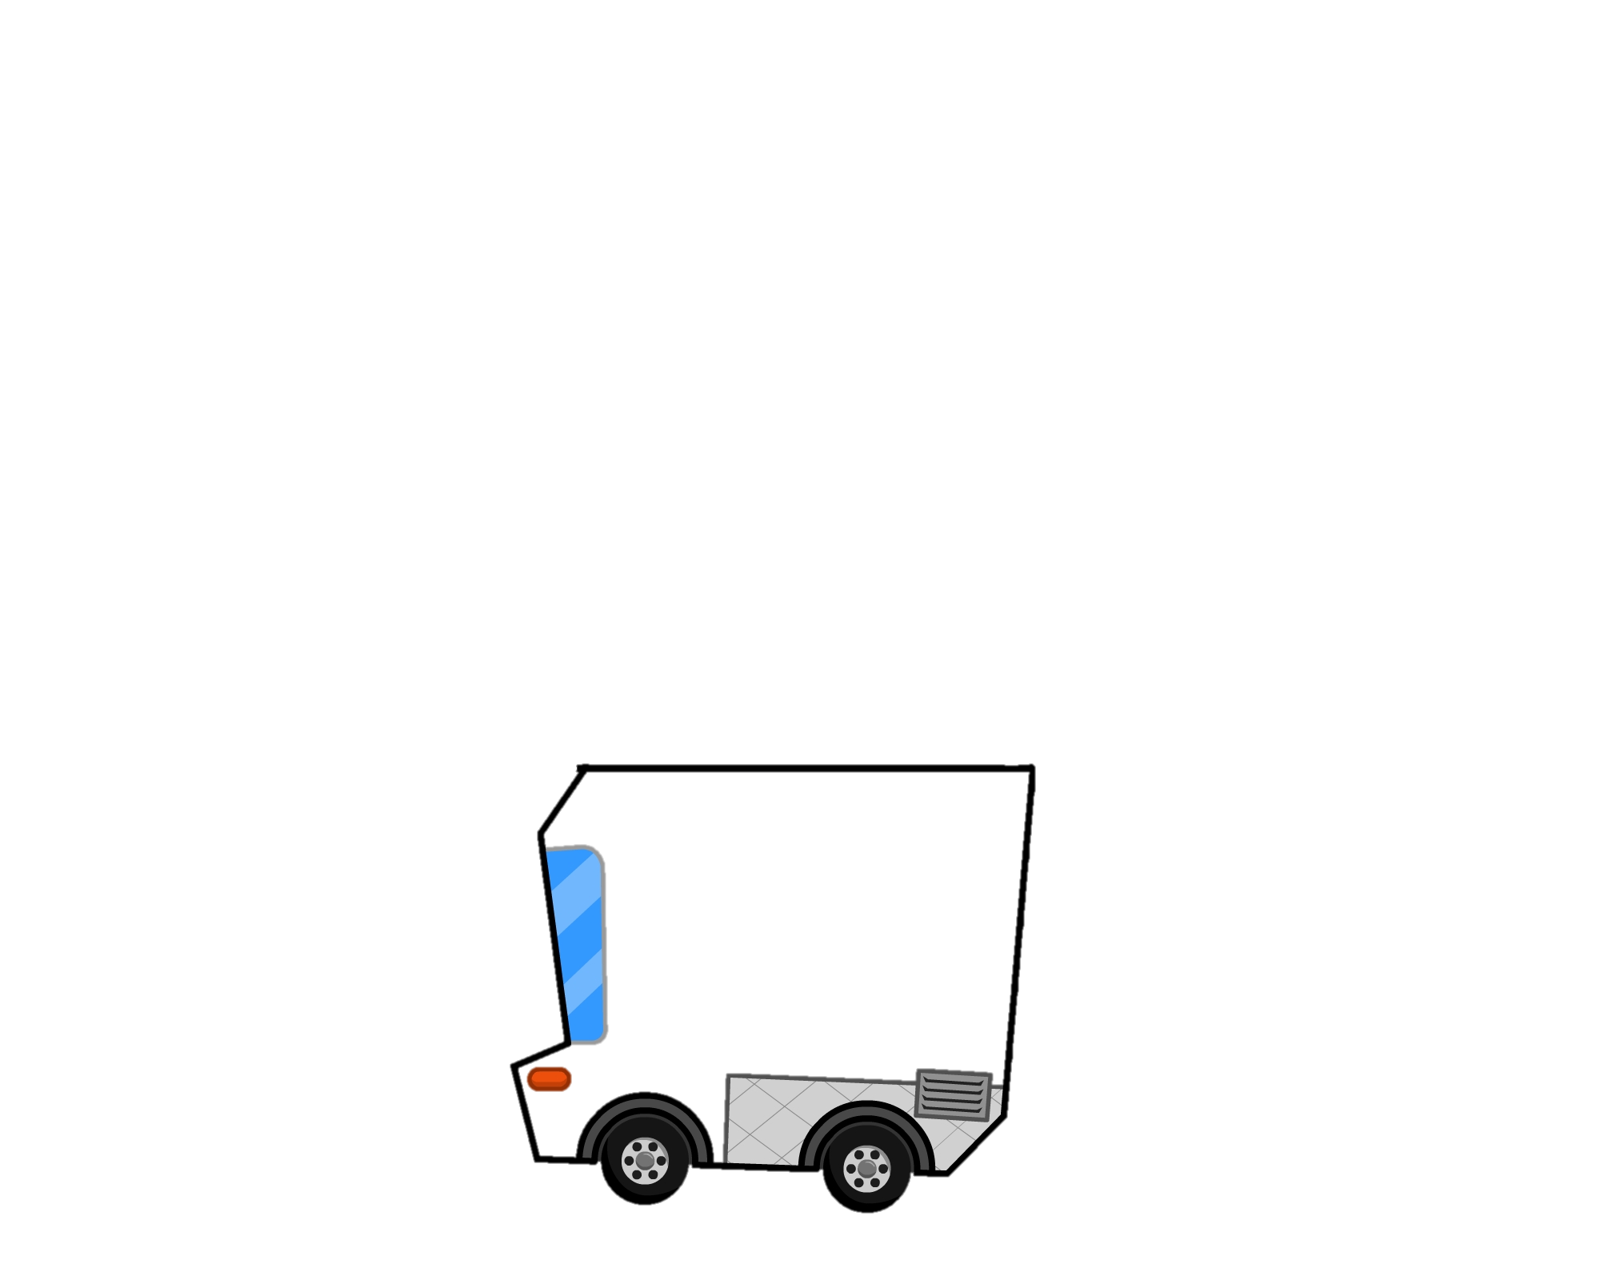

Slide 2
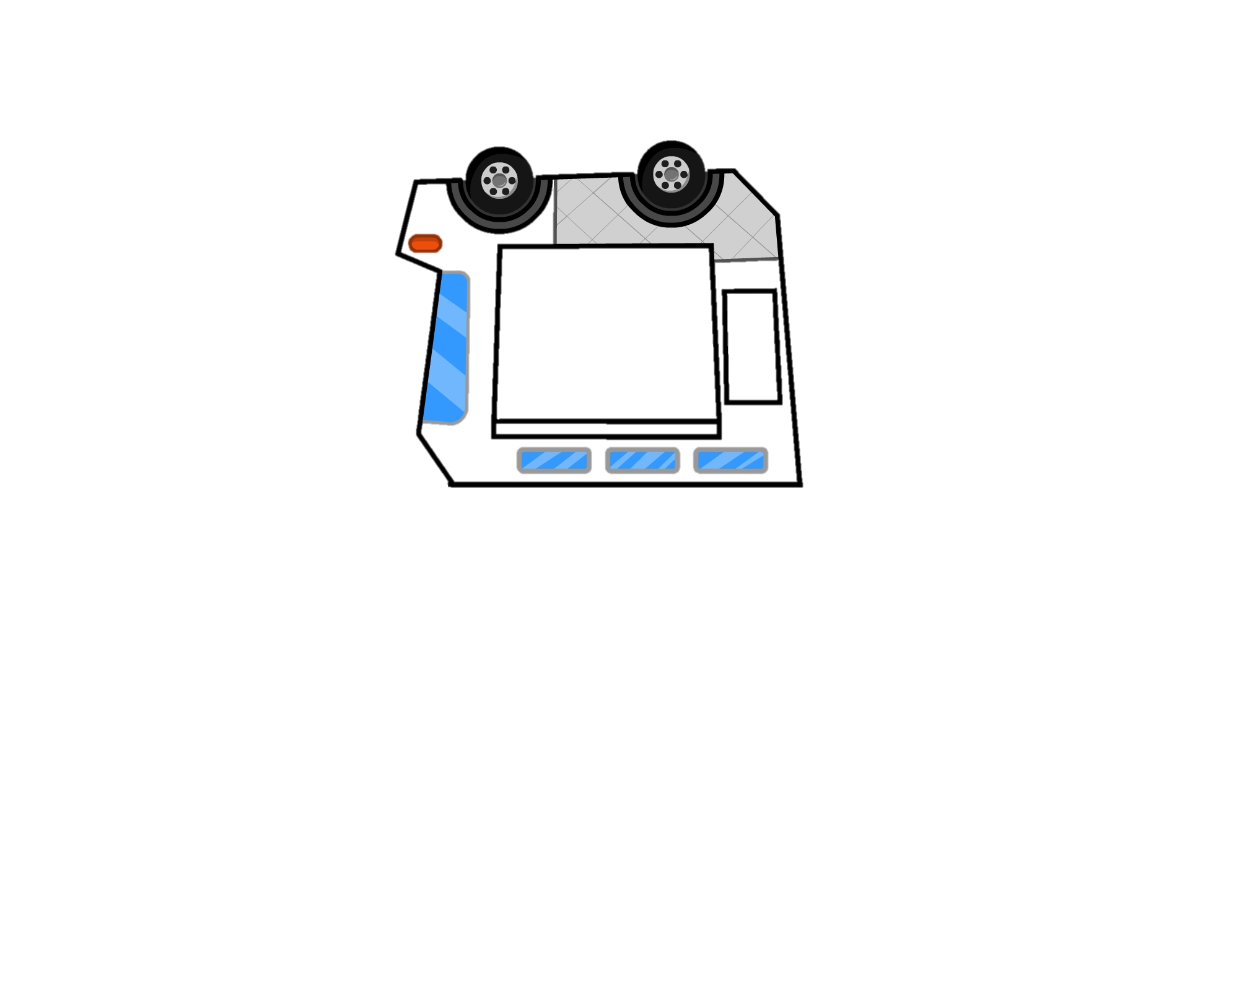

Slide 3
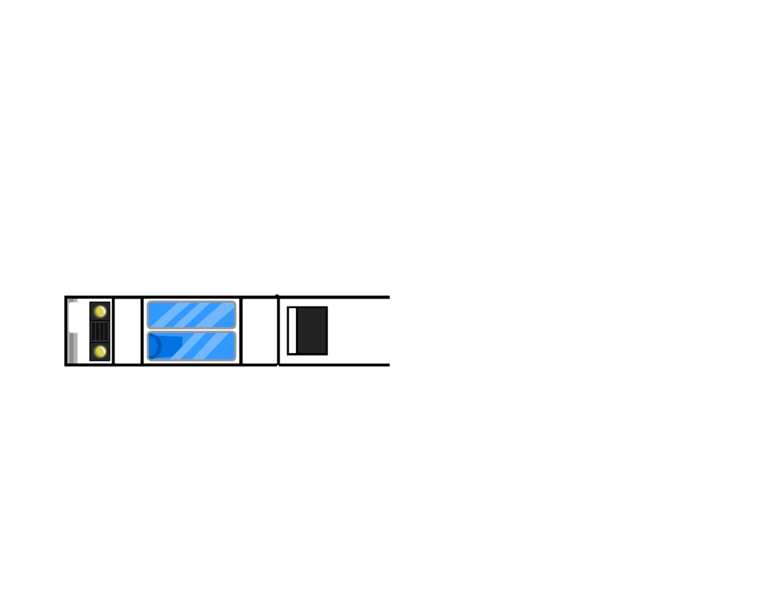
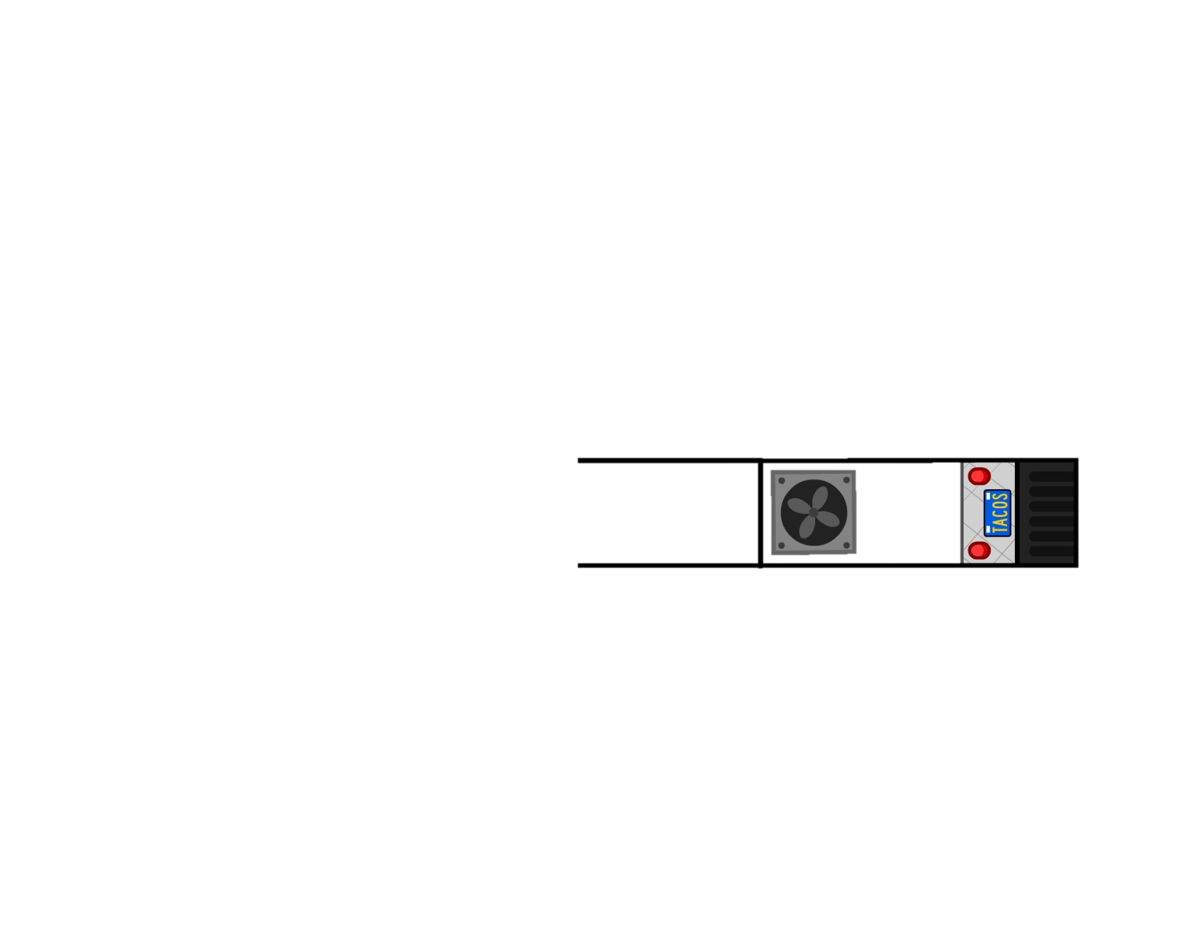


Truck Front
Truck Back

Slide 4
Truck Top
Cut this part out to create the “bank” for the money you will collect.
Truck Bottom

