Slide 1

Entrepreneurship Basics

Slide 2

What is an Entrepreneur?
A person who manages an enterprise or business.
What are benefits of owning your own business?
What are disadvantages of owning our own business?
Notes:
Have the kids come up with ideas. Things we’ve discussed in the past: Good = You’re the boss, you can set your time (unless you open a business in a mall that has certain hours of operation), you get the money made, you can have people work for you so you don’t have to do as much of the work, you sell usually what you choose and like. Negatives of owning a business include: If someone doesn’t show up you have to cover for them, if the business fails you lose money, if something goes wrong you are in charge, etc.

Slide 3

Top 10 Traits of Entrepreneurs
Determination
Risk Takers
Confidence
Craves Learning
Willing to Fail in Order to Learn
Passion
Adaptability
Money and Resource Management
Expert at Networking
Ability to Sell and Promote Product

Slide 4
The key to any good business is first, being a good employee!
Why would a company want to hire you?
What qualities help you stand out from the rest?
You’ll want to look for those same qualities
as an entrepreneur.

Slide 5

Top 10 Employability Skills
Dress/Grooming
Positive Attitude
Work Ethic
Responsibility
Dependability
Integrity
Communication
Teamwork
Planning
Adaptability
Qualities Employers Are Looking For

Slide 6

Business
The sole owner, partnership, or corporation that creates and sells a product or service.

Slide 7
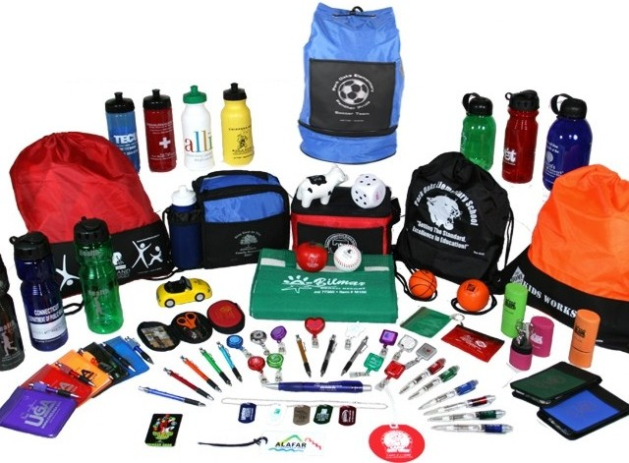
Product
Something produced, or made, to sell.
  Lemonade Stand
  T-Shirts
  Food

Slide 8

Service
Work done by others for others.
  Haircut
  Auto Repair
  Catering

Slide 9

Salary
Money paid to someone (usually employees) for the work or service they perform.

Slide 10

Revenue
Money a company received from selling a product or service.

Slide 11
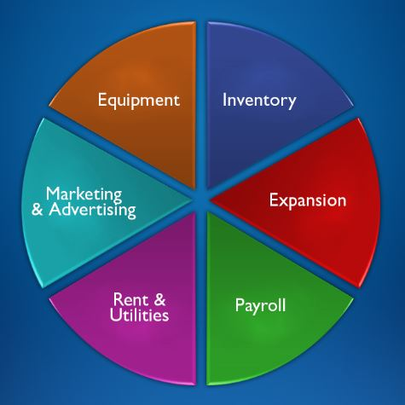
Expense
A cost associated with operating a business.

Slide 12
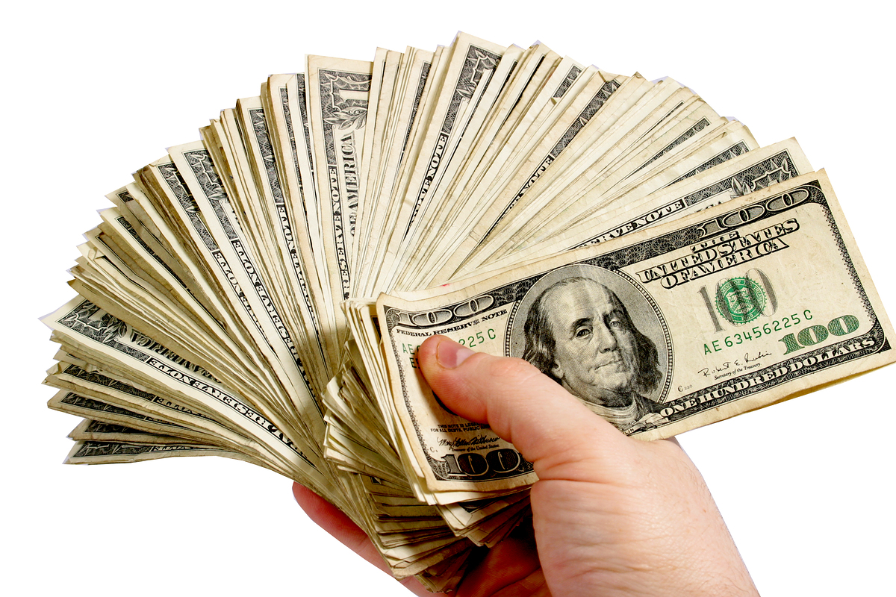
Profit
Money gained after expenses have been paid.

Slide 13

Loss
The amount of money lost when expenses exceed the revenues.

Slide 14

Profit Equation
Revenue
- Expenses
Profit or Loss

Slide 15

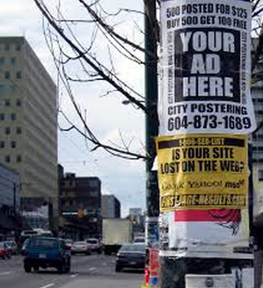
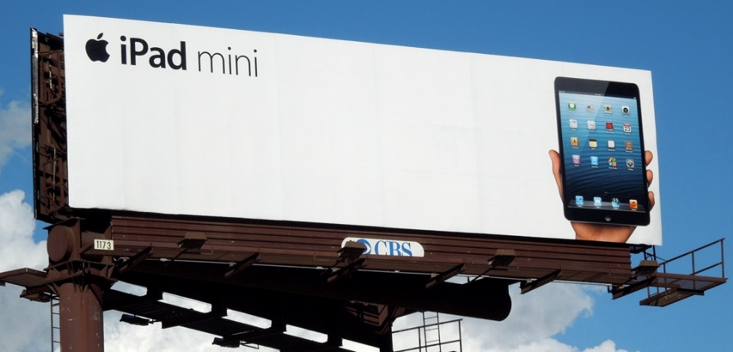





Advertising & Marketing
Ways of attracting public attention to a product or business.
Promotion of the company:
  TV Commercials
  Flyers
  Radio Ads
  Coupons

Slide 16

What Makes a Good Company?
Make quality products or services.
Provide a healthy working environment.
Treat employees well.
Benefit the community.
Support community efforts (schools, parks, etc.)
Demonstrate good business ethics (honesty, rules, standards, etc.)

