Slide 1
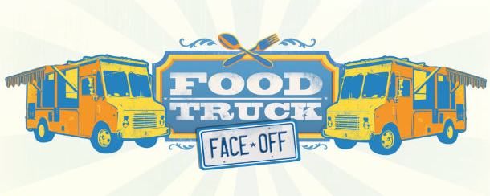
Food Truck Face-Off

Slide 2
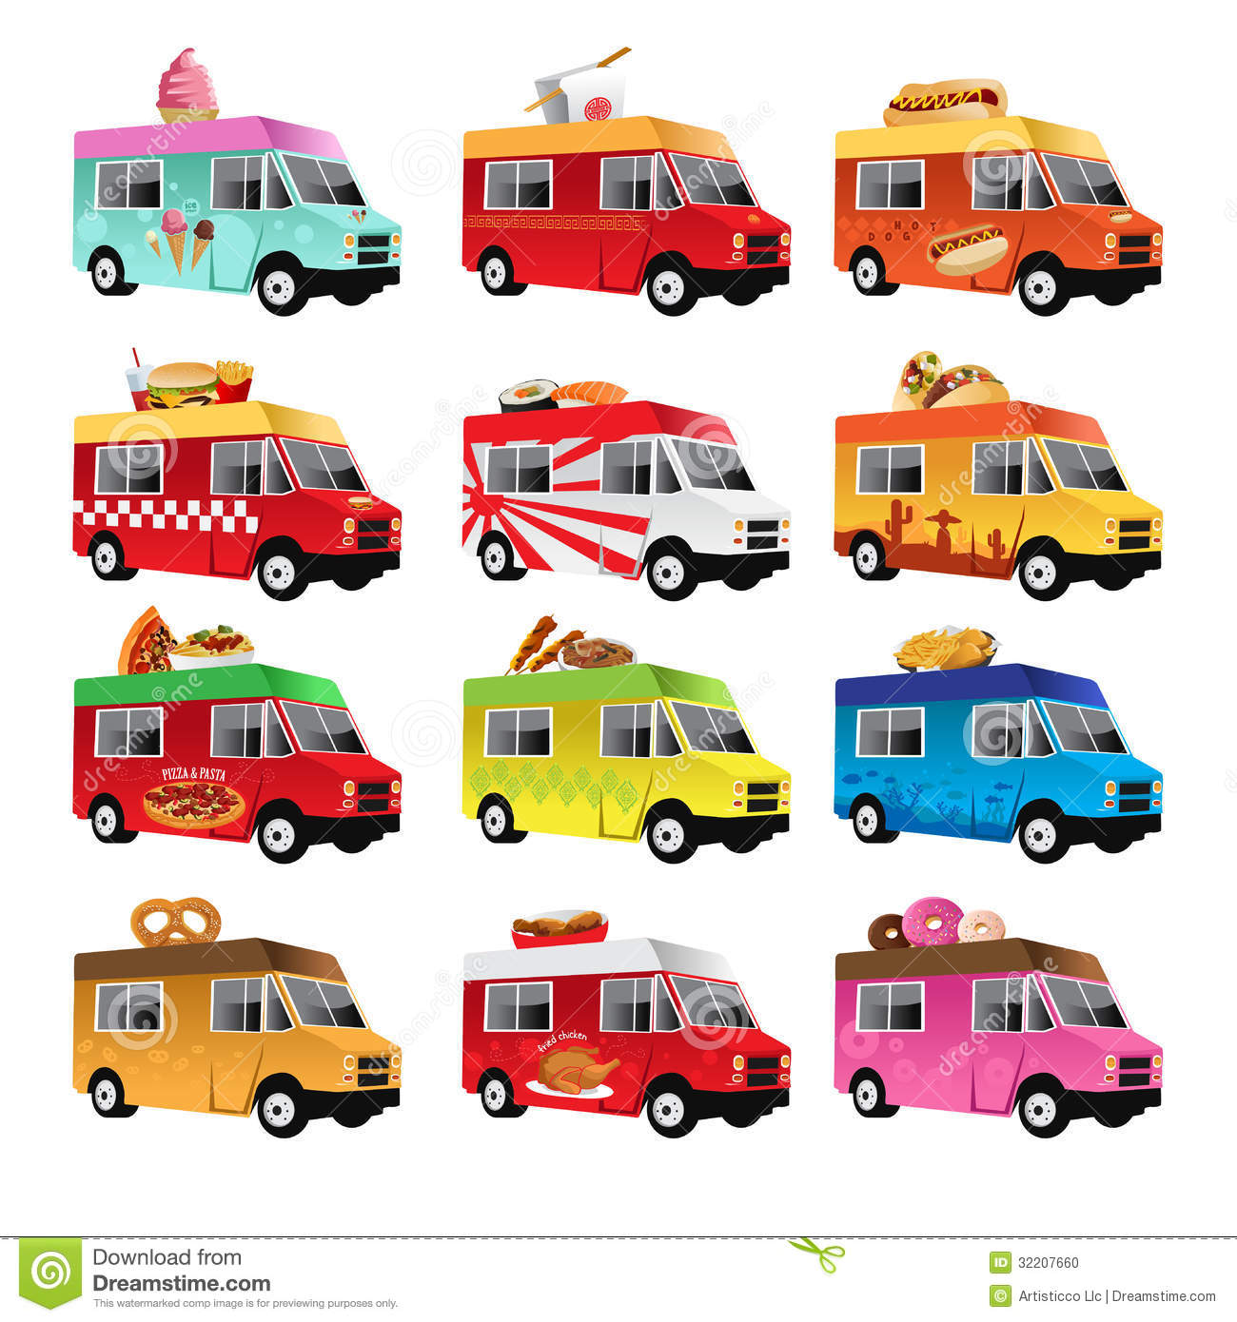
Create a Business Plan
Select the “Employees” You Will Be Working With (Kitchen Groups)
Decide on ONE Product to Be Sold
Create a Company Name
Determine the Goals of the Company
Address Possible Company Concerns
Create a Plan of Action
Supplies needed?
Target market?
Effective advertising?
What Will You Make? Be Creative!
Smoothies, Waffles, Mini Tacos, Doughnuts, Sandwiches, etc.
Be creative and think outside the box!

Slide 3
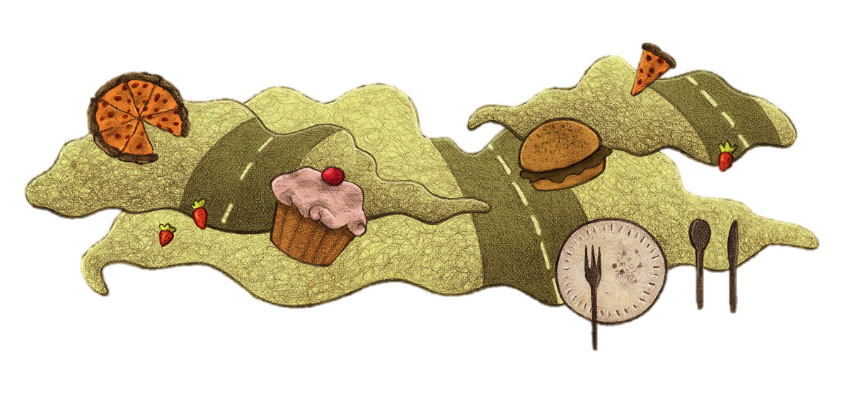
Brainstorming
Make a list of menu ideas.
Star the TOP 3 ideas.
Use resources to help you research.
How are you going to attract people to your business? (Unique theme, garnishes, creativity, advertising, samples, etc.)

Slide 4




Advertising
Create a logo to advertise your company.
Memorable
Simple
Professional

Slide 5

Profit - Loss Calculations
Company revenue (income) will be calculated with a Ticket Conversion System.
You will need to “spend” some tickets as a group to get started in your business.
During the Food Truck Face-Off Competition, you will earn tickets from those buying your product.
Each student will have six tickets to spend at any food truck business they want (except their own) during the completion.

Slide 6
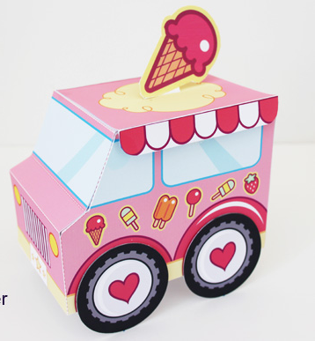
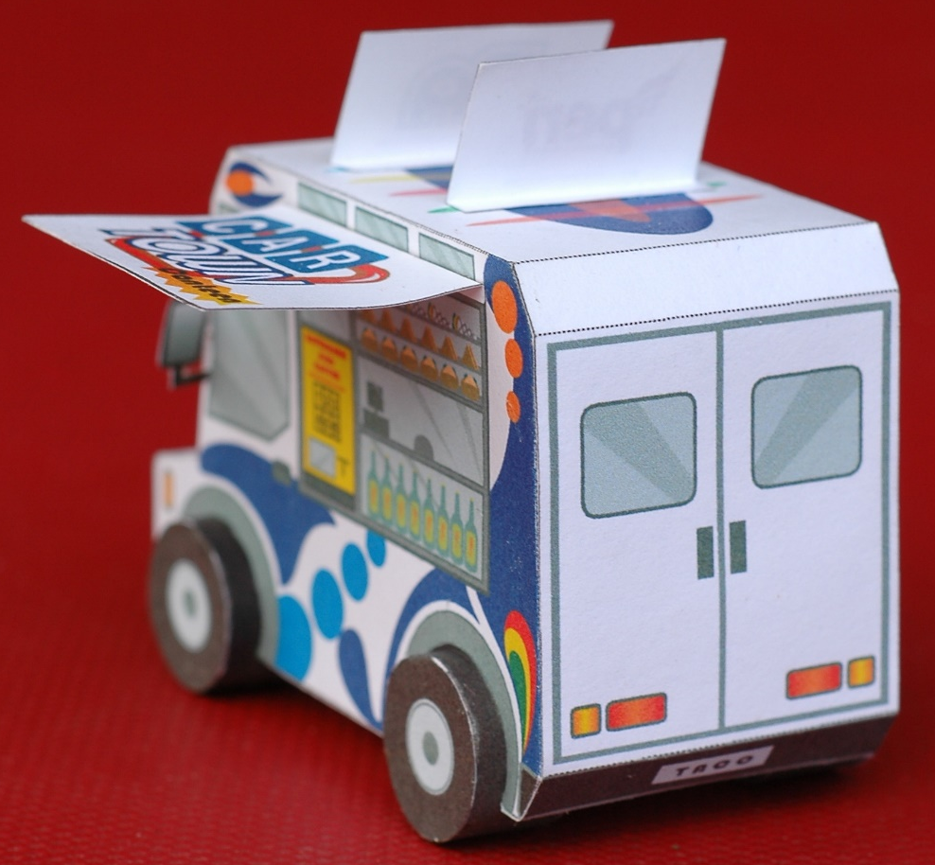
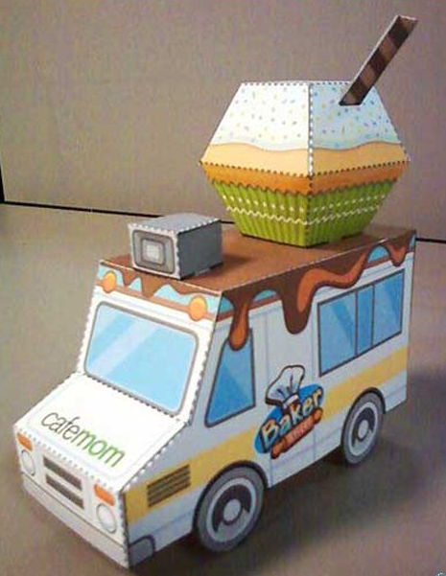
Food Truck Ticket Bank
You will construct a food truck that will double as part of your advertising and as a ticket bank.

Slide 7
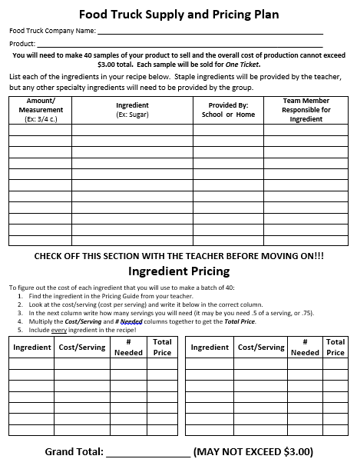
Supply and Pricing Plan
As a group, you will need to fill out and CHECK OFF your Supply and Pricing Plan.
Each group will need to make 40 bite-sized samples for the competition day.

Slide 8
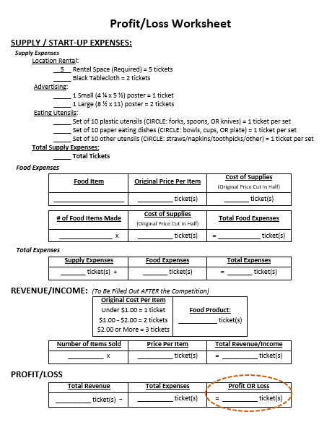
Profit / Loss Worksheet
After the competition, each group will calculate their supply costs and their revenue (income) to determine if they made any profit or if they suffered a loss.
The team with the greatest revenue wins!

