Slide 1

Free Enterprise & Entrepreneurship

Slide 2

Careers Related to Clothing Production & Fashion Design

Slide 3
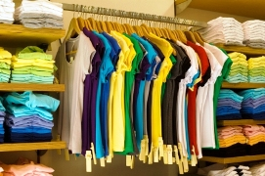
Apparel Production & Distribution

Slide 4
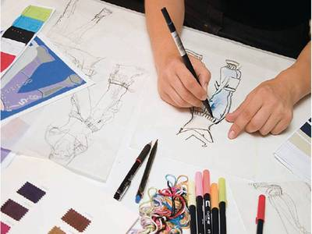
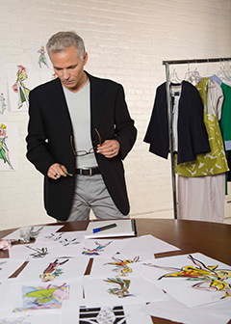
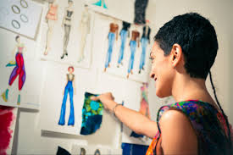
Fashion Designer

Slide 5
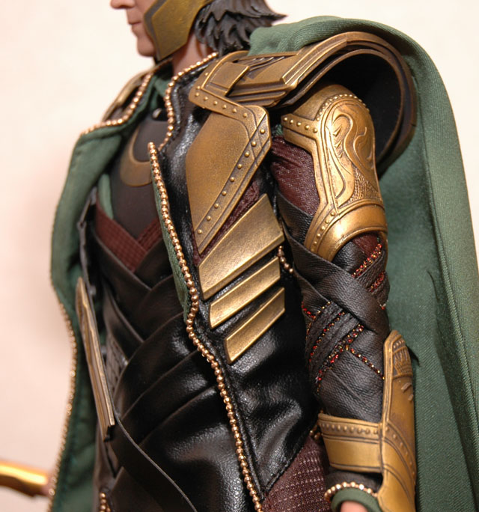
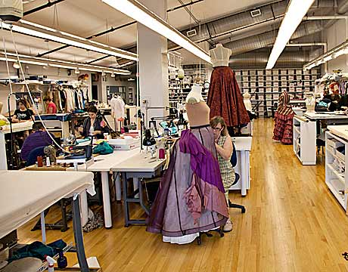
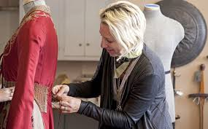
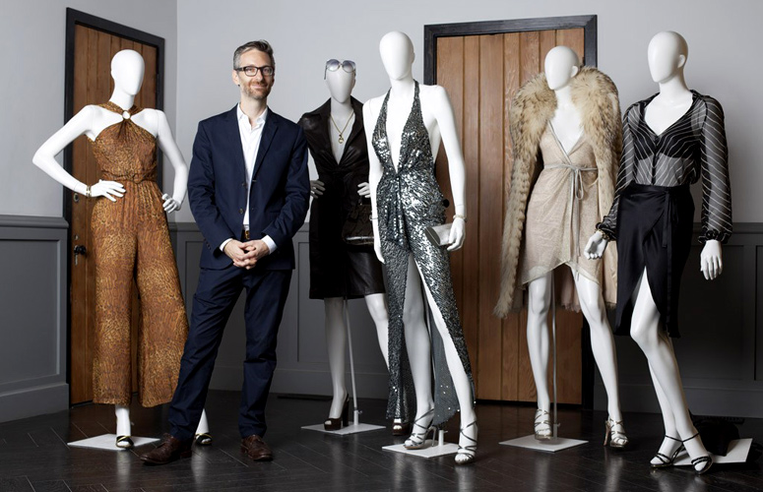
Costume Designer

Slide 6
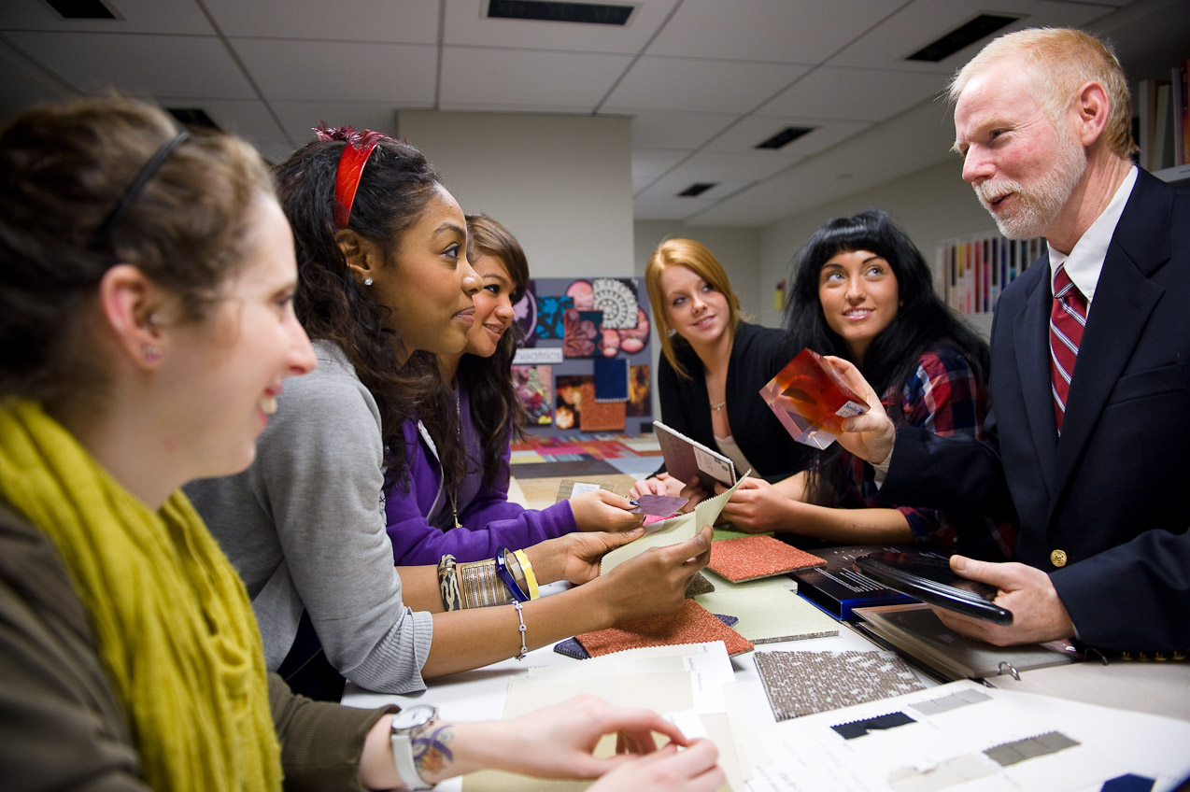
Fashion Merchandiser

Slide 7
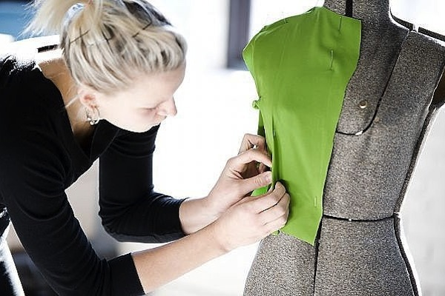
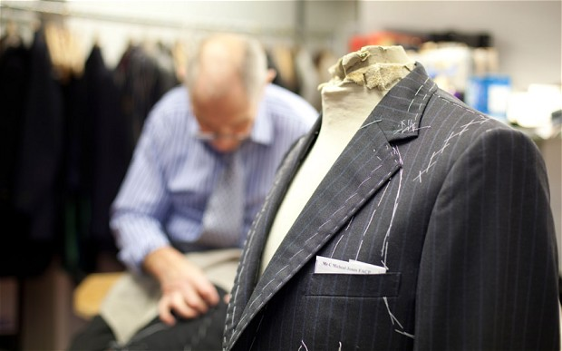
Seamstress / Tailor

Slide 8
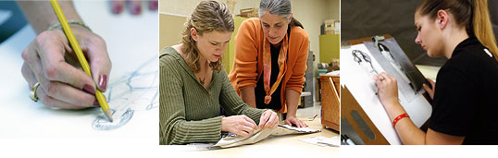
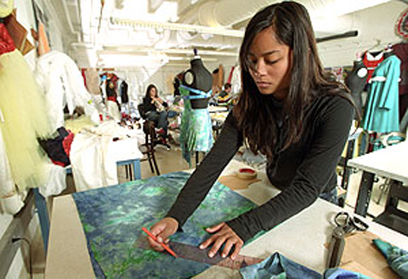
More careers…
List One
Apparel Workers
Apparel Manufacturer
Apparel Merchandisers
Buying Agents
Cutters
Laundry and Dry Cleaning Workers
Merchandise Displayers / Window Dressers / Visual Merchandising
Pattern Makers
Photographers - Fashion & Glamour
Pressers
Production Management / Engineering
Retailers - clothes
Set and Exhibit Designers
Shoe & Leather Workers
Textile Bleaching & Dyeing Machine Operators
Textile Machine Operators
Writers and Editor Job Descriptions

Slide 9

Entrepreneurship Basics

Slide 10

What is an Entrepreneur?
A person who manages an enterprise or business.

Slide 11

Top 10 Traits of Entrepreneurs
Determination
Risk Takers
Confidence
Craves Learning
Willing to Fail in Order to Learn
Passion
Adaptability
Money and Resource Management
Expert at Networking
Ability to Sell and Promote Product

Slide 12
The key to any good business is first, being a good employee!
Why would a company want to hire you?
What qualities help you stand out from the rest?
You’ll want to look for those same qualities
as an entrepreneur.

Slide 13

Top 10 Employability Skills
Dress/Grooming
Positive Attitude
Work Ethic
Responsibility
Dependability
Integrity
Communication
Teamwork
Planning
Adaptability
Qualities Employers Are Looking For

Slide 14
Mo’s Bows
Shark Tank

Slide 15

Entrepreneurship Unit Goal
Create the best product for the best price with the best quality.
Create a Tie or Bag Company

Slide 16

Create a Business Plan
Select the “Employees” You Will Be Working With
Decide Between Tie or Bag
Create a Company Name
Determine the Goals of the Company
Address Possible Company Concerns
Create a Plan of Action
Supplies needed?
Target market?
Effective advertising?
What Will You Make? Be Creative!
Bow Ties, Pocket Ties, Glow in the Dark Ties, Textured Ties, Zipper Ties
Ribboned Bags, Pocket Bags, Embroidered Bags, Etc.

Slide 17
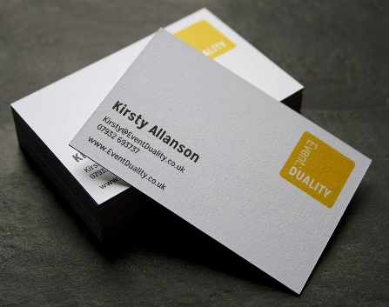

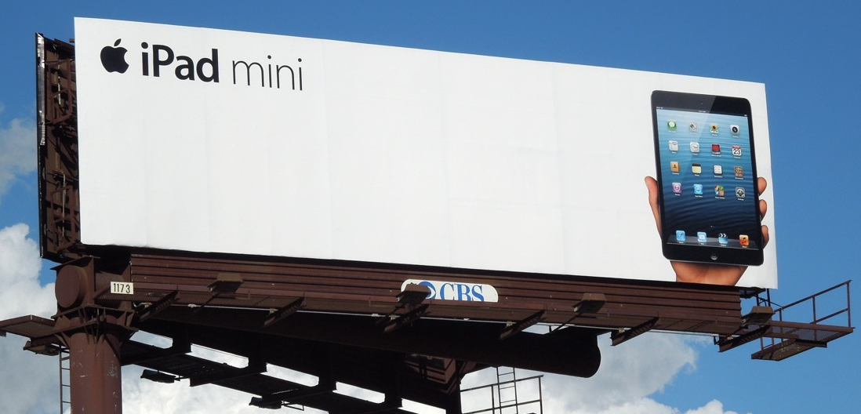
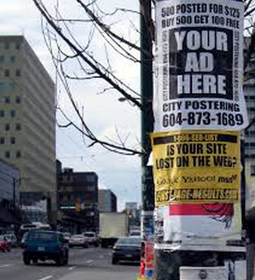



Advertisement Plan
What are ways businesses advertise?

Slide 18
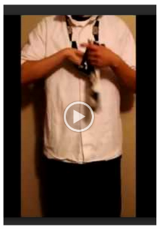
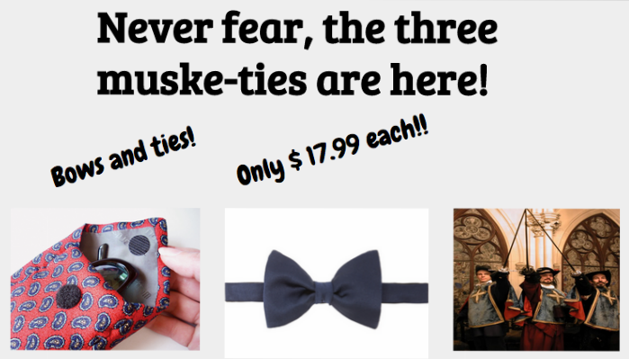
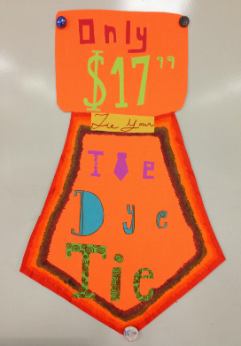

Advertisement Plan
How will YOUR company advertise?

Slide 19
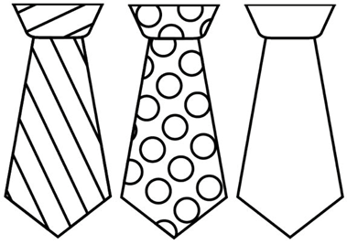
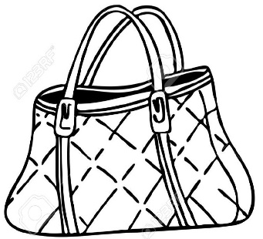
Market Survey
Each member of your team will be required to survey FOUR different people on the product you will be selling. Use the survey in your booklet. Plan ahead so you can use the information to plan your project.
Survey data from faculty and staff at school will be provided for you so you must collect data from other people. No teachers allowed!

Slide 20
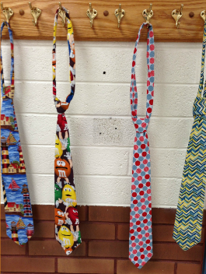
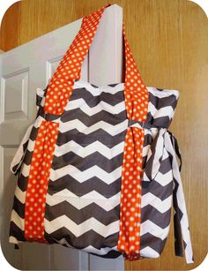
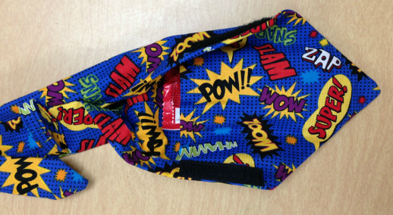
Entrepreneurship Contest
Work Together
Multi-Task/Split the Duties (One designer, one advertiser, etc.)
Everyone does their part (Dependability)
All SEWING must be done at school
Best Tie
Best Bag
Best Business

Slide 21

Business Evaluation
At the end of the contest, fill out the Business Evaluation form in the packet.
Each person fills out their own evaluation.
The teacher is the ONLY one who sees this evaluation so be honest and fair as you evaluate your co-workers.
Tear this page out of your packet and turn it in.

