Slide 1
The 6 Essential Nutrients
What You Need to Know!
WATER
Carbs
Protein
Fats & Oils
Vitamins
Minerals

Slide 2
“Essential” Nutrients
Nutrients are categories of substances we need for our nutrition.
Essential Nutrients are nutrient substances that we can only get from food, because our bodies cannot produce them on our own.
**For example, your body can’t just decide “hey, I need some calcium so I’m going to make it!” You have to consume something that contains calcium in order for it to get into your body

Slide 3
CARBOHYDRATES (“carbs”)
What comes to your mind when you think of Carbs?

Slide 4
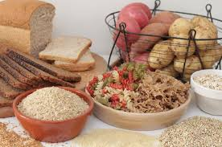
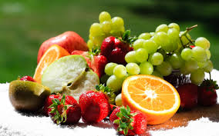
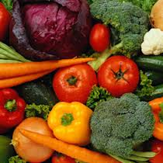
Carbohydrates, continued
Carbohydrates, or “carbs,” are an essential nutrient because they are your primary source of ENERGY.
Carbohydrates have 2 categories: Simple and Complex
We get simple carbs from anything sugary, or even lactose (in dairy).
We get complex carbs from starchy foods like pasta, grains, rice, and vegetables.

Slide 5
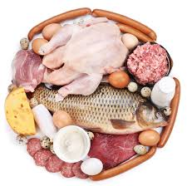
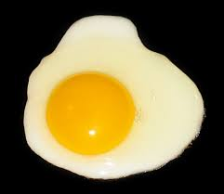
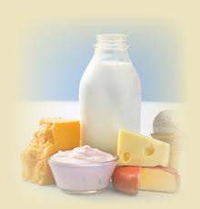
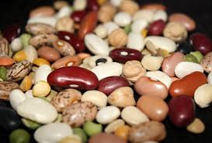
PROTEIN
Protein is more than just a big shake at the gym, or a hunk of steak.
The function of protein is: to build and repair body tissues
So where do we get protein?
-animal sources (meat, eggs, dairy)
-some plant sources (beans, soy, nuts, legumes)

Slide 6
PROTEIN
Protein, Bro

Slide 7
Fats & Oils

Slide 8
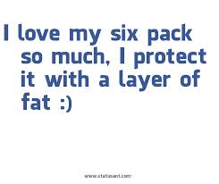
Fats & Oils
Believe it or not, fats are GOOD for you!!!! But in the right amounts. (Americans tend to get too much)
The function of fats/oils is:
Insulate your body
Cushion your organs from shock
Transport vitamins A,D,E,K
Give taste and flavor to food

Slide 9
Vitamins Minerals
Maintain proper body functions like cell and nerve health, skin and tissue health
Maintain proper body functions like organ functions, breathing, heart function, and growth
A
E
Sodium
Potassium
Chloride
magnesium
Iodine
calcium
iron
And many more!!!!
C
D
K
B

Slide 10
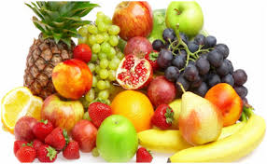
Vitamins and Minerals, cont….
Vitamins and Minerals are in different amounts, in all sorts of foods.
Some of our richest sources of vitamins and minerals are
fruits
vegetables

Slide 11
Last but not least….
WATER!!!!!!
Water helps you:
Process certain vitamins (that can only dissolve in water)
Hydrates you
Regulates body temperature
WATER is the most important of all the nutrients because we CANNOT survive long without it!

