Slide 1
Use and care tips
Appliance

Slide 2
Microwaves
Clean regularly with a clean wet cloth.
Use appropriate items in the use of this appliance. Name some safe ones…….

Slide 3
Refrigerator
Keep temperature below 40F
Keep freezer set at 0
Do not overload!
Wipe away spills ASAP
Clean often with baking soda and warm water.
Clean the condenser coils with the brush of a vacuum periodically.

Slide 4
Dishwasher
Scrape dishes before loading
Load carefully following guidelines
Use ONLY automatic dishwasher detergent.
Do only FULL loads!
Clean condenser screen periodically

Slide 5
Food Waste Disposal
Run plenty of water when using
Grind small batches at a time.
Avoid putting fibrous foods like onion skins or corn husks in disposal.
NEVER PUT YOUR HAND IN DISPOSAL!!!!

Slide 6
Small Appliances
Always check owners manual to see which parts are safe to immerse in water.
Never unplug by pulling on the cord
Rinse beaters and blade immediately after use.
Clean the crumb tray on toasters regularly.
Never insert anything into the toaster to remove stuck food.
Check cord to make sure it is not damaged. Let cool before cleaning

Slide 7
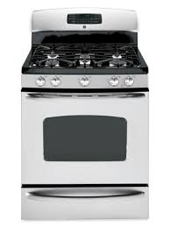
Range Safety
Be careful not to drop heavy items on range.
Wipe up spills when cooled.
Do not block range vents
Clean drip pans
Clean oven regularly

