Slide 1
Kitchen Safety and Sanitation
Think!

Slide 2
You have 3 minutes:
Please look at the following picture for 3 minutes and note all of the UNSAFE aspects of the picture.

Slide 3
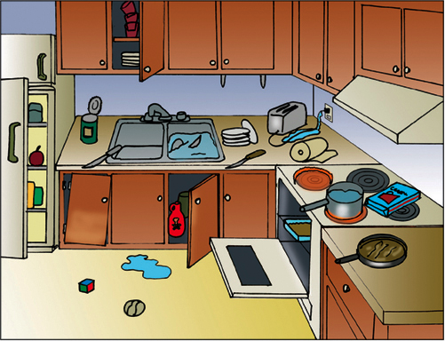
UNSAFE KITCHEN…why??
Notes:
Look at the picture for 3 minutes and write down all the unsafe aspects of the kitchen. Discuss for about 7-10 minutes about the safety issues.

Slide 4
Some reasons why this kitchen is unsafe:
Open fridge door (someone could run into it)
Open cupboards above (things fall out, bump your head on the corner)
Broken cabinets below
Open can with sharp lid
Knife sticking out of dish water
Open cabinets below (chemicals at reach of children)
Spills
Knives facing out
Toys
Open oven
Dishes everywhere
Unstable stacked dishes
Water with plugged in toaster
Pot handle facing out
Heated Ranges
Box on/near hot ranges
Pan handle out
No oven mitts
Paper towels near hot range (unused)
No person
No soap
Notes:
Okay, there are a lot of things wrong with this kitchen. Maybe yours doesn’t have ALL of these. But what are some common problems we can think of in our kitchens? What things obviously don’t mix? (anything flammable by hot stove ranges, water + electricity, chemicals at child’s reach, open cupboards above and below, etc…

Slide 5
3 Major Lab Safety Issues
Notes:
The 3 major accidents in our lab kitchens can be divided into these 3 categories. Tell the story of Elisa’s brother, 2nd degree burns all over his front because of the pan handle sticking out from the stove with hot spaghetti sauce. READ FROM PRINT OUT KITCHEN SAFETY

Slide 6
How can we prevent these accidents?
Oven mitts
Immediate clean-up
Prior knowledge of equipment
“Yellow” state--caution
Awareness/placement
Careful planning of lab assignments
Notes:
This is not a complete list…but guidelines for discussion. Yellow state: Guatemala…always be aware. Know where things are, when things will be done. AWARENESS/placement…flammable things, reach of children; clean up (spills), careful planning—you know who is responsible for what. It is more difficult managing a kitchen with multiple cooks. Why? Because if you don not communicate, things will get crazy! Oven mitts—Dr. Moore’s student reached right in the oven to grab a pan (stupid but true).

Slide 7
General Safety Knowledge
Know first aid for cuts, spills, burns
Knife safety
Safety includes sanitation
Hair, jewelry, clothing, aprons, etc…is it in the way? Will it catch fire? Is it touching food?
Quick response clean-up is essential
Read appliance manuals first
NO horseplay, rough-housing
Cleanliness!
Emergency response procedures
Our FIRE EXTINGUISHER is LOCATED: by Kitchen Eight (Front of room)
Notes:
Discuss dangling things: hair, jewelry, clothing. We use aprons to not only prevent spills, but also to keep clothing (baggy shirts, flowing blouses) back from heat sources.

Slide 8
Preventing CUTS
Hand placement: the CLAW or the FLAT HAND TOP
Wash knives separately
Put all broken glass in the SHARPS BIN
Remove can lids completely, place in the sharps bin
Notes:
Discuss these procedures. Talk about the first aid.

Slide 9

KNIFE SAFETY
http://www.youtube.com/watch?v=sLuU390MX9M
Notes:
We can also get cuts from blender/mixer blades, graters, papers, can tops, apple slicers…

Slide 10
Sharp vs. Dull
A dull knife is dangerous and inefficient.
The best knives are SHARP knives because they use less pressure.

Slide 11
First Aid for CUTS
If it’s spurting, we get emergency help (arterial cut)
If it’s oozing (as most cuts will), you need to
Wash with soap and water
Apply direct pressure
Clean up and bandage
Any more than that, we can get the nurse

Slide 12
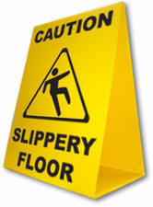
Preventing SPILLS
#1 Rule in this class: CLEAN IT UP…QUICK!
Spills lead to slips and falls.

Slide 13
First Aid for FALLS
If the person fell because they slipped on a spill, we PICK THEM UP
  Unless… they hit their head. We DO NOT move them and we tell Mrs. Milburn right away. Moving a person with a head injury could cause further damage or paralysis.

Slide 14
Preventing BURNS
Use oven mitts and hot pads
Open lids away from you (to avoid steam burn)
No hanging jewelry or loose clothing
Wear an apron
Avoid touching hot surfaces

Slide 15
About burns….
TYPES:
1st (like a sunburn)
2nd (usually has blisters)
3rd (severe tissue damage)
SOURCES:
Thermal (heat), Chemical, Electrical
*Did you know? Just 3 seconds of exposure to water at 140 degrees can cause a 3rd degree burn in an adult. At 156 degrees the same burn occurs in one second. That’s still 40 degrees less than boiling water.

Slide 16
First Aid for Burns
Run cold water over the area or apply a wet, cold cloth. NOT ice. Ice can cause further tissue damage (freeze the skin)
If you are on fire, stop drop and roll! (don’t run)
We will call 911 and/or get nurse

Slide 17
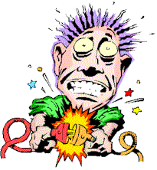
Preventing:
ELECTRIC SHOCK!
Know how the equipment works!
Attach things before plugging it in
Make sure the cord is not near any water
Do not put near hot objects
Avoid octopus outlets (one outlet with many cords)
Disconnect appliances before cleaning them
Don’t use damaged appliances
Keep metal away (i.e. don’t use fork in a toaster)
WATER & ELECTRICITY don’t mix!

Slide 18
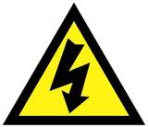
Electric Shock: What to Do if It happens
Turn off the power source (do NOT touch the person!)
Remove the person from the source
Begin compressions if necessary, call 911

Slide 19
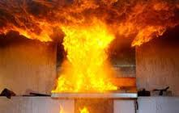
GREASE FIRES
CAUSE: Oil/fat left on heat too long, will spontaneously combust (light itself on fire)
PREVENTION:
use a thermometer
watch the oil (smoke warning)
Lower or turn off the heat
How to put it out:
Don’t panic
Baking soda or salt (lots)
Fire extinguisher
Lid (metal)
NEVER EVER EVER EVER EVER EVER put water on a grease fire. It will blow up!!!

Slide 20
Grease Fires

Slide 21
SUMMARY
What are the 3 main injuries in the lab?
How can we prevent them?
How do we treat them?
Tell me about Grease fires? What do we NOT put on them?

