Slide 1
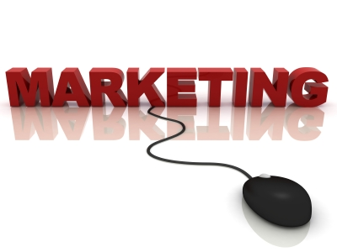
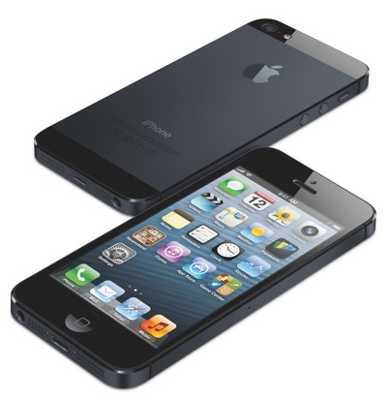

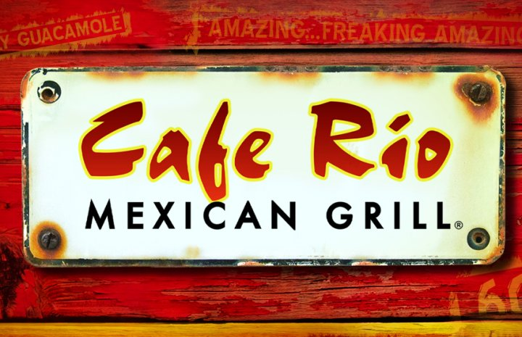

Slide 2
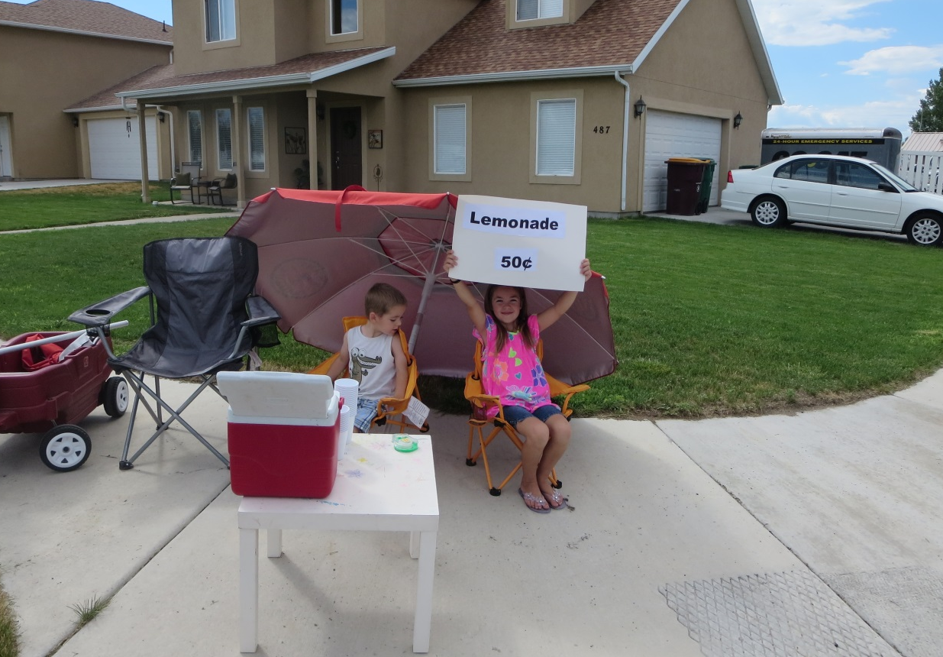
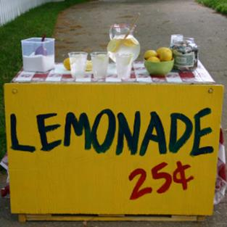

What is Free Enterprise?
►Definition: individual ownership of a company in a competitive market, free from government restraint

Slide 3
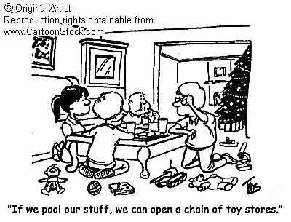
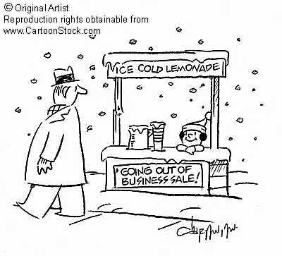
Owning a Business…
What might be the benefits?
What might be the negatives?

Slide 4
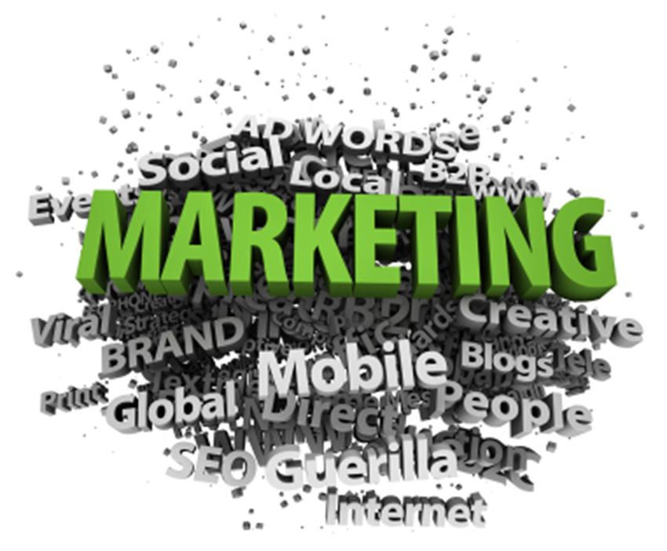
What is Marketing?
►Definition: the process of developing, promoting, and distributing products in order to satisfy customer’s needs and wants.

Slide 5
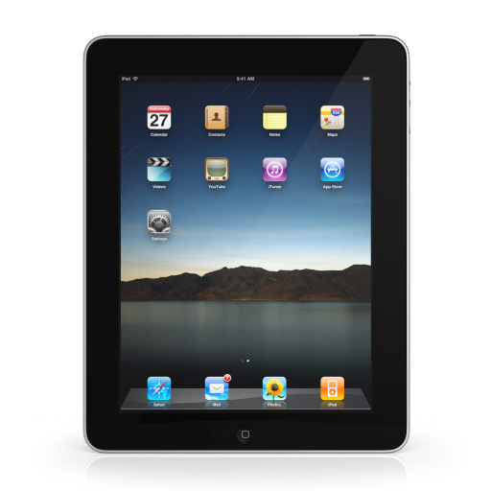
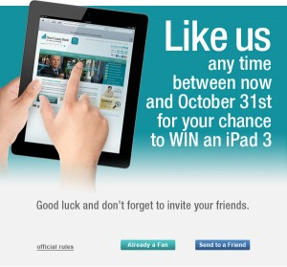
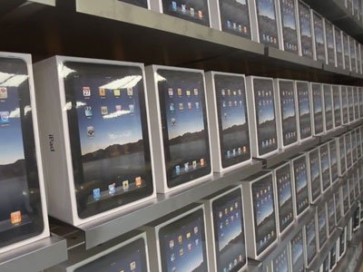
DEVELOP
↓
PROMOTE
↓
DISTRIBUTE

Slide 6
Examples of Marketing: Restaurants, Retail, Magazines, Music, Newspapers, Books, Movies, Inventions, Physical objects, etc.
Did you know…
Marketing supplies 1/3 of our nation’s jobs.
Marketing is exciting work with successful people.
Marketing provides great working and people skills.
Some of the highest paid jobs are in Marketing.

Slide 7
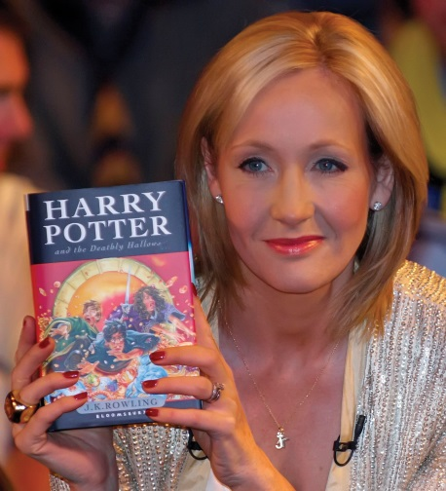
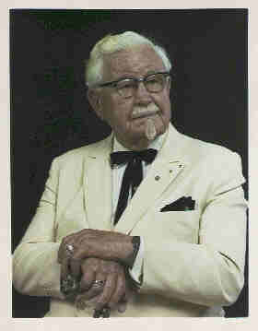
Entrepreneur
A person who starts a business and is willing to risk loss in order to make money
Sometimes you must fail before you can succeed
J.K. Rowling- nearly penniless, severely depressed, divorced, trying to raise a child on her own while attending school. She went from depending on welfare to survive to being one of the richest women in the world.
Harland David Sanders (Col. Sanders) famous secret chicken recipe was rejected 1,009 times before a restaurant accepted it.

Slide 8
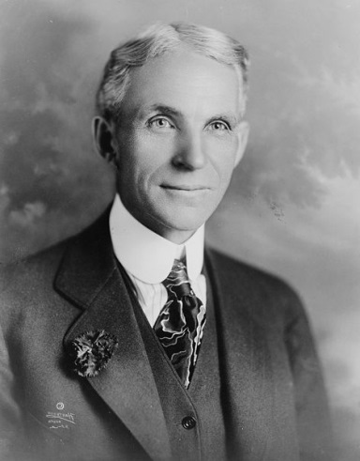
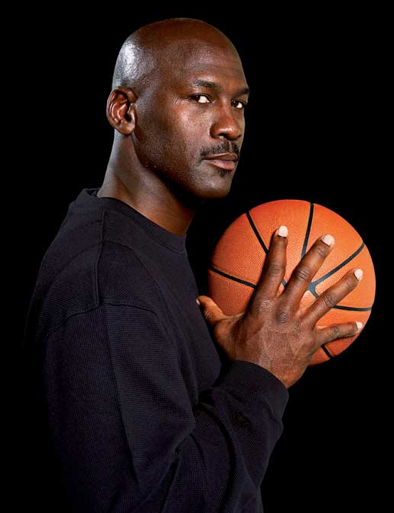
Henry Ford- Early businesses and left him broke five times before he founded the successful Ford Motor Company.
Michael Jordon- cut from his high school basketball team before being hailed as one of the greatest players ever.
"I have missed more than 9,000 shots in my career. I have lost almost 300 games. On 26 occasions I have been entrusted to take the game winning shot, and I missed. I have failed over and over and over again in my life. And that is why I succeed."

Slide 9
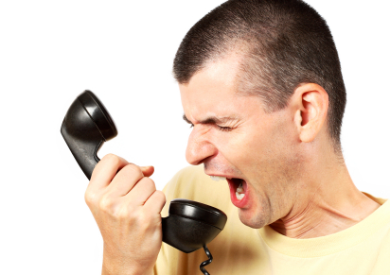
Customer Service
The process of ensuring customer satisfaction with a product or service. Customer service can take the form of an in-person interaction, a phone call, self-service systems, or by other means.

Slide 10
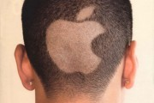
Brand Loyalty
The tendency of some consumers to continue buying the same brand of goods rather than competing brands.

Slide 11
What are the
Four P’s
of Marketing?

Slide 12
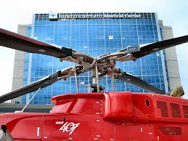
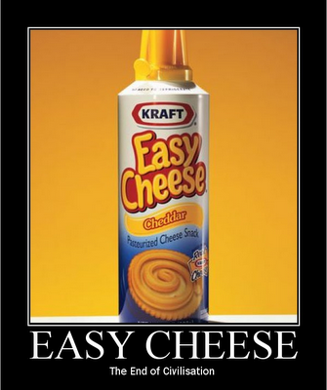
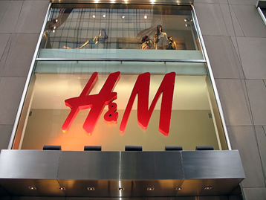
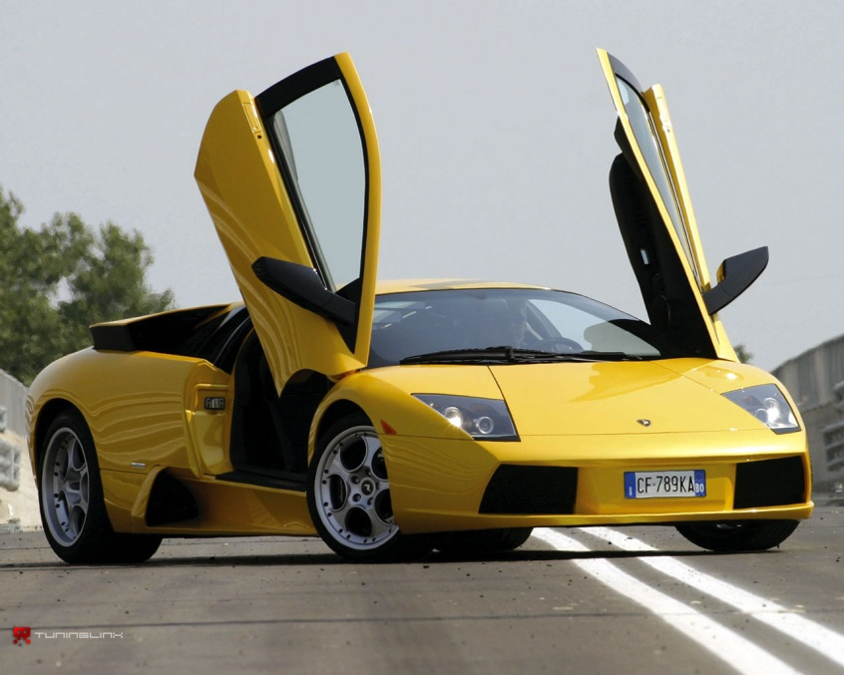
PRODUCT
►What are you selling to the customer? (goods, services, ideas)

Slide 13
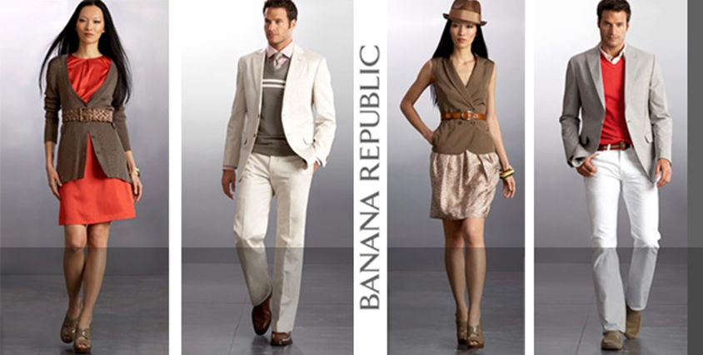
What are Products?
Goods: Car, Food, Home, and Clothes
Services: Hospital, TV Repair, Auto Mechanics, Carpet Cleaning, House Cleaning, Babysitting
Ideas: Internet, Training, Computers, Printed Materials, Inventions

Slide 14
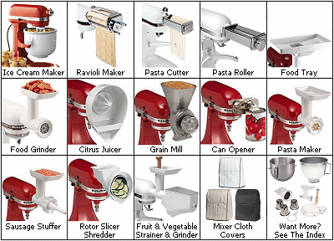
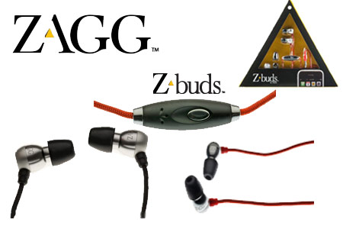

What Matters Most?
1. Features
2. Brand
3. Quality Level
4. Format/Packaging

Slide 15
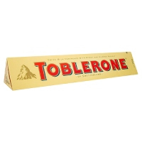
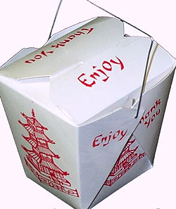
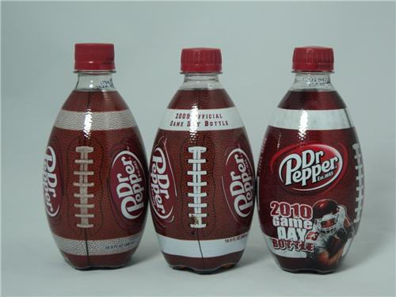
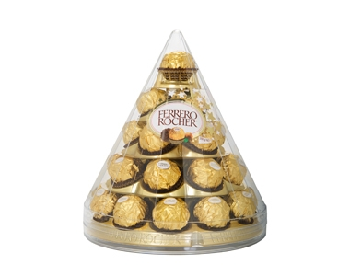
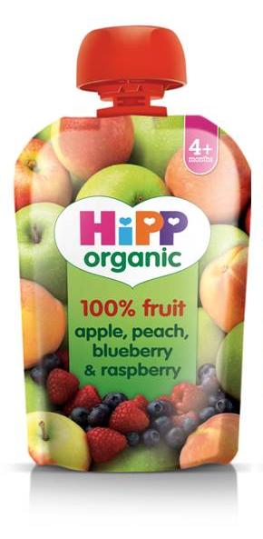
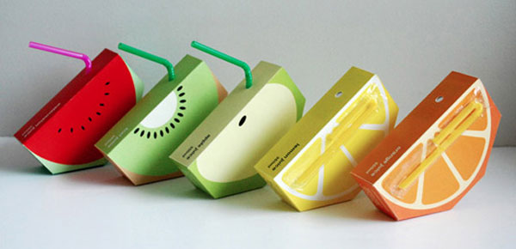
Packaging

Slide 16
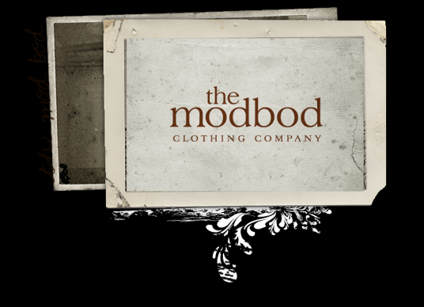
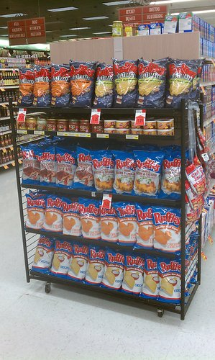
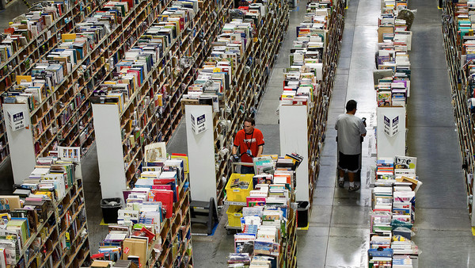
Place
Locations
Transport
Coverage
Inventory

Slide 17
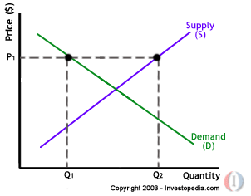

PRICE
List Price
Discounts
Allowanaces

Slide 18

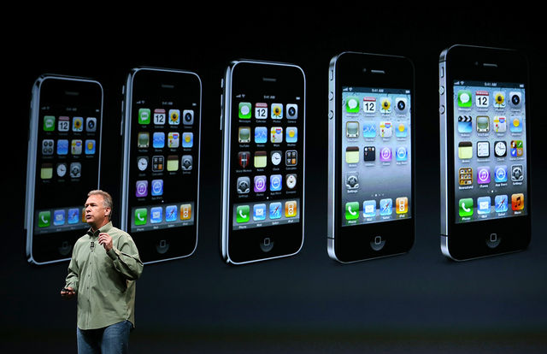
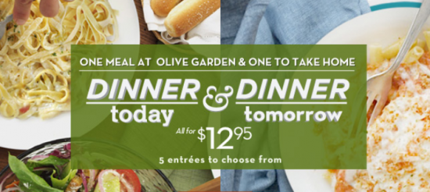
Promotion
►Advertising
Public Relations
Direct Marketing
Social Media
Events

Slide 19
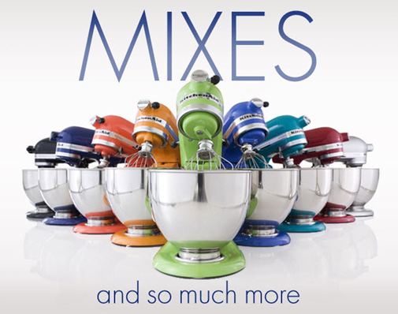
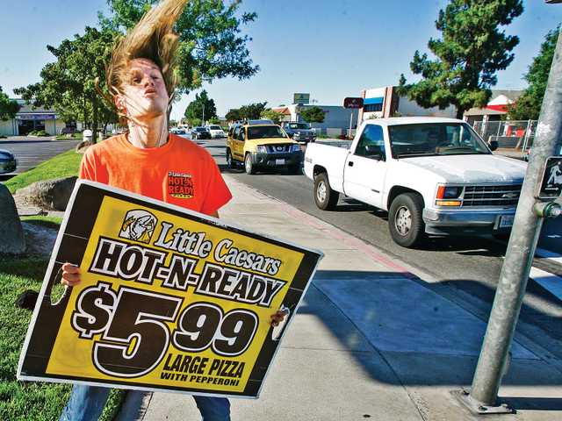
Advertising: The activity of attracting public attention to a product or business.
What are some good advertisements you have seen?

Slide 20

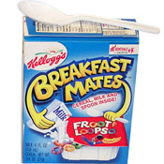
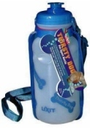
Failures
Colgate TV dinners
Breakfast Mates
Thirsty Dog
  Why fail? …infuse the water with flavors like
  crispy beef (for dogs) and tangy fish (for cats).

Slide 21
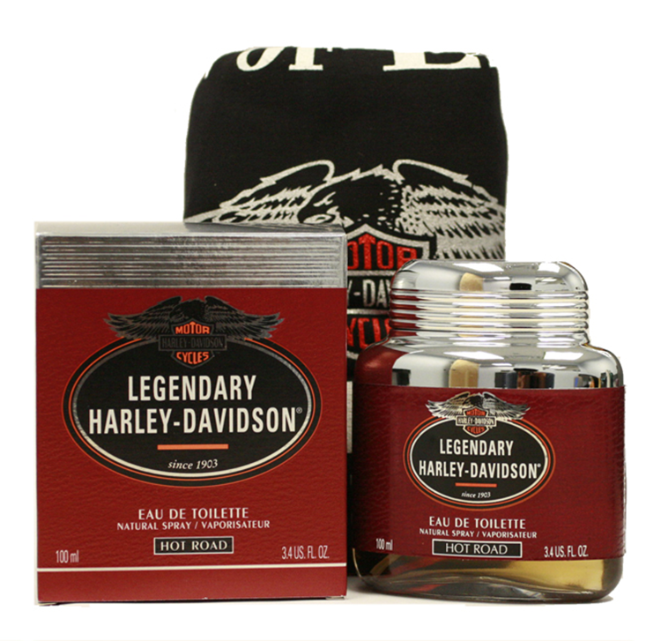
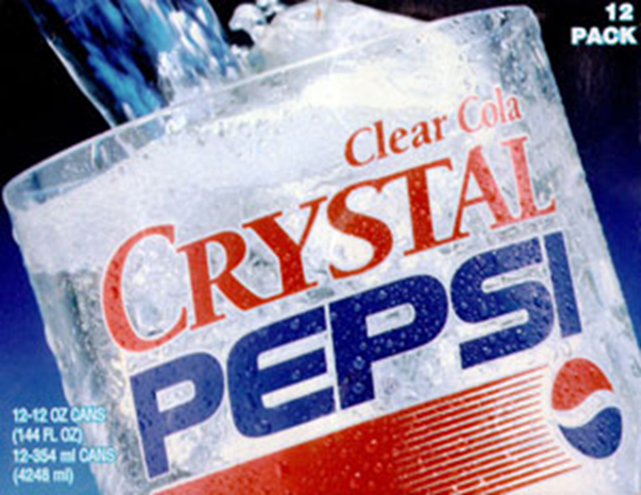
Failures
Harley Davidson Cologne
Crystal Pepsi

