Slide 1
FCCLA
FCCLA is here to help members, like yourself, travel beyond their limits. Joining FCCLA will broaden your creative thinking, allow you to experience leadership, participate in community service, build life skills, and create new friendships.

Slide 2

What does FCCLA stand for?
Family, Career and Community Leaders of America

Slide 3

What is the name of the National Outreach Program?
The Lead2Feed student leadership program is the nation’s leading and fastest growing free service learning program, attracting more than a million students in 3,500 schools and clubs across all 50 states.
This free service learning program nurtures a new generation of leaders while working to end local and global hunger.
Check out more at lead2feed.org

Slide 4

How many National Executive Council Members (National Officers) are there?
There are 10 National officers

Slide 5
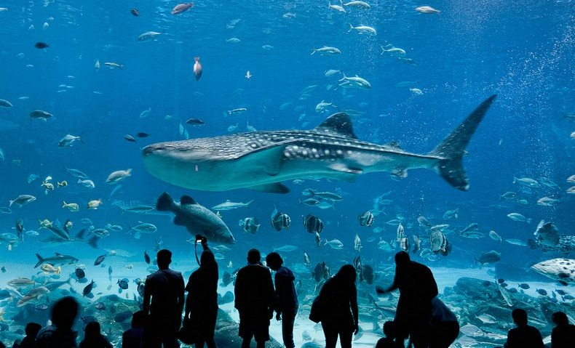
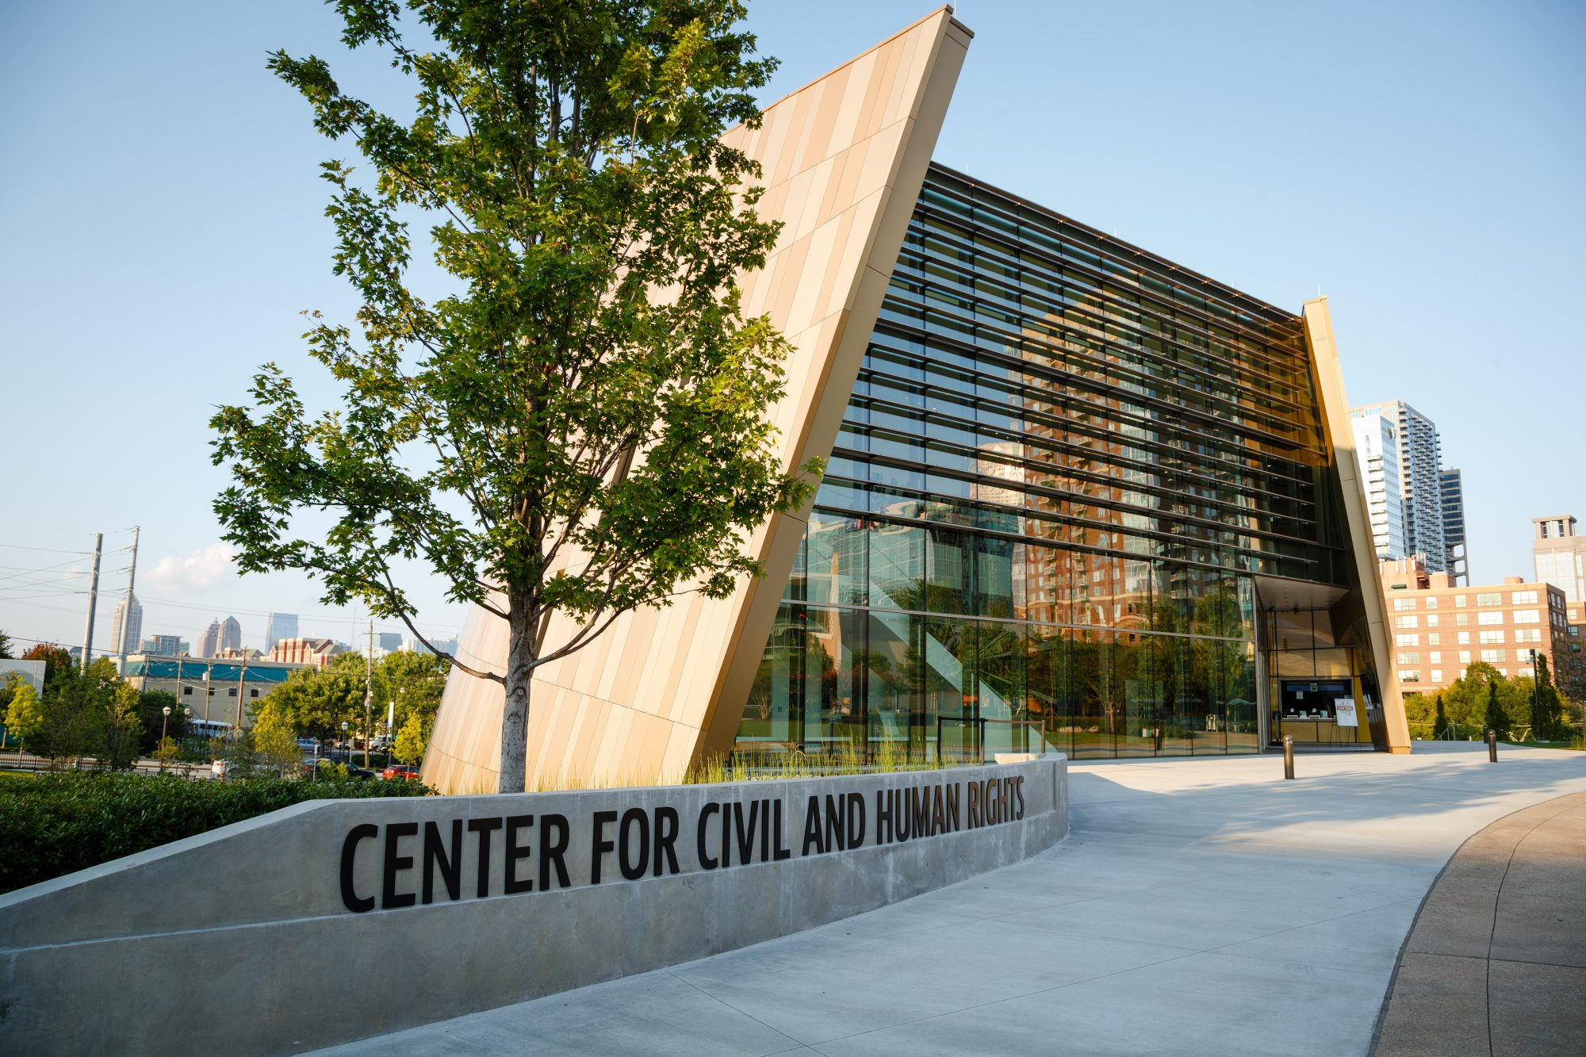
Where is the next National Leadership Conference?
Atlanta, Georgia
Georgia Aquarium
Center for Civil and Human Rights

Slide 6
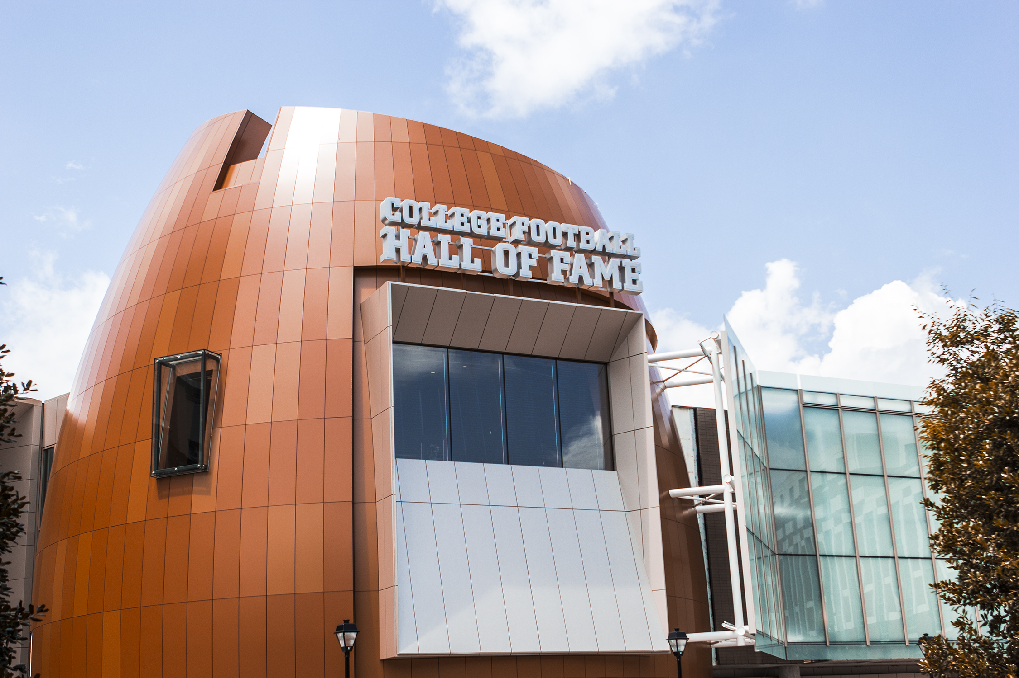

Atlanta Highlights
College Football Hall of Fame
World of Coca-Cola

Slide 7

What is the Families First Program?
Families First is a National peer education program. Its goals are to:
  (1) help youth become strong family members & leaders for today & tomorrow.
  (2) strengthen the family as the basic unit of society.

Slide 8

What is FACTS?
  FACTS is a National peer education program where students strive to save lives educating adults & youth about traffic safety.
  Its an acronym for Families Acting for Community Traffic Safety
    Think SMART — Keep youth from driving when under the influence of alcohol & drugs.
    Buckle UP — Promote safe use of seat belts, child safety seats, booster seats & air bags.
    Arrive Alive — Educate safe driving habits & not texting while driving.
    Speak Up — Empower teens to speak up for their own safety.
    Bridge the Gap — Encourage conversation & training for parents of teens to work together for their traffic safety.

Slide 9

Define Financial Fitness?
Financial Fitness is a National peer education program involving youth to teach one another how to make, save & spend money wisely.
    Banking Basics - Conquer bank accounts, credit & investments
    Cash Control – Track & plan personal spending
    Making Money - Sharpen on-the-job financial fitness
    Consumer Clout - Become a savvy spender
    Financing Your Future - Apply financial skills to real life.

Slide 10

Describe the Power of One? List its five Units?
Power of One helps students find & use their personal power to set their own goals, work to achieve them & enjoy the results.
  A Better You — Improve your personal traits
  Family Ties — Get along better with family members
  Working on Working — Explore work options, prepare for a career, or sharpen skills useful in business
  Take the Lead — Develop leadership qualities
  Speak Out for FCCLA — Tell others about positive experiences in FCCLA.

Slide 11

Describe the FCCLA Leadership Service in Action Program?
The FCCLA Leadership Service in Action program guides students to develop, plan, carry out & evaluate projects that improve the quality of life in their communities.
Leadership Service in Action helps young people build skills for family, career & community roles; provides youth-centered learning & encourages young people to develop positive character traits of trustworthiness, respect, responsibility, fairness, caring & citizenship.

Slide 12

Describe Student Body? List the three Student Body Units?
Student Body is a National peer education program helping young people to establish healthy attitudes & habits to last a lifetime. The four unit areas include:
  The Healthy You— Empowering teens to make wise food and lifestyle choices
  The Fit You— Empowering teens to take charge of their health and their level of fitness
  The Real You— Empowering teens to maintain positive mental health
  The Resilient You-Empowering teens to live in ways that build emotional health

Slide 13

Describe Career Connection?
Career Connection is a National program which guides youth to link their options, look at career pathways & their skills to build success in their families, careers & communities by— discovering their strengths, targeting career goals & initiating a plan for achieving the lifestyle they desire.

Slide 14

What does STOP (in STOP the Violence) stand for?
Students’ Taking On Prevention (STOP) the Violence empowers youth with attitudes, skills & resources in order to recognize, report & reduce youth violence. Whether it is fighting, making threats, or bullying, violence is a concern.
  FCCLA members use peer education to:
    Reach their peers with violence prevention education
    Recognize warning signs of potential youth violence
    Encourage young people to report troubling behavior
    Collaborate with the school & community to address youth violence
    Develop & implement an a project to reduce potential violence in their school.

Slide 15

What does STAR (in STAR Events) stand for?
Students Taking Action with Recognition
  Star Events are competitive events where members are recognized for achievement in chapter & individual projects, leadership skills, & career preparation. STAR Event participants learn through the following activities:
  cooperative – a team works to accomplish specific goals
  individualized – an individual member works alone to accomplish specific goals
  competitive – individual or team performance is measured by an established set of criteria.

Slide 16


What is the current Membership Campaign & name the three “R’s”?
The 2017-2018 Membership Campaign is:
The three “R’s” to Membership is:
    Recruit
    Retain
    Recognize

Slide 17

State Theme 2017-18

Slide 18

How many chapters & members have joined FCCLA Nationally?
Nearly 6,000 Chapters & 200,000 members have joined FCCLA in the 50 United States, Puerto Rico & the Virgin Islands.
The organization has involved more than 10 million people since its founding in 1945.

Slide 19
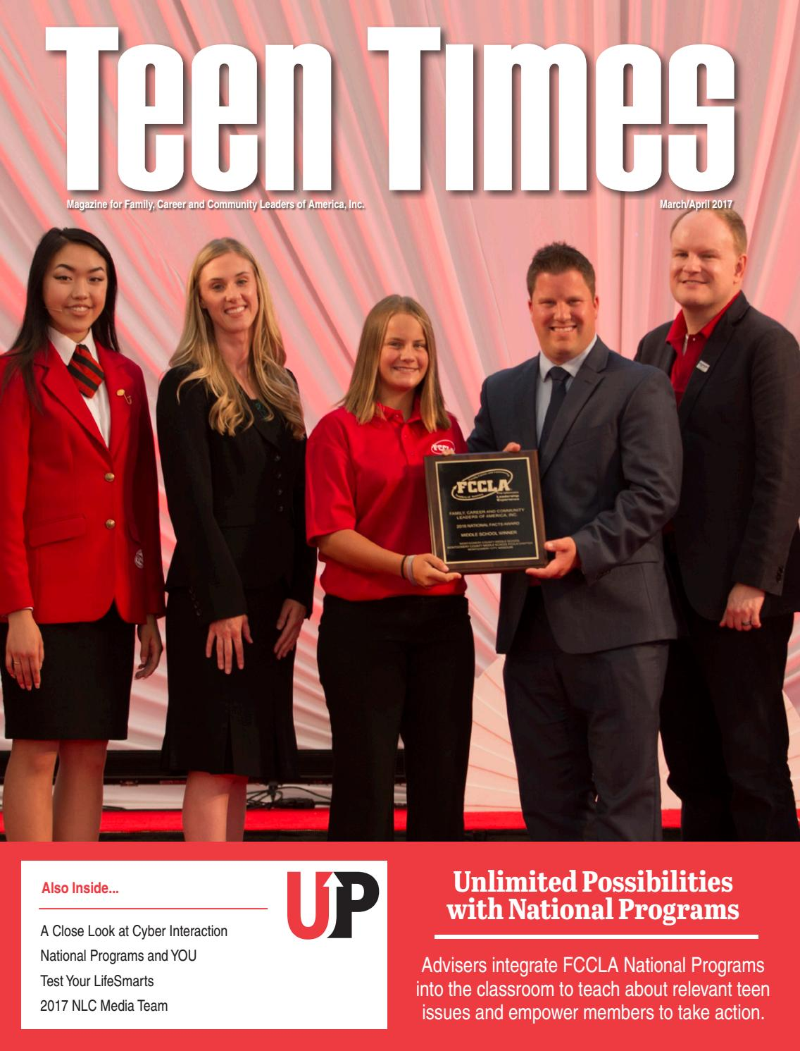
What is the official magazine for FCCLA?
Teen Times
Now available online

Slide 20

When is National FCCLA Week?
FEBRUARY 12-17, 2018

Slide 21
Watch for meeting times and
“Reach for the Stars!”

