Slide 1


Slide 2
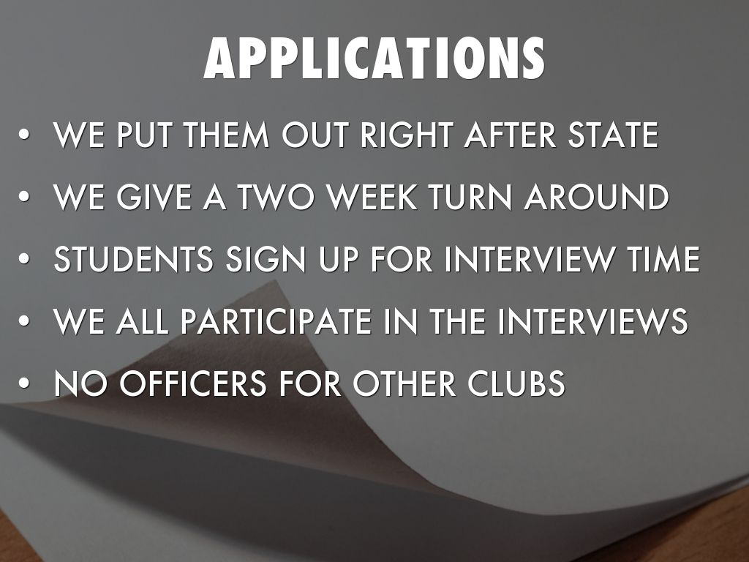
Photo by Neal. - Creative Commons Attribution License https://www.flickr.com/photos/31878512@N06
Created with Haiku Deck

Slide 3


Slide 4
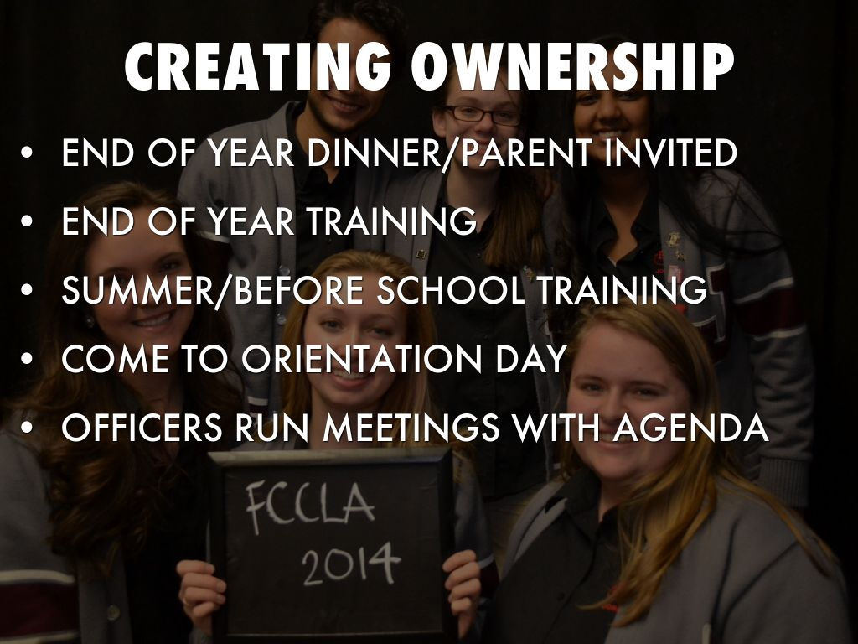

Slide 5
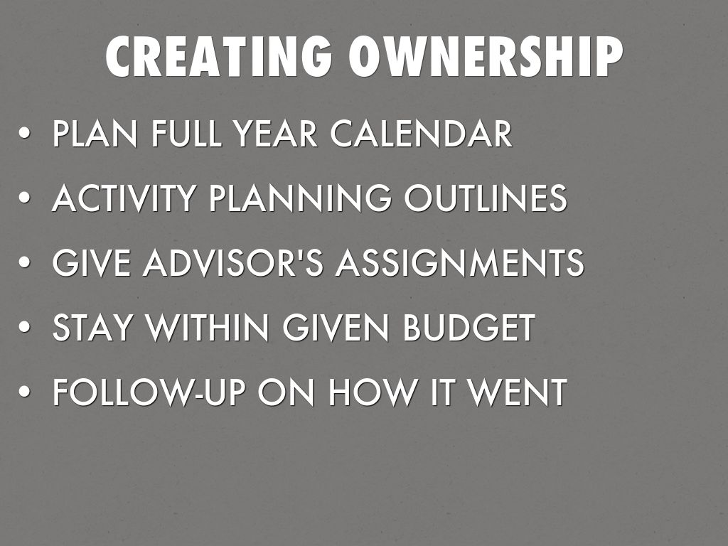

Slide 6


Slide 7
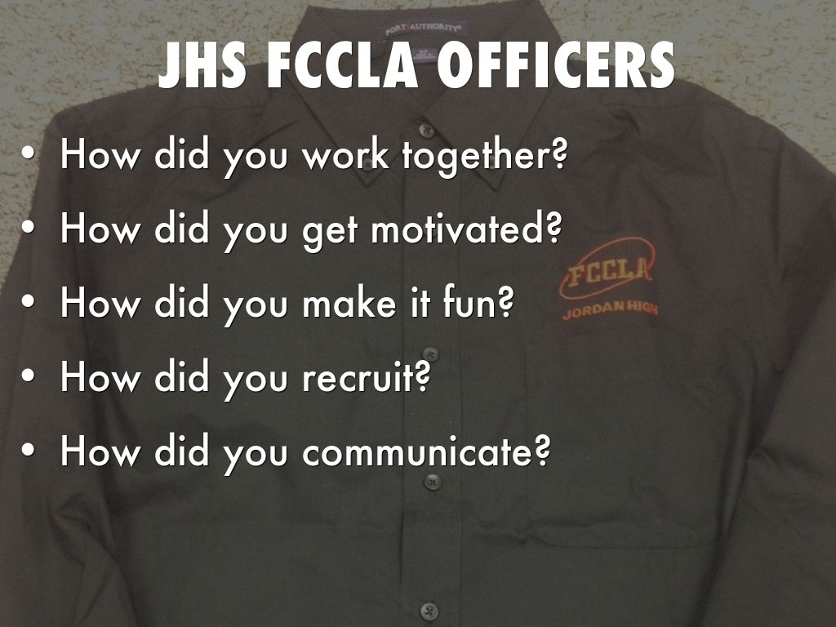

Slide 8
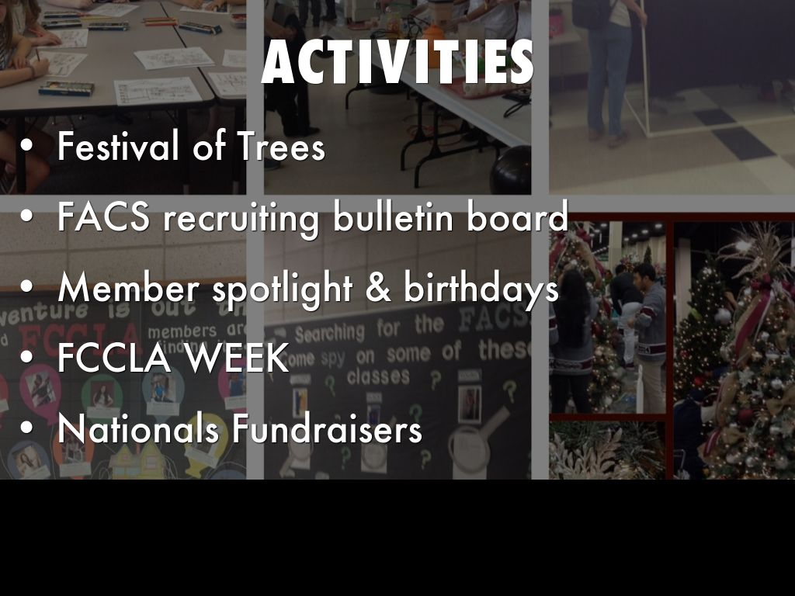

Slide 9

Photo by Silly Little Man - Creative Commons Attribution-NonCommercial License https://www.flickr.com/photos/44036847@N05
Created with Haiku Deck

Slide 10

Photo by Leo Reynolds - Creative Commons Attribution-NonCommercial-ShareAlike License https://www.flickr.com/photos/49968232@N00
Created with Haiku Deck

