Slide 1
SIMPLE DIGITAL PORTFOLIOS
By Jen King

Slide 3
fashion merchandising portfolio
By Mrs. King

Slide 4
Create your Portfolio
Title: “Fashion Merchandising Portfolio-Your Name”
Share: Jennifer.king@jordandistrict.org
Choose theme:
Premade templates
Blank & create your own template
Title Page:
Fashion Merchandising Portfolio
By Your Name

Slide 5
Pic inspiration
USE PINTEREST!
Great, inspiring, current pictures
Create a board for fashion merchandising
Please send me a link to this board!
May use phone WHEN I SAY to use pinterest to find pictures
Save pic to phone then email to your school email to copy to your portfolio

Slide 6
Editing Tips
Add borders
Cropping pics
Layering & Order pics

Slide 7
my style assignment
Due February 4th

Slide 8
My Style
Title each slide “My Style”
15-20+ pics of your style, clothes, accessories, jewelry, style icons, fav stores, hair, makeup, quotes, etc…
Should ADEQUATELY show your style (not all summer or winter clothes...
Arrange so it draws people in (Madewell vs Ross)

Slide 9
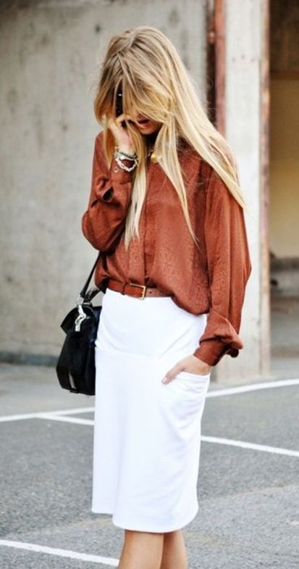
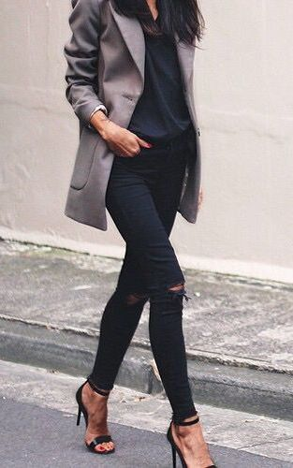
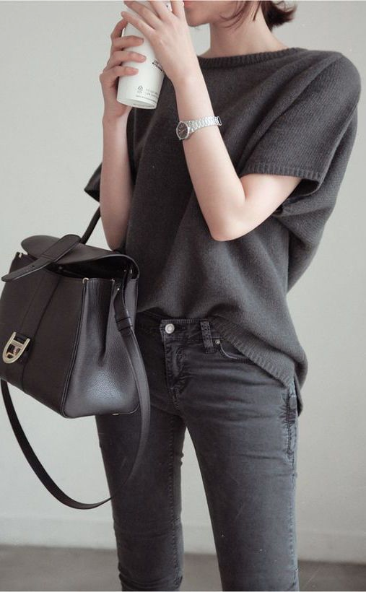
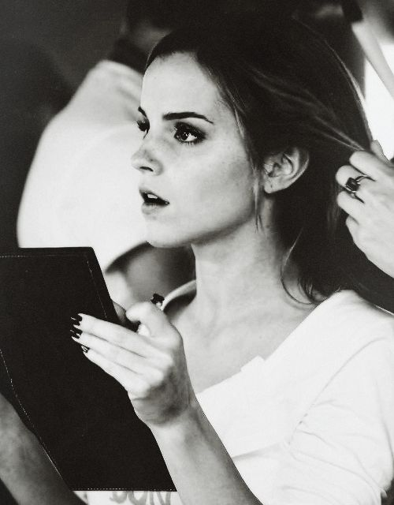
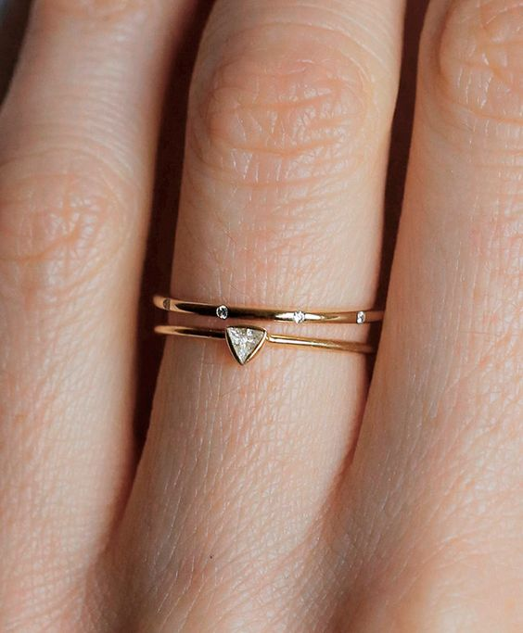
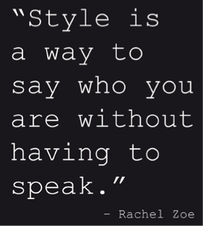
My Style

Slide 10
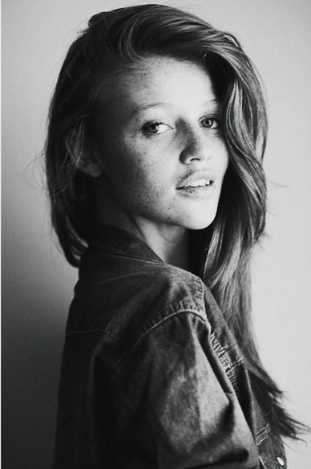
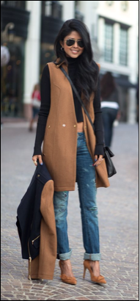
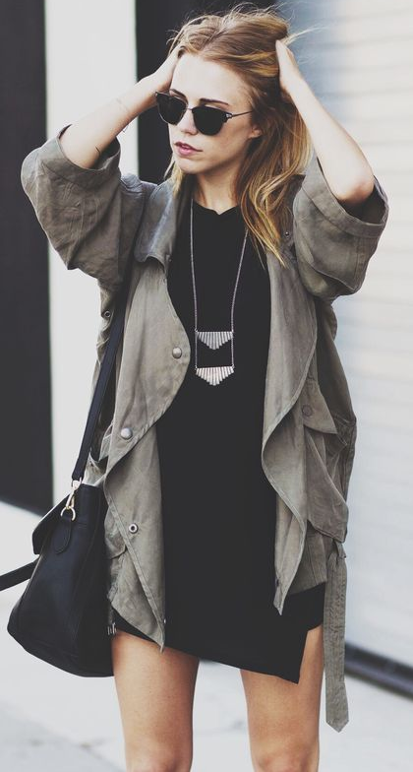
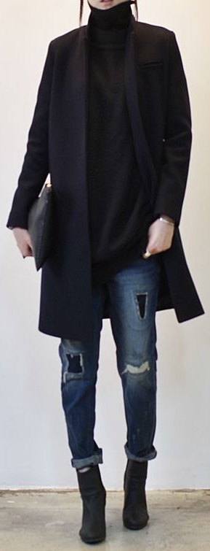
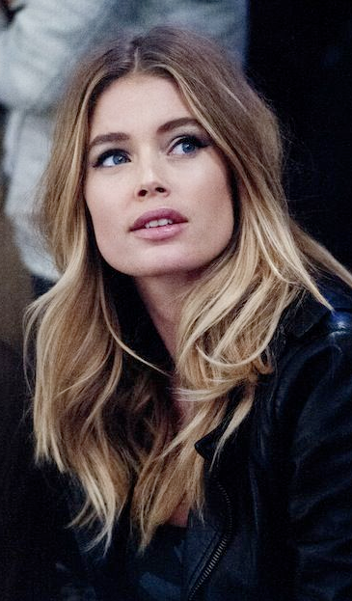
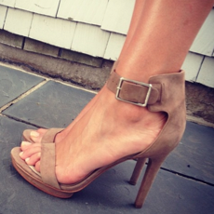
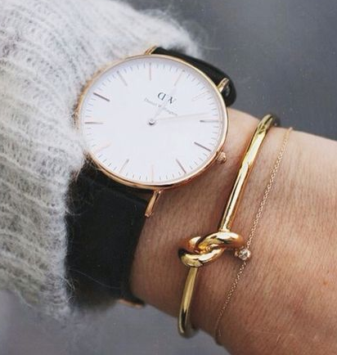
My Style

Slide 11
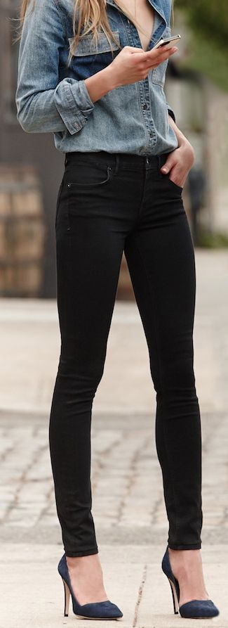
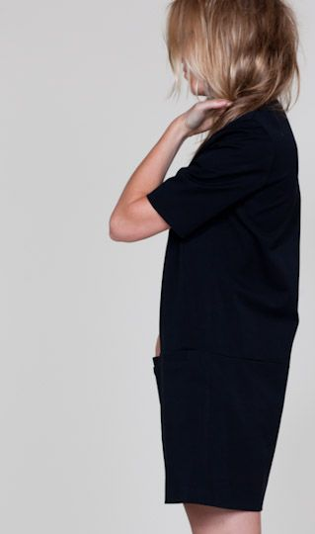
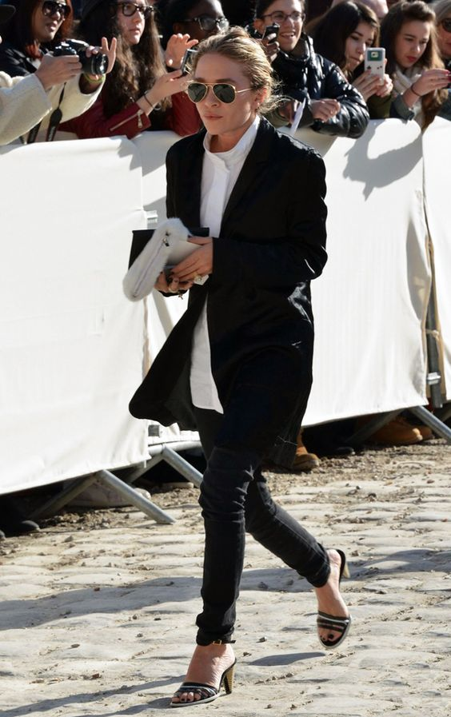
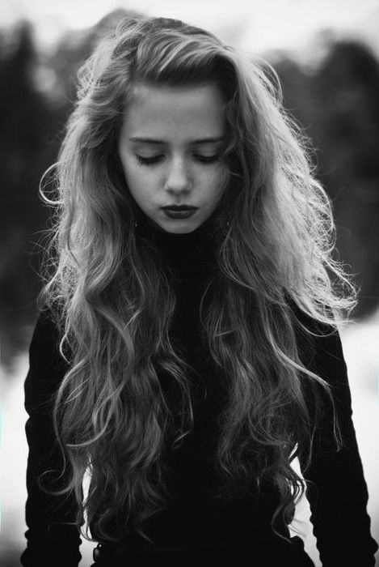
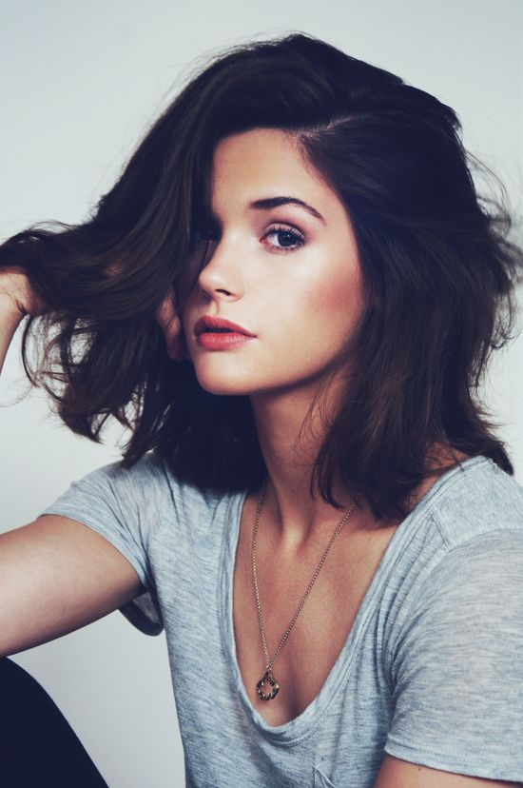
My Style

Slide 12
Fashion Terminology
Due February 10

Slide 13
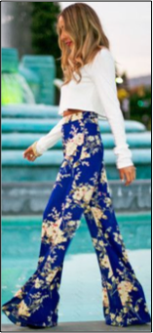
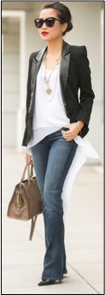
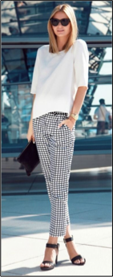
Garment type-Pants
Cigarette
Palazzo
Boot Cut
Jogger
Trouser

Slide 14
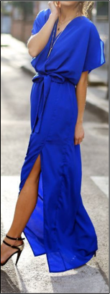
Draped
Dress

Slide 15
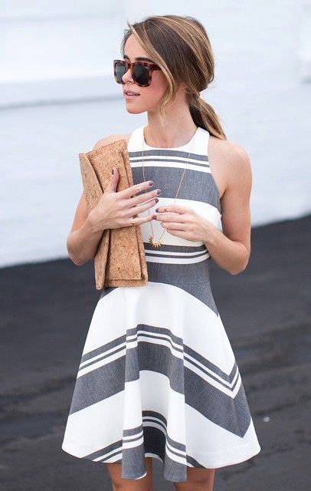
Tailored
Dress

Slide 16
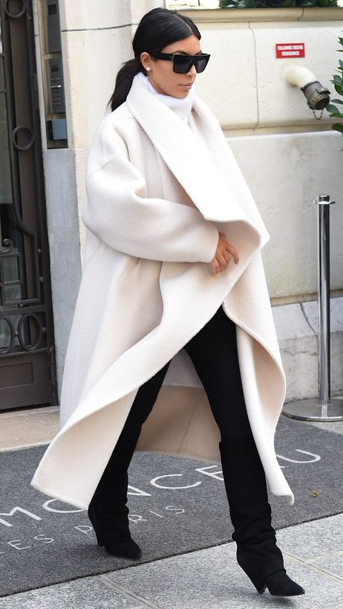
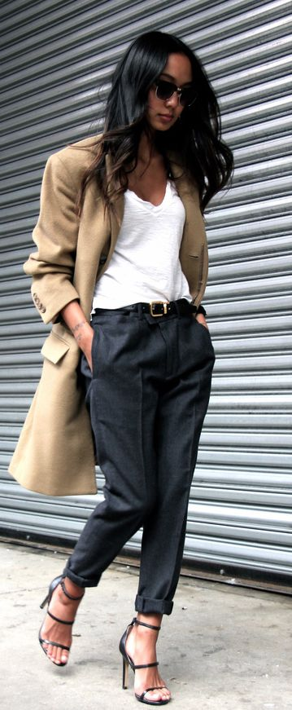
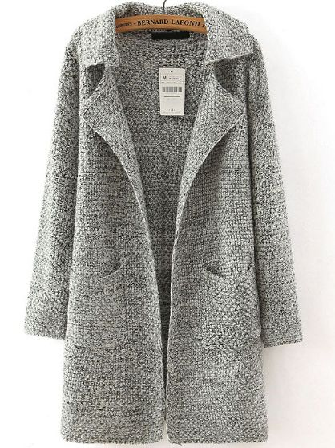
TRENDING
Long drapey jackets

Slide 17
Fad
Blanket Scarf

Slide 18
classic
Pencil Skirt

Slide 19
Wardrobe tips
How to have a great, complete,
& organized wardrobe
Due February 12

Slide 20
Wardrobe Tips
Imagine you write for Buzzfeed, ___ or a blog. Write an article with 5 ways to develop a great, complete & organized wardrobe
Do some research & write to an audience
Think Buzzfeed/Blog article, the kind of thing that if you found it on Pinterest you’d click on it & pin!

Slide 21
Wardrobe Tips
Title your “Article”
Come up with 5 tips (in your own words, no plagerizing)
Each tip should have a picture or gif
Works cited page (at least 4 sources)

Slide 22
5 tips for an enviable wardrobe

Slide 23
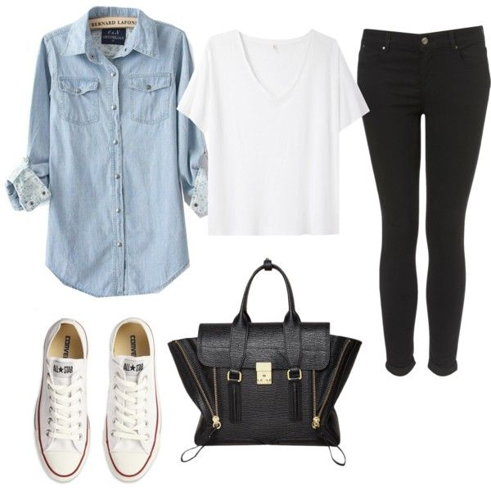
1. Define your style
Easiest way to create a vision board is definitely pinterest! Take some time to define your ideal style.
Once you have a vision for where you want to go with your style, you’ll have a reference to keep in mind every time you find yourself getting stumped on the other steps!

Slide 24
2. Clear out & Take Inventory
Now that you know exactly what you want out of your wardrobe it’s time to see what you have in your wardrobe! Pull everything out of your closet and make decisions based on 2 criteria:
Does this align with your wardrobe vision?
Does this spark joy?
If you haven’t read “The Life-Changing Magic of Tidying Up: The Japanese Art of Decluttering & Organizing” by Marie Kondo, well you better do it soon. The KonMari method is a game changer to say the least. But here is the big take away: if it doesn’t bring you joy GET RID OF IT!

Slide 25
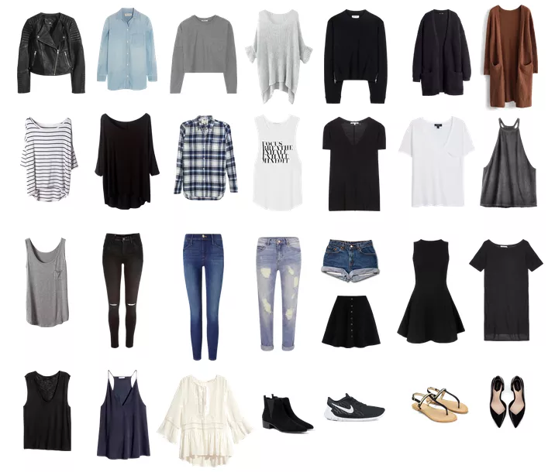
3. Make a Shopping List
Ok, what’s left in your closet is stuff that brings you joy. Awesome.
Chances are you just realized that you don’t have some pretty important basics. There are probably some beautiful things on that vision board you’re dying for also.
Before you run off to the store though, make a detail list. So you need a black dress - what details should it have? Long or short sleeve? Above the knee or maxi? Know what you’re looking for so you don’t walk away more crap!

Slide 26
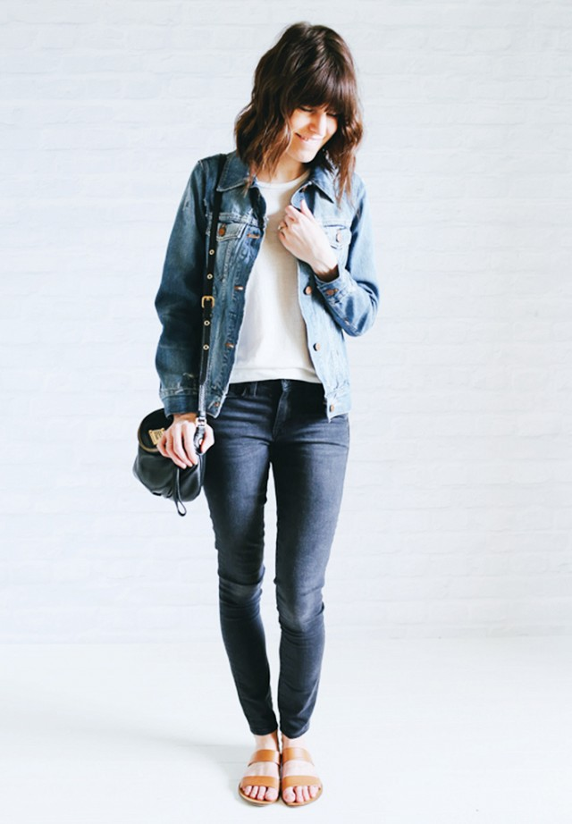
4. Shop!
Alright, you have your vision board, you’ve decluttered your closet and you found the holes in your wardrobe.
NOW you can shop!
Make sure you invest a little into the classic pieces on your list like a little black dress. Also, continue to ask yourself that ever-appropriate KonMari question, “Does this spark joy???”

Slide 27
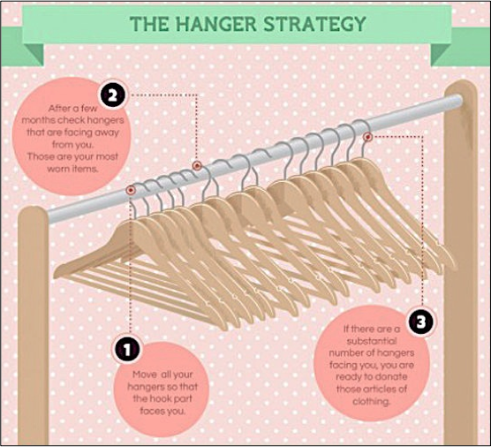
5. keep the clutter at bay
There may be a few items still lurking in your closet that you think you’ll wear or you’ve promised yourself you’d find a way to wear but, well, you just won’t. Use the hanger-flip trick to weed out these lingering buggers & convince yourself once & for all to get rid of them!

Slide 28
Works Cited
http://www.in-dependent.org/blog/updateonabudget
http://theblissfulmind.com/2015/03/23/creating-a-capsule-wardrobe/
“The Life-Changing Magic of Tidying Up: The Japanese Art of Decluttering & Organizing” -Marie Kondo
http://www.buzzfeed.com/alessiasantoro/my-closet-overfloweth-with-ill-fitting-shit?utm_term=.umboB84Jk
http://lifegoalsmag.com/minimalist-wardrobe-checklist/

Slide 29
World & U.S.
Fashion Capitals

Slide 30
Find Info & Pics for the following cities
WORLD CAPITALS:
Paris, France
Milan, Italy
London, England
Tokyo, Japan
U.S. CAPITALS
New York, NY
Los Angeles, CA
Miami, FL
Chicago, IL

Slide 31
Each slide should include:
2-3 items of interesting information about that capital
Style or look city/designers known for
Designers from that city
Popular shopping sites
Other interesting FASHION facts about that city
Pictures
City
Common Street Fashion

Slide 32
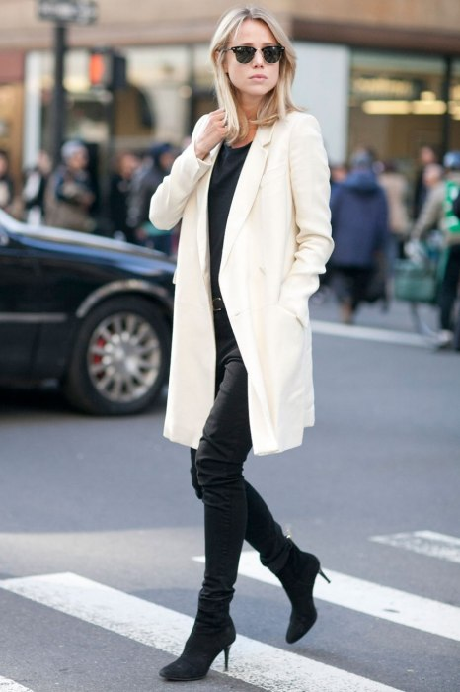
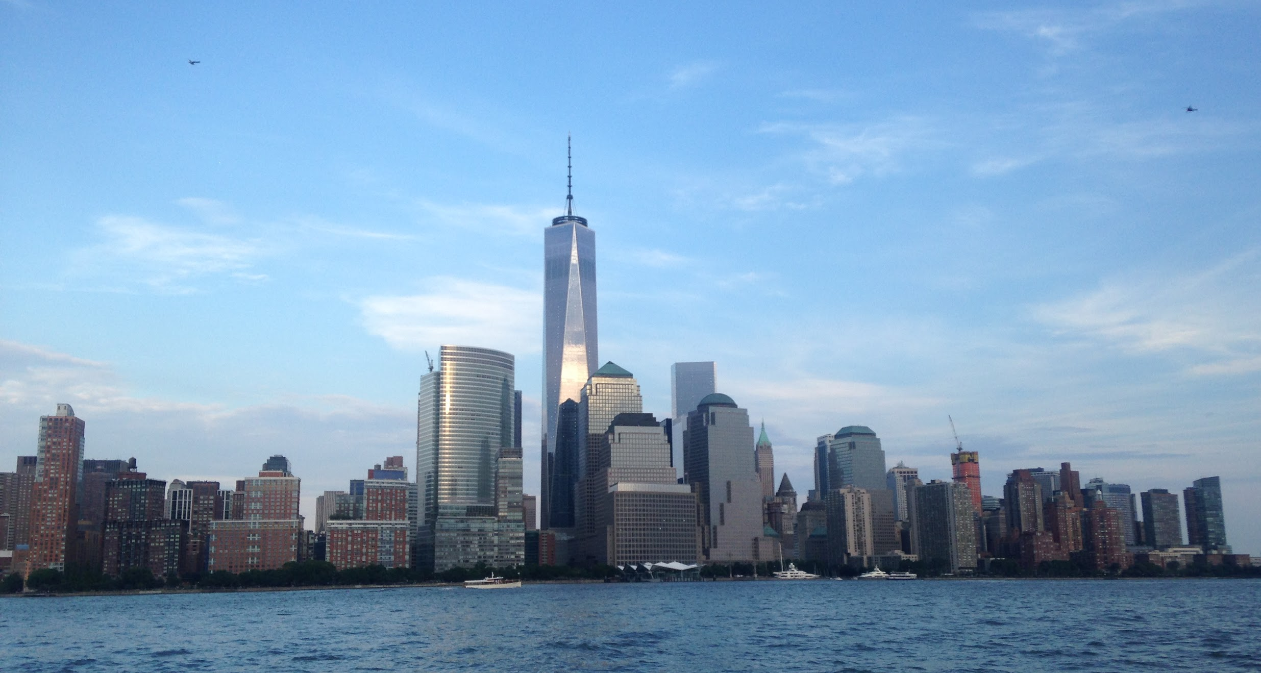
New York, NY
Interesting Fact #1
Interesting Fact #2

Slide 33
Designer Presentation
Instructions for your presentation

Slide 34
By Mrs. King

Slide 35
About the Designer
Background: 1-2 Slides
Birthdate & Age (Alive or Dead)
Where From (City, Country)
Education
How they got started in fashion
Any awards or honors
Picture of the Designer

Slide 36
About Monique Lhuillier
September 15, 1971 (age 44)
Cebu, Philippines
Fashion Institute of Design & Merchandising
Mother modeled & worked as a seamstress
Started designing a bridal collection when she couldn’t find her own gown.
Member of CFDA since 2003

Slide 37
Target Market
1. Who did they design for?
Gender
Age
Socioeconomic status ($$$)
Clothing price point
2. Advertisement (for targeting market)

Slide 38
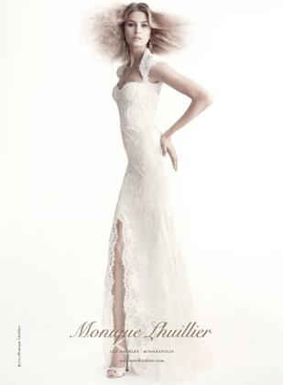
Target Market
A-List Women in their late 20’s-early 60’s
Price Point:
Evening dresses average between $2,000-$7,000
Daywear retails in the range of $250-$750
Notes:
http://www.prweek.com/article/1262239/fashion-forward

Slide 39
Key Contributions
1. Look/style/collection they are know for designing
Include at least 2 pictures
HINT: Use the answer given to you!!

Slide 40
Key Contributions
Known for her Bridal Gowns

Slide 41
Types of Merchandise & Where Sold
1. What kind of merchandise do they sell?
Men’s, women’s, children’s apparel?
Specific kind of apparel? Couture, Ready-to-Wear, etc
Accessories
Home goods
2. Where is the designers merchandise sold?
Department stores
Flagship stores
Boutiques
Fashion House
Couture House
3. Picture of the store front

Slide 42
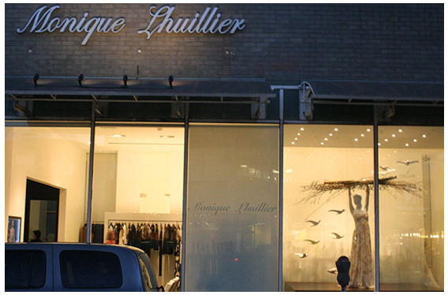
Shopping Lhuillier
Began designing her first bridal collection in 1996
She has a Couture Fashion House in Los Angeles, CA & Upper East Side in Manhattan.
Also sells formal gowns, ready-to-wear, & home goods at Neiman Marcus, Nordstrom & other high-end department stores

Slide 43
What Do You Think?
1. What is your opinion of this designer and their designs?
Give & informed opinion with a thorough analysis of what you have seen from them in the past and through your research
If you say just “I Like their stuff” or something equally unspecific & lame I’ll give you a zero on the whole thing. I’m not kidding. Really though. REALLY.
2. Another Picture

Slide 44
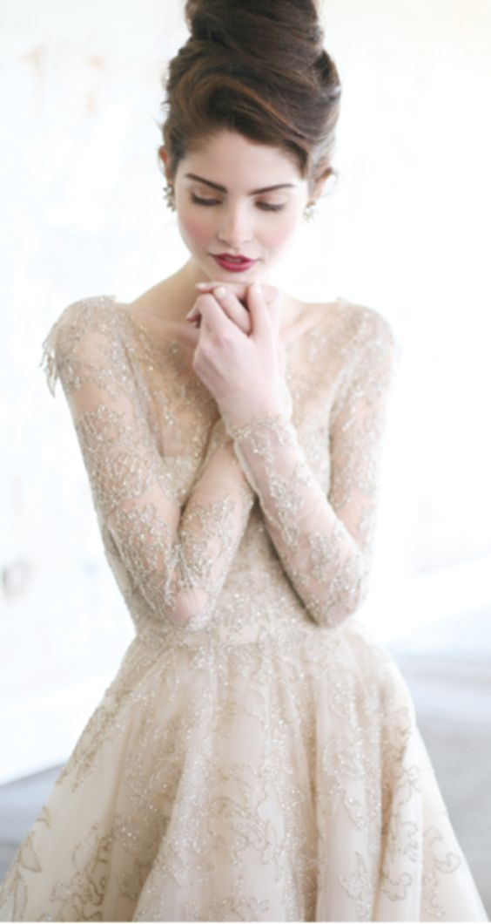
My Opinion
I am really impressed with Monique Lhuillier:
High quality construction and materials
Attention to detail
Love the delicate aesthetic
Also, I love her story - I can (kind of) relate

Slide 45
Works Cited
List all websites used!

Slide 46
OTHER IMPORTANT TIPS
Other Tips for a good grade:
Use the correct name pronunciation
At least one picture per slide
5-7 minutes
Short statements, not paragraphs
Visually Pleasing & Organized
Don’t read off of the screen, LOOK AT THE AUDIENCE
Tell stories
Make it interesting!!!!!!!!!!! Please don’t bore us!

Slide 47
The Fashion Cycle & Trends

Slide 48
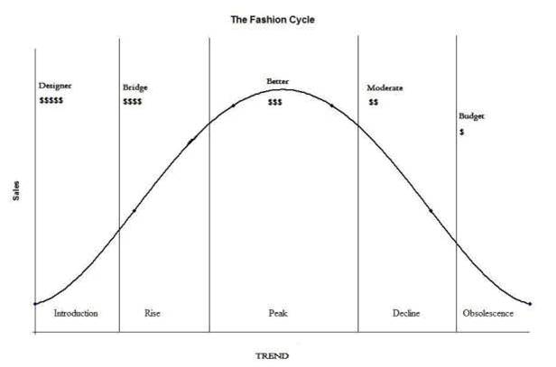
The Fashion Cycle
Please include a picture of the fashion cycle including the CORRECT STAGES
Introduction
Rise
Peak
Decline
Obsolete
HINT-
Google: Fashion Cycle Pictures

Slide 49
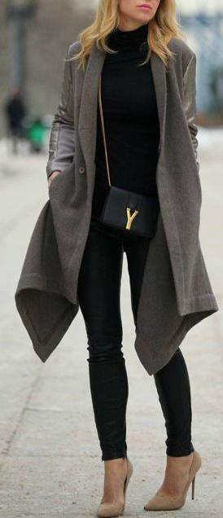
Summer/Fall 2015 Trends
What were you wearing when school started?
BE SPECIFIC.
List 3 Trends w/ PICTURE of EACH & LABELS
(different then your trend slide from fashion terminology)
Long, Loose Wool Coats

Slide 50
Spring 2016 Trends
When you shop for Spring what will you buy? What are other people wearing for spring time?
BE SPECIFIC.
List 2 new Spring trends, include pics and label
Gingham Check

Slide 51
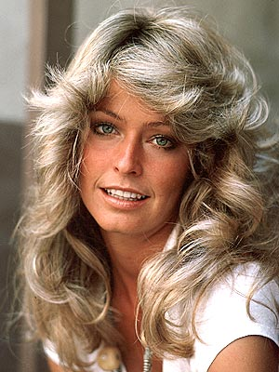
Fall 2016 Trends
PREDICT! What do you think people will be wearing the first day of school next year?
BE SPECIFIC.
List atleast 1 thing you think will be trending next fall PLUS pictures! (List a 2nd for 5 points extra credit!)
“Farrah Hair”

Slide 52
What Not To Wear
Applying the Elements & Principles of Design

Slide 53
Meet your Clients
You will be assigned 2 clients-It will be your job to help them look their best!
As part of the Client profile you’ll learn some information about them, not only what they look like but also what they feel confident and insecure about, and some other things that you’ll need to take into consideration
REMEMBER:: You are NOT the client do not dress them strictly how you would dress. Keep in mind their personality & lifestyle.

Slide 54
Include Client Profile & Pic
Please also include the picture of your client and their client profile (copy & paste) on the slide before your outfit suggestions & explanations
See “WHAT NOT TO WEAR - CLIENT PROFILES” (Shared with you)

Slide 55
Help Them Out
You’re job will be to help these clients look and feel their very best.
Find or Create 2 outfits that would be flattering on your client. You may consider doing a casual outfit & a Work outfit. Other occasion outfits may be appropriate as well (Date, Lunch With Friends, Interview, etc)
Color Season Reference: http://outfitideas4you.com/what-season-am-i-seasonal-color-analysis-quiz/
Teach your client why that outfit works. Use the Elements & Principles of Design to Validate your outfit suggestions. Reference at least 2 Elements & 2 Principles in your explanation.

Slide 56
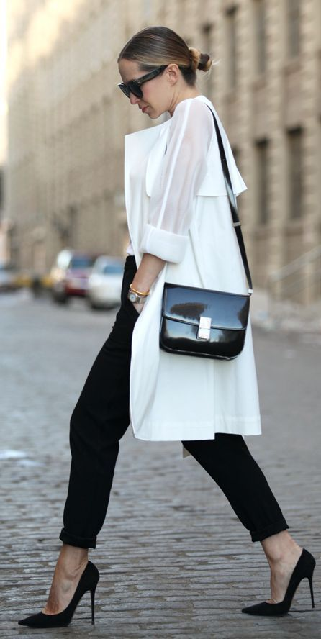
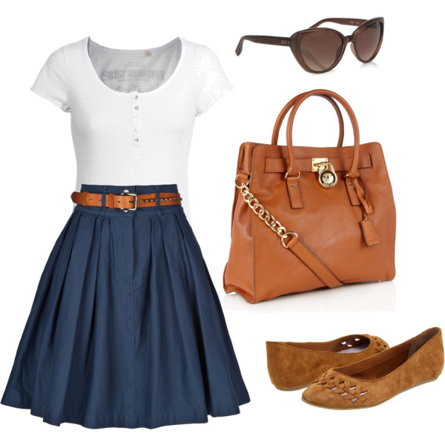
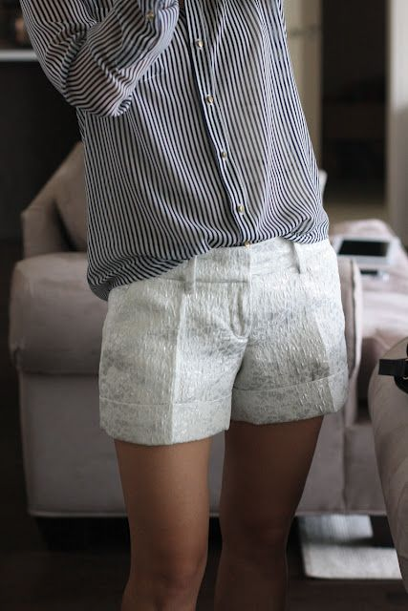
Outfits
YES
1. FIND Outfits in all the usual ways (pinterest, google, etc)
-Please include pictures that show a standing, face-forward view of the entire model including the shoes. We need to see exactly what all of the parts of the outfit are doing to the body
2. CREATE figure flattering outfit on Polyvore.com
-Please include top & bottom, coats or jackets as needed, accessories & shoes. Arrange to be visually pleasing
NO
NO

Slide 57
WHAT NOT TO WEAR
Applying the Elements & Principles of Design

Slide 58
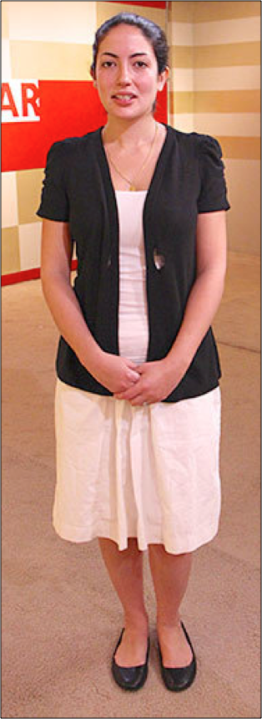
CLIENT PROFILE #1
KATHERINE
Age 23
Hazel Eyes
Dark Brown Hair
Cool Undertone
Triangle Body type
Confident: Collarbone, Long hair, Thin Arms
Not-So-Confident: Wide hips & belly
Illusion Wish List: Long Legs
Shy but would like to look more confident without being too bold.
Works as a Paralegal at a law firm
Favorite Color to Wear: Grey
Won’t Wear: Red

Slide 59
CLIENT PROFILE #1
KATHERINE
THE WORK OUTFIT
Something like this outfit would be a great option for Katherine. It projects tailored confidence without being too bold for her shy personality.
The because the pants & shirt are the SAME COLOR, a long slender silhouette is created through her legs, hips and torso.
The EMPHASIS in this outfit is certainly the blazer with a high collar. This leads the eye to the upper body and face.
The blazer has a lightly padded shoulder creating a HORIZONTAL LINE. This will slightly widen her shoulders & balance out her hip width.
This outfit is perfect for a young professional with its SYMMETRICAL, formal design.

Slide 60
Store Segmentation
A Progressive Assignment :)

Slide 61
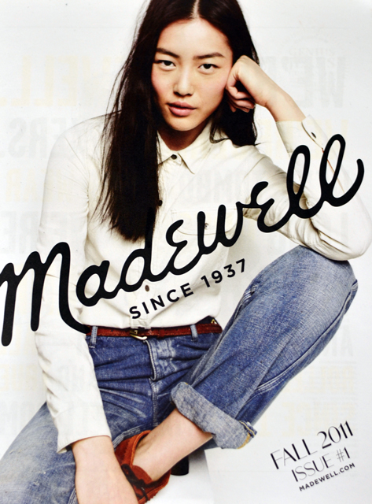
Pick a Store
SLIDE 1 - Pick a Store
Pick your favorite store (physical &/or online) to shop at
Examples:
Bohme (physical)
ASOS (online)
Forever 21 (Both)
You’ll be doing some research on this store!
Each slide should include a picture!!!

Slide 62
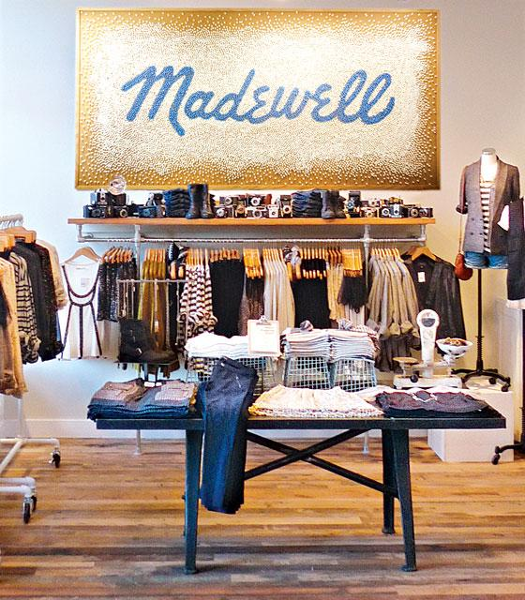
4 P’s of Marketing
Define the 4 P’s according to your chosen store
SLIDE 2 - PRODUCTS
Goods &/or Service?
Is there a range of products?
What needs or wants is it satisfying?
Madewell Products:
GOODS: Women’s apparel especially jeans, shoes, bags, jewelry & accessories
SERVICES: Jean alterations
Satisfies NEED for clothing to cover body especially basics like jeans and t-shirts and WANT for quality casual wear.

Slide 63
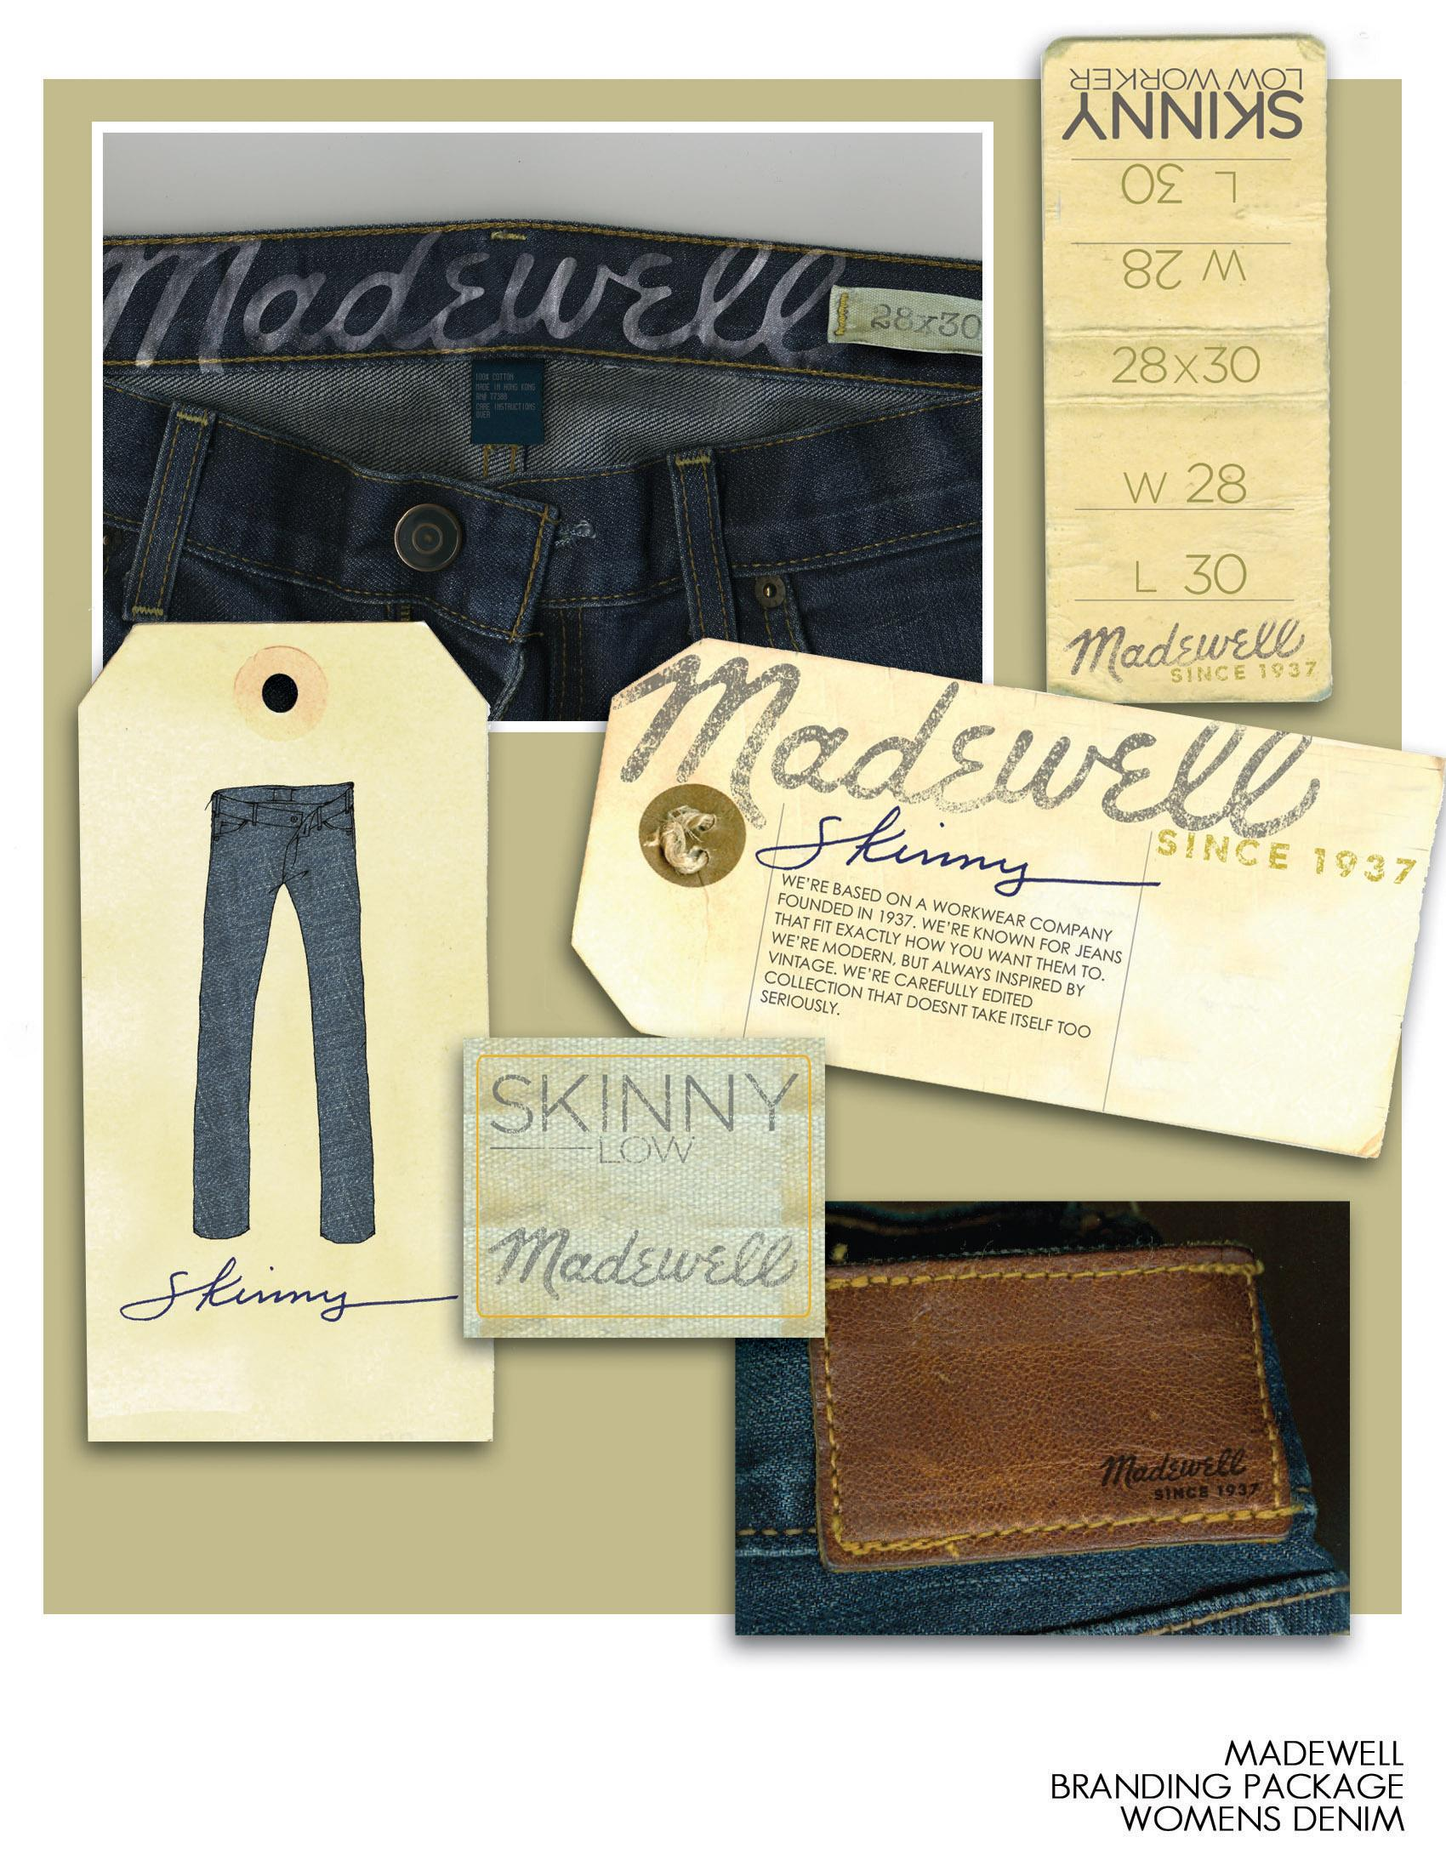
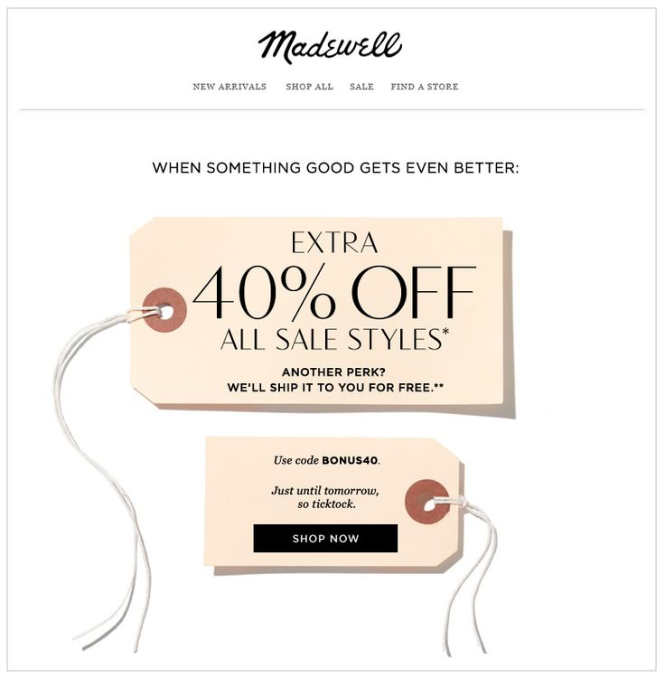
4 P’s of Marketing
Define the 4 P’s according to your chosen store
SLIDE 3 - PRICE
What is the range of REGULARLY priced products?
Are there often sales or coupons?
Madewell Prices:
REGULAR PRICES: Most products range $15-$300
SALE PRICES & DISCOUNTS:
Student & Teacher Discount of %15
Often 30% off Reduced Clearance
Other seasonal sales

Slide 64
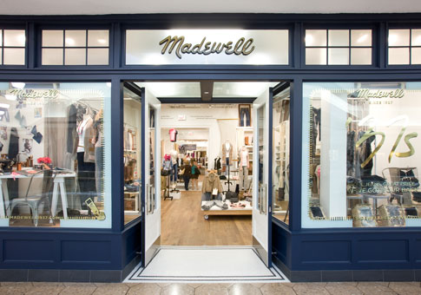
4 P’s of Marketing
Define the 4 P’s according to your chosen store
SLIDE 4 - PLACE
Where does the store sell their product?
Physical store? Online? Both?
Stand alone store? Malls? Strip malls?
Locations? (Cities? Areas of the country? URL?)
How is the product distributed?

Slide 65
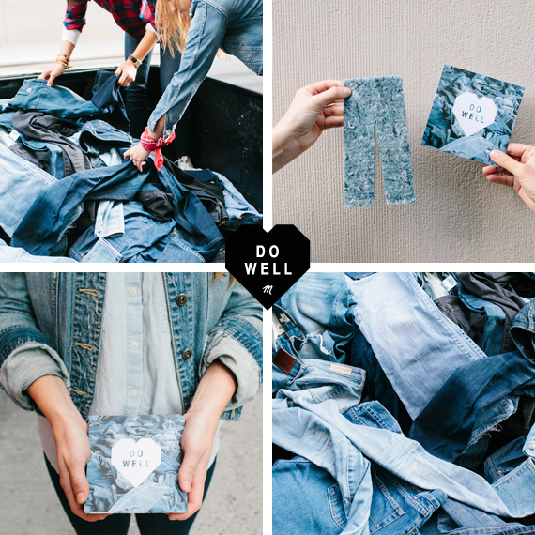
4 P’s of Marketing
Define the 4 P’s according to your chosen store
SLIDE 5 - PROMOTION
How does the business communicate to consumers about the goods & services? (All advertising & events that bring name recognition, branding status, & drive customers to buy)
Magazines
Pop-up ads
Bloggers
Emails
Commercials
Events
Sales
etc

Slide 66
TARGET MARKET
SLIDE 6 - DEMOGRAPHICS
Personal characteristics:
Age
Gender
Income
Ethnic background
Education
Religion
Occupation
Lifestyle

Slide 67
TARGET MARKET
SLIDE 7 - GEOGRAPHICS
Statistics about where people live. Could include:
Country
Region
State or County
City
Climate

Slide 68
TARGET MARKET
SLIDE 8 - PSYCHOGRAPHICS
Based on social & psychological characteristics like:
Attitudes
Interests
Opinions

Slide 69
TARGET MARKET
SLIDE 9 - BEHAVIORAL
Statistics about consumers based on their knowledge, attitudes, use or response to a product.

