Slide 1
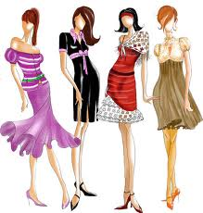
Fashion Merchandising A
Standard 1

Slide 2
Standard 1 – What is Fashion?
Students will understand basic fashion concepts and terminology.
Objective 1 – Define Fashion Terms
Objective 2 – Identify Fashion Products
Objective 3 – Describe the Importance of Fashion

Slide 3
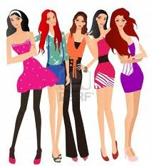
Fashion
Fashion is the existing type of clothing that is preferred by a large segment of the public at a given time.
Retailers view fashion as whatever is currently selling.

Slide 4
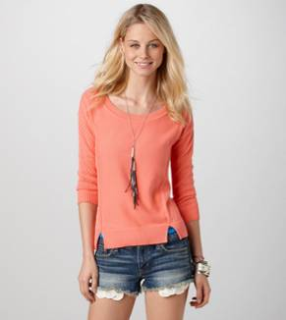
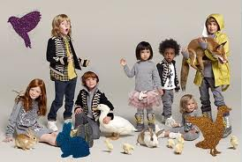
Apparel
Apparel is any or all men’s, women’s, and children’s clothing.

Slide 5
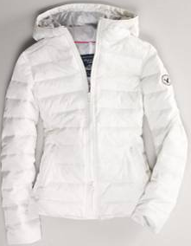
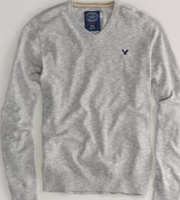
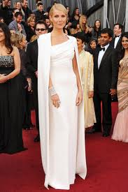
Garment
Garment: Any article of apparel, such as a dress, suit, coat, evening gown, or sweater.

Slide 6
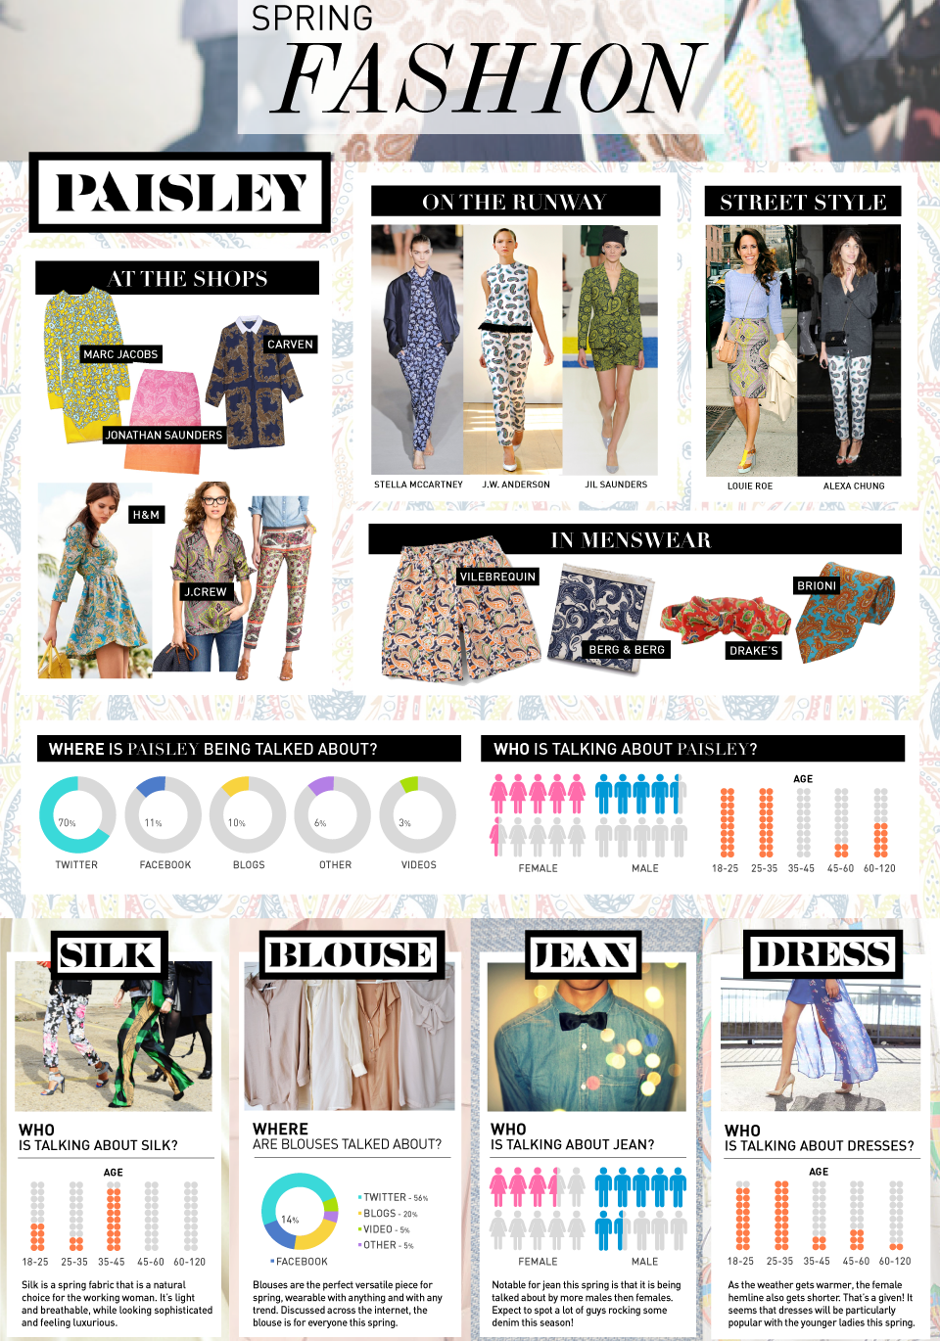
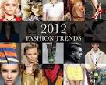
Fashion Trend
Fashion Trend: The direction in which fashion is moving.

Slide 7
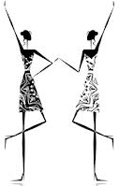
Silhouette
Silhouette: The shape of a clothing style. (If you squint your eyes and look at a clothing item, it is the shape you see-or outline)

Slide 8
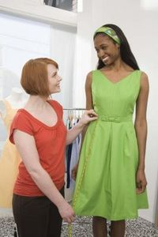
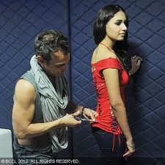
Fit
Fit: to be the proper size and shape.
Fitted Garment: Shaped to follow the lines of the body.

Slide 9
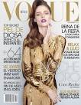
High Fashion
High Fashion: The very latest and newest fashions. Usually of top quality and fine workmanship.

Slide 10
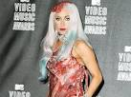
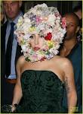
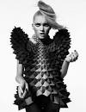
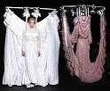
Avant-garde
Avant-garde: Clothes that are the most daring and wild designs.

Slide 11
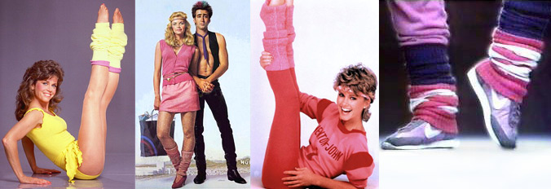
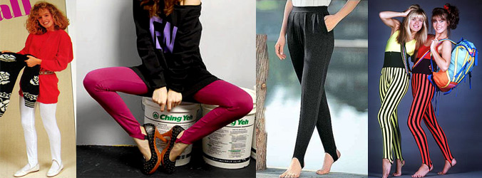
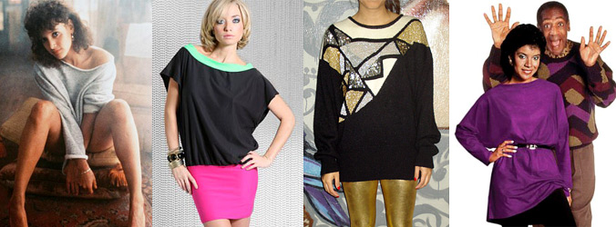
Fad
Fad: A temporary, passing fashion. It is an item that has great appeal to many people for a short period of time.

Slide 12
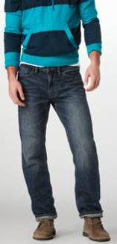
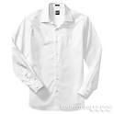
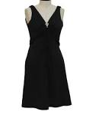
Classic
Classic: A clothing item that continues to be popular even though fashions change.

Slide 13
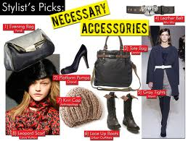
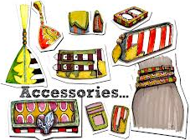
Accessories
Accessories: Articles added to complete or enhance your outfits. Ex: belts, gloves, jewelry, shoes, hats, etc.

Slide 14
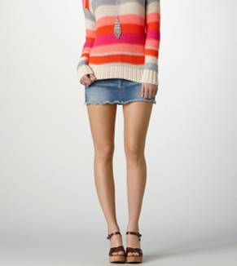
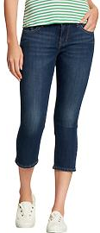
Style
Style is a particular shape or type of apparel item identified by the distinct features that make it unique. Examples – mini skirt, capri’s.

Slide 15
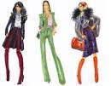
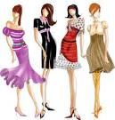
Design
Design: a particular or unique version of a style because of a specific arrangement of the basic design elements
4 Elements of Design
Color
Line
Shape
Texture

Slide 16
Ready To Wear
Ready-To-Wear: Garments that are mass-produced in factories. Made to fit standard sizes.

Slide 17
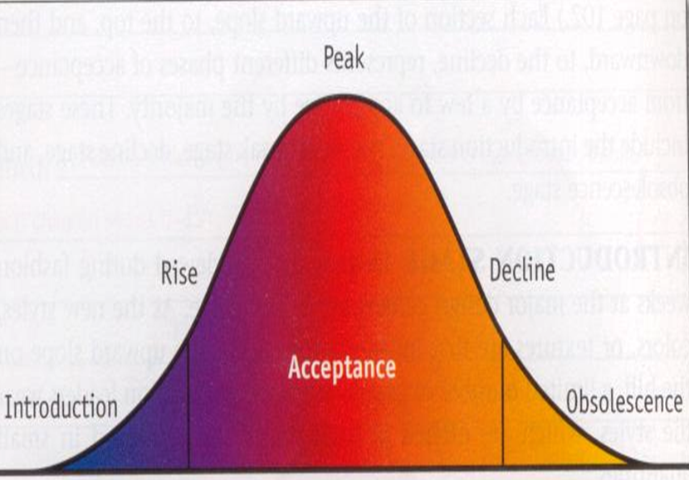
Fashion Cycle
Fashion Cycle: the period of time or life span during which the fashion exists, moving through five stages.
Introduction
Rise
Peak
Decline
Obsolescence

Slide 18
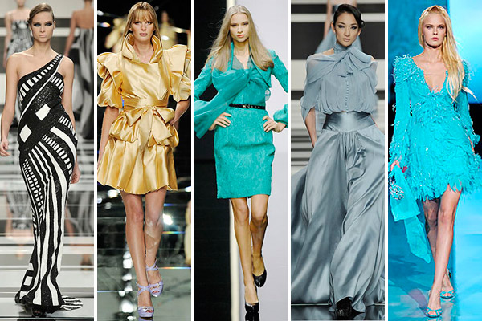
Haute Couture
Haute Couture: (French) “finest dress making”. Refers to a group of “fashion houses”, each with a designer who creates original, individually designed fashions

Slide 19
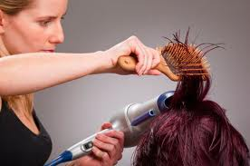
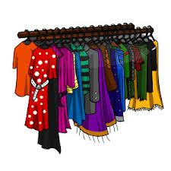
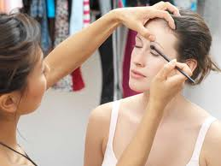
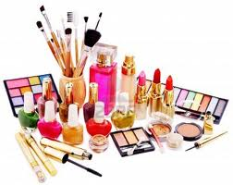
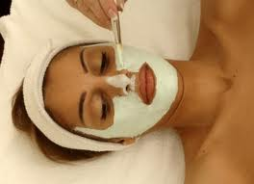
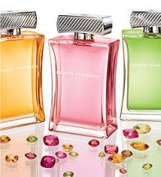
Fashion Products: Goods & Services
Goods are intangible items that are made, manufactured, or grown. They include apparel, textiles, accessories, & other fashion products.
Services are intangible things that people do, such as tasks performed for customers.

Slide 20
The Importance of Fashion
Economic & political trends, current events, and social issues are often reflected in fashion.
Fashion serves as a historical record of culture & lifestyle, and can be an indicator of what is occurring in a society at a particular time.
Throughout history, fashion has played an important role in personal appearance. Appearance can identify social position. At every level of society, people care about appearance as it affects self-esteem & their interactions with others.
As one of the largest industries in the world, fashion affects global & local economies.
Fashion can be a reflection of the economic environment. In an era of war, or difficult economic times, clothing styles take on a more conservative style. In better economic times, when spirits are high, styles are more fun and adventurous.

