Slide 1
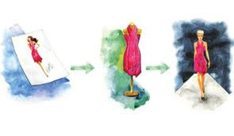
Fashion Merchandising A
Standard 3 - Fashion Cycle

Slide 2
Standard 3 – Fashion Cycle
Standard 3 – Students will be able to understand the basics of the fashion cycle.
Objective 1 – Define Fashion Terms
Objective 2 - Describe the Stages of the fashion cycle
Objective 3 – Describe the theories of fashion movement

Slide 3
Fashion Movement
The ongoing motion of fashions moving through the fashion cycle.
There are many factors that can affect the fashion movement.
Economic Factors
Social Factors
Introduction of new fibers & fabrics
Advertising Techniques

Slide 4
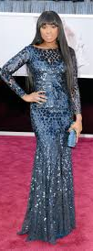
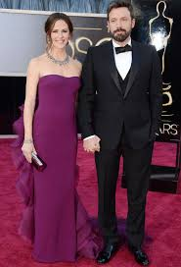
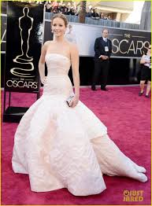
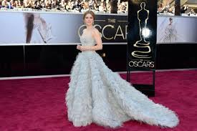
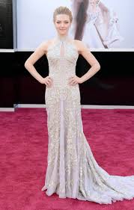
Fashion Leaders
Fashion leaders are Trendsetters, or individuals who are the first to wear new styles, after which the fashion is adopted by the general public.
Fashion leaders may be high-profile people who get media attention. This exposure results in more people seeing the new designs and causes the general acceptance of a fashion.
These trendsetters used to be royalty or the very wealthy. In today’s society, media celebrities often set the fashion cycles in motion. For example, during the 2003 academy awards, many of the female stars attending the televised ceremony wore chandelier-style earrings. This media exposure immediately caused that style of jewelry to be in demand.

Slide 5
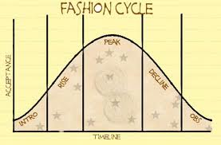
Fashion Cycle
The Fashion Cycle is the period of time or life span during with the fashion exists, moving through five stages.
Introduction stage
Rise stage
Peak stage
Decline stage
Obsolescence stage

Slide 6
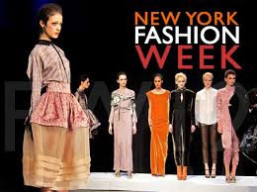
INTRODUCTION STAGE
Designs first previewed during fashion weeks at the major design centers are in this stage.
As the new styles, colors, or textures are first introduced, or begin the upward slope on the hill, a limited number of people accept them.
Fashion leaders wear the styles, which are offered at high prices and produced in small quantities.

Slide 7
RISE STAGE
MANUFACTURERS WHO COPY NEW DESIGNER CLOTHES WILL REPRODUCE THE STYLES AS APPAREL THAT COSTS LESS BY USING LESS EXPENSIVE FABRICS OR BY MINIMIZING DETAILS.
IN THIS STAGE THE FASHIONS BECOME MORE ACCEPTED BY MORE PEOPLE BECAUSE THEY CAN AFFORD THEM.
AS CONSUMER INTEREST INCREASES, ADDITIONAL MANUFACTURERS COPY THE FASHIONS BY ADAPTING OR CHANGING SOME OF THE POPULAR FEATUERS.
MASS PRODUCTION REDUCES THE PRICE OF THE fashion, AND MORE SALES RESULT.

Slide 8
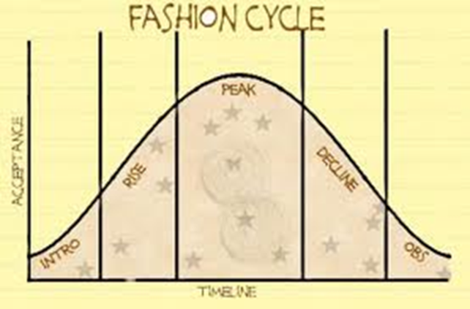
PEAK STAGE
DURING THIS STAGE THE FASHION IS AT ITS MOST POPULAR & ACCEPTED STAGE IN THE FASHION CYCLE.
THE MERCHANDISE IS MASS PRODUCED & DISTRIBUTED.
the prices are not necessarily at the lowest levels. Because so many versions of the fashions have been offered, the prices may vary at this stage.
Popularity of a fashion can determine how long it remains at this stage.

Slide 9
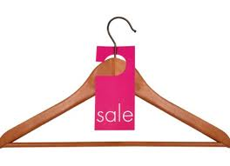
DECLINE STAGE
AT THIS STAGE CONSUMER DEMAND IS DECREASING.
THERE ARE SO MANY OF THE FASHION ITEMS AVAILABLE THAT THEY HAVE OVERSATUATED, OR FLOODED, THE MARKET.
FASHION RETAILERS BEGIN TO MARK DOWN THE PRICE OF THE MERCHANDISE TO MAKE ROOM FOR NEW DESIGNS.

Slide 10
OBSOLESCENCE STAGE
THIS STAGE MARKS THE END OF THE FASHION CYCLE.
CONSUMERS ARE NO LONGER INTERESTED IN THE FASHION.
THE PRICE OF THE FASHION PRODUCT MAY BE LOW AT THIS POINT, BUT CONSUMERS WILL PROBABLY NOT BUY THE MERCHANDISE.

Slide 11
FASHION THEORIES
TRICKLE-DOWN THEORY
TRICKLE-UP THEORY
TRICKLE-ACROSS THEORY

Slide 12
TRICKLE-DOWN THEORY
FASHION STARTS AT THE TOP WITH CONSUMERS OF HIGHER SOCIECONOMIC STATUS & MOVES DOWN TO THE GENERAL PUBLIC.
ACCORDING TO THIS THEORY, PEOPLE WITH LOWER INCOMES, AT THE BOTTOM OF THE LADDER, WILL ONLY WEAR FASHIONS THAT HAVE BECOME POPULAR AMONG CONSUMERS WITH HIGHER INCOMES, AT THE TOP OF THE LADDER.
AS MORE PEOPLE BEGIN TO WEAR THE FASHIONS, THOSE AT THE TOP BECOME LESS INTERESTED IN THE FASHION & BEGIN LOOKING FOR SOMETHING NEW.

Slide 13
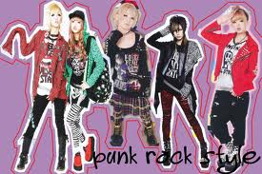
TRICKLE-UP THEORY
FASHION STARTS WITH CONSUMERS ON LOWER-INCOME LEVELS & THEN MOVES TO CONSUMERS WITH HIGHER INCOMES.
CONSUMERS ON LOWER-INCOME LEVELS MAY ALSO INCLUDE YOUNGER CONSUMERS.
EXAMPLES OF THIS THEORY:
ATHLETIC APPAREL STYLE
HAIR STYLE
PUNK STYLE

Slide 14
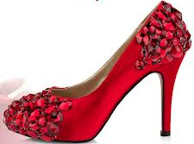
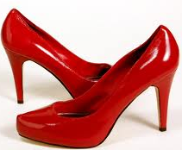
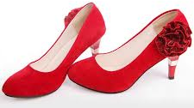
TRICKLE-ACROSS THEORY
FASHION ACCEPTANCE BEGINS AMONG SEVERAL SOCIOECONOMIC CLASSES AT THE SAME TIME, BECAUSE THERE ARE FASHION LEADERS IN ALL GROUPS.
THESE LEADERS INFLUENCE THEIR GROUPS TO ACCEPT NEW STYLES.
THIS THEORY IS ESPECIALLY PROBABLY IN THE 21ST CENTURY BECAUSE TECHNOLOGY ALLOWS DESIGNER FASHIONS TO BE COPIED QUICKLY & EASILY, MAKING THEM AVAILABLE FOR ALL CONSUMERS.
$125.00
$50.00
$500.00

