Slide 1
Fashion A: Standard 5
Fashion Retail and Promotion

Slide 2
Objectives
Students will understand forms of fashion retail and promotion.
Objective 1: Describe types of fashion retail
Objective 2: Identify the types of fashion promotion

Slide 3
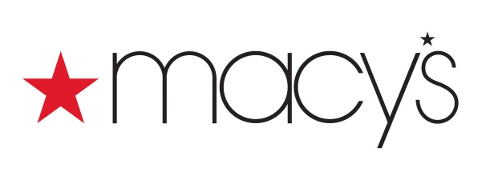
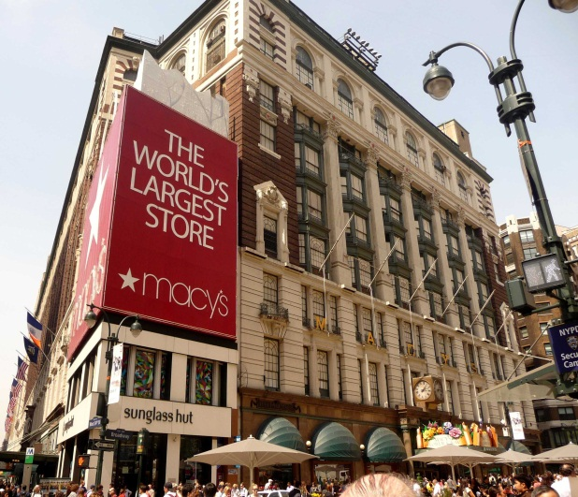
Types of Fashion Retailers
Department Stores: retail establishments that carry different kinds of merchandise and house them in separate sections or departments.
Ex:
Flagship Stores: Core stores for brand name retailers, usually the “original” store.
Ex: Macy’s Herald Square, New York

Slide 4
Types of Fashion Retailers
Specialty Stores: stores that handle only apparel or even only one specific type of apparel.
Ex: Maternity, shoes, bridal, children’s apparel, etc.
Boutique: specialty store that offers a limited selection, items tend to be more trendy
Ex: Bella Me
Chain Stores: a group of stores owned and managed by a central office.
Ex: American Eagle, most “mall” stores, etc.
Designer Stores: store that is owned and operated by a designer or manufacturer and carries only its own lines.
Ex: Gucci, Chanel, Ralph Lauren. etc.

Slide 5
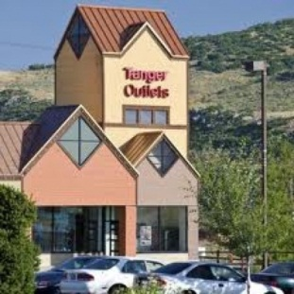
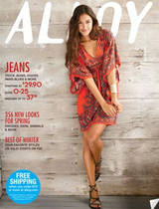
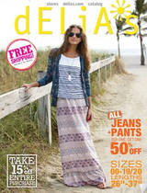
Types Fashion Retailers
Outlets: an off-price retailer that sells overruns or damaged items from a prior season
Ex: Tanger Outlet Center, Park City
Discount Stores: sell clothing and other merchandise at lower prices, may be private or national brands.
Ex:
Mail-order Houses: Direct-mail marketing done by selling merchandise through the use of catalogs.
Ex:

Slide 6
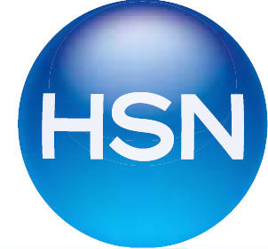
Other Types Fashion Retailing
Television retailing:
Ex:
On-line retailing: Almost every type of retailer- whether department store, boutique, discounter, or designer- offers online services. Customers are able to shop 24/7 and have the merchandise shipped directly to their home.

Slide 7
Fashion Promotion
Promotion:
Any form of communication a business uses to inform, persuade or remind people about its products.
Types of Fashion Promotion:
Advertising
Publicity
Sales Promotion
Visual Merchandising
Personal Selling

Slide 8
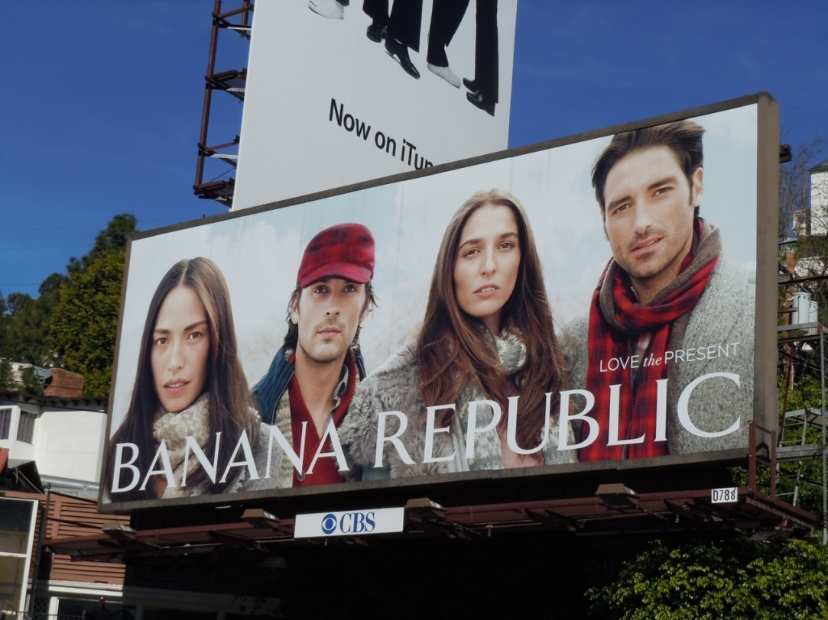
Advertising
A paid promotional message by an identified sponsor about its fashion products or ideas.
Companies use different types of media to get their message to the customer.
Broadcast Media
Television
Radio
Print Media
Magazine
Newspaper
Directory
Direct Mail
Outdoor (Billboards /Transit)
Online Media
Popup Ads
Banner Ads

Slide 9
Publicity
Includes nonpaid messages to the public about a company’s merchandise, activities, or services.
Press releases/ Press kits: sent out by some companies to the press with information, written as news stories, hoping to have it included in news presentations.
Fashion businesses do not have control over the publicity they receive.

Slide 10
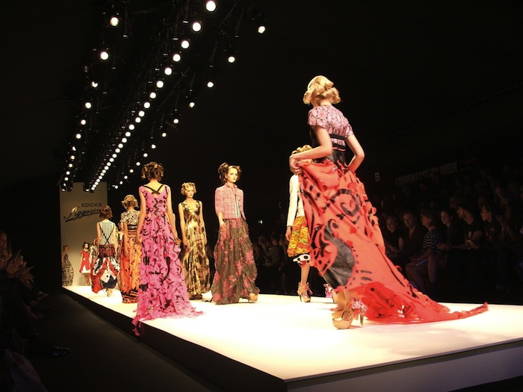
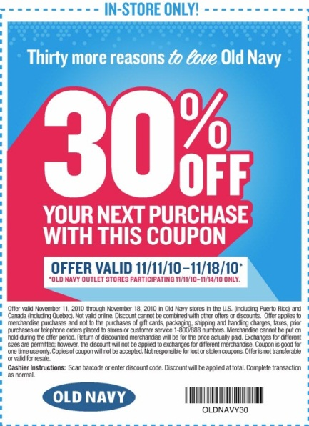
Sales Promotion
Short-term incentives used to interest customers into buying products.
Examples:
Fashion shows
Special appearances
Contests
Premiums
Samples
Coupons
E-mail offers

Slide 11
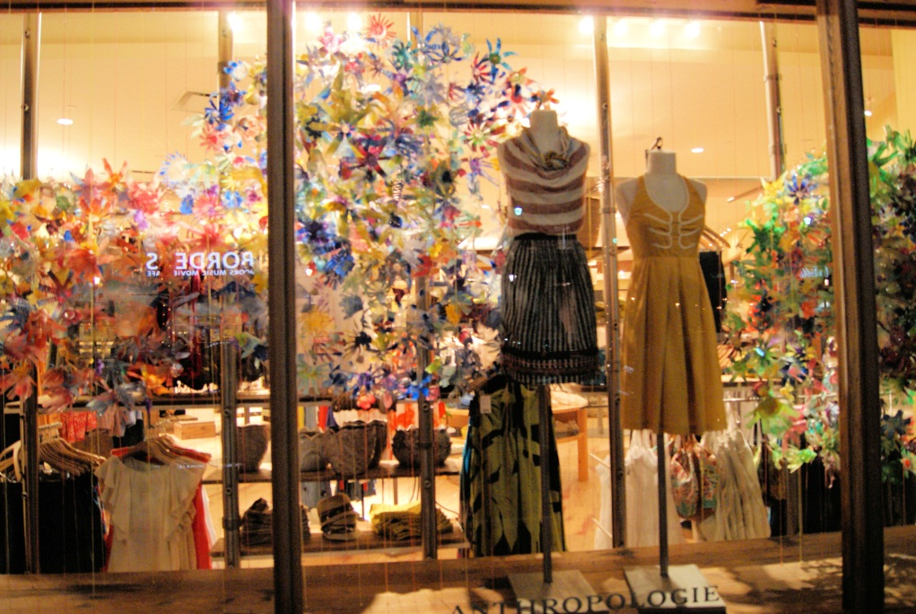
Visual Merchandising
The integrated look of an entire store.
The goal of effective visual merchandising is to sell goods by promoting the store image and creating a positive shopping experience for the customer.
Types of Visual Merchandising:
Storefront
Store layout
Store interior
Interior displays

Slide 12
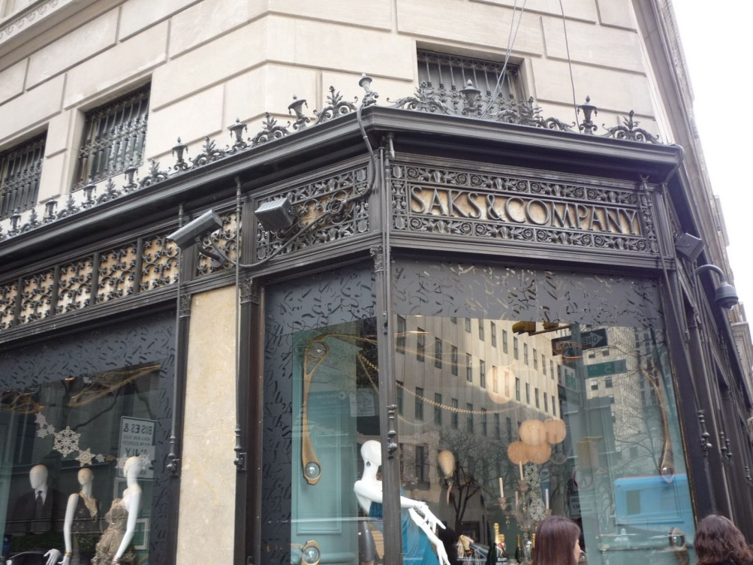
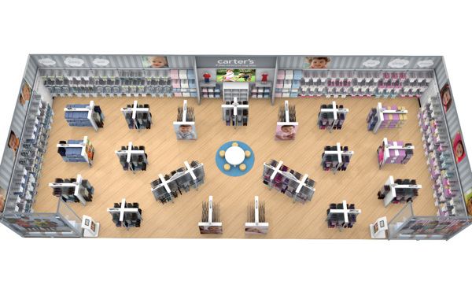
Visual Merchandising
Store front: exterior of the store, gives the first impression
Signs, marquees, window displays
Store layout: arrangement of floor space
The customer should be able to walk through the store and easily view the merchandise

Slide 13
Visual Merchandising
Store interior:
Lighting, color schemes, store fixtures
Interior displays:
Space design, fixture and hardware, mannequins, floor and wall coverings, in-store signage

Slide 14
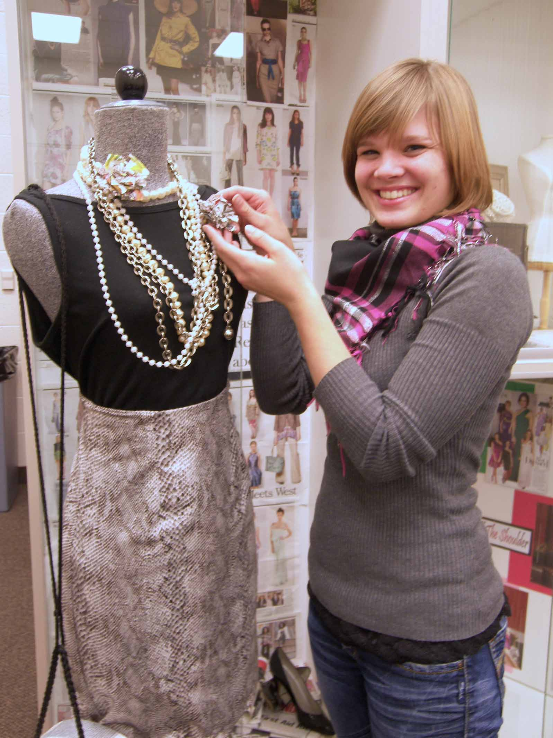
Personal Selling
Requires direct contact with the customer.
Can take place in any of fashion industry segments.
Final stage of a sale, after the customer has been prompted by advertising, publicity, sales promotions and visual merchandising.

