Slide 1
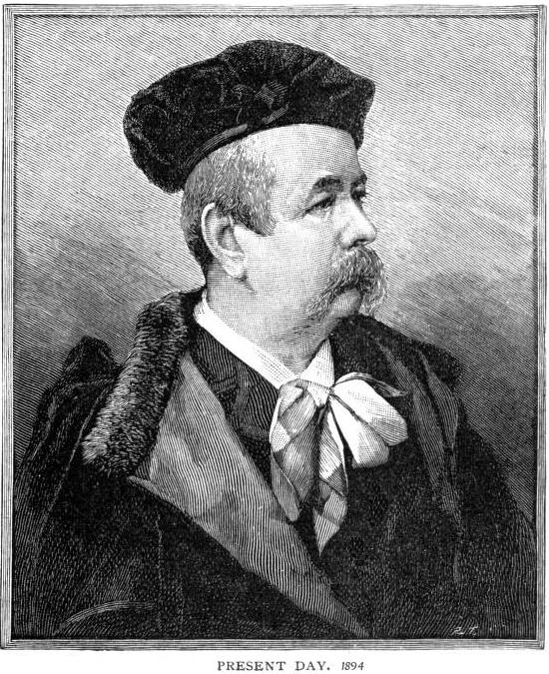
Father of Haute Couture
Charles Frederick Worth
1825-1895
Notes:
http://www.metmuseum.org/toah/hd/wrth/hd_wrth.htm

Slide 2
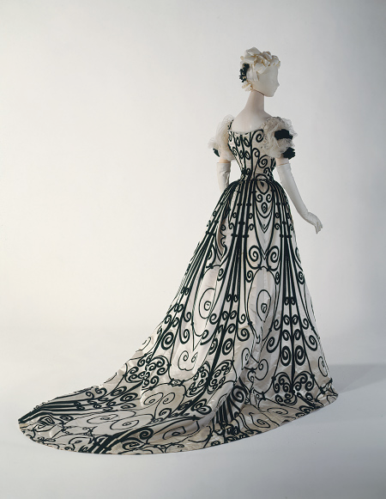
Originator of Fashion
Designing for the Napolen III and his wife
Empress Eugeine.
Marketed his design as fashions from the House of Worth
Created regular seasoned Fashion Shows (1870’s)

Slide 3
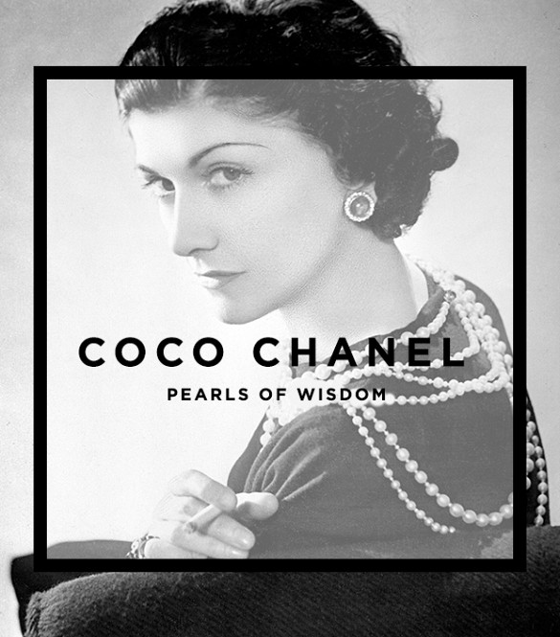
Coco Chanel
Born as Gabrielle Bonheur Chanel
1883-1971
Born in France
Decades of Influence 1920-1940
Women’s right to vote played a role in what she designed
Notes:
http://www.biography.com/people/coco-chanel-9244165
Play the video on this web page featuring Coco.

Slide 4
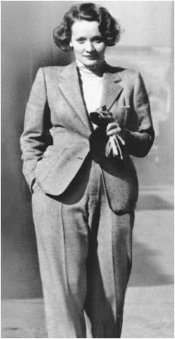
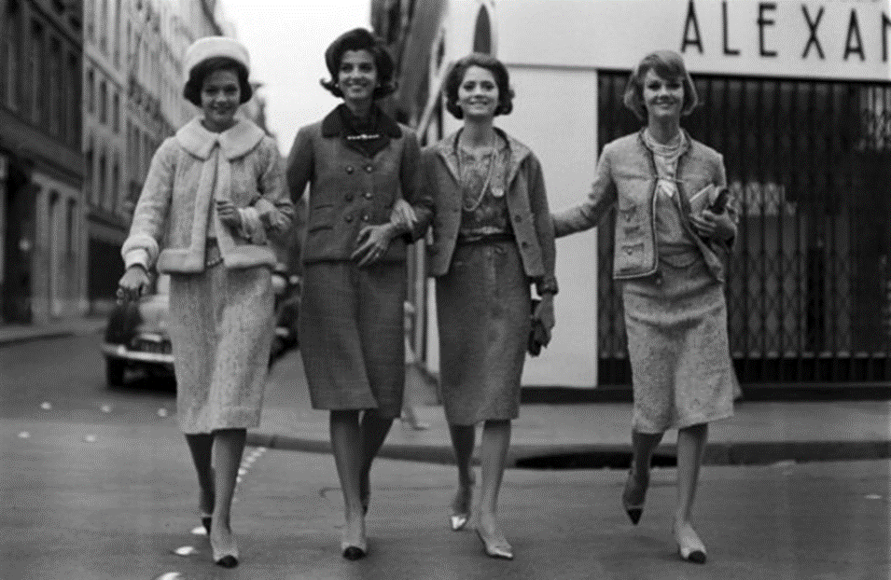
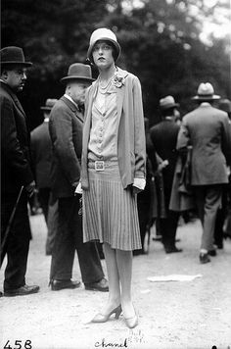
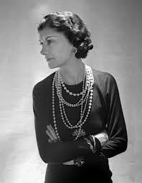

Slide 5
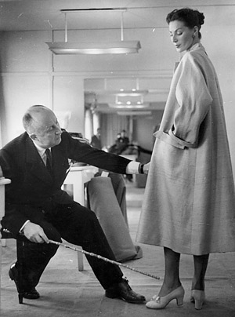
Christian Dior
1905-1957
Born in France
Decades of Influence 1940s-1950s
The New Look
Notes:
Play this video for information on Dior
http://www.biography.com/people/christian-dior-9275315
http://www.biography.com/people/christian-dior-9275315/videos/christian-dior-mini-biography-17746765

Slide 6
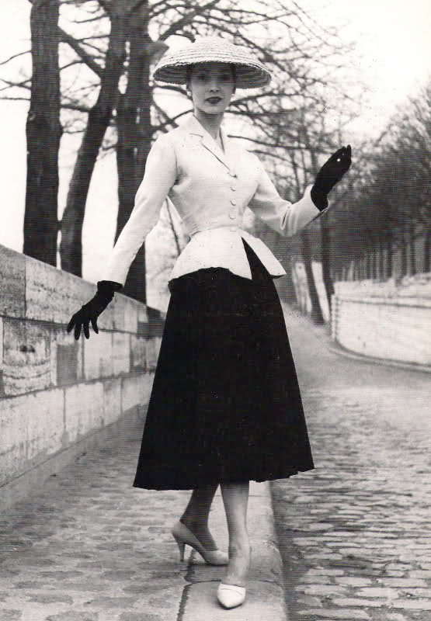
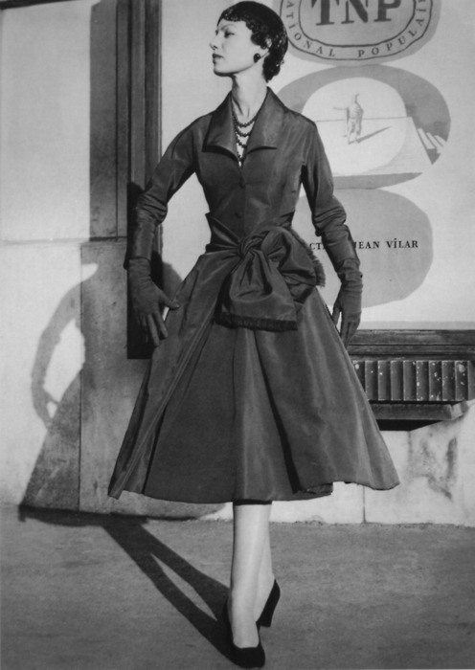
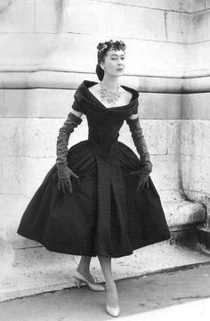

Slide 7
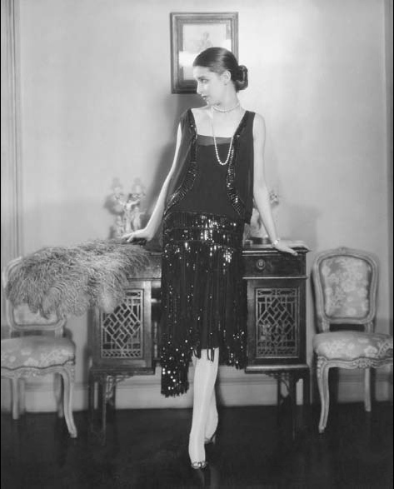
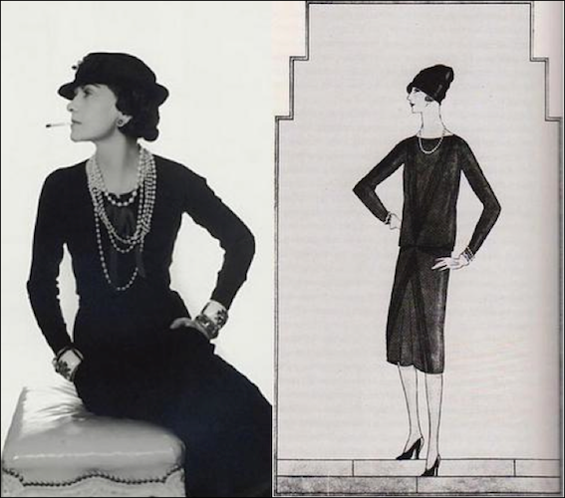

Slide 8
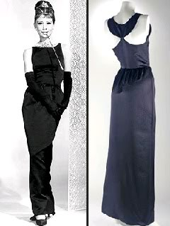
The birth of the “wonder dress” took place in Paris. Its creators were designers Jean Patou and Coco Chanel. Patou, a forerunner of Ralph Lauren provided the architectural line, while Chanel contributed that dash of risk. What I mean by that is that she made it black, which is the color worn by the maidservants of her couture clientele. Fashion consultants have for decades praised the little black dress as s slimming garment, as a bridge between day and evening wear, and as the ideal backdrop for accessories.

Slide 9
Design a Little Black Dress that you would wear -1 sketch - sign your name -Color your design -List any details you can not sketch
The Little Black Dress—Page Label

