Slide 1
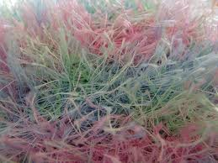
Textile Fibers
Created By:
Mrs. Christine Holt
FACS Educator
Westlake High School

Slide 2
What are Fibers?
Fibers are the basic units of all textiles. Textiles are a form of cloth or fabric from which clothing and other items are made. Fibers are put together to form a continuous strand, making a yarn. Yarns are woven or knitted together to make fabrics.

Slide 3
Fiber Characteristics
Knowledge of fiber characteristics will help you select the right fabric for your needs.
Strength: the ability to withstand pulling and twisting.
Shrinkage: the ability to maintain size.
Warmth: the ability to maintain body temperature.
Durability: the ability to hold up to repeated usage.
Absorbency: the ability to take in moisture.
Wicking: the ability to pull moisture away from the body and toward the surface of the fabric where it can evaporate quickly.

Slide 4
Fiber Characteristic Continued (2)
Wrinkle Resistance: the ability to resist creasing.
Resiliency: the ability to spring back when crushed or wrinkled.
Elasticity: the ability to return to its original size.
Shape Retention: the ability to retain the original shape.
Abrasion Resistance: the ability to withstand rubbing.
Luster: the natural sheen or shine of some fibers.
Static Resistance: the ability to withstand the buildup of electricity.

Slide 5
Groups of Fibers
There are two main groups of fibers.
Natural fibers which are made from natural sources—plants and animals.
Manufactured fibers which are made from chemicals in factories.

Slide 6
Natural Fibers

Slide 7
Natural Fibers
The most common natural fibers are cotton, linen, wool, and silk. Natural fibers vary in quality depending on the kind of animal or plant and the growing conditions. The fibers must be cleaned before they can be made into yarns. Supplies of natural fibers vary, according to the season. They each have unique characteristics that cannot be copied by science.
There are two categories of Natural Fibers:
Cellulosic Fibers
Protein Fibers

Slide 8
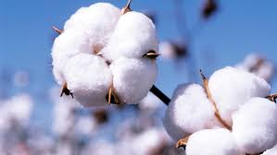
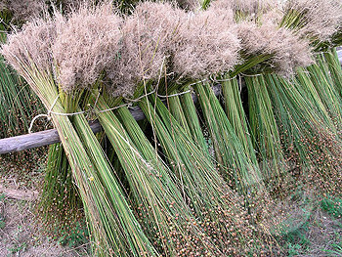
Cellulosic Fibers
Cellulosic Fibers come from plant sources. There are many kinds of cellulosic fibers, but few are used in fabric. Cotton, and flax are the main cellulosic fibers that are used in the fashion industry.
Cotton
Flax

Slide 9
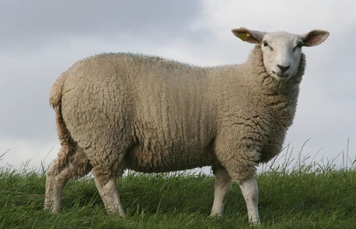
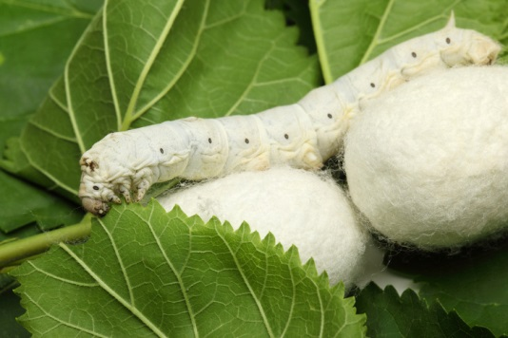
Protein Fibers
Protein Fibers come from animal sources.
Wool and silk are the main protein fibers.
Wool
Silk

Slide 10
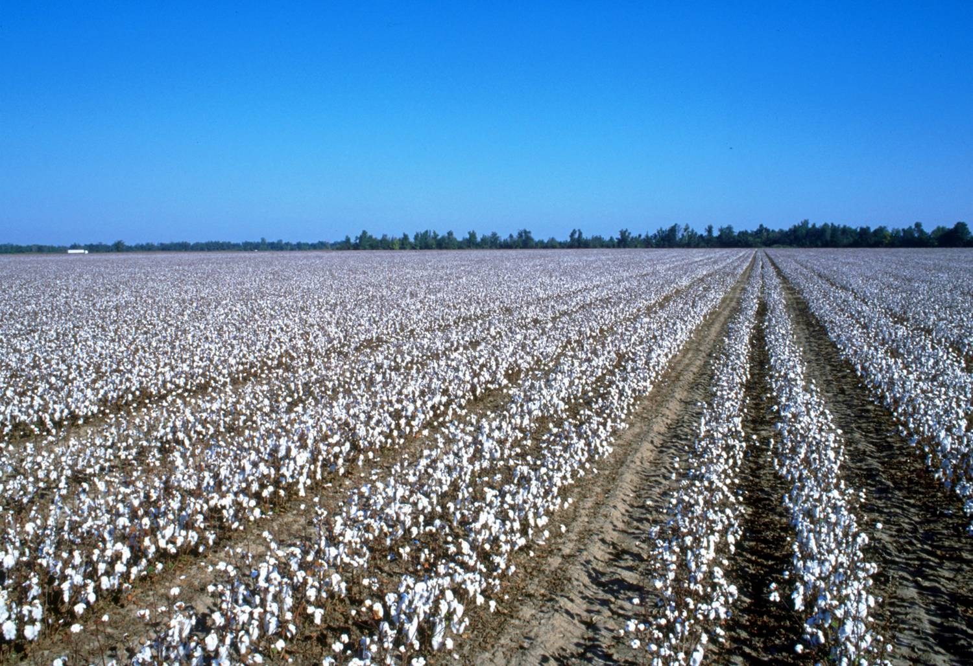
Cotton
Cotton is a natural fiber that is obtained from the cotton plant. It is the most widely used natural fiber.
The cotton plant can grow in any part of the world where the growing season lasts six or seven months. China leads in cotton production, followed by the United States and India.

Slide 11
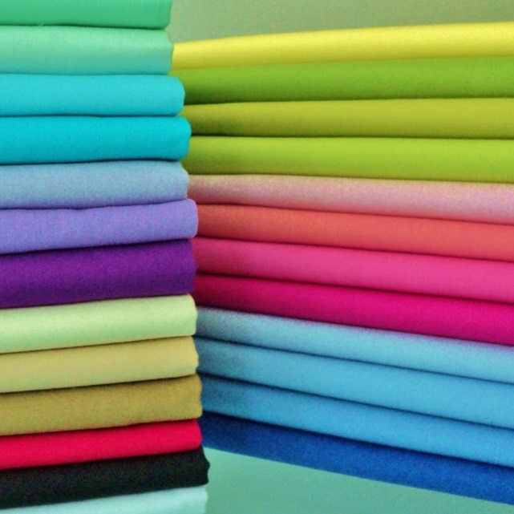
Advantages & Disadvantages of Cotton
Advantages
Disadvantages
Inexpensive
Launders Well
Soft
Hydrophilic—Absorbent
Dyes Well
Wrinkles Easily
Soils Easily
Mildews is stored damp.
A discoloration caused by a fungus that grows on the fabric when it is stored moist over a period of time.

Slide 12
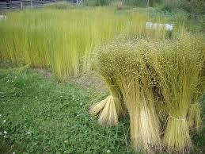
Flax (Linen)
Flax is the fiber used to make linen fabric. It was the first cellulosic fiber used for making fabric.
The Egyptians grew fields of flax along the Nile River over 4000 years ago and made it into fine cloth. Pieces of linen have been found in tombs of the Pharaohs. Egyptian mummies, wrapped in linen, are still seen in museums.
Today, Belgium, France, the Netherlands, and Poland produce most of the linen fabric.

Slide 13
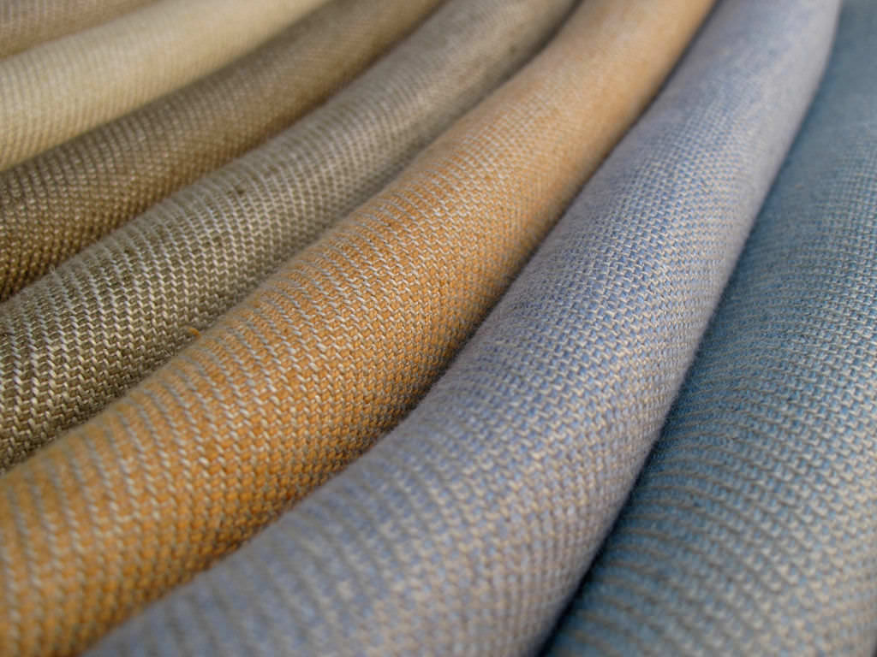
Advantages & Disadvantages of Linen
Advantages
Disadvantages
Durability
Absorbent
Lint Free
Harder to soil
Wrinkles Easily
Expensive

Slide 14
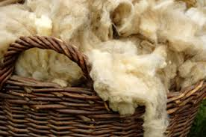
Wool
Wool is made from the fleece/hair of the sheep or lambs. It is the most common animal fiber people wear today, but its use goes back to early times.
Crude wool fabrics have been found in the ruins of the Stone Age. Even then, people knew that the fleece of the sheep was softer and warmer than the skins of other animals.
Sheep were the first animals to be domesticated and raised for their fleece.

Slide 15
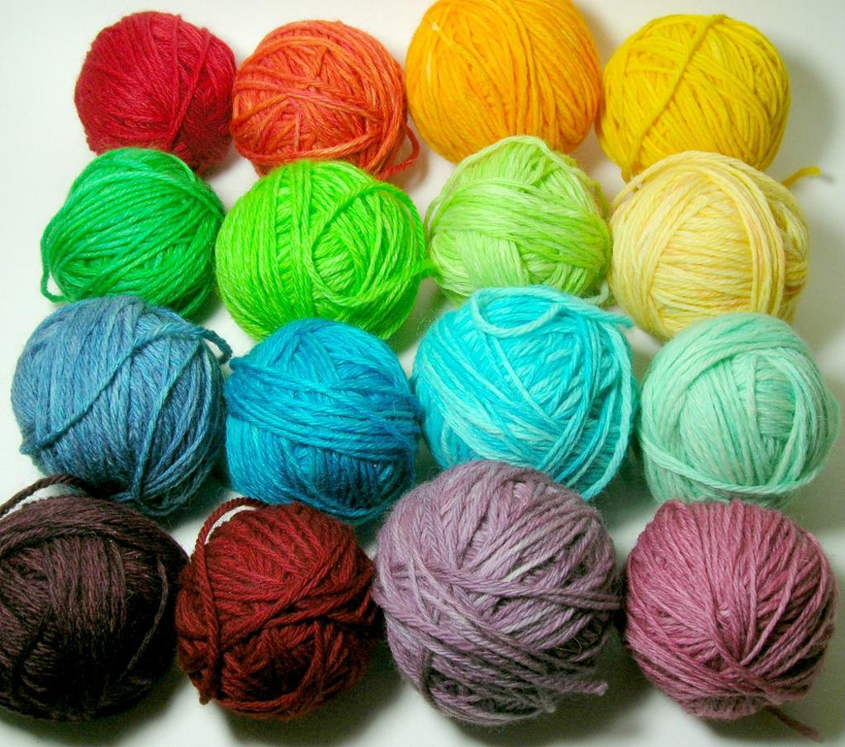
Advantages & Disadvantages of Wool
Advantages
Disadvantages
Warmest Natural Fiber
Natural Insulator
Strong and Durable
Lightweight
Absorbent
Wrinkle-Resistance
Fire Retardant
Shrinks easily
Requires dry cleaning.
Expensive

Slide 16
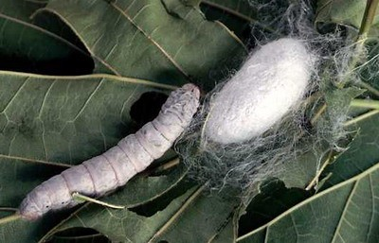
Silk
Silk is a protein fiber that comes from the cocoons of silkworms. Manufactures unwind the cocoons to obtain the fiber. The silk fiber is the longest natural fiber, sometimes reaching a thousand yards or more.
Japan is the leading producer of raw silk today. China, Italy, France, and India also produce large amounts of silk. The United States does not produce raw silk because of the high cost of labor. However, it is the world’s largest manufacturer of silk products.

Slide 17
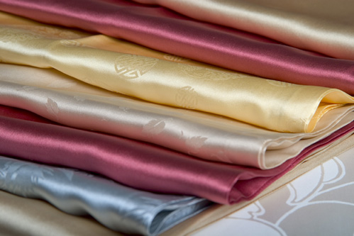
Advantages & Disadvantages of Silk
Advantages
Disadvantages
One of the strongest fibers.
Has a natural shine or luster giving fabrics a luxurious look.
Very Elastic
Resists Wrinkling
So smooth that dirt doesn't cling to it.
Hard to wash, usually requires dry cleaning.
Expensive

Slide 18
Manufactured Fibers

Slide 19
Manufactured Fibers
Rayon was the first commercially produced fiber. It was followed by acetate. These fibers are made from cellulose, the fibrous substance in plant life. They are called cellulosic fibers.
Combining molecules of nitrogen, oxygen, hydrogen, and carbon makes most other manufactured fibers. The molecules are linked in various ways to form chemical compounds called polymers. These manufactured fibers are called synthetic fibers since they are made from chemicals.

Slide 20
How Manufactured Fibers are Made
The raw materials and chemicals used to make manufactured fibers can vary. They all go through the same basic steps before they become fibers:
The solid raw material is changed to a liquid.
The liquid is extruded (forced or pushed) throughout a spinneret—a small nozzle with many tiny holes, similar to a bathroom showerhead.
The liquid hardens in the form of a fiber often called a filament. A filament is a continuous strand of fiber. Any manufactured fiber can be made in filament form.
Silk is the only natural fiber that comes in a filament form.
Other natural fibers are short and are called staple fibers.

Slide 21
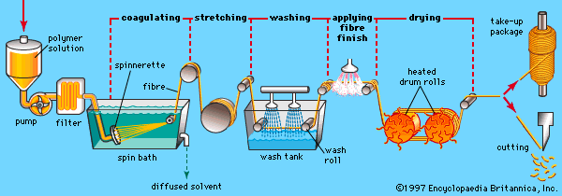
How Manufactured Fibers are Made (2)

Slide 22
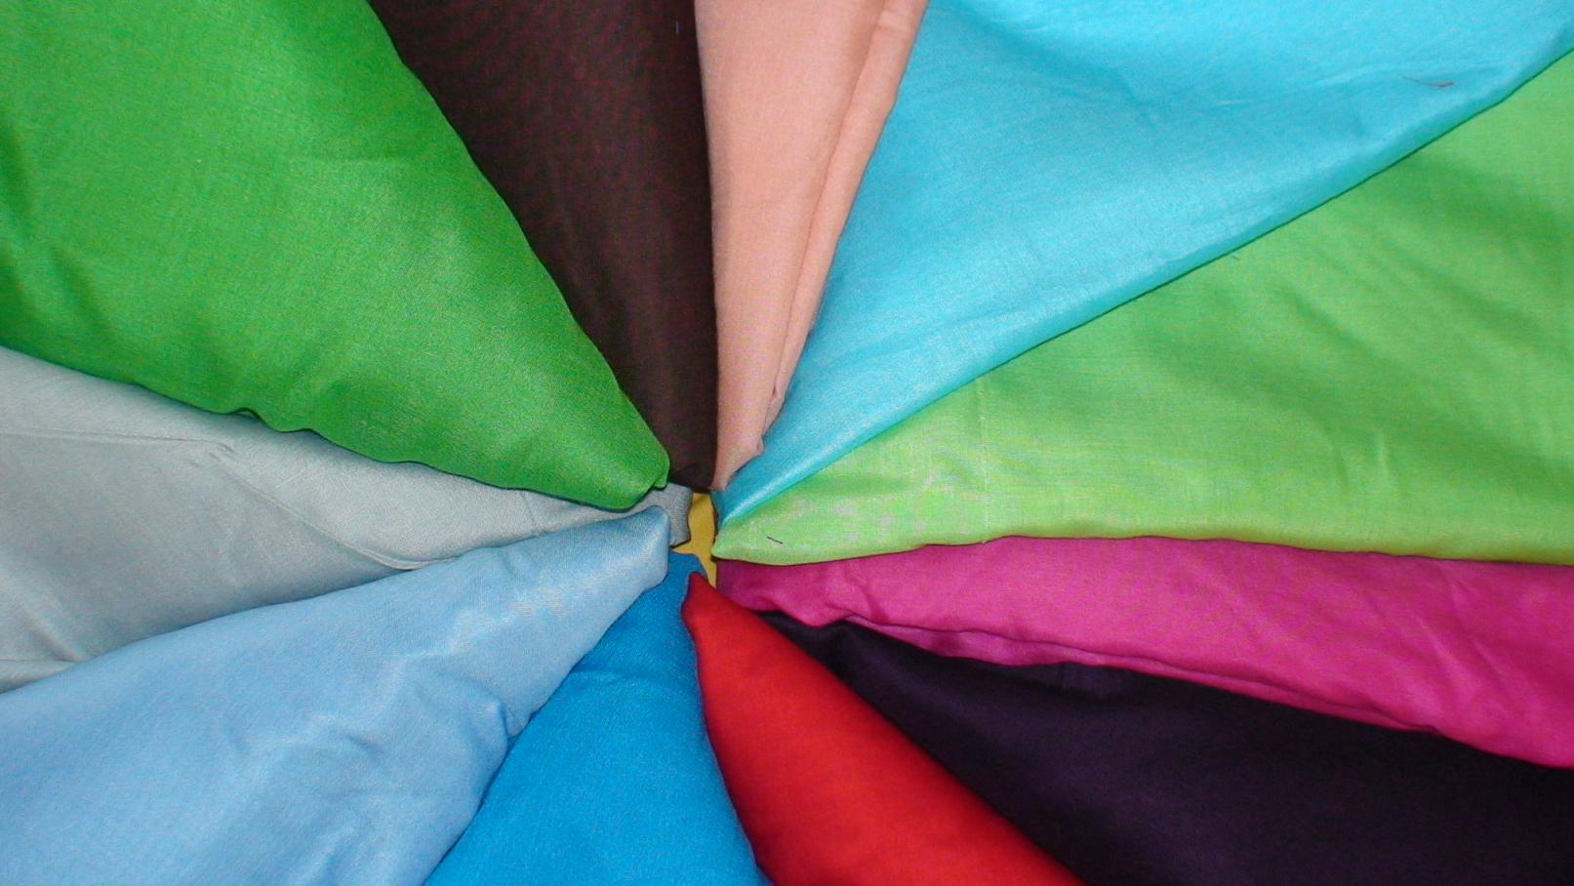
Rayon
Rayon is a manufactured regenerated cellulose fiber. It is made from purified cellulose, primarily from wood pulp, which is chemically converted into a soluble compound.
Has many of the same characteristics as cotton. It was the first manufactured fiber. Often found in lingerie, shirts, blouses, dresses, slacks, coats, and work clothes.

Slide 23
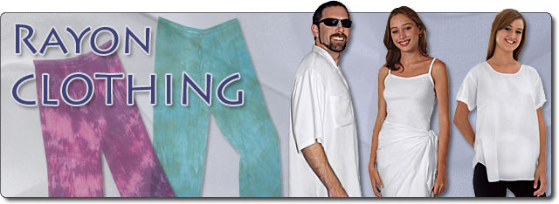
Advantages & Disadvantages Rayon
Advantages
Disadvantages
Soft
Comfortable
Absorbent
Inexpensive
Versatile
Shrinks & wrinkles easily
Low Resiliency
Heat sensitive
Mildews
Dry Clean or Hand Wash Only.

Slide 24
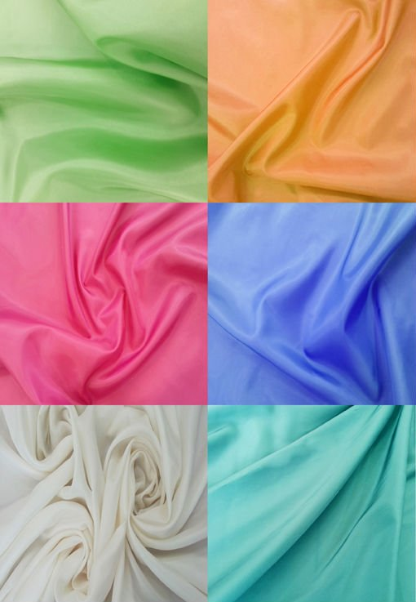
Acetate
Acetate is a chemical compound made of salt or ester of acetic acid. Also known as acetate rayon. A synthetic filament, yarn, or fabric composed of a derivative of the acetic ester of cellulose, differing from viscose rayon in having greater strength when wet and greater sensitivity to high temperatures.

Slide 25
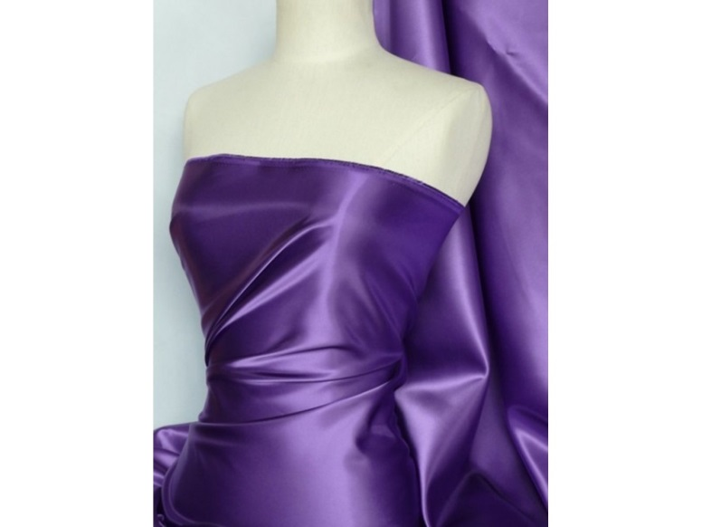
Advantages & Disadvantages of Acetate
Advantages
Disadvantages
Looks and Feels Luxurious
Silky appearance & feel
Crisp and Drapes well
Dyed in a range of colors.
Resistance to moths and mildew.
Absorbent & dries quickly.
Inexpensive
Poor abrasion resistance
Weak
Dry Cleaned Only
Melts under High Heat

Slide 26
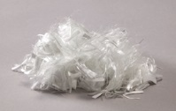
Nylon
A tough, lightweight, elastic synthetic polymer with a protein-like chemical structure, able to be produced as filaments, sheets, or molded objects.
Nylon is very strong and durable and the strongest out of all the fibers.

Slide 27
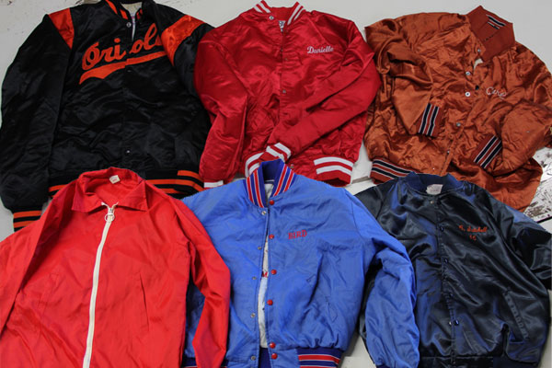
Advantages & Disadvantages of Nylon
Advantages
Disadvantages
Elastic but able to retain it’s shape.
Lightweight, lustrous, and easy to dye.
Heat sensitive
Damaged by sun
Picks up oils and dyes when washed
Low absorbency leading to high amounts of static electricity.
Pilling is a huge problem.
Formation of small balls of fibers on the fabric surface due to wear.

Slide 28
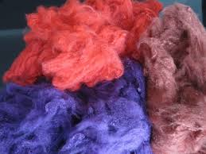
Polyester
A synthetic resin in which the polymer units are linked by ester groups, used chiefly to make synthetic textile fibers.
It is the most widely used out of all the fibers.

Slide 29
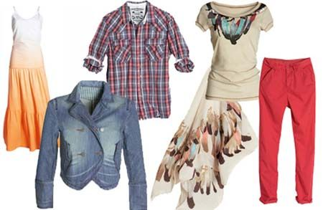
Advantages & Disadvantages of Polyester
Advantages
Disadvantages
Very resistant to wrinkling, stretching, shrinking, bleach, sunlight, moths, and mildew.
Retains oily stains.
Hydrophobic—doesn’t absorb moisture well
Static electricity

Slide 30
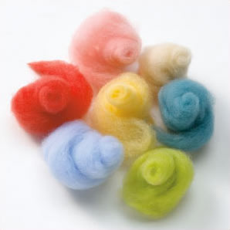
Acrylic
Acrylic is synthetic resins and textile fibers made from polymers of acrylic acid or acrylates.
Acrylic is often a replacement for wool in garments.

Slide 31
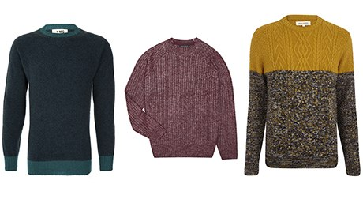
Advantages & Disadvantages of Acrylic
Advantages
Disadvantages
Soft, warm, and lightweight.
Keeps it shape well.
Resists sunlight damage and wrinkles.
Pills easily
Prone to static electricity
Low absorbency
Heat sensitive

Slide 32
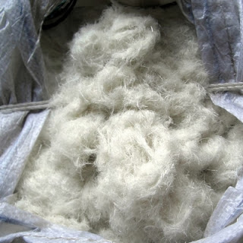
Spandex
Spandex is a type of stretchy polyurethane fabric. Used in a variety of different clothing styles, especially under garments.

Slide 33
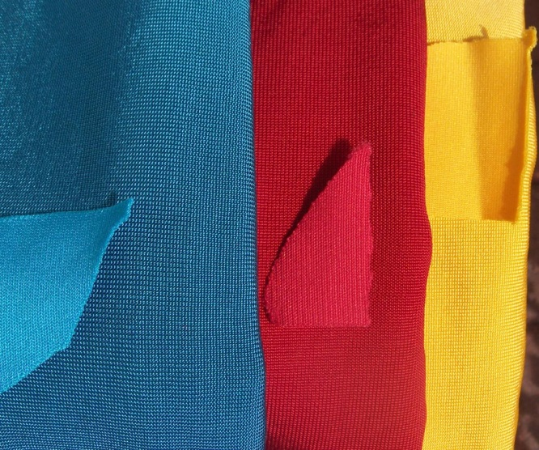
Advantages & Disadvantages of Spandex
Advantages
Disadvantages
Great stretch and will retain shape quickly.
Resistant to sunlight, oil, perspiration, and abrasion.
Lightweight
Strong and durable
Soft and smooth
Easy care.
Heat sensitive
Nonabsorbent
Yellows with age
Harmed by chlorine bleach

Slide 34
Fabric Construction

Slide 35
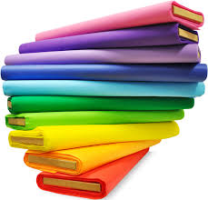
Making of Fabric
The two most common methods of making fabric are weaving and knitting. Other methods include felting and bonding. From only a few construction methods come many different fabrics.

Slide 36
Weaving Fabrics
Weaving is the process of interlacing yarns at right angles to each other to create a woven fabric. It’s done on machines called looms. For generations, weaving was done by hand.
Weaving requires the use of two sets of yarns. The lengthwise yarns are the warp yarns. The crosswise yarns are the filling yarns. The warp yarns are threaded onto the loom. They must be strong and durable to withstand the strain of the weaving process.
The filling yarns pass over and under the warp yarns. When they reach the edge, they turn back and weave across the wrap yarns in the other direction. The turned filling yarns along each side of the woven fabric form the selvage—the fabric edge that is very strong and will not ravel.

Slide 37
Types of Weaves
Through the weaving process, passing the filling yarns over and under different numbers of warp yarns can create various types of woven fabric. There are three basic types of weaves:
Plain Weave
Twill Weave
Satin Weave

Slide 38
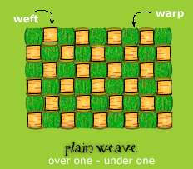
Plain Weave
Passing a filling yarn over one wrap and then under one wrap yarn makes the plain weave. The netting of a tennis racket is an example of the plain weave.
Plain weave fabrics are strong, durable, and easy to sew. They wrinkle more and absorb less moisture than fabrics of other weaves.

Slide 39
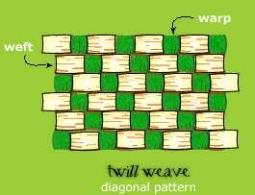
Twill Weave
The twill weave forms when a yarn in one direction floats over two or more yarns in the other direction. Each float begins one yarn over from the last one. The floats can be either filling or wraps yarns. Twill weaves fabrics have a distinct diagonal line or wale.
Twill weaves are very durable wrinkle-resistant, and hide soil. They are less stiff than plain weave fabrics that have the same number of yarns.

Slide 40
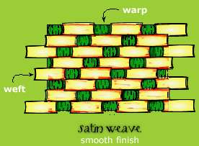
Satin Weave
The satin weave forms by floating a yarn from one direction over four or more yarns from the other direction and then under one yarn. Each float begins two yarns over from where the last float began. It is used to make fabrics with a smooth surface.
Satin weaves fabrics have great luster. The luster is due to the exposed floats reflecting light. Satin weaves feel smooth and are drapable. However, satin weaves are not very durable. The floats tend to catch other surfaces, causing them to snag or break.

Slide 41
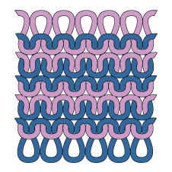
Knitted Fabrics
Knitting is a process that loops yarns together. One loop of yarn is pulled through another loop, just as you would knit at home. The loops or stitches can be varied to create different patterns and textures. Different yarns produce different effects. Textured filament yarns are often used in knits.

Slide 42
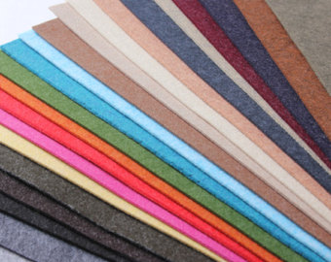
Felt Fabrics
Felt is made from short wool fibers. Wool fibers have overlapping scales. Under a microscope you can see they look like fish scales. As heat, moisture, and pressure are applied to the fibers, the scales interlock to form a solid mass.

Slide 43
Fabric Finishes

Slide 44

Fabric Finishes
After the cloth is woven or knitted into fabric, it is still in an unfinished state. The unfinished fabric is called greige goods. The fabric still has a way to go before it is ready to be sewn into finished garments. Color needs to be added if it was not added earlier in the process. A design may be printed onto the fabric in some way.

Slide 45
Solution Dyeing
Manufactured fibers are solution dyed. In solution dyeing, the dye is added to the thick liquid before it is forced through the spinneret.

Slide 46
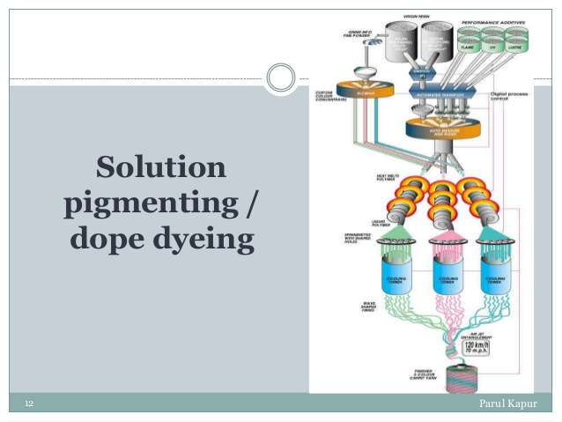

Slide 47
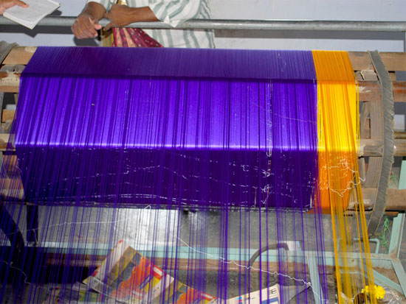
Yarn Dyeing
Before some yarn is knitted or woven into fabrics, it goes through a process called yarn dyeing. After spinning, the yarns are tightly wound on tubes, and then placed in the dye bath. Most fabrics that are plaid or striped are yarn dyed. Generally, yarn dyeing costs less than fiber dyeing, but more than piece dyeing.

Slide 48
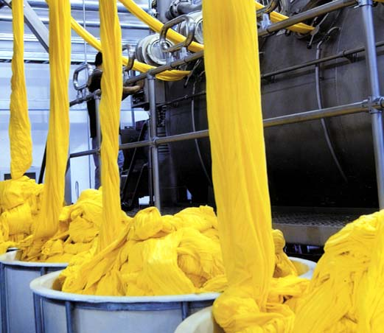
Piece Dyeing
The most common method of dyeing is piece dyeing. During the piece dyeing process, color is added after the fabric has been made. Piece dyeing allows manufacturers to follow fashion trends closely. Most, but not all, piece-dyed fabrics are solid colors.

Slide 49
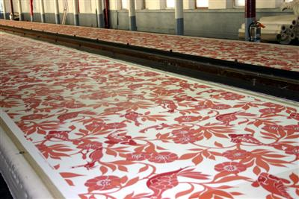
Printed Fabric
Printing also adds color to fabrics. Printing is the process of adding color, pattern, or design to fabric surfaces. You can easily tell whether fabrics have been colored in a dye bath or by printing. The wrong side of most printed fabrics is much lighter than the right side. Both sides of dyed fabrics are the same color.

