Slide 1
How to Get a Job…
And keep it!

Slide 2
Food Fact
The main reason why teens are fired from their jobs is for TARDINESS

Slide 3
Employers value these…
Honesty
Punctuality
Dependability
Creativity
Skilled
Able to adapt
Team-worker
Motivated

Slide 4
How to get a job…
Channel 1 Video
About.com video –Dressing for the Interview
About.com video –Interview Tips

Slide 5
Reading Activity
As a group, read through the article (divide into sections), highlight at least 4 main points, with one sentence/fact to support it
Write a 4 sentence summary (1 paragraph) of the article
What was interesting about the article?
Anything you didn’t know?
What worries you?
What gives you hope?

Slide 6
Some job ideas
Sno-cone shack
Parades
Spring/Summer/Fall agricultural (all down the Wasatch front)
Special skills: teaching an instrument, horseback riding
Make a summer camp (idea of Friends back home that did this)
Paper route
Babysitting
Lawn/Yard care
Janitorial
Amusement park/fairs
Farmers Markets/Craft Fairs/County and State Fairs
Government election campaigns
Selling Avon/Tupperware/MaryKay
Create you own business!
  Floral (enroll in a class at UVU…less than $200)
  Sell a product or special skill
  Tutoring

Slide 7
Basic Facts
A resale (business) license can cost anywhere from $22 to $70.
It takes 15 minutes to 150 days, depending on the business
With the internet and free web hosting sites, you can advertise for free!

Slide 8
Resumé
A resume is: a brief document showcasing your skills and qualifications for a specific objective or job
Who needs a resume? Anyone applying for a job, internship, scholarship, position in an organization, etc…
What’s in a resume? A short summary of your skills, abilities an accomplishments as well as direct personal contact information
How do I make a resume? There are many resume templates available online and in Microsoft Word
What’s the most important part of a resume? You want your resume to be your advertisement; it’s your foot in the door to get an interview. It should be concise, eye-catching and neat. And, of course, ERROR-free!

Slide 9
Resumé: The Basic Steps
Personal Information
Name (in bold, centered)
Email/Phone Number/Address
Experience
Make it relatable
May or may not be chronological
Education
Optional
Showcase skills certficates, specialized classes
Use Action Verbs!
Objective
Briefly state your intent of this application [are you seeking a job? A scholarship? An internship? A position in a club?]

Slide 10
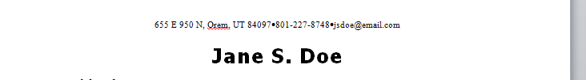
Resumé: Personal Info
A resume includes personal info:
Your name (in bold and centered at the top)
An email (professional)
A phone number (make sure the voicemail is not a song or confusing)
An address (mailing address)

Slide 11
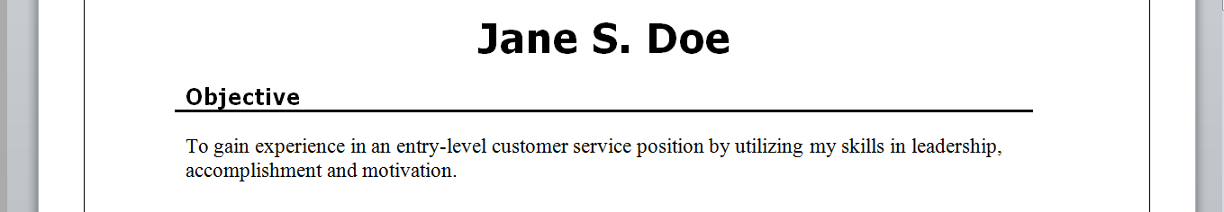
Resumé: Objective
In an entry-level position, it is good to write an “Objective” using strong-action verbs to illustrate what you are seeking
If you are trying to save space, the Objective is optional

Slide 12
Resumé: Experience
Functional resumé: One that focuses on specific skills, regardless of timeline
Chronological resumé: One that focuses on the chronological events of your experience, listed from most recent to least recent
Comprehensive resumé: Combines Functional and Chronological

Slide 13
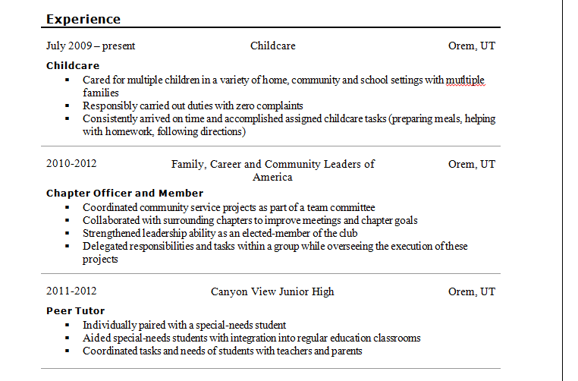
Resumé: Experience

Slide 14
Resumé: Experience
Accurately date the times of experience
Use different bold fonts or italics to focus on different positions or categories
Use strong ACTION VERBS (See attached list handout) to demonstrate your skills
Don’t lie. Make the truth sound exciting! E.g. Instead of saying: “was part of” say “Collaborated with”
Focus on YOUR skills. For an entry-level (beginning) job, you will have to focus on things you have learned in school. Classes like Peer Tutor, CTE classes with skills certificates, advanced science or English or Math classes are great
Focus on improvement: even if you weren’t in advanced classes, did you improve in the ones you were part of? Talk about that briefly!

Slide 15
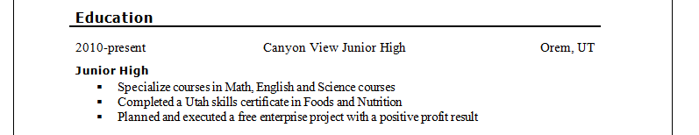
Resumé: Education
As a grade-school applicant, the employer knows you are in school, so including the “Education” section is optional.
However, it is a great place to list your skills and assets you have acquired in your class, BRIEFLY!

Slide 16
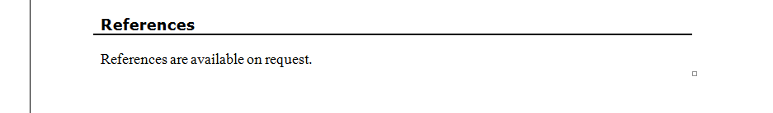
Resumé: References
Some people still recommend writing “References Available upon Request” at the bottom of their resumé…THIS IS UNNECESSARY!
References should be listed on a separate sheet of paper in the same portfolio/folder as your resume

Slide 17
Resumé: The Basic Steps
Personal Information
Name (in bold, centered)
Email/Phone Number/Address
Experience
Make it relatable
May or may not be chronological
Education
Optional
Showcase skills certficates, specialized classes
Use Action Verbs!
Objective
Briefly state your intent of this application [are you seeking a job? A scholarship? An internship? A position in a club?]

Slide 18
Preparing Your Resumé
Keep extra copies handy (go to the interview with 2 or 3)
Keep it updated
Print on plain white/off white paper (bond is best)
Cardstock = NO!!!!
Remember, it’s your ADVERTISEMENT! Lots of white space, less is more!
Keep it clean and organized
LEGALLY BLONDE CLIP ☺

