Slide 1
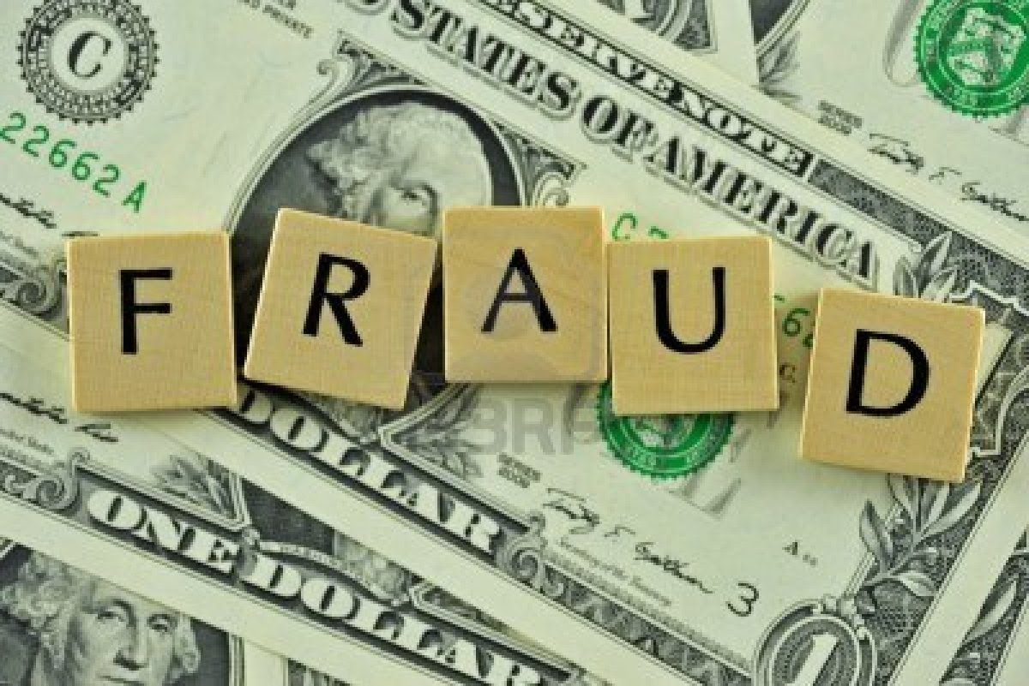
Consumer Fraud
and unfair sales tactics

Slide 2
Unfair or deceptive selling methods that are illegal.
Indicating a warranty that does not actually exist
Selling an item as free when purchased in conjunction with another item and then raising the price of the other item
Failing to provide an estimate for repairs exceeding $25.00
Saying that repairs are necessary when they are not
Saying that repairs have been made when they have not
Offering a prize that is contingent upon observing a sales promotion without informing the consumer
Selling an item as new, when it is, in fact, used
Providing a substitution of an advertised consumer commodity when there was no intention to supply the original commodity
To tell a customer that he/she has been especially selected to receive a bargain or discount when it is not true
To tell a customer that he/she is a winner of a contest when it is not true
Requiring a deposit from a consumer unless the deposit obligates the seller from offering the items to another buyer and is accompanied by a dated receipt.

Slide 3
Other laws to know about:
There are additional laws which prohibit unfair competition among businesses: laws that prohibit selling an item at a price less than cost, advertising goods they are not prepared to supply, and to prevent a seller from offering different prices to different customers.
These laws were enacted to prohibit monopolies by allowing one competitor to use deceptive practices to put other competitors out of business.

Slide 4
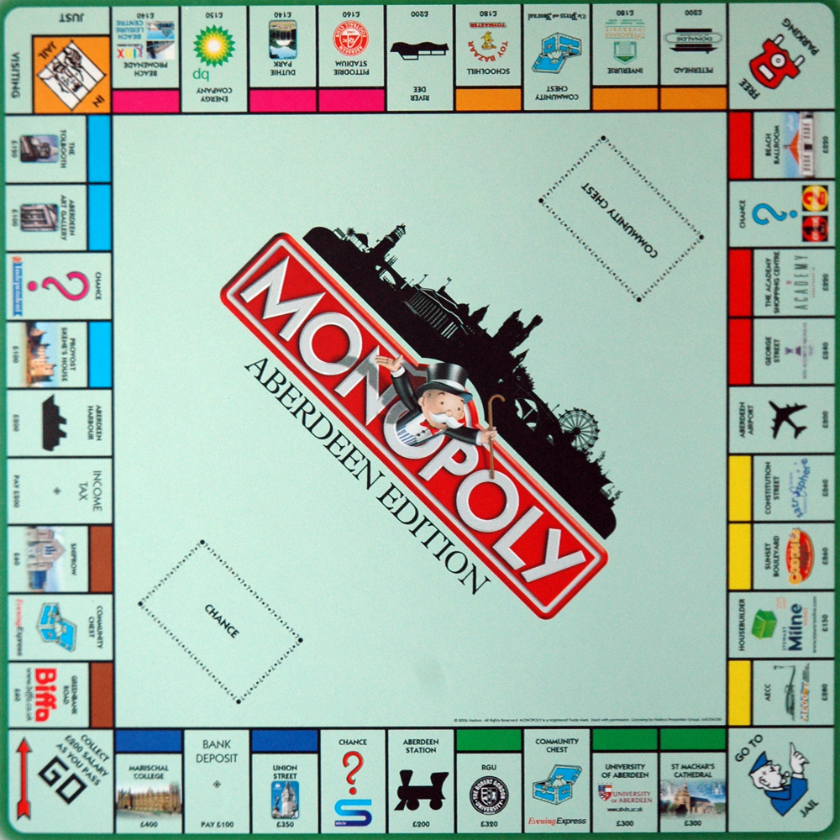
What is a Monopoly?
More than just a catchy board game, a monopoly happens when one company or entity has the majority of control of a certain product, or service, so much so that they can manipulate the prices because of a lack of competition in the market.

Slide 5

Lemon Law
Many states, including Utah, have what is known as the Lemon Law. This law provides that consumers who buy a new automobile or motor home with significant defects that cannot be repaired, or is a lemon, can obtain relief, through a cash refund or replacement.

Slide 6
The Cooling off Rule
When a consumer buys an item at a home or at a location that is not the seller's regular place of business, the consumer has three days to cancel that purchase if the cost was $25.00 or more. The consumer's opportunity to cancel for a full refund extends until midnight of the third business day following the sale. This is a rule set by the Federal Trade Commission (FTC).

Slide 7
Pyramid Schemes
Pyramid schemes are illegal scams in which large numbers of people at the bottom of the pyramid pay money to a few people at the top. Each new participant pays for the chance to advance to the top and profit from payments of others who might join later. A typical pyramid looks like this:

Slide 8
Ponzi Schemes
Ponzi Schemes are very similar to pyramid schemes, except that in a pyramid scheme there is an actual product to be sold by the people at the bottom. In a Ponzi scheme, the only thing that is purchased is the ‘Membership’ so, selling more memberships is the only way to get more income. These generally fall apart, and everyone except the people at the top lose all the money they have invested.

Slide 9

The story of the lemonade stand:
Little Kenny wants to open a lemonade stand, but he doesn’t have any lemons or sugar. Kenny goes to his friends Mike and Rick and says “Hey guys, I want to start a lemonade stand, for a small initial investment of only $5 each, you can have a cut of the profits.

Slide 10

The story of the lemonade stand:
So, Mike and Rick decide to give Kenny $5 each, because this seems like a good investment. When Kenny sells his lemonade at $.50 a cup, they’re sure to make a profit.

Slide 11
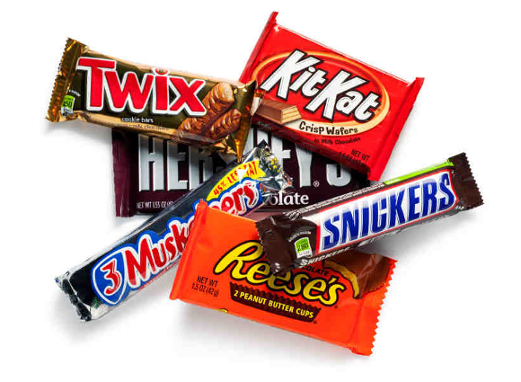

The story of the lemonade stand:
The only problem is, Kenny gets distracted and uses their money for candy bars instead of lemons and sugar.
Mike and Rick eventually start asking questions about where their profit is.

Slide 12


The story of the lemonade stand:
Kenny doesn’t have any more money to buy lemons and sugar, so he can’t make a profit selling lemonade to pay Mike and Rick back, so instead, he goes to his friends Cherie, Calvin, Todd, and Sam. He makes them an offer, just like with Mike and Rick, but this time, he askes each of them for $10. He pays Mike and Rick their original a few dollars that he tells them is profit from the lemonade, so they each get $3, and he keeps the rest to buy more candy bars, and go to the movies.

Slide 13
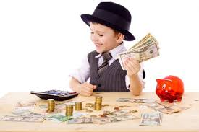
The story of the lemonade stand:
There’s still no lemonade, but Kenny’s feeling pretty rich, after all, he only had to pay Mike and Rick $6, but he got to keep $.

Slide 14

The story of the lemonade stand:
The only problem is, now Cherie, Calvin, Todd, Sam, and Michelle are asking for their share of the profit, and Mike and Rick want more profit from their investment. The only way Kenny can keep going is if he recruits more people to invest.

Slide 15

The story of the lemonade stand:
So Kenny recruits even more of his friends to invest, In fact this time, he gets 10 friends and asks for $15 from each of them. So, he pays Cherie, Calvin, Todd, and Sam some ‘profit’ and he pays Mike and Rick some more ‘profit’, and keeps the rest. Meanwhile, he has to go find more people to pay the last 10 friends, and everyone else.

Slide 16

The story of the lemonade stand:
Finally Rick asks, “Hey, where’s all the lemonade, anyway? I don’t see lemons. I don’t see sugar, or a stand. What’s going on?”

Slide 17

The story of the lemonade stand
Kenny gets scared, and moves to Cortuguay with everyone’s money.

Slide 18
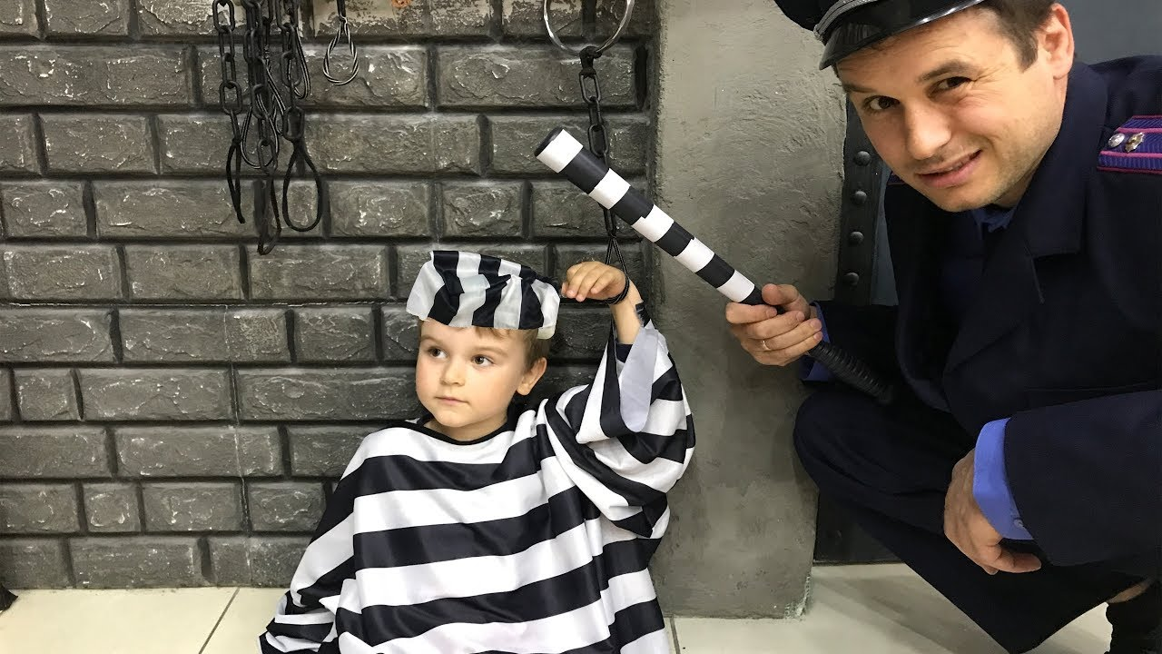

The story of the lemonade stand
Meanwhile, the police get wind, and arrest Mike and Rick for participating in a ponzi scheme because the did not do Due Diligence to make sure their investment was legal.
The rest of the recruits lose their money, and everyone is sad.

Slide 19

The story of the lemonade stand
The End

Slide 20
Things you should know:
1. They are losers. Pyramiding is based on simple mathematics: many losers pay a few winners.
2. They are fraudulent. Participants in a pyramid scheme are, consciously or unconsciously, deceiving those they recruit. Few would pay to join if the diminishing odds were explained to them.
3. They are illegal. There is a real risk that any pyramid operation will be closed down by police and the participants subject to fines and possible arrest.
*Taken from pamphlet, "Pyramid Schemes: Not What They Seem"

Slide 21






Multi-level Marketing (MLM’s)
These are more or less legal, but be careful.
You have to pay for the product you are selling
The structure is nearly identical to a pyramid scheme, but in order to be legitimate, they need to have more profit from actual product sales to consumers than from membership fees.
Product is sold to friends and family through “parties.” Another name for this is Network marketing.

Slide 22

Affinity Fraud
A type of fraud that targets a certain demographic. Perpetrators may attempt to relate to or exploit characteristics common to a certain group of people. Targeted groups are typically the Elderly, Ethnic groups, and Religions.

Slide 23

HOME IMPROVEMENT FRAUD
Written Contract-put every promise in writing– A down payment of 10-30% is reasonable, but NEVER pay in full until job is done with proof subcontractors have also been paid.
Set standards of quality for all materials used.
Check with the Consumer Protection Agency or the Better Business Bureau to see if there have been any complaints against the contractor.
Ask Utah contractor's license and to get references from other jobs that have been done.
Many con artists will approach owners of homes that obviously need repairs and tell the owner that they were doing a job in the neighborhood and have leftover materials, then offer them a great deal. After the job is done, they claim there has been a misunderstanding and that the customer owes a lot more money than was originally quoted.

Slide 24
Other Types of Fraud:
Vacation fraud
Mechanic fraud
Telephone fraud
Health and nutrition fraud
Student loan/scholarship companies
Skimming
Identity theft/credit card theft
Fake websites
Phishing
Tax fraud (pretending to be the IRS)

Slide 25

Agencies that help:
Federal Trade Commission (FTC)
Food and Drug Administration (FDA)
Consumer Product Safety Commission (CPSC)
Bureau of Consumer Protection
Better Business Bureau (BBB)
Consumer Protection Agency

Slide 26

How to navigate a contract:
A contract is a legal agreement between two or more parties. It is enforceable by law.
Disclosure: The fine print. This gives you all the information about an institutions policies, such as fees, late fees, grace periods, cancellation fees, etc. ALWAYS READ EVERYTHING!!!
Grace period: The time between the billing date and the payment due date when no interest is charged.

Slide 27

Common Late Penalties
Late fees
Finance Charges
Increased interest rate

