Slide 1

Consumerism pt. 1
Rights and Responsibilities, Comparison Shopping, Online Commerce

Slide 2
...what is consumerism?

Slide 3
hi
1. Organized-efforts by individuals, groups, and governments to help protect consumers from policies and practices that infringe consumer rights to fair business practices.
2. Doctrine that ever-increasing consumption of goods and services forms the basis of a sound economy.
3. Continual expansion of one's wants and needs for goods and services.
[www.businessdictionary.com]

Slide 4
What’s your consumer score?
If you were given $1,000.00 today, what would you do with it?
Do you check your receipts to make certain that you have been charged
correctly?
3. Do you count your change to make certain that it is correct?
4. Do you compare different prices and brands of the same item at more than
one store, then select the best value to purchase?
5. Do you compare the warranties of different brands when selecting a brand
to purchase?
6. If you feel you have been wronged by a business, do you complain to the business and attempt to right the wrong?
7. Do you find yourself buying things that you had not planned to buy?
8. Do you save money regularly?
9. Do you often find yourself borrowing money from parents, friends or
siblings?
10. Do you keep a record of what you earn and what you spend?
11. Do you shop sales?
12. Do you read the instructions for use and care of a product and follow
them?
13. Do you keep your sales receipts, warranties, and instructions?
14. Do you read the store's return and exchange policy before making your
purchase?

Slide 5
Figure your score
On question #1, give yourself five points if you selected something to do with your money that is consistent with your goals and values in life.
Give yourself two points for each question you answered, as follows:
#2—yes #6—yes #10—yes
#3—yes #7—no #11—yes
#4—yes #8—yes #12—yes
#5—yes #9—no #13—yes
#14—yes

Slide 6
SO WHAT TYPE OF A CONSUMER ARE YOU?????
25-31 points Great! Keep up the good work!
19-25 points Fair. You should begin to make some changes.
14-19 points Not too good. Consider making some big changes
Less than 14 Take good notes during this lecture , you'll need them!

Slide 7
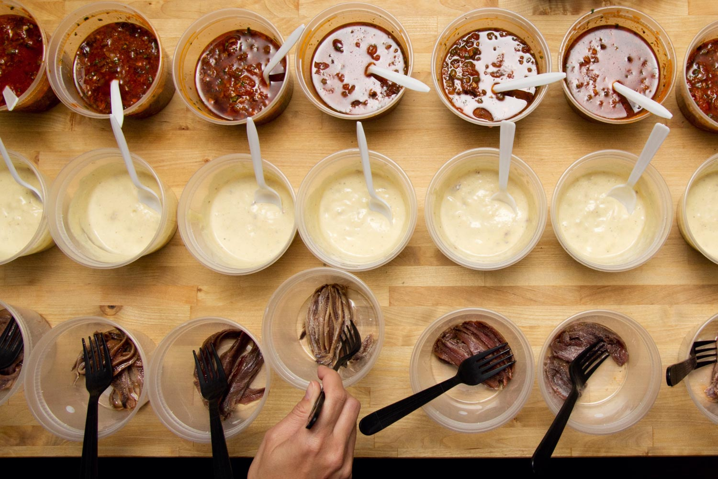
Taste Testing
Notes:
chocolate chips
craisins
cheezits

Slide 8
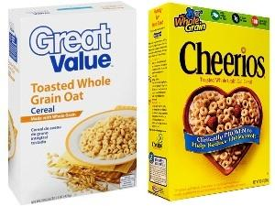
Name Brand vs. Store Brand
After this activity, are you more or less inclined to buy the name brand or store brand?
Is name brand/store brand always better?

Slide 9
1 Minute Reflection
1 minute reflection
What are some “Pro Tips” on how to comparison shop?
Notes:
check multiple sources

Slide 10
Rights and Responsibilities of Consumers
In 1962, President Kennedy presented a speech to the United States Congress in which he extolled four basic consumer rights, later called the Consumer Bill of Rights.
The Right to…
Safety
Be Informed
Choose
Be Heard
The United Nations Guidelines for Consumer Protection later expanded these to 8 rights, which added the following:
The Right to…
Satisfaction of Basic Needs
Redress
Consumer Education
A Healthy Environment
Notes:
1. The right to choose. Within reason, consumers have the right to be assured that a selection of quality products and services are available for them to purchase at competitive prices. It means that a consumer should have the opportunity to select the goods or services that he or she wants to purchase.
2. The right to safety. Consumers have the right to expect protection from hazardous products and services purchased in the marketplace, particularly if used properly for their intended purpose. Consumers have protection from the sale and distribution of dangerous goods and services.
3. The right to be informed. Consumers have the right to receive adequate information about products on which to base buying decisions. Reliable sources exist to inform consumers about products or services.
4. The right to be heard and the right to voice. Consumers have the right to equal and fair consideration in government policy-making situations, as well as prompt treatment in administrative courts or legal communities. In other words, consumers have a right to complain when there are problems or concerns. They have the right to speak up, to be heard, and to expect positive results. Through this right, both business and government are expected to respond to consumers.
5. The right to redress or remedy. Consumers are afforded an opportunity to have a hearing to voice dissatisfaction such that a resolution is reached and the complaint is settled satisfactorily.
6. The right to environmental health. Consumers should be protected from the devastating effects of air, earth, and water pollution that may result from the performance of daily marketplace operations. Consumers have the right to live and work in an environment that does not threaten the well-being of present and future generations.
7. The right to service. Consumers may expect convenience, the right to be treated with respect, an appropriate response to their needs and problems, and good quality design and workmanship in a product. Additionally, consumers may expect a courteous manner while in a store or other establishment even if a purchase is not made. Service means access to essential goods and services to include adequate food, shelter, clothing, healthcare, education and sanitation¬ basic needs that should be available to all consumers.
8. The right to consumer education. Consumers are extended the right to continuing consumer education that supports the benefits and enjoyment of other specific rights. Consumers have the right to some form of training and mastery of knowledge and skills needed to make informed decisions in the marketplace.

Slide 11
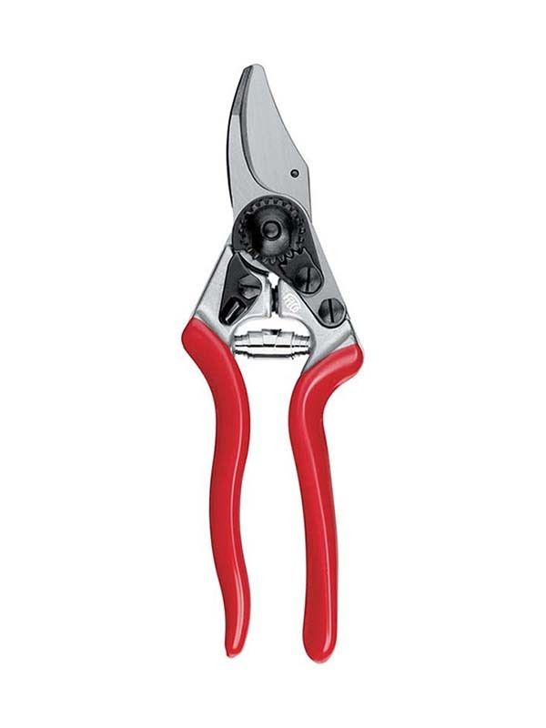
Recognize the “value” of an item, not only the price.
For an avid gardener, good pruning shears are key. You might prefer a pair of high-quality, Swiss-made ones which sell for $50 retail. But to save, you purchase a $15 pair made in China from a hardware store. Your set wears out every 6 months, you toss and replace them for another $15. Instead, you could’ve bought the pruners you wanted new for $32 on eBay. In time, you would have saved money on a long-lasting item of higher value.
Cost per use: value of an item is directly related to how much use you get out of it. The 'sweet spot' of a purchase, then, is the one that has the most uses for the cost
Notes:
compare different store brand by name brand stuff

Slide 12
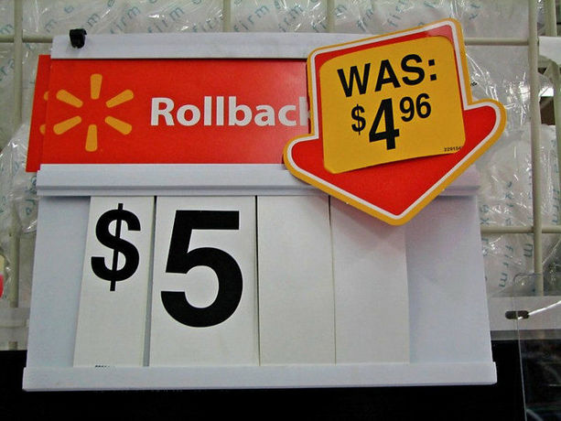
Beware of deals that aren’t really deals.
Just because a store is going-out-of-business doesn’t mean it’s offering good deals. You’ll see lines of uninformed consumers snaked around stores advertising liquidation sales. Often these shoppers could go to a discount store and buy their items for less everyday! It’s easy to get swept up in the excitement of a crowd-buying mentality and overpay.
Notes:
The plate story.

Slide 13

Use the Internet to compare prices of the same or similar items
Dozens of websites were created to help consumers comparison shop.
Make sure the sites you use do not only include companies who pay them to be included in their resource lists. This business model creates a conflict of interest and disregards offers from companies that do not advertise with them. When searching for flights on Orbitz, for instance, also check fares on Southwest Airlines’ site. Orbitz was started by six of the largest airlines of which Southwest was not a part. Despite having some of the lowest prices, Southwest doesn’t advertise regular passenger tickets on other sites.

Slide 14
Role Play
Smaller groups create a role play based on a consumer right and responsibility.
About 2 minutes
Acting
Write a script on paper, everyone sign their names.
Perform for the class.
keep it simple, 10 min.

Slide 15
What are my Responsibilities as a Consumer?
“As a consumer, it is your responsibility to educate yourself about your rights and also to shop around and gather as much information as you can before making a purchase. After making a purchase, it is your responsibility to read and follow any product instructions or warnings, so as to keep yourself safe. If you observe breaches of the Consumer Protection Act, you should bring it to our attention this helps us in our job of protecting consumers’ rights.”
Federal Trade Commission (FTC)

Slide 16
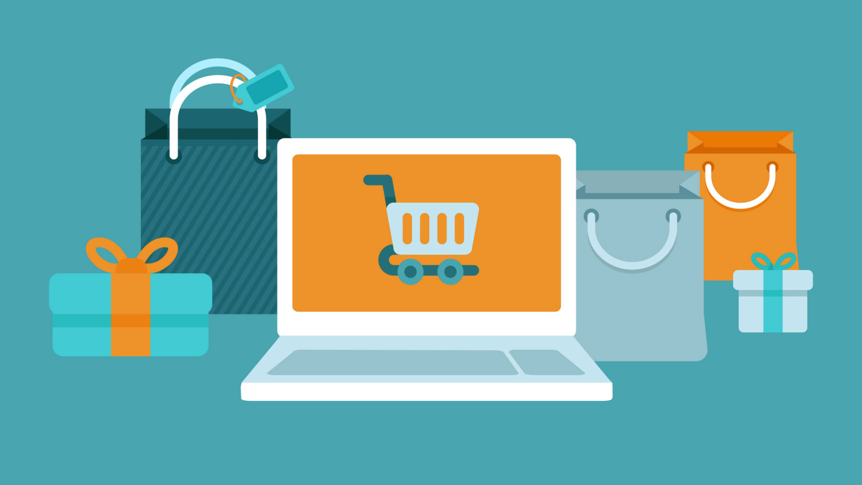
Online Commerce (or “Ecommerce”)
What are some pros and cons of Ecommerce?

Slide 17
Pros and Cons
Con: Lack of Personal Touch
Pro: Easier to Compare Prices
Pro: Access to Stores Located Remotely
Con: Inability to Experience the Product Before Purchase
Pro: No Need for a Physical Store
Con: Need for an Internet Access Device
Pro: Lots of Choices
Pro: Stores Are Open All the Time
Con: Credit Card Fraud
Pro: Instantaneous Purchase of Digital Goods
Con: Delay in Receiving Goods
Pro: No Standing in Queues or Being Placed on Hold Forever

Slide 18
How to Shop Safely Online
1. Use Familiar Websites
2. Look for the Lock
3. Don't Tell All
4. Check Statements
www.pcmag.com
Notes:
Students will research how to shop safely online.
Make a poster with tips.
Use glogster to make posters. Turn in to me.

Slide 19
Components of a Safe Website
1. No pop-up ads.
2. Other shoppers had good experiences.
3. The site has a physical address or phone number.
4. There is a return policy.
5. Prices aren't too low to believe.
6. Credit cards are accepted.
7. The site has a privacy statement.
Notes:
1. No pop-up ads.
Be very careful about clicking on realistic-looking retail ads that pop up on your screen while you surf the Web, says BBB Online’s Salter. Pop-ups often don’t take you to a website at all, but rather to a phony operation designed to steal your personal information. Meanwhile, most reputable retailers don’t use pop-ups: they know that customers strongly dislike them and that using them may turn customers away.
2. No unsolicited email.
Reputable online retailers don't send you solicitations via email unless you specifically signed up to get information from them or their partners. Be especially suspicious of unsolicited email from seemingly reputable sites like PayPal, eBay, or national banks -- many of them are from “spoof sites,” sites meant to fool you into giving personal information by mimicking other sites you may do business with. You can always contact the name-brand retailer separately or by phone to check if the email was authentic.
3. Other shoppers had good experiences.
Check with #IF($EnableExternalLinks)BBBOnline.o#COMMENT#ENDCOMMENTrg#ELSEBetter Business Bureau#ENDIF, which maintains a list of more than 38,000 online merchants that have agreed to the BBB's best-business practices, including full disclosure of return and delivery policies and their costs. BBB member websites will carry an emblem with a yellow torch. Shoppers can also look at online customer feedback sites to see what others say. “Even some big brand-name websites can have very poor customer service,” notes Jane Driggs, president and CEO of BBB Utah in Salt Lake City. “Shoppers really should go on a search engine and look up what others are saying about a company before they buy.”
4. The site has a physical address or phone number.
If they do, that's a good sign that the business is for real. “Reputable companies will post their location and phone number so you can get in touch with them if there’s a problem,” says Salter. Call the number for reassurance.
5. There is a return policy.
Reputable sites will spell out their return policy, including their shipping policies. If you can’t find this information on the site, shop elsewhere.
6. Prices aren't too low to believe.
Everyone likes a bargain, but be wary of sites that offer products like software or music for prices that are far lower than those for the same product from any other merchant. “They could be unlicensed products, or stolen goods,” BBBOnline’s Salter warns. Knock offs of brand-name merchandise are quite often peddled over the Internet.
7. Credit cards are accepted.
Credit cards give you more protection than a debit card does. This is important if the wrong person gets your account number, says Friedman. Reputable sites will accept a variety of credit cards. That's a good sign that they are legitimate, because they had to apply to the leading card issuing companies for approval. Suspicious sites may ask for checks or debit card numbers -- be wary.
8. The site features a padlock or unbroken key icon.
Before giving that credit card number out, check that the site is enabled and encrypted for online safety. Encryption is a data-scrambling technology that keeps crooks from stealing your personal financial information. Look for icons such as a padlock or unbroken key at the top or bottom of your browser as a sign that encryption is used.
9. An "h#COMMENT#ENDCOMMENTttps:" starts the web address when you check out.
Make sure that “h#COMMENT#ENDCOMMENTttps:” -- not just an “h#COMMENT#ENDCOMMENTttp:” -- begins the webpage address at the top of your screen before you key in your credit card information at checkout. That final “s” means that a secure, encrypted connection is in place between your computer’s browser (i.e., Internet Explorer) and the website you’re visiting. If you don’t see the final “s” starting the address when checkout time occurs, stop the transaction.
10. The site has a privacy statement.
Reputable sites will tell you how they protect your personal information and secure your credit-card data and whether they sell information about their customers to other companies. This is a disclosure statement and you should consider whether you feel comfortable with a retailer’s policy before buying.
'Tis the season to be jolly, so follow these tips to end up a happy shopper. “Just make sure you do your homework," advises Portaro. "Make sure it’s a reputable company first.” That's good advice from someone who learned the hard way.
Copyright (c) Studio One Networks. All rights reserved.

Slide 20
Financial Contracts- Some terminology
Automatic renewal clauses."If we don't hear that you are terminating, you will automatically be renewed for another year, month or whatever the term of the original contract is.
Early termination fees. With some companies, if you want to end the relationship before the contract is over, you'll have to pay a penalty. "
Liability waivers. These are common in many contracts, especially ones in which there is risk involved in an activity you or a family member is about to participate in. If you have children who have gone to a skating rink or laser tag facility, you have probably signed one of these.
Unilateral amendment clauses. ...can be translated into: "We can change the terms of this contract at any time."
Notes:
find some financial contracts, finance in the classroom, booklets, like cell phone or gym

Slide 21
Example Contracts
Spotify Agreement
part 15
Netflix Agreement
part 5

Slide 22
Consumer Protection Laws
A group of laws and organizations designed to ensure the rights of consumers as well as fair trade, competition, and accurate information in the marketplace.

Slide 23

Example: State-Specific Lemon Laws
Most state lemon laws specify that a manufacturer must provide a refund or replacement for a defective new vehicle when a substantial defect cannot be fixed in four attempts, a safety defect within two attempts or if the vehicle is out of service for 30 days within the first 12,000 to 18,000 miles or 12 to 24 months.

Slide 24
Protections Under the Utah Lemon Law
Under the law, the buyer is entitled to a refund or replacement if the vehicle meets all of the following criteria:
The vehicle must have been bought in Utah.
It must be new and under warranty.
It must weigh under 12,000 lbs.
The defect must "substantially impair the use, market value, or safety of the vehicle."
The manufacturer must have tried to resolve the defect at least 4 times OR the buyer must have been unable to use the vehicle a total of 30 days, whichever comes first, during the first 12 months of the warranty.
The defect must not be caused by owner neglect, abuse, or unauthorized vehicle modifications.
The buyer must adhere to the manufacturer's informal dispute settlement or arbitration procedure, if there is one.
  Many manufacturers use the Better Business Bureau Auto Line as an informal dispute settlement service. Contact your vehicle's manufacturer or refer to your owner's manual for details.

Slide 25
Consumer Protection Agencies
Group 1. FDA
Group 2. BBB
Group 3. FTC
Group 4. USDA
Group 5. CPSC
Now YOU get to be the expert
Google Slides
create a one slide “poster”
3 computers/group
Notes:
binder

Slide 26

(Agency Name in Full)
Were you wronged? Let [Agency Name] help!
“Consumer quote about how awesome the agency is.”
did you know their website is found at Ms. Brown ?
Facts about the Agency: they are really awesome!
they are super cool too
they help a lot of people each year
stat- stat- stat- stat- stat
use this agency to help you be happier in life

Slide 27
How to Complain
First, take up your issue with the company.
Then, if that didn’t work, look for a third party (like a consumer protection agency) for help.

Slide 28
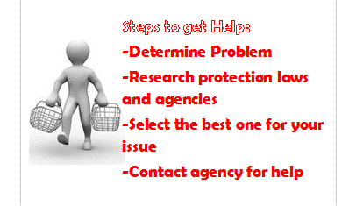
Steps to get Help

