Slide 1

Identity Theft & Consumer Protection

Slide 2
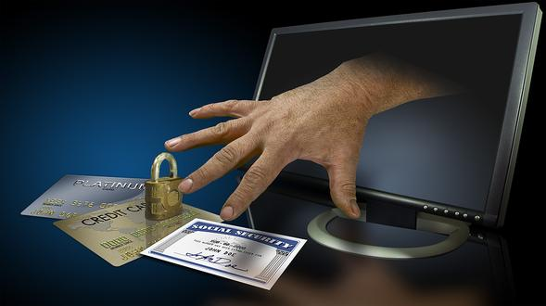
Fraud Quiz
Identity Fraud Quiz
How to defend yourself against Fraud

Slide 3
Questions to Consider
What are consumers rights and responsibilities?
What is the purpose of consumer protection laws and agencies?
How can I avoid identity theft and fraud?
How do I understand financial contracts?
What are ways to avoid financial scams?

Slide 4
Consumer Rights & Responsibilities
RIGHTS | RESPONSIBILITIES
To Safety | To Use Products Safely
To Be Informed | To Seek Information and Use it to make Decisions
To Choose | To Choose Goods and Services Carefully
To Be Heard | To Speak Up and Let Likes and Dislikes Be Known
Consumer Bill of Rights (State of the Union Address of 1962, President John F. Kennedy) Source: Thomson South-Western, Economic Education for Consumers; USOE Adult Roles & Responsibilities

Slide 5
Agencies & Sources of Assistance
Food & Drug Administration (FDA)
Consumer Product Safety Commission (CPSC)
Federal Trade Commission (FTC)
Better Business Bureau (BBB)
Bureau of Consumer Protection (BCP)
Consumer Unions (Consumer Product-Testing Organizations)
Source: USOE Adult Roles & Responsibilities Curriculum

Slide 6
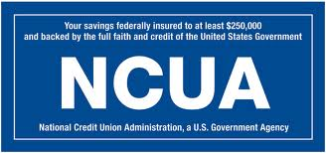
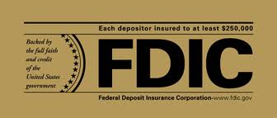
Who Protects Savers?
Credit Unions
Banks
Notes:
FDIC- Federal Depository Insurance Corporation
-Insures funds in a federally chartered bank up to $250,000 per account.
-Created in 1933 to maintain public confidence and stability
NCUA- National Credit Union Association
-Insures funds in a credit union up to $250,000 per account.

Slide 7
Identity Theft
“True-name Fraud”
Someone wrongfully acquires and uses a consumer’s personal identification, credit, or account information without your permission.
They may ask for this information:
  Social Security Numbers
  Name
  Address
  Date of Birth
  Mother’s Maiden Name
  Passwords
  PINs

Slide 8
Fraud
A deliberate deception, designed to secure unfair or unlawful gain.
  (“Cheating the Consumer”)

Slide 9
Ways to Avoid Identity Theft
Monitor your credit report.
Don’t give out personal information to unknown people or companies.
Protect your credit and debit cards.
Protect your mailbox.
Protect your wallet.
Use passwords and PINs that cannot be easily guessed.
Use anti-virus software on your computer.
Notify your bank when you change your address or phone number.

Slide 10
Respond to the following scenarios based on what you have learned.
Bethany purchased a new pair of shoes from the Internet. What steps should she take to ensure her identity was protected while making the purchase?
Source: FEFE 3.1
Notes:
Bethany should have all of the details about the shoes before buying, make sure her purchase is made over a secure line stating “https” or “shttp”, she should use a credit card or escrow service, keep proof handy, and research the company to ensure they are reputable.

Slide 11
Respond to the following scenarios based on what you have learned.
Dana went out to dinner and left her credit card there. The next day she called the restaurant and they said they didn’t have the card. What should she do?
Source: FEFE 3.1
Notes:
Dana should call and cancel her credit card immediately and follow up in writing; keep a record of all correspondence, file a police report, contact the three major credit bureaus, and file a complaint with the Federal Trade Commission.

Slide 12
Respond to the following scenarios based on what you have learned.
Jacob has just finished writing bills. What steps should he take to ensure the bills reach their destination safely?
Source: FEFE 3.1
Notes:
Jacob should destroy all statements not needed and store the rest in a locked file and he should not leave statements lying around. He should deposit mail in a post office collection box or at the post office.

Slide 13
Respond to the following scenarios based on what you have learned.
Sam purchased a bicycle on credit. When he received his credit card statement, he noticed several charges he did not make. What should he do?
Source: FEFE 3.1
Notes:
Keep receipts of purchases made with a credit card, file a complaint with the credit card company immediately (within 60 days), follow up with writing, keep a detailed record of correspondence, contact the credit bureaus, and contact the Federal Trade Commission.

Slide 14
Understanding Financial Contracts

Slide 15
Disclosure Information
Provides full information about a financial institution’s policies.
Such as electronic funds transfer policies, lending policies, interest crediting, and compliance with banking regulations. These statements are required by law.

Slide 16
Grace Period
The time between the billing date and the payment due date when no interest is charged.

Slide 17
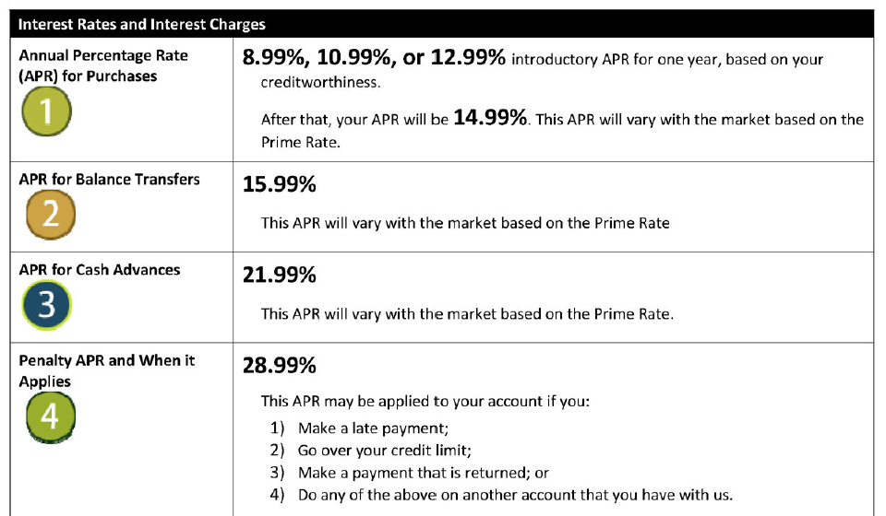
Late Payment Penalties
Late Fees
Finance Charges
Increased Interest Rate

Slide 18
Method of Interest Calculation
Average daily balance excluding new purchases
Average daily balance including new purchases with a grace period
Average daily balance including new purchases with no grace period
Two-cycle average daily balance including new purchases

Slide 19
Tips To Help Dump Debt
Write it down
  Make a list of how much money you owe and the interest rate.
Start the snowball rolling
  Pick the debt with the highest interest rate and put extra cash toward that balance. Negotiate a repayment schedule.
Cut it out
  Select an activity and stop it for a month or two, put it toward the debt. Or, sell assets.
Don’t forget to save
  Start saving, even if it’s a small amount every week.
Source: NEFE

Slide 20
Concerning interest on debt…
Interest never sleeps nor sickens nor dies;
It never goes to the hospital;
It works on Sundays and holidays;
It never takes a vacation;
It never visits or travels;
It takes no pleasure;
It is never laid off work nor discharged from employment;
It never works on reduced hours

Slide 21
Quote
Once in debt, interest is your companion every minute of the day and night; you cannot shun it or slip away from it; you cannot dismiss it; it yields neither to entreaties, demands, or orders, and whenever you get in its way or cross its course or fail to meet its demands it crushes you.
~ J. Ruben Clark

