Slide 1
Vitamins
Fat Soluble
Water Soluble
A –Eyesight (r/o/y F&V)
D – Bones (sunlight, milk)
E – cell membranes
K – blood CLOTTING
C – Immune system, collagen, wounds (citrus, broccoli)
B-complex
Folate –neural tube (whole grains, dark green veggies, nuts): *spina bifida
Thiamin -*beriberi
Riboflavin
Niacin -- *pellagra

Slide 2
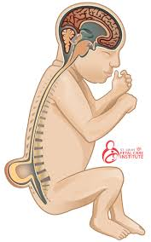


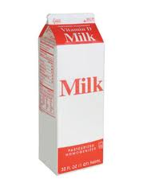
VITAMINS
Folate
Prevent neural tube birth defects
Whole grains, dark green veggies
Vitamin C
Immune system, collagen, heal wounds
CITRUS, broccoli
Vitamin D
Build bones and teeth
Fortified in our milk
AKA…Ascorbic acid
Also comes from the sun

Slide 3
Minerals
MACRO
TRACE
All for building bones and teeth
Calcium: *osteoporosis
Phosphorus:
Magnesium:
Iron: *anemia
Iodine: *goiter
Copper:
Zinc:
Fluoride:

Slide 4
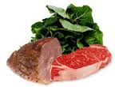
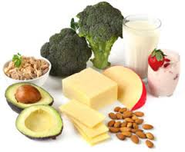
MINERALS
MOST DEFICIENT IN THE USA:
Iron
Red meats, leafy greens
Deficiency: Anemia (low red blood cell count)
CALCIUM
Milk & Dairy, green veggies
Deficiency: Osteoporosis
Function: bones and teeth
Function: build red blood cells

Slide 5
ELECTROLYTE MINERALS **SALTY (NaCl) Bananas (Potassium)**
SODIUM (Na)
POTASSIUM
CHLORIDE (Cl)
Prevent cramps
Maintain fluid balance
Maintain fluid balance
ELECTROLYTES maintain fluid balance in cells, tissues and muscles. They are imbalanced easily when you are dehydrated. To prevent cramps, get your electrolytes!!!

