Slide 2
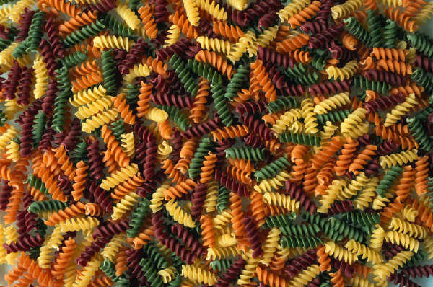
PASTA!!!

Slide 3


Don’t cut long pasta with a knife –twirl it with your fork.

Slide 4
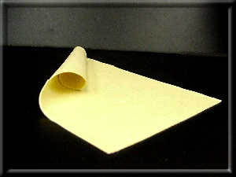
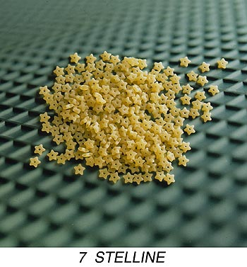
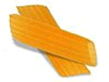

Types of Pasta
Dried
Frozen
Short
Shaped
Fresh
Long
Sheet

Slide 5
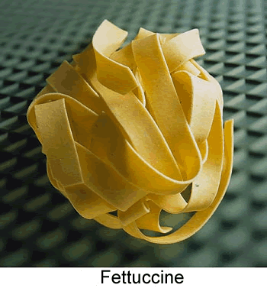
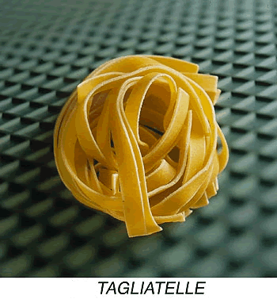
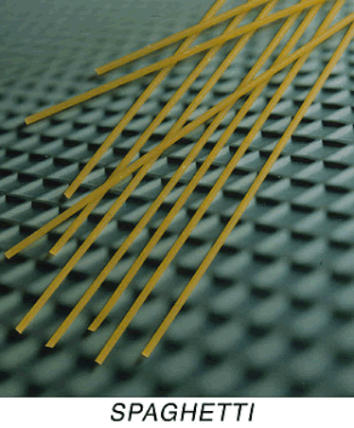
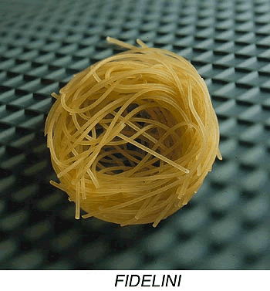
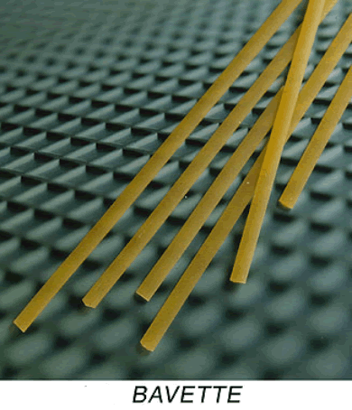
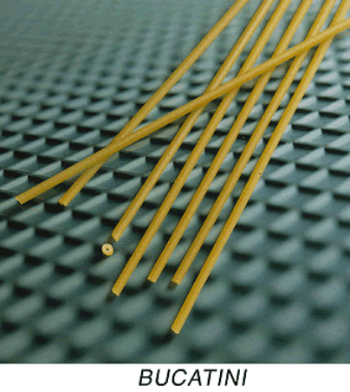
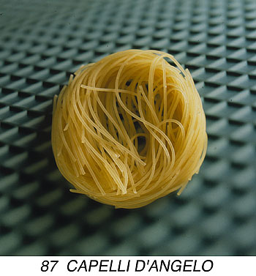
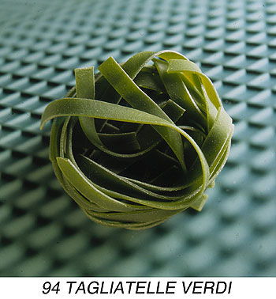
Long Pasta

Slide 6
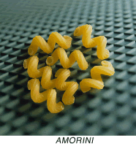
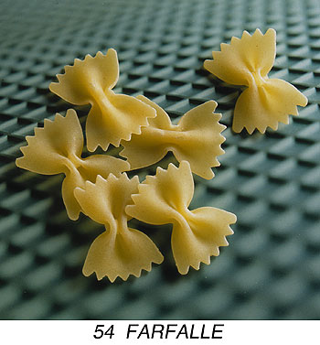
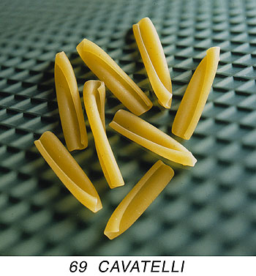
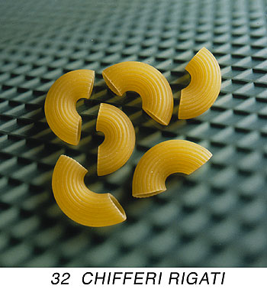
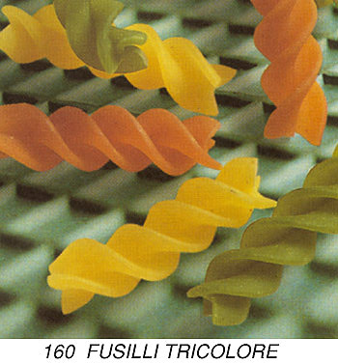
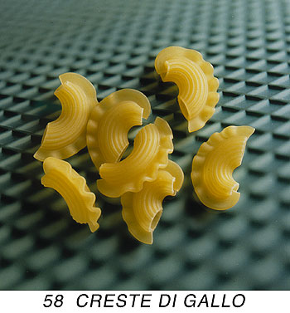
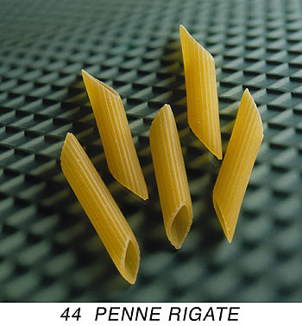
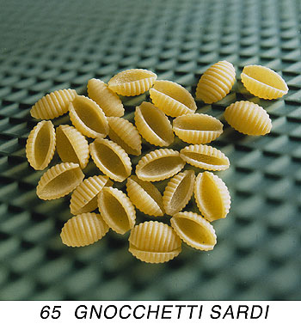
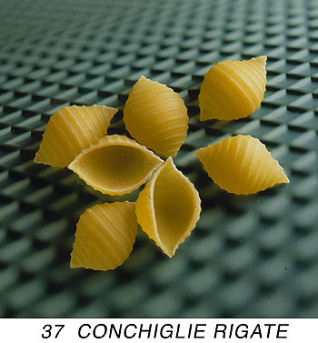
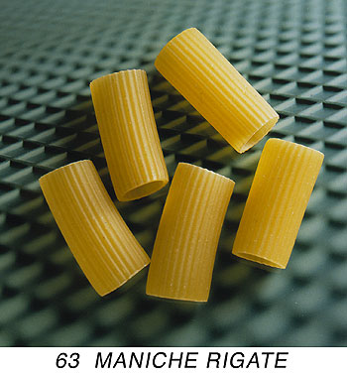
Short Pasta

Slide 7
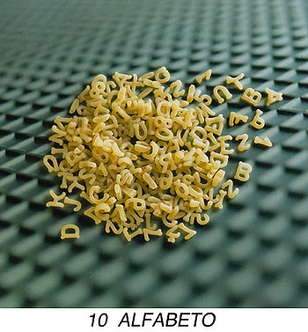
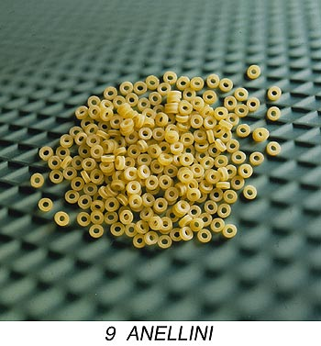
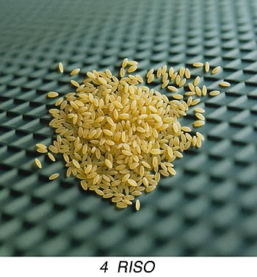
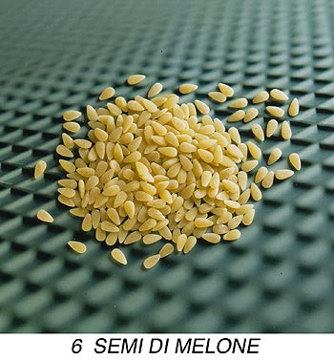
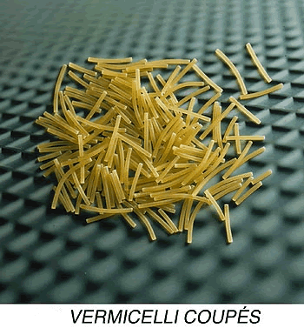
Pasta used in Soups

Slide 8
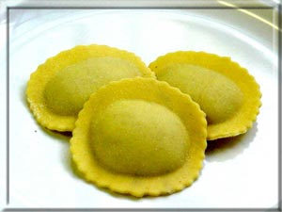
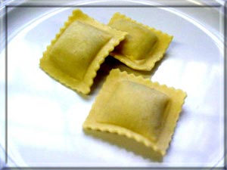
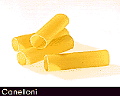
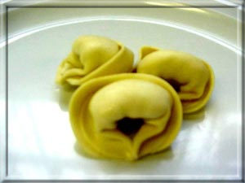
Shaped Pasta
Ravioli
Canelloni
Tortellini

Slide 9
Uses of Pasta
Mainstream cooking
Complement to main dish
Alternative to potato
Quick and easy to cook; can be stored easily
Vegetarian Cooking
Blends well with vegetables and sauce
Can be served plain
Cooking for people with special food needs
Very adaptable products
Can be served plain

Slide 10


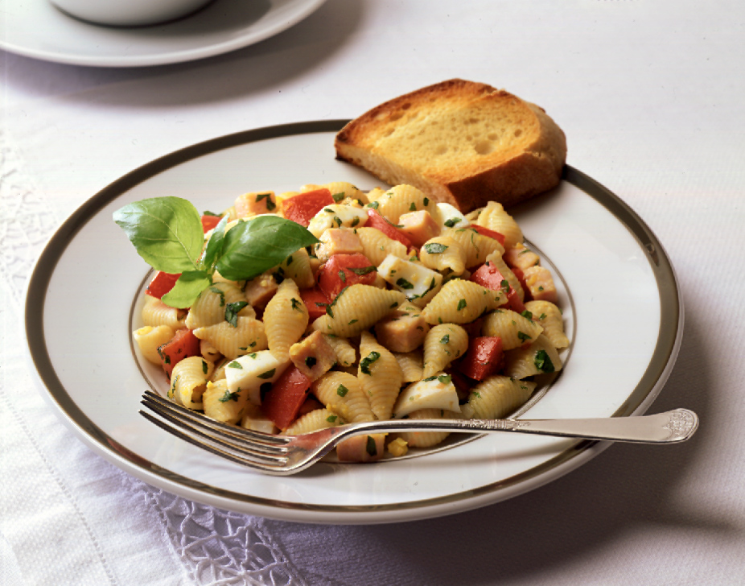

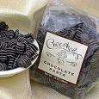
When is Pasta Served?
Appetizer
Garnishes for soups
Salads
Entrée
Dessert
Notes:
When making delicious pasta dishes, be sure to choose a pasta shape and sauce that complement each other. Thin, delicate pastas like angel hair or thin spaghetti, should be served with light, thin sauces. Thicker pasta shapes, like fettuccine, work well with heavier sauces. Pasta shapes with holes or ridges like mostaccioli or radiatore, are perfect for chunkier sauces.

Slide 11
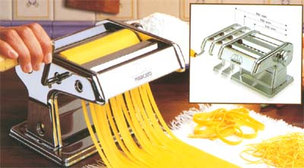
Production of Fresh Pasta
Plain flour, medium gluten content
Semolina Flour
Eggs
Olive oil
Pasta machine & attachments

Slide 12
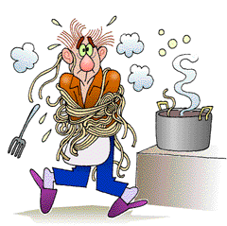
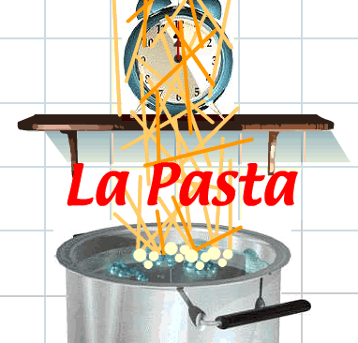
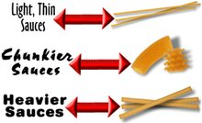
Methods of Cooking Pasta:
1 quart water : 3 oz. pasta & 1 Tbsp. salt
Gently simmer , cooking time determined by size and thickness of pasta
Freshly cooked and served immediately
Cooked “al Dente”
Fresh pasta usually requires shorter cooking time
Notes:
How to cook pasta
It is cooked in plenty of water, at least 1 litre per 100g. This is to avoid the pasta sticking together.
It is best to use a large low sided saucepan in order to absorb the most heat from the stove. Do not use a lid.
Add salt, 10g per litre, as soon as the pot is placed on the stove. The heat should be high to bring about boiling rapidly.
When boiling is reached, the pasta must be added a little at a time. Before putting in the pasta, some cooks add a teaspoon of olive oil, particularly with spaghetti, to prevent the pasta sticking together. As soon as the pasta is added, reduce the heat.
The cooking time varies depending on the quality of the pasta. You can rely on the times stated on the packet pasta produced commercially.
The simplest way of determining that the pasta is "al dente", is to taste it. Why "al dente"? Because it is more tasty and more digestible not, as some believe, because it is an Italian perfectionism.
It is worth remembering, before draining the pasta, to pour a small glass of cold water into the pot to stop the cooking; this is important to prevent overcooking.
The water from the cooking can be retained to be used for making a sauce, for example "pesto genovese" or "ricotta alla romana".
If you mix the pasta in the saucepan it is better to use a wooden spoon rather than a metal one.
In the tureen, first add the grated cheese (if required in the recipe), then the pasta and lastly the sauce which has been separately prepared; with the heat of the pasta the cheese is melted and the whole is combined to enhance the aroma and the taste.
Serve immediately at the table.
(Text taken from: Nino Romano - Le ore della pasta - Ed. Achantus 1987)

Slide 13

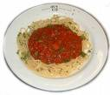
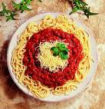

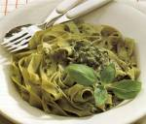
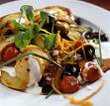

Pasta Sauces:
Bolognese
Tomato
Provencale
Cream
Pesto
Carbonara
Marinara

Slide 14




Fettuccine Alfredo
Fettuccine – flat pasta
Cream Sauce
Parmesan Cheese
Often served with chicken

Slide 15

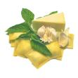

Ravioli
Stuffed pasta
Many types of fillings: cheese, meat, seafood.
Different shapes
Served as an appetizer or entrée.

Slide 16




Manicotti
Stuffed pasta tubes
Traditional ricotta cheese filling
Served with tomato sauce and more cheese!!!

Slide 17




Garlic Bread
Use fresh garlic and other herbs.
Cut lengthwise or in slices.
Parmesan cheese may be added to butter.

