Slide 1

KITCHEN SAFETY with
®

Slide 2
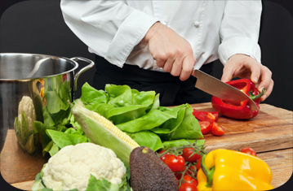
Kitchen Safety
The kitchen can be one of the MOST dangerous places in the home, in the classroom and in the industry.
It is critical that you understand the principles of kitchen safety and sanitation in order to keep yourself and others safe while cooking.

Slide 3
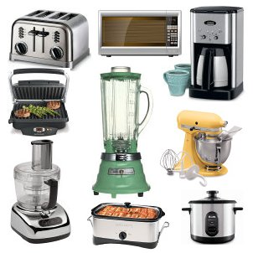
Electrical Appliances
Use dry hands.
Stand on a dry floor.
Keep appliances away from water.
Plug removable cords into the appliance first and then plug into the power source.

Slide 4
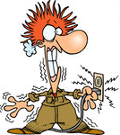
Electrical Appliances
In case of electrocution, turn off the MAIN POWER SOURCE (power breaker) before touching the person or the appliance.

Slide 5

Knife Safety
Sharp knives are safer than dull knives.
Store knives with a safety guard over the blade or in a knife block/rack.
First-aid for a severely bleeding cut is to apply direct pressure over the wound. Very deep cuts may require medical attention.

Slide 6
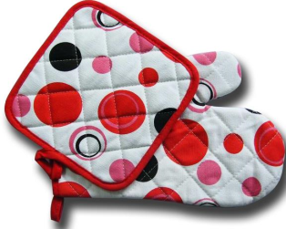
Avoiding Burns
Keep clothing away from direct heat.
Avoid paper/plastic on or near the stovetop.
Use hot pads/oven mitts for handling hot pans. (Including microwave cooking.)

Slide 7
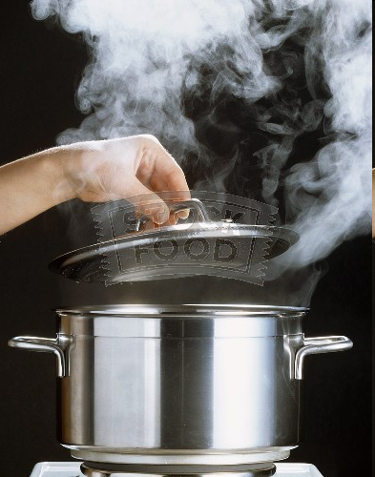
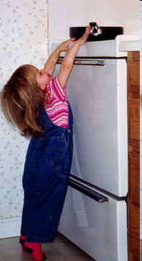
Avoiding Burns
Lift lids on hot foods away from you and your face. Direct the steam away.
Turn pan handles toward the inside or back of the stovetop.

Slide 8
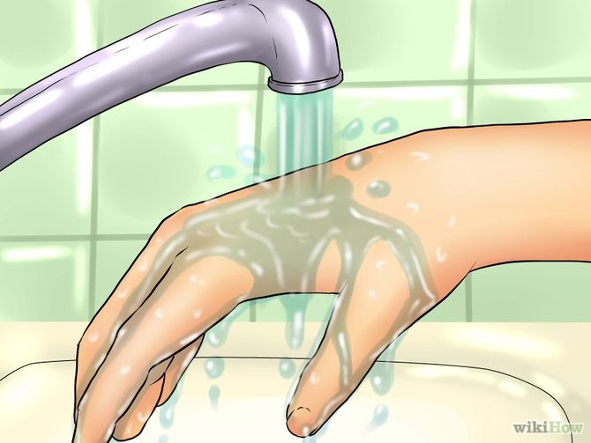
Avoiding Burns
First-aid for a first degree burn is to run the burned area under cold running water.

Slide 9
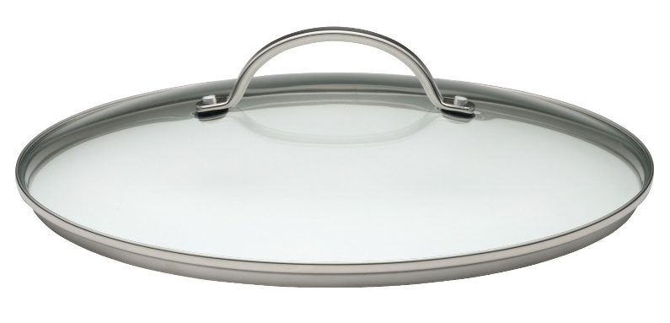
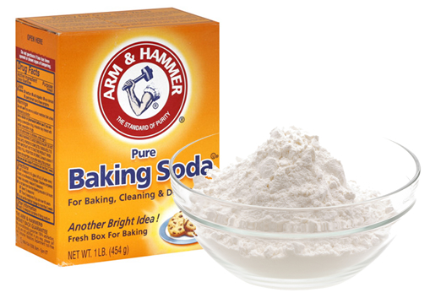
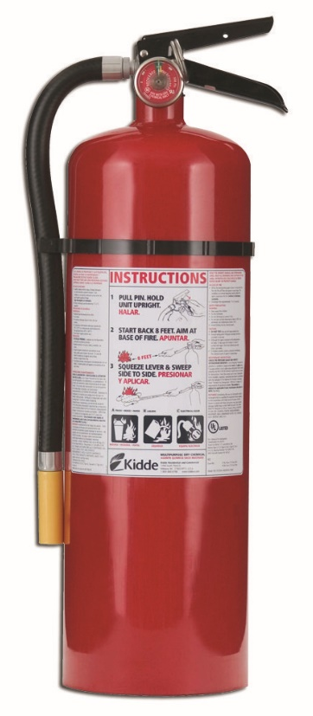
Extinguishing a Grease Fire
Cover with a lid.
Smother with baking soda
Use a fire extinguisher.

Slide 10
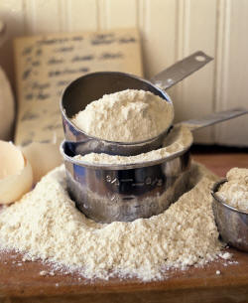

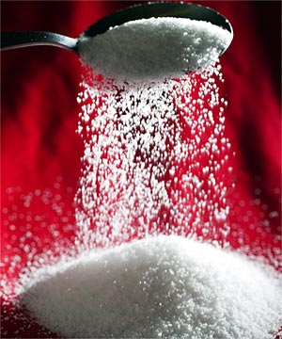
Never Use on a Grease Fire
Water
Sugar
Flour

Slide 11
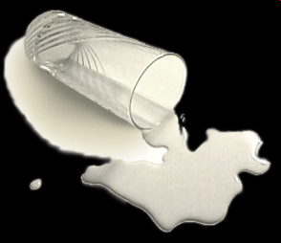

Avoiding Tripping/Falling
Clean up spills as soon as they happen.
Use a step stool to reach things in high places.
Store heavy items on lower shelves.

Slide 12
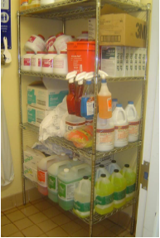

Cleaning Supplies and Chemicals
Store cleaning supplies away from food in designated areas, equipment, utensils, linen and single-use items in a designated area.
Keep cleaning chemicals in their original containers or have them clearly labeled.

Slide 13
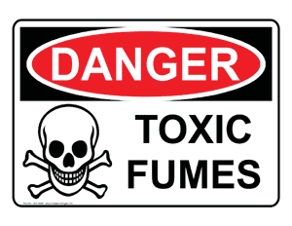
Cleaning Supplies and Chemicals
Never mix cleaning supplies.
Combinations like ammonia and bleach will produce toxic deadly fumes.

