Slide 1
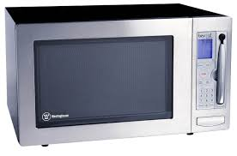
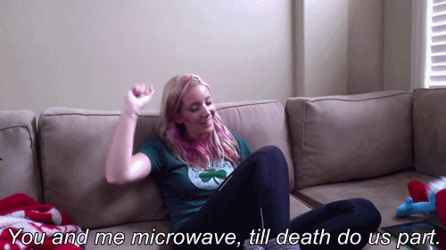
Microwaves

Slide 2

Why do we love microwaves?
Because they make us feel like this…

Slide 3
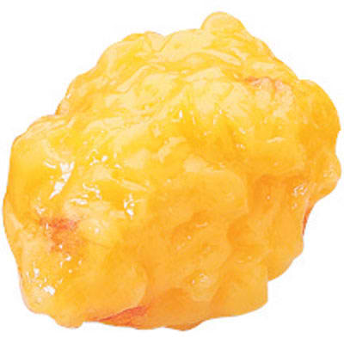
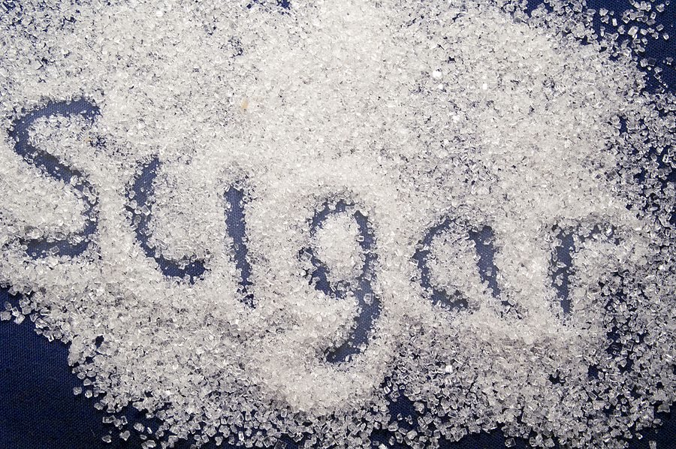

I
Microwaves are attracted to fat, sugar, and water molecules.

Slide 4
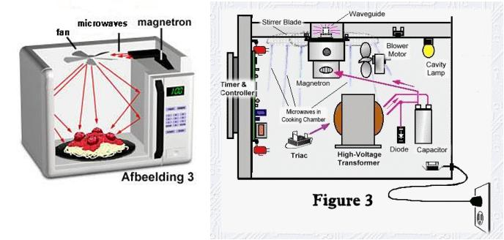
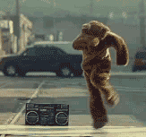
How do microwaves cook food?
Microwaves cause molecules to vibrate.
Vibration creates friction, which produces
heat that cooks the food.
Notes:
How microwaves work

Slide 5
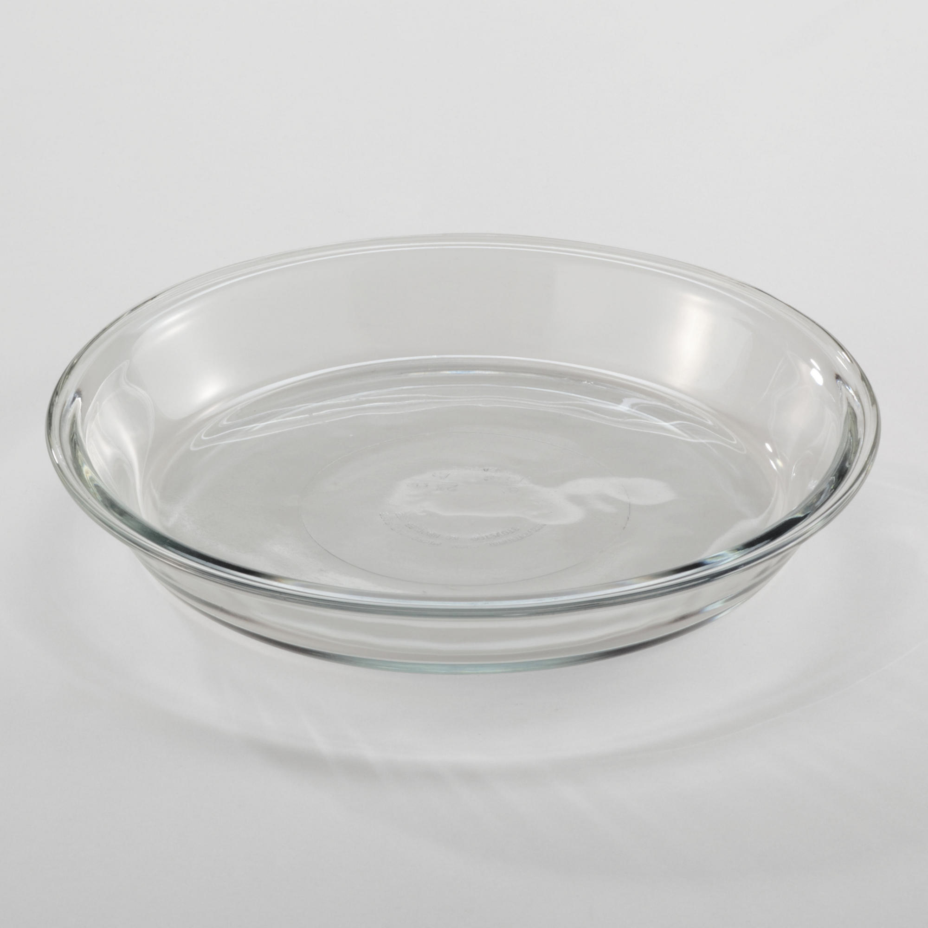
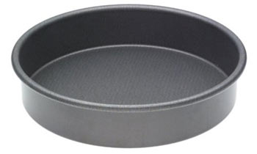
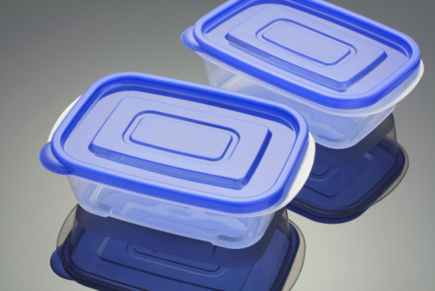
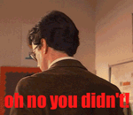
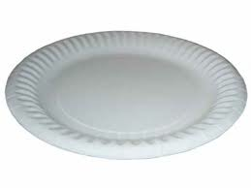
MICROWAVE COOKING CONTAINERS
SAFE
NOT SAFE
GLASS
METAL
PLASTIC
(Microwave-Safe)
PAPER
Notes:
Safe cooking containers

Slide 6
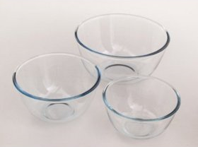
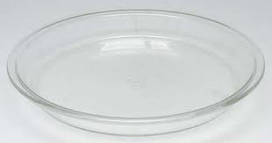
Which container cooks more evenly…
ROUND
or
Why?!?
Shallow containers cook more evenly because there is more surface area for the microwaves to touch.

Slide 7
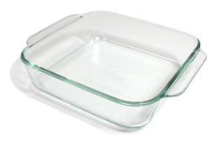
Which container cooks more evenly…
ROUND
or
Why?!?
Because there are no corners, the microwaves
enter the food from as many sides as possible.
They wont “bounce off” the corners.

Slide 8

Microwave cooking time: The time the food needs to cook with microwave energy.
Standing time: the time food continues to cook after the microwave has stopped. (think: hot pocket)
Notes:
Microwave times: cooking, standing, etc.

Slide 9

What increases the microwave standing and cooking time?
The amount of food you are cooking.
Notes:
covering

Slide 10

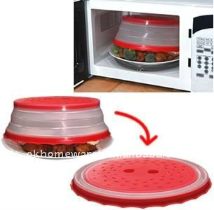
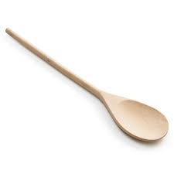
Cooking foods evenly in a microwave
1. Stir
2. Rotate
3. Cover
Notes:
does not brown foods or give a crisp crust

Slide 11
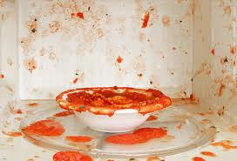
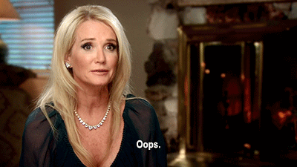
Covering foods…
Holds in moisture and helps foods cook more evenly.
Prevents splattering.
How many of you have ever done this?
And then this?
Notes:
burns and splattering

Slide 12
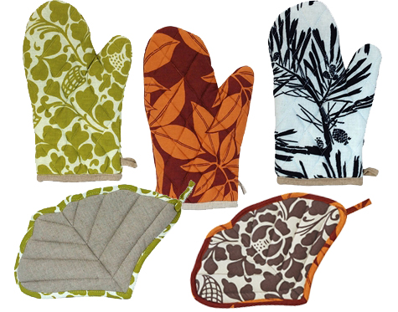
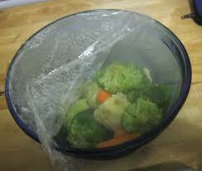
To prevent burns…
1. Use potholders
2. Direct steam away from body.

Slide 13
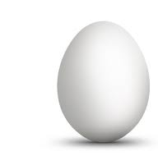
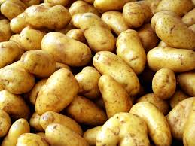
Use caution when cooking these foods in the microwave

Slide 14

And FYI…
microwaves do NOT brown foods or give them a crisp crust. This is because they do not have a dry heat source.

